Slide 1
Welcome
Well come

Slide 2
English 1stpaper
Unit 12
Lesson 5
Time 45 mnts
29/4/21
Md Hasanul Kabir
Lec in English
H. A, Harindia Alim Madrasa
Harindia , Kotchandpur, Jhenaidah

Slide 3
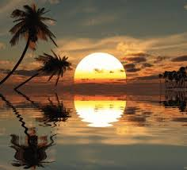

Slide 4
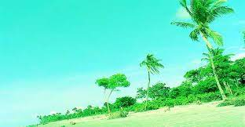
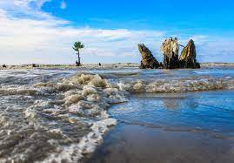

Slide 5
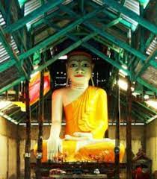
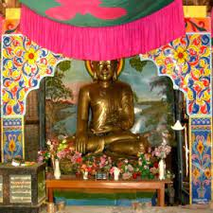

Slide 6
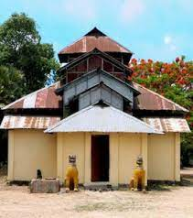
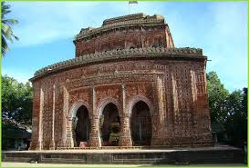

Slide 7
Lesson declaration
KUAKATA

Slide 8
At the end of the lesson
A student will be able to know
About kuakata
Relegious importance
Vocabs

Slide 9
Kuakata is a town in southeastern Bangladesh known for its panoramic sea beach. Kuakata beach is a sandy expanse 18 kilometres long and 3 kilometres wide. From the beach one can have an unobstructed view of both sunrise and sunset over the Bay of Bengal. Wikipedia
District: Patuakhali District
Upazila: Kalapara
Division: Barisal Division

Slide 10
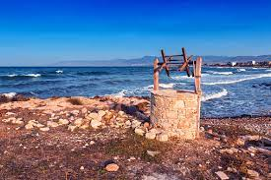
The word kuakata has come from the word , the well. Means kua used for drinking water from the deep position of the earth.
Maker:Rakhaine Settlers.

Slide 11
Relegious importance
Kuakata plays an important role for Hindu and Buddhist.
Their prayer houses are there.
Maghi Purnima is one of the most celebrated .

Slide 12
Individual work
Answer the following question
Where is the word kuakata originated from?
Where is it?
Write the importance of the beach kuakata.

Slide 13
Group work
What is the importance of kuakata.
It has a economic value “ explain it.

Slide 14
Home Work
Write a paragraph about kuakata
( you can take help from GOOGLE)

Slide 15
Locally ………regionally
Scenic ……… lovely
Rare…………. Scare
Ply …………….run
Bathe ………..wash
Indicate ………show

Slide 16
No more today, when more again.

