Slide 1
welcome

Slide 2
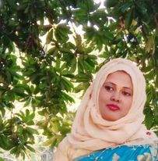
Teacher’s Introduction
Mst.Sharmin Akter
Assistant teacher
Matoin Govt. Primary School
Hajigonj, Chandpur
E-mail:
mstsharminakter1985@gmail.com

Slide 3
Lesson Identity
Class : Five
Subject : English
Lesson :4-5
Unit:1
Activity:E
Time : 40 min
A
e
r
G

Slide 4
Learning Outcomes
Student’s will be able to-
Listening:1.3.1-recognize which words in a sentence are stressed.
Speaking:1.1.1-say words and phrases and sentences with proper sounds and stress.
Reading:1.5.1-read words , phrases and sentences with proper pronunciation , stress and intonation.
Writing:5.1.3-read silently with understanding dialogue.

Slide 5
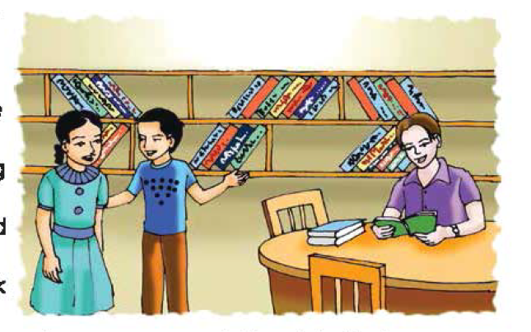
We can see here 3 persons are in the public library.
What can you see in the picture ?

Slide 6
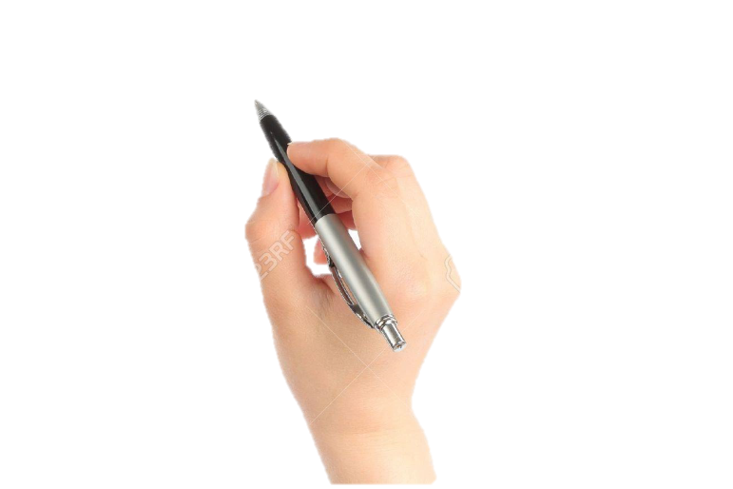
Lesson declaration
Our todays lesson is Hello !

Slide 7
New word
Town hall
club
Young man
Gentleman
person

Slide 8
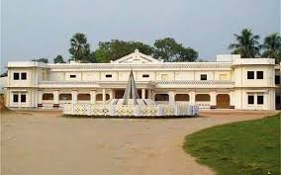
Town hall
guildhall
Sima and Tomal are in the Town Hall Language Club.

Slide 9
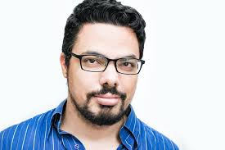
person
man
He is a new person here.

Slide 10
Club
organization
Sima and Tomal are in the Town Hall Language Club.

Slide 11
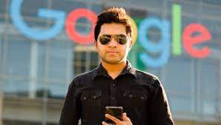
Young man
youth
He is a young man.

Slide 12
gentleman
gent
He is a gentleman.

Slide 13
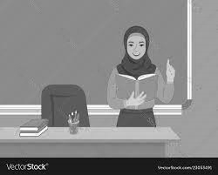
Teacher’s Reading

Slide 14
Sima and Tomal are in the Town Hall Language Club . They come to the club to practise
Speaking English. They listen to CDs and Watch DVDs in English , or speak English With friends.Today there is a new person in the club. He is a young man. He is reading a book about Bangladesh .

Slide 15
Sima: Look,Tamal! Who’s that gentleman ? Do you know him ?
Tamal:Yes.That’s Andy Smith. He is working with an NGO here. I met him yesterday at the bookshop.

Slide 16
Maybe we can practise our English with him.
Good idea. I’ll introduce you to him. Come with me.

Slide 17
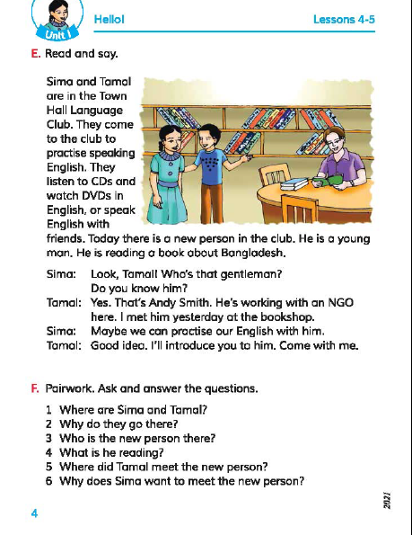
Open your book at page 4.

Slide 18
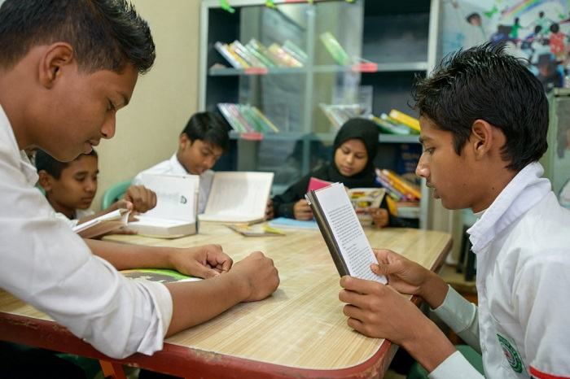
Group reading

Slide 19
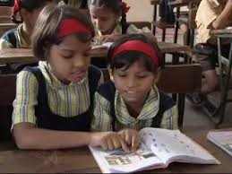
Read in pair

Slide 20
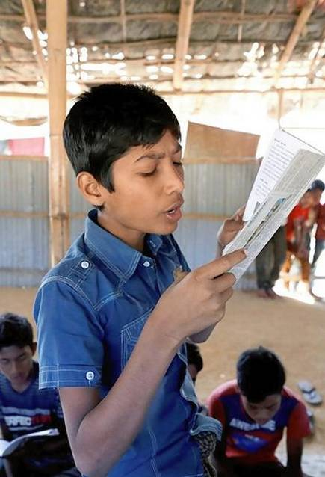
IW
Student’s reading

Slide 21
Practise the conversation with your partner.

Slide 22
Questions:
1.Where are Sima and Tomal ?
2.Why do they go there ?
3.Who is the new person there?
4.What is he reading ?
5.Where did Tamal meet the new person?
gw

Slide 23
Answers:
1.Sima and Tamal are in the Town Hall Language Club .
2.They go there to practise English.
3Andy Smith is the new person.
4.He is readin a book about Bangladesh.
5.Tamal met the new person at the bookshop .
gw

Slide 24
Bingo game
town
reading
language
person
gentleman
speaking
working
practice
watch
bookshop

Slide 25
One day one word
Bookshop-বইয়ের দোকান

Slide 26
Good bye

