Slide 1
WELCOME
To Online Class
Organized by –
Shahid Abdul Ali Academy, Rangamati.

Slide 2
Presented by -
UZZWAL CHOWDHURY
Assistant Teacher
Shahid Abdul Ali Academy
Rangamati Sadar, Rangamati.

Slide 3
Subject: English First Paper Class: Eight.
Section: A / B

Slide 4
ASSIGNMENT CLASS
After showing the class, I believe that you will write an assignment on your fixed topic.

Slide 5
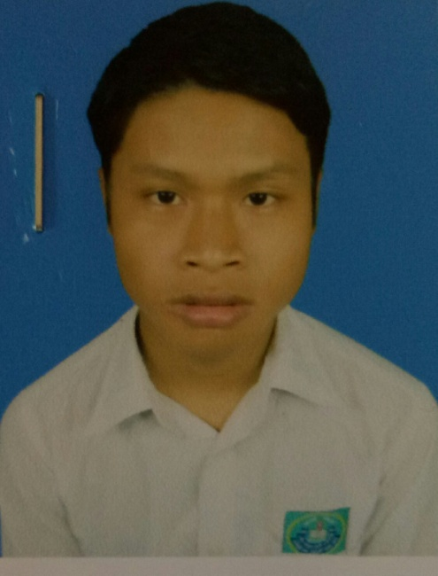
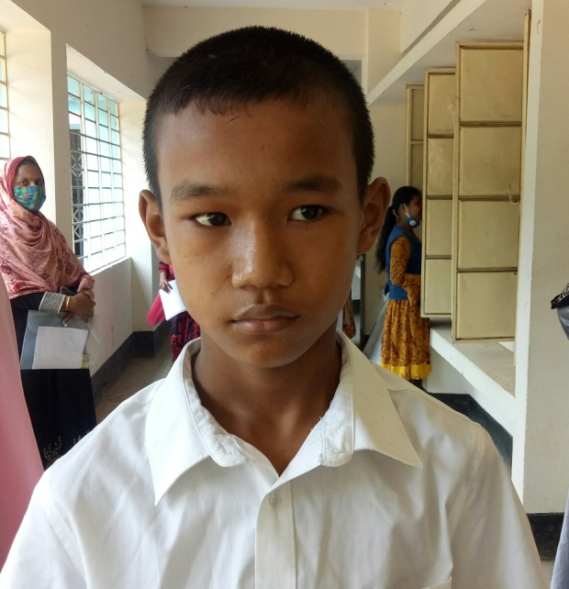
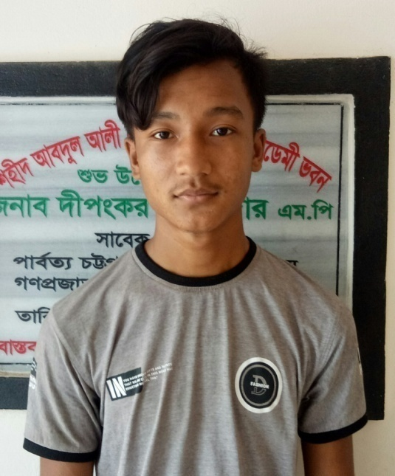
Apon Tanchayanca
Bishal Tripura
Apurba Tripura

Slide 6
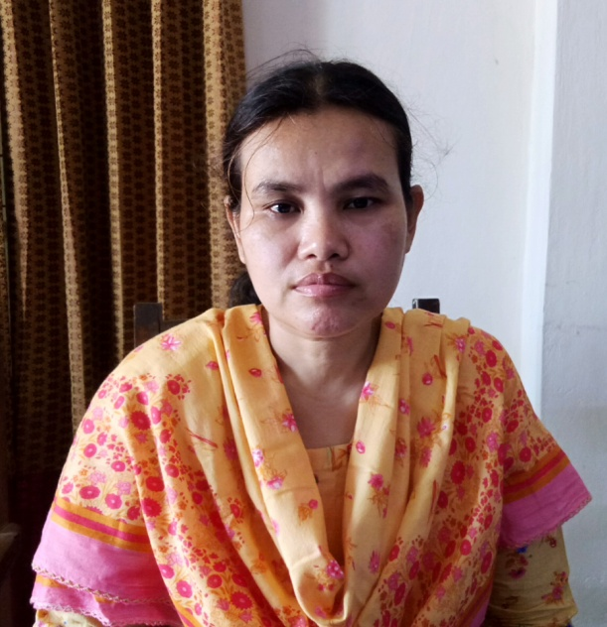
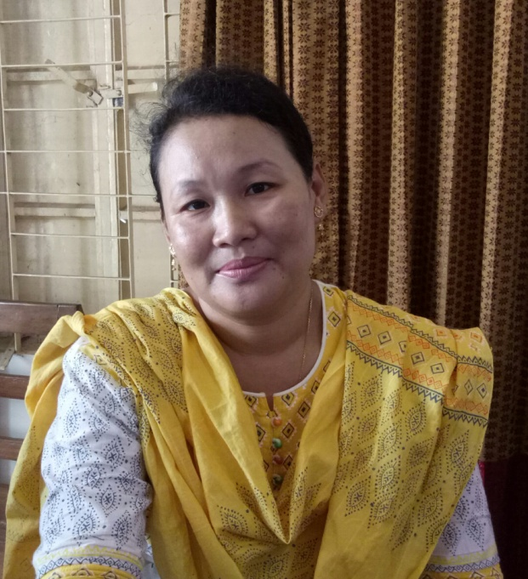
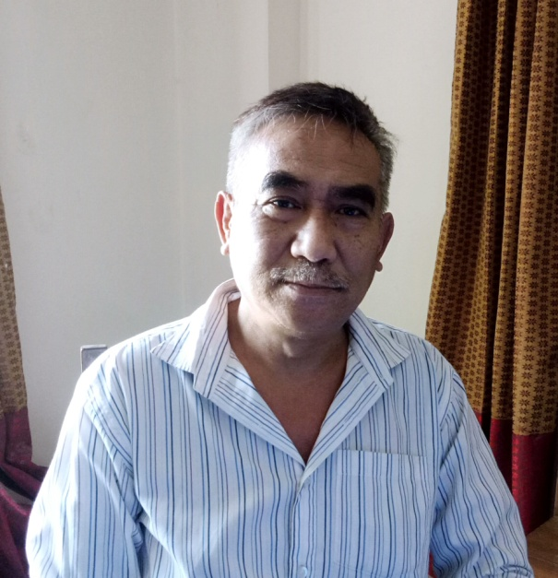
Mita Madam
Monita Madam
Debabar Sir

Slide 7
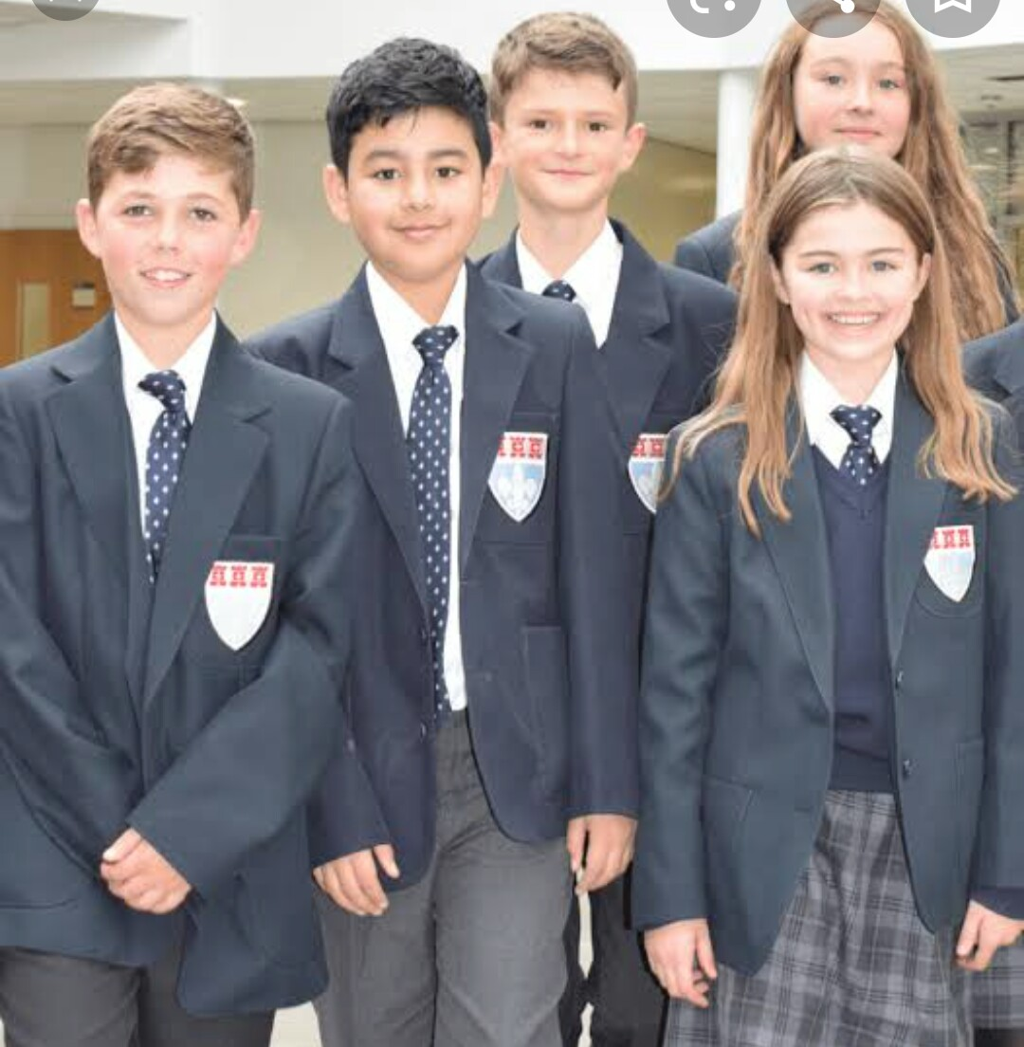
Suppose, you have foreign friends who is very curious to know about the tribes from your country.

Slide 8
There are about 50 classes of Tribes in our country but 13 classes of tribes are very familiar in Bangladesh.

Slide 9
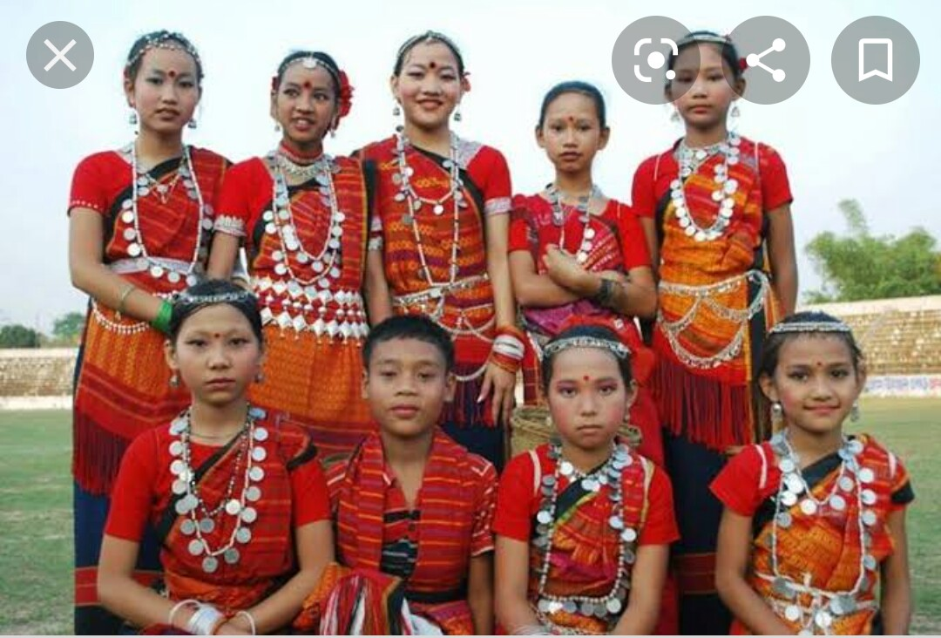
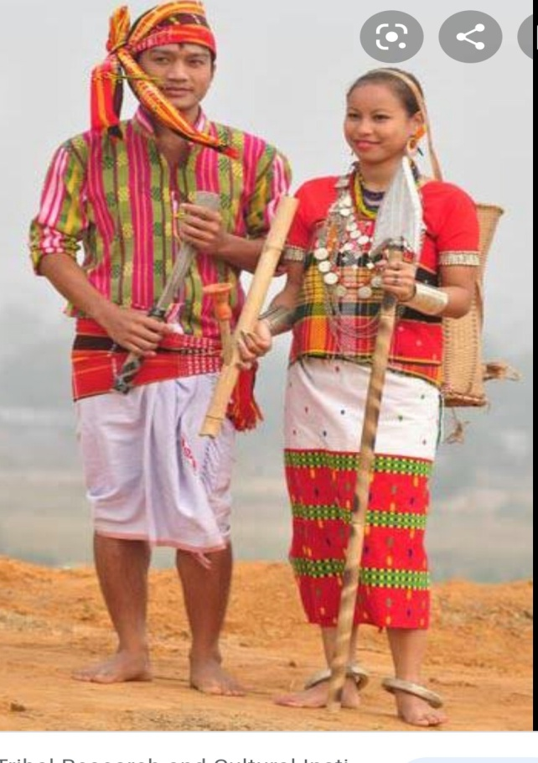
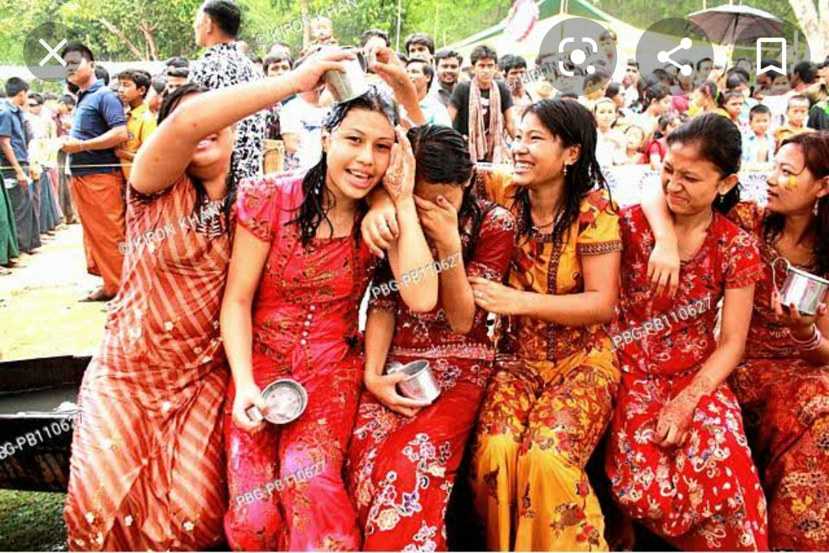
They are --------
Chakma
Marma
Tripura

Slide 10
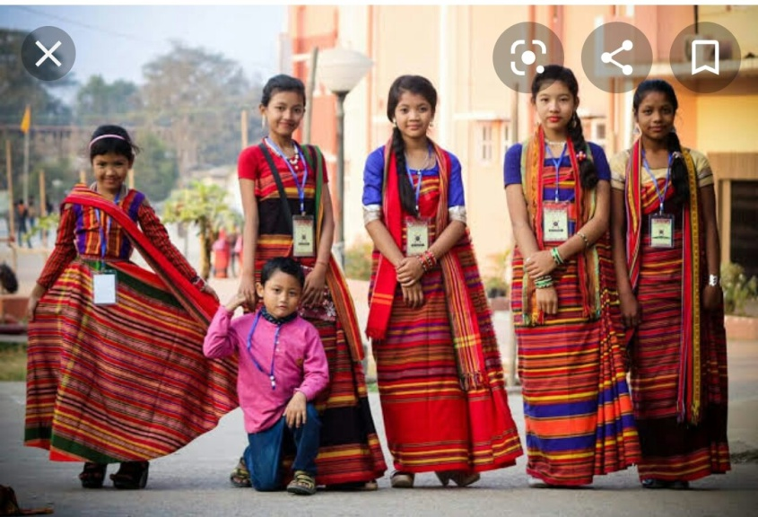
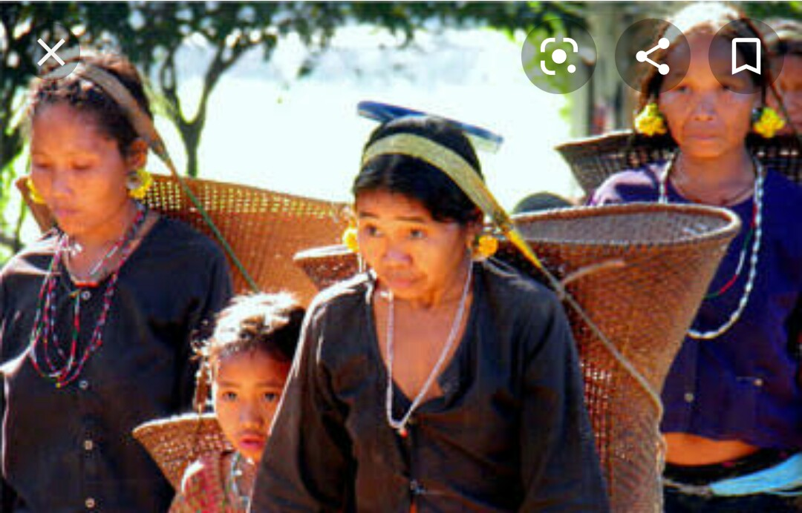
Monipuri
Khasia

Slide 11
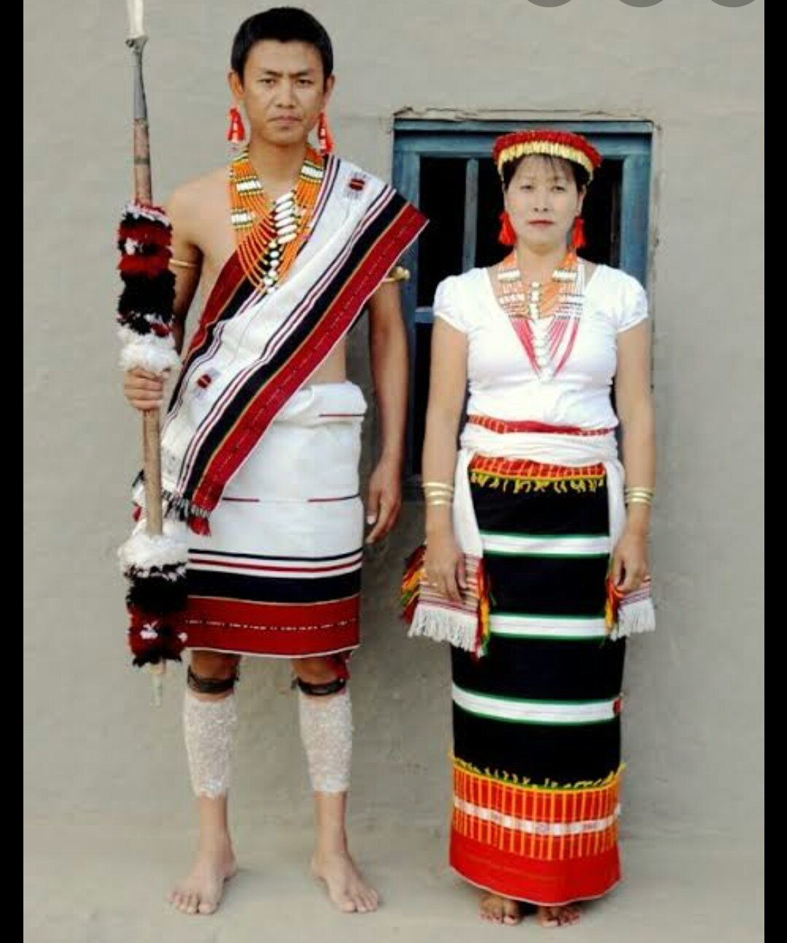
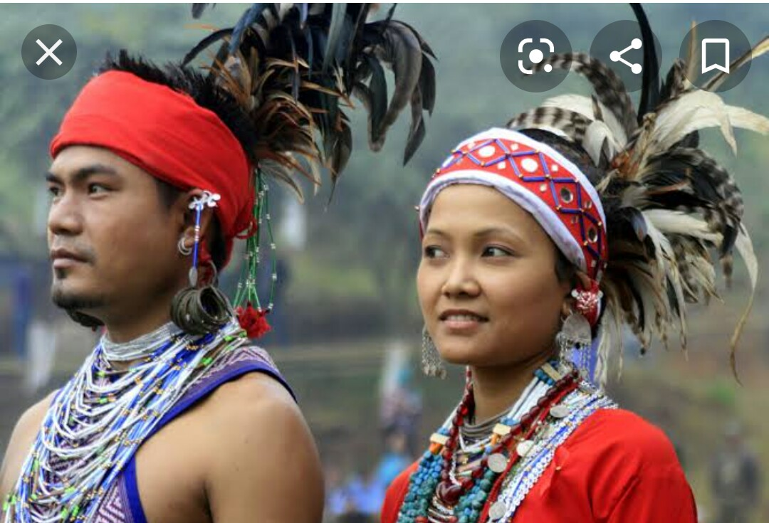
Garos
Hajong

Slide 12
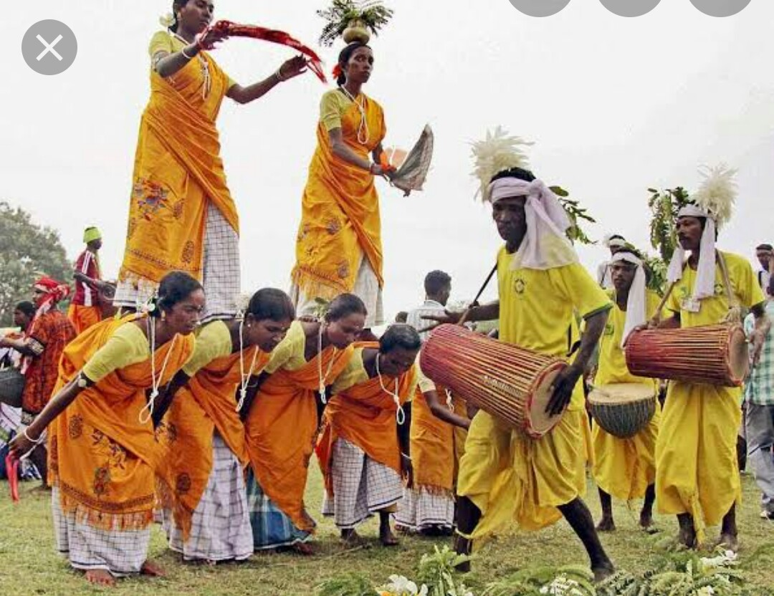
Santal
Tanchayanga

Slide 13
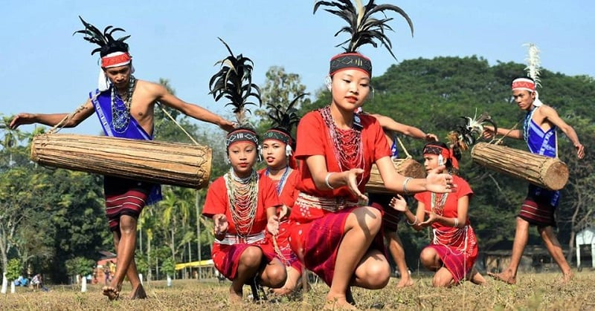
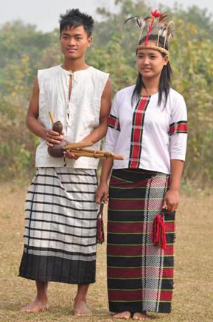
Khumi
Lushai

Slide 14
Cast | Living Place
Chakma | Chattogram Hill Tracts
Marma | Same
Tripura | Same

Slide 15
Cast | Living Place
Santals | Rajshahi
Khasias / Monipuris | Sylhet
Hajongs and Garos | Mymenshingha

Slide 16
Cast | Living Place
Khumi | Chattogram Hill Tracts
Lushai | Same
Tanchayanga | Same
In a word, they have been living in rural areas. Now it has changed. Someone is living in city areas

Slide 17
Food habits | Their food is very special from us. They like to eat vegetables, fish, dried fish etc. Mainly, their staple food is rice. They eat three times.

Slide 18
Cloths | Their dress is also very different from us. They like to their own weaving cloths. Such as – Thami, Lungi, Pinon, Panjabi, Dhuti, Fatua etc.

Slide 19
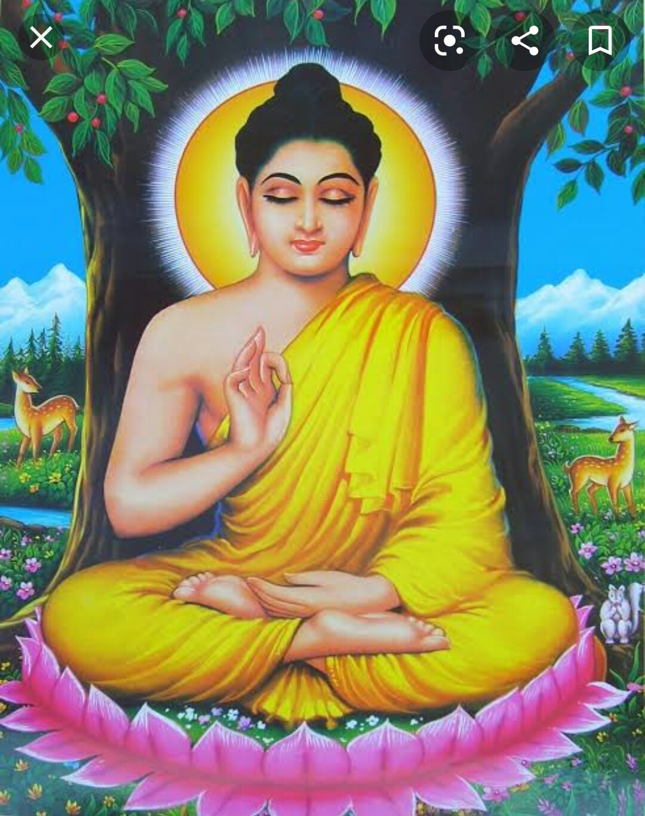
Cast
Chakma
Marma
Tanchayanga
Monipuries
Festivals: Boisabi, Maghi Purnima, Buddha Purnima etc.

Slide 20
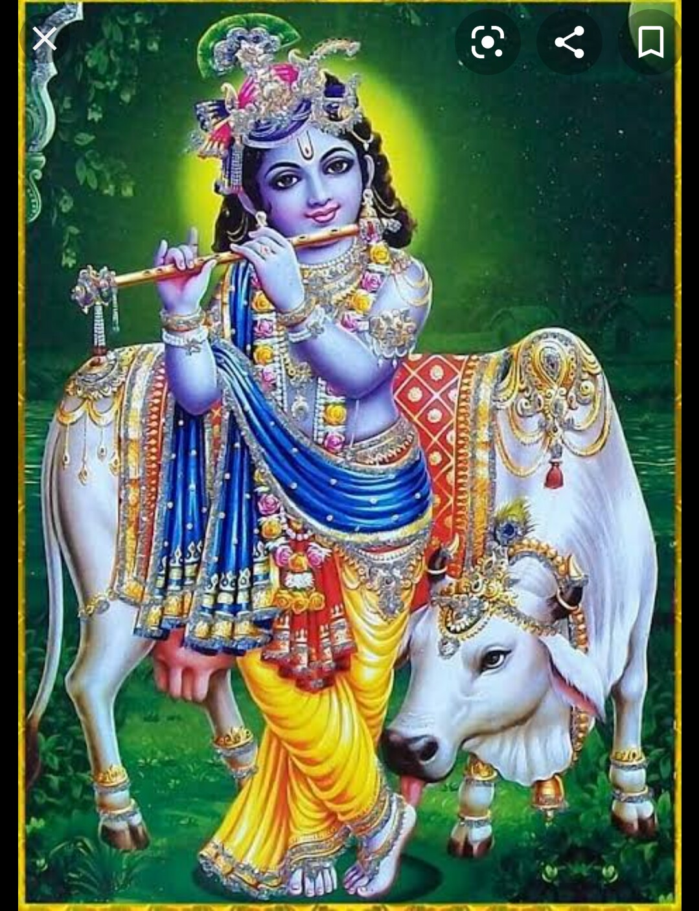
Cast
Tripura
Santals
Monipuris
Festivals: Durga Puja, Laxmi Puja, Kaali Puja etc.

Slide 21
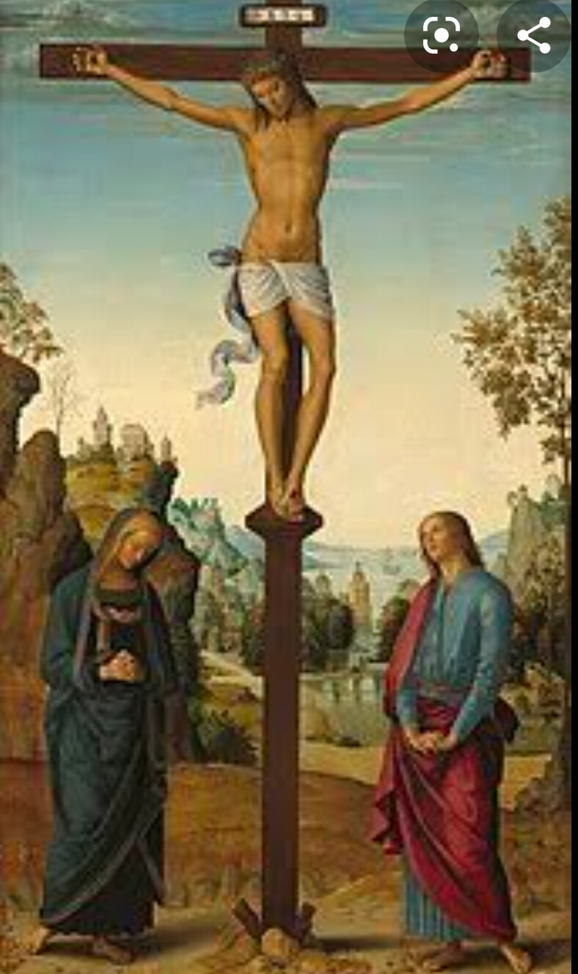
Cast
Khasias
Garos
Hajongs
Lushai
Khumi
Festivals: Christmas day, Easter Sunday etc.

Slide 22
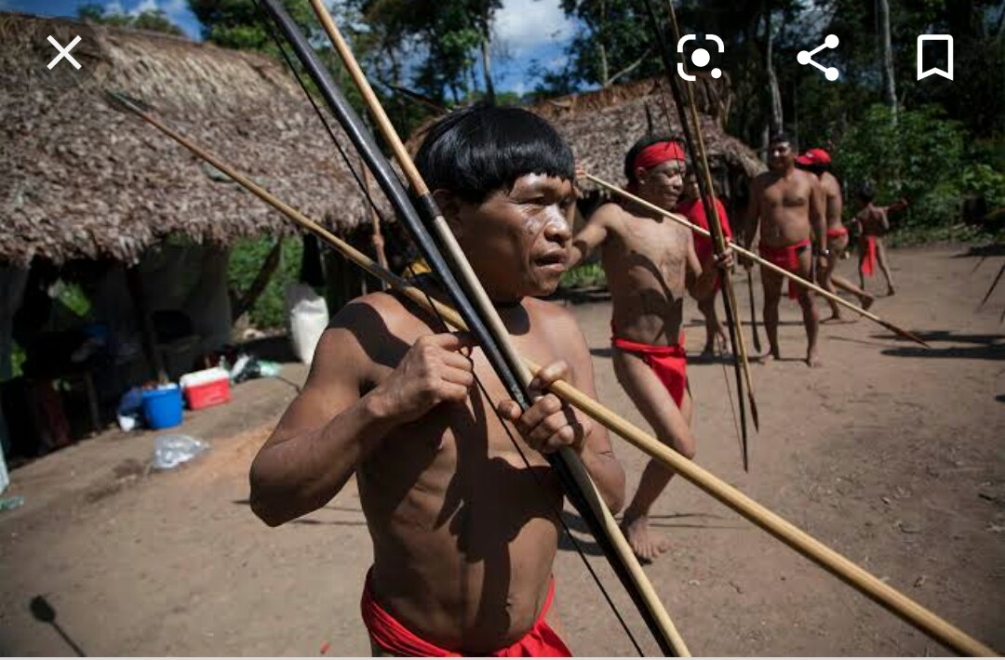
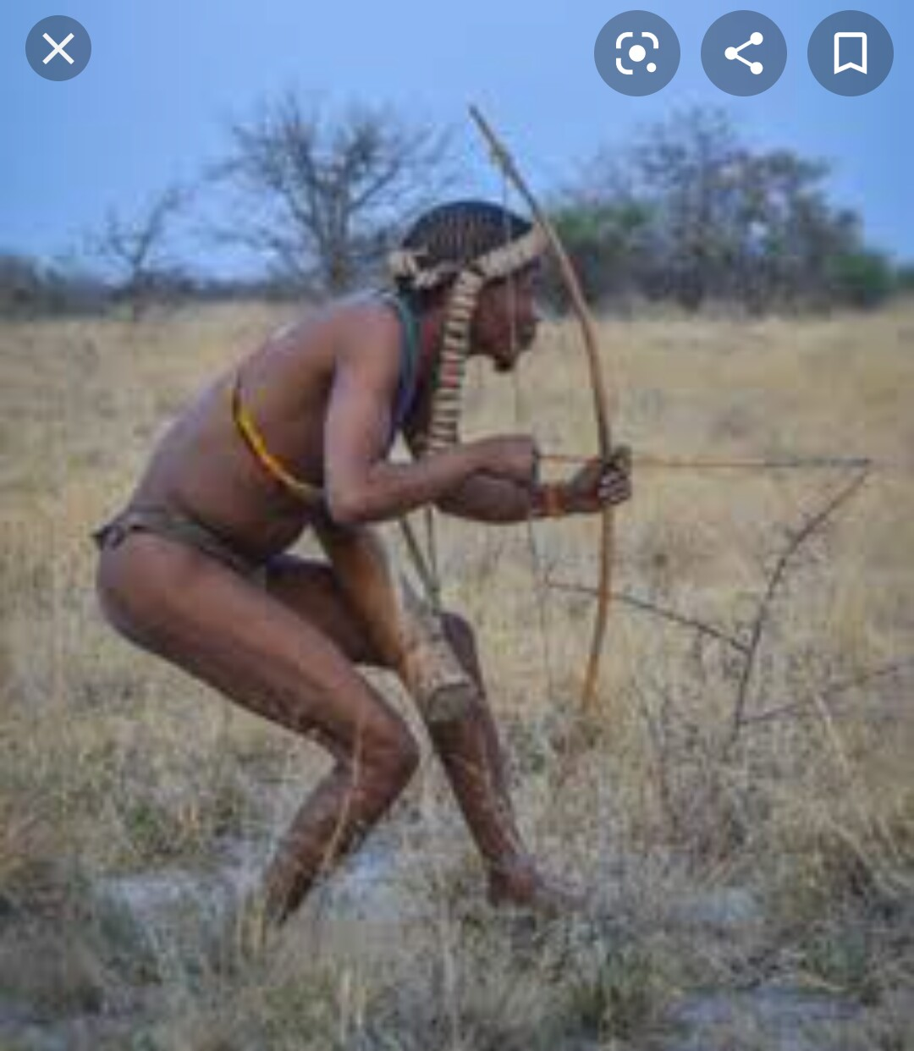
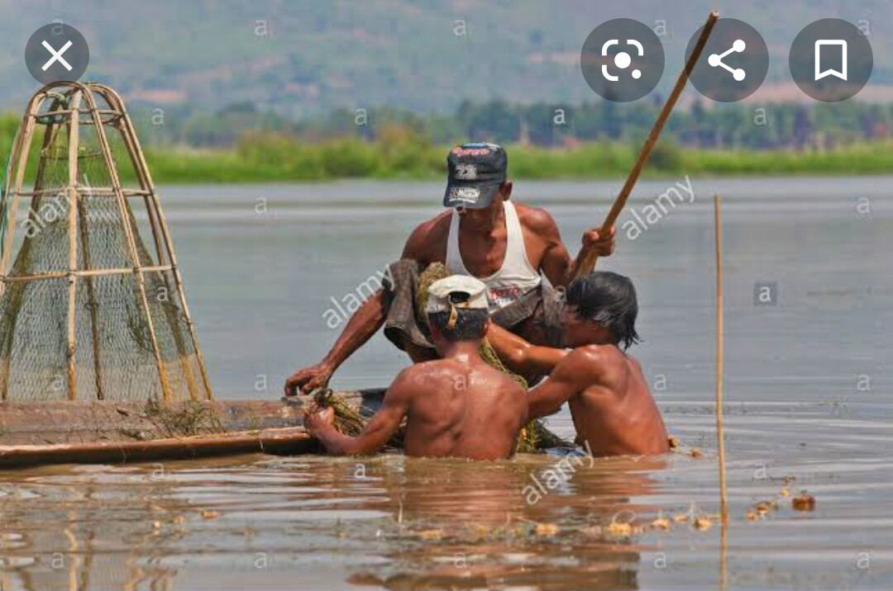
Hunting and Fishing are their favorite pastimes.

Slide 23
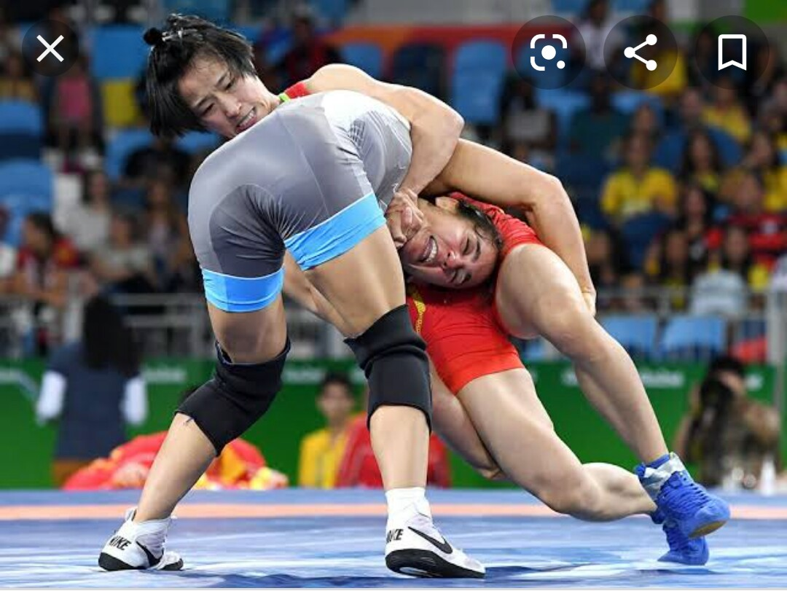
Wrestling is also very popular sport for them.

Slide 24
They are fond of songs, music, dances, theatre and fairs. Traditional musical instruments used are bugle made form buffalo horns, drums and bamboo flutes.

Slide 25
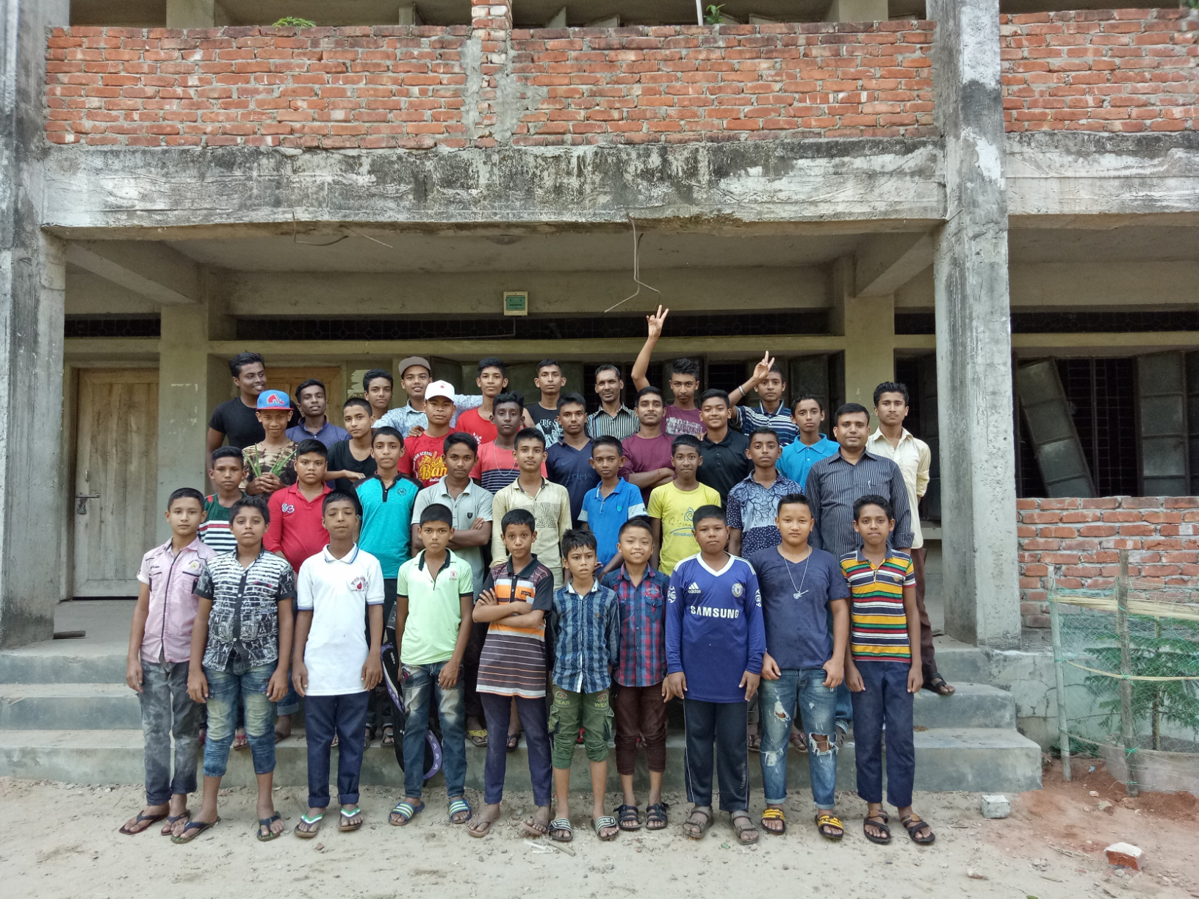
GOOD BYE

