Slide 1
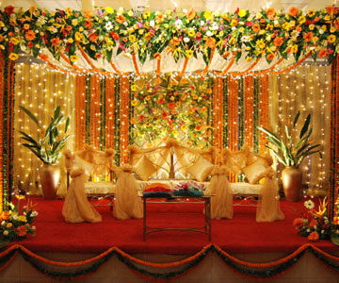
Welcome

Slide 2
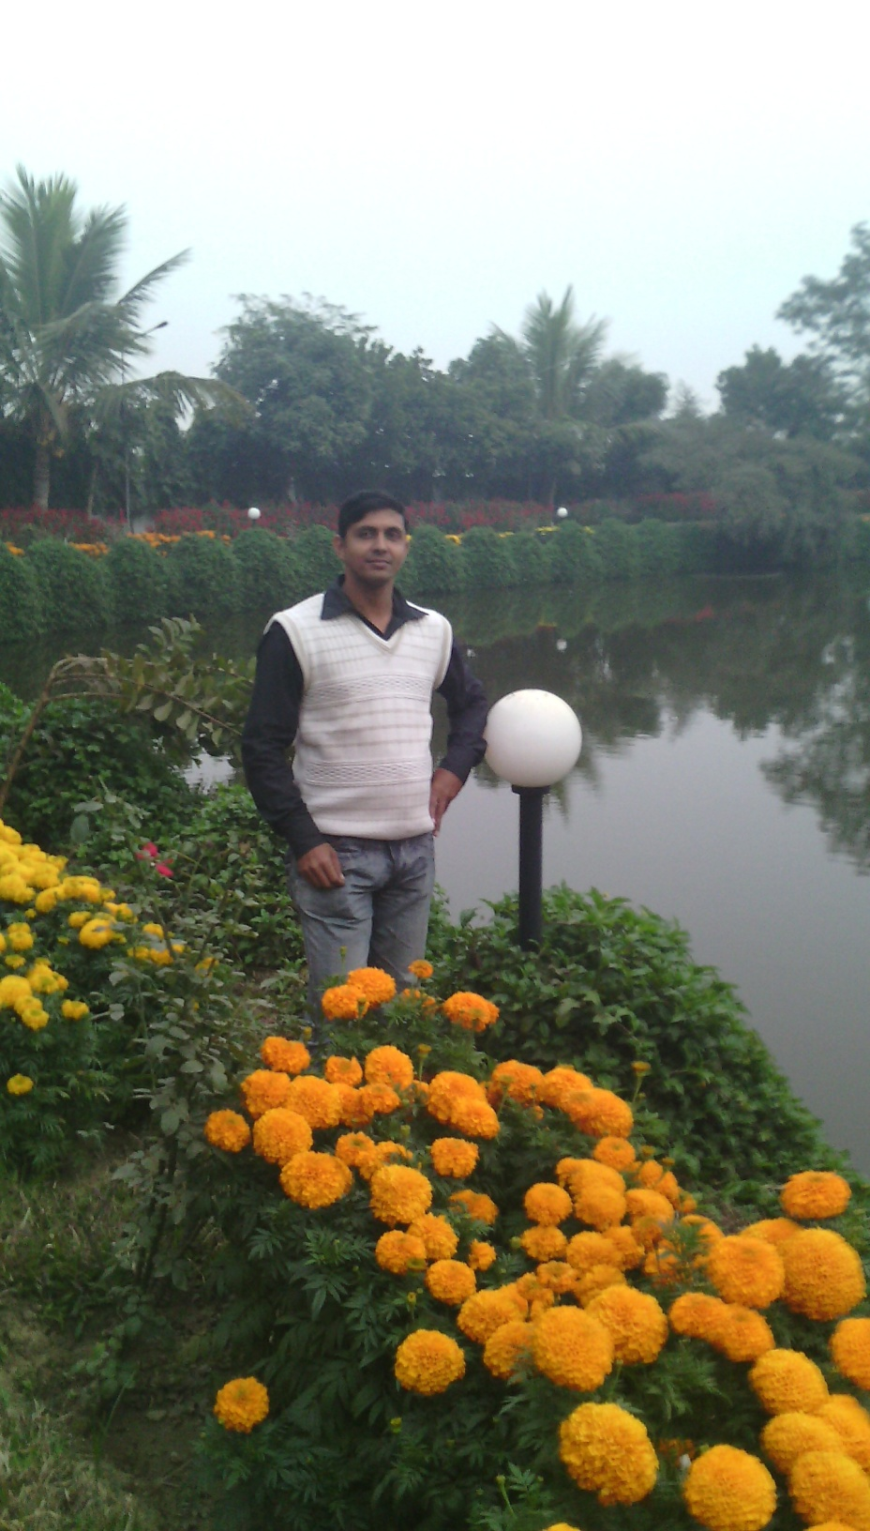
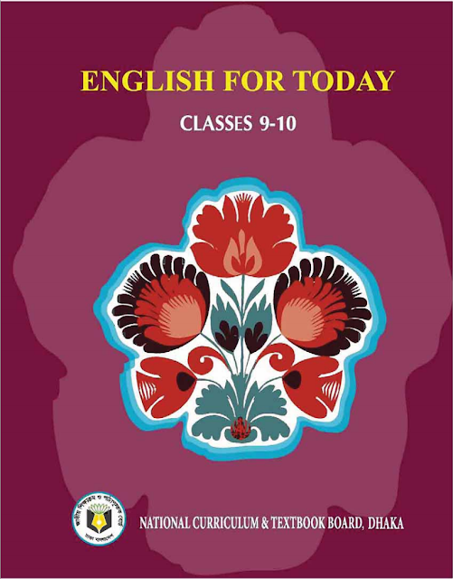
Ujjal Kumar Ghosh
Assistant Teacher(English)
Chuadanga Krishnanagor high school
Panjia,Keshabpur,Jassore.

Slide 3
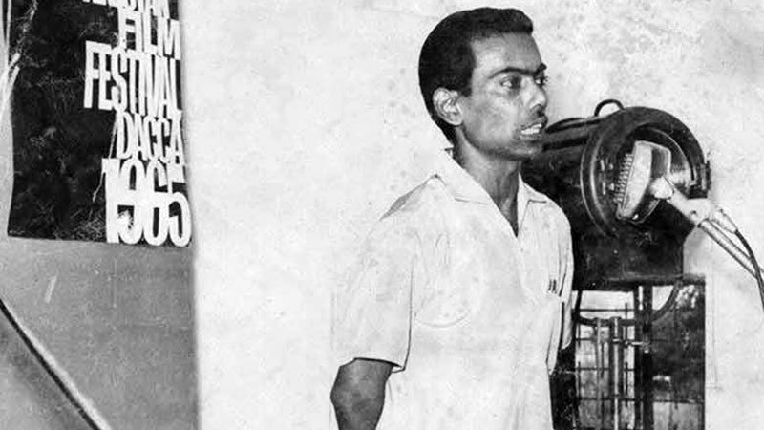
Do you know this man?
Film maker

Slide 4
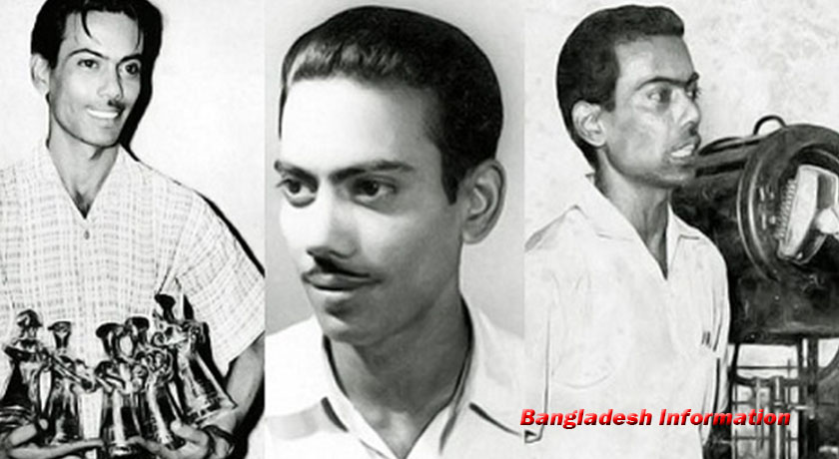
What is the name of this film maker?
This film maker’s name is Zahir Raihan .

Slide 5
Yes, Today’s lesson is ----
They had dreams 2
Unit Ten
Lesson 4
Page number -154
Class-9,10

Slide 6
Learning outcomes
By the end of the lesson learning will be able to
Talk about the picture.
Use new words and make sentences.
Use appropriate information from the text to complete the grid.
answer to the question.
Write a paragraph

Slide 7
Talented
Talented means gifted ,expert ,master ,brilliant
Zahir Raihan was one of the most talented film makers in Bangladesh.
legendary
Legendary means famous, celebrated, well-known
He made a legendary film Jibon Theke Neya based on the Language Movement of 1952.
Genocide
Genocide means mass extermination, mass murder
His great documentary on Pakistani atrocities, Stop Genocide, helped create world sentiment in favour of our liberation war.

Slide 8
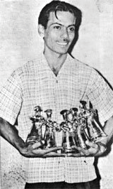
Reading Test

Slide 9
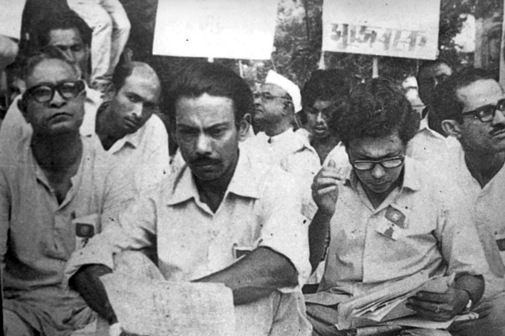

Slide 10
Zahir Raihan was one of the most talented film
makers in Bangladesh. He was born on 19 August 1935 in the village Majupur, in Feni district. He was an active worker of the Language Movement. He was one of the ten students to go out in a procession on 21 February 1952 despite a ban on such activities. As a result, he and many others were arrested and taken to prison. Zahir was also present at the historical meeting of Amtala on February 21, 1952. He also took part in the mass movement in 1969. In 1971, he joined theLiberation War.

Slide 11
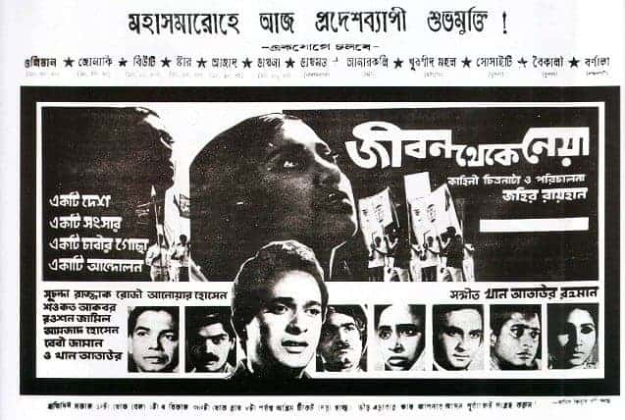

Slide 12
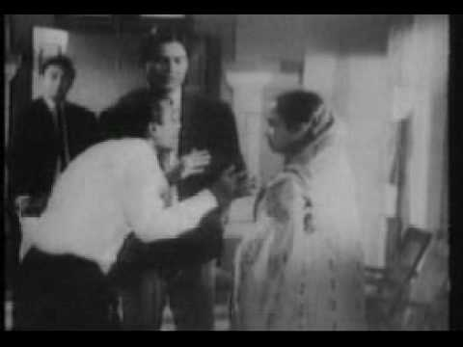

Slide 13
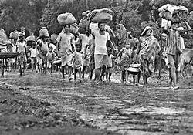

Slide 14
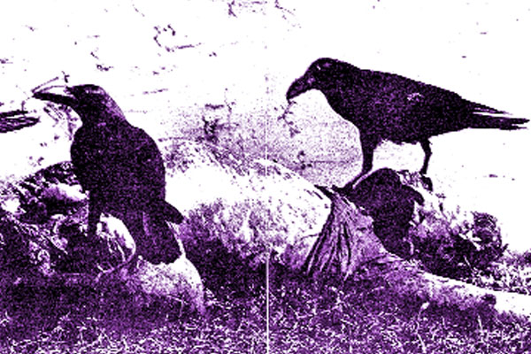

Slide 15
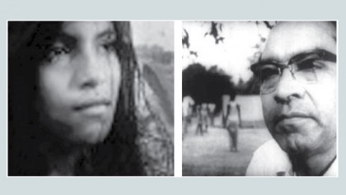

Slide 17
All through his life, Zahir dreamt for a democratic society, a society that will ensure freedom of speech and will. He had many dreams about our film industry too. He made a legendary film Jibon Theke Neya based on the Language Movement of 1952. It was a revolt against the then autocratic government. The family presented in that film was a miniature East Pakistan ruled by an autocrat who had to go to the prison for her conspiracy. During the liberation war this film was shown outside Bangladesh. Critics like Satyajit Ray, Mrinal Sen, and Ritwik Ghatak appreciated this film. Zahir gave all his money to the Freedom Fighters’ trust that he got from his film shows. Besides, his great documentary on Pakistani atrocities, Stop Genocide, helped create world sentiment in favour of our liberation war.

Slide 18
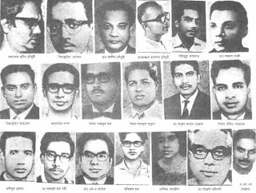

Slide 19
On 30 December 1971, someone informed Zahir about an address somewhere at Mirpur, where he might find his brother, the famous writer Shahidullah Kaiser. Shahidulla was captured and killed by the Pakistani army and the local collaborators during the last days of the war. Accordingly Zahir left home to get his brother back
and he never returned. Zahir’s dream was fulfilled. He could see the inception of a free independent Bangladesh though he did not get back his brother. And it’s a pity that this dreamer was missing at such a time when his dream came true.

Slide 20
Group work
C Use appropriate information from the text above to complete the grid.
Zahir Raihan
participated in | famous as | best document ary | movie based on language movement | missing since | his dream
The Liberation war,Language Movement
30 December,1971
Jibon theke Neya
Stop Genoside
Democra-tic
society
Film maker

Slide 21
Individual work
D Read the following sentences and complete them.
1 Zahir Raihan is famous as …………………
2 Zahir was imprisoned because ………………………………
3 He participated in …………………………………..and …………….
4 Jibon Theke Neya symbolizes…………………………………….. .
5 He donated ………………………………………………………
6 He worked to organize ………………………………………………
by his great documentary Stop Genocide.
7 His disappearance is a great……………………………. .
Film maker.
he participated in the procession on 21 february,1952
the language movement
the liberation
War.
the language movement of 1952.
money to the freedom fighters’ trust.
World sentiment against pakistaini
atrocities
Shock in the history of
Bangladesh.

Slide 22
Pair work
E Work in pairs. Discuss
1 Why is Zahir Raihan considered a freedom fighter though he was a film
maker?
2 How does the title of the lesson fit to the story of Zahir Raihan?
Answer:1.It is because in 1971 he joined the liberation war.
2.A great freedom fighter zahir Raihan fits to the story of zahir Raihan.

Slide 23
Homework
Meet a freedom fighter in your locality. Interview him/her. Then write a paragraph on him/her.

Slide 24
Goodbye

