Slide 1
Welcome

Slide 2
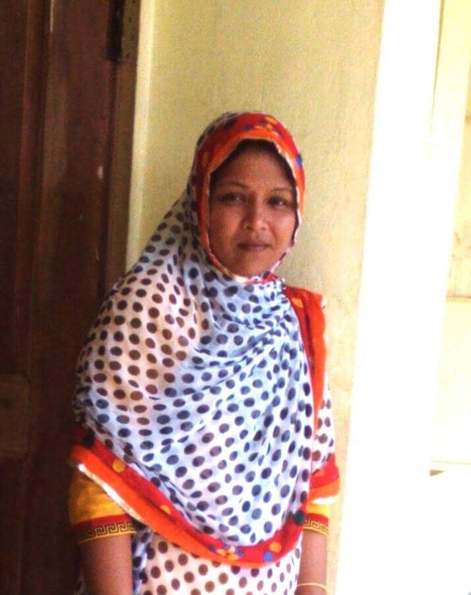
Me
Margaret Adhikari
Asst:Teacher
Baligoan govt. Primary School
Kamalgonaj
Moulvibazar

Slide 3
Class: Two
Subject: English
Unit: 29
Lesson: 4-6

Slide 4

Learning outcomes
Students will be able to:
Listening:1.1.1 become familiar with English sounds by listening to common English words.
4.2.1 Enjoy simple stories.
Speaking :1.1.1 repeat after the teachers simple words and phrases with proper sounds and stress.
1.1.2 say simple words and phrases with proper sounds and stress.

Slide 5
What is this?
It’s a goose

Slide 6
What is this?
It’s a Egg

Slide 7
Today’s lesson
The Golden gooes

Slide 8
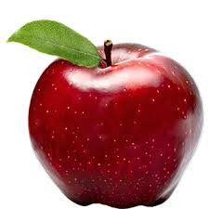
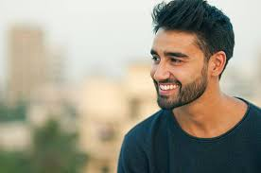


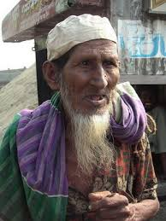
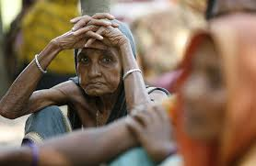
Review of previous lessons
Big
Happy
Rich
Small
Sad
Poor

Slide 9
New words and meaning.
1. Farmer = কৃষক
2.Egg = ডিম
3.Goose = হাঁস
4. Poor = গরীব
5.Rich = ধনী
6.Belly = পেট
7.Inside = বাহির
8.Opens = খোলা
9.Kills = মেরেফেলা
10. Money = টাকা

Slide 10
A poor farmer has a goose. Every day, the
goose lays an egg. It’s a golden egg. Every
day, the farmer sells the egg.
This is a poor farmer and goose.

Slide 11
The farmer thinks, “I want to be rich. I have
an idea!”
He kills the goose. He opens its belly, but
there are no eggs!
The farmer thinks all the eggs are inside the
goose.
This is a poor farmer.

Slide 12
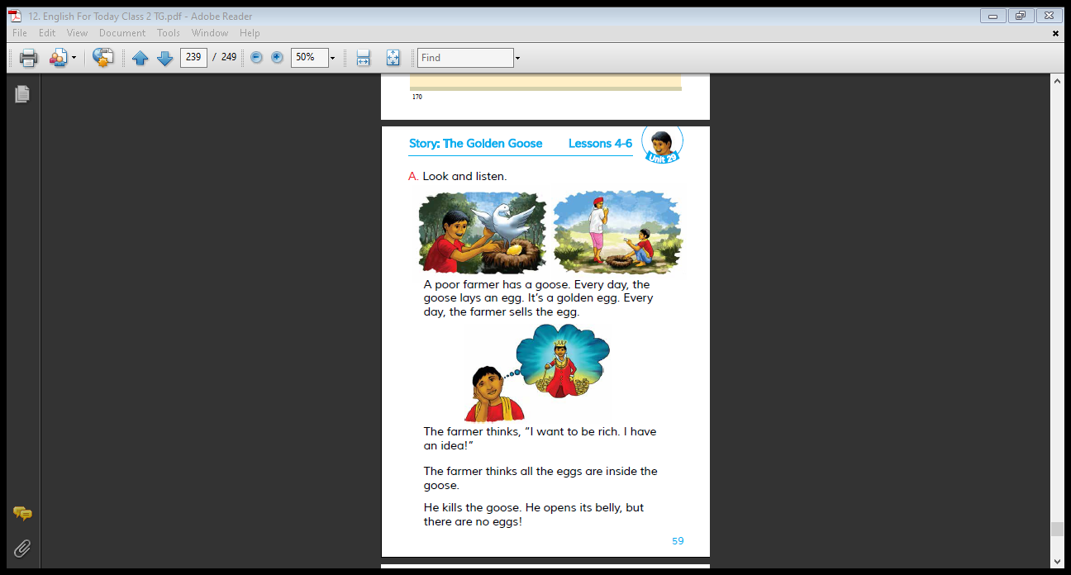
Teacher’s Reading
Dear students, open your book .

Slide 13
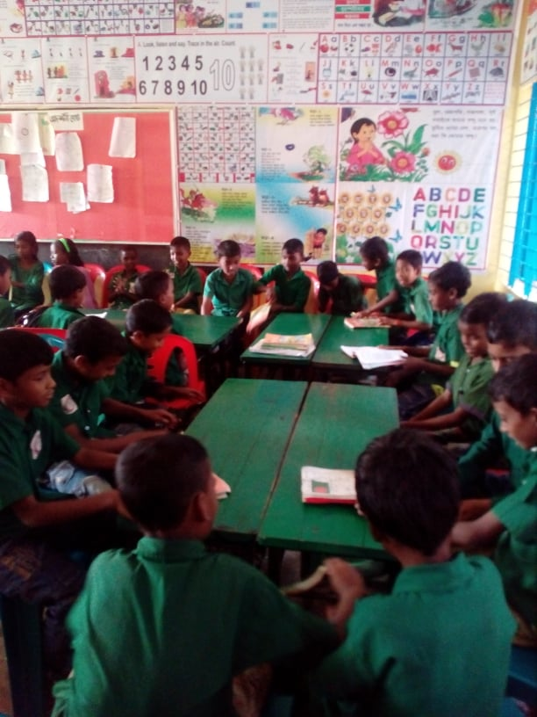
GW
One group will read and other group will follow them.

Slide 14
Matching:
Goose
Farmer
Egg
Rich

Slide 15
Write true or false.
IW
1 The farmer sells the egg every day
2 The farmer buys eggs every day.
False
True
3 The farmer is rich.
False

Slide 16
IW
Read the passage about ‘ The Golden Goose’ from the text book and write the answer of the following questions.
1. What kind of eggs did the goose lay?
Ans: The goose lays golden egg .
2. What did the farmer do with the egg?
Ans: The farmer sells the egg.
Notes:
The teacher can ask SS to go to the textbook. After reading the passage student will find out the answer from the passage. 10 minutes can be given for the task. Then the teacher can elicit answer from 4/5 students. Then the teacher can show the answer.

Slide 17
Let’s us learn a word
Rich
ধনী

Slide 18
Home work
1.Write in your note book 5 sentences about the story.

Slide 19

Thank you everybody.
See you again.
Bye Bye

