Slide 1
Welcome

Slide 2
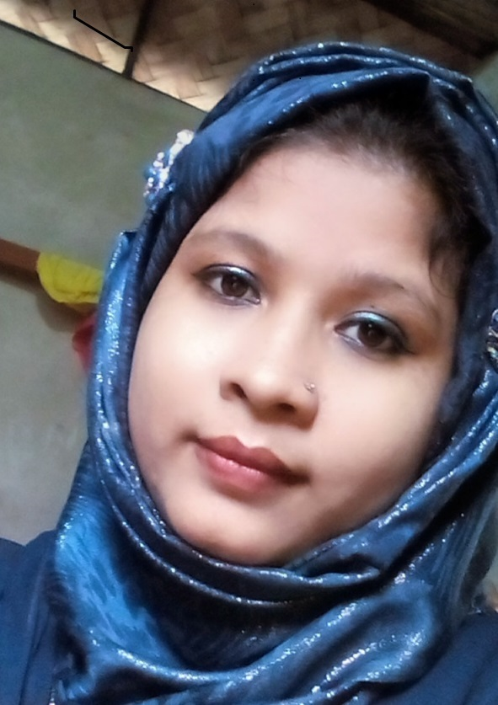
Introduction
Amena Ferdosi (Nizum)
Assistant Teacher (English)
Bhimpur High School
Chatkhil, Noakhali
Teacher Introduction
Class: Ten
Subject: English 1st Paper
Unit:14, Lesson: 9

Slide 3
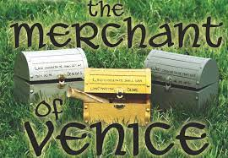
What do you see in the picture?

Slide 4
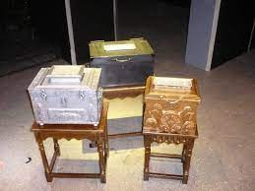
Today our lesson topic is………..
The three caskets

Slide 5
Learning Outcomes
After we have studied this lesson, we will be able to—
ask and answer questions
narrate incidents and events in a logical sequence
understand and enjoy stories and other texts
read and understand the text through silent reading

Slide 6
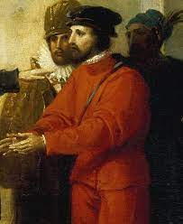
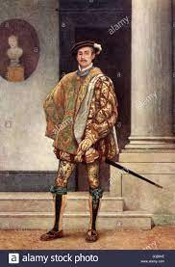
Once upon a time in Venice, there was a very rich merchant named Antonio.

Slide 7
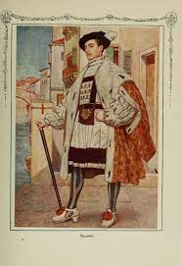
Antonio had a close friend named Bsssanio. He was a handsome young man and was born in a noble family.

Slide 8
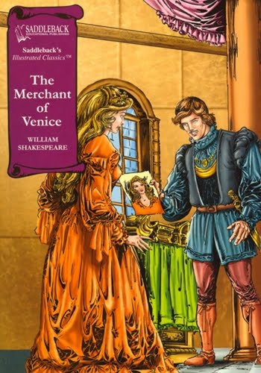
Bassanio fell in love with a wealthy lady named Portia.Portia known not only for her beauty but also for her wisdom.

Slide 9
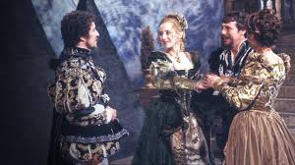
Portia’s father had death lately. Before his death he had thought of an unusual plan to find a good husband for his daughter, he wanted a man to marry Portia for herself not for her wealth.

Slide 10
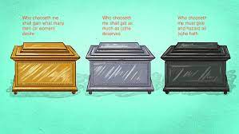
He had three caskets made, one of gold, one of silver and one of lead. One of the caskets had Portia’s portrait in it. The suitor, who would first choose the casket with the portrait would marry her.

Slide 11
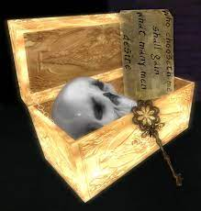
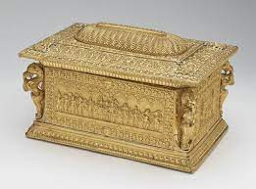
The first one to try was the prince of Morocco. He chose the gold casket. But all he found was a picture of a skull with a massage that said, “All that glitters is not gold”.The prince very sad and went back home.

Slide 12
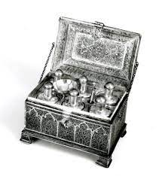
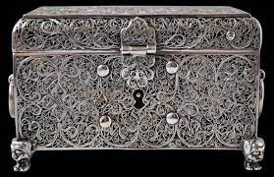
Then came the prince of Spain. He chose the silver casket and opened it. Inside the casket he found the picture of a blinking fool. He was disappointed and immediately rode away.

Slide 13
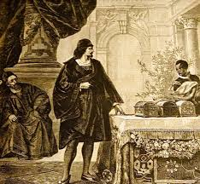
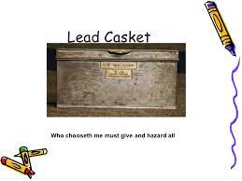
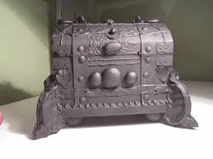
Then it was Bassanio’s turn . He thought, Appearances are misleading. Bad men appear good and they hide their inner ugliness under fine clothes.” He chose the plain looking lead caskets. On opening the casket, he found the portrait of Portia inside.

Slide 14
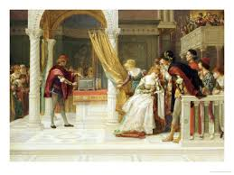
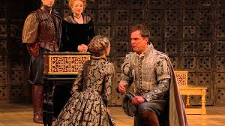
Bassanio and Portia got married. There was a great joy at Belmont and the newly married couple was spending their time happily.

Slide 15
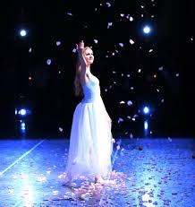
Let us know some key words.
Grandly
In a proud, impressive.

Slide 16
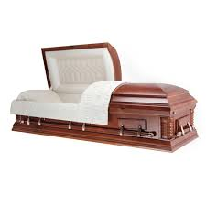
Casket
a small ornament box

Slide 17
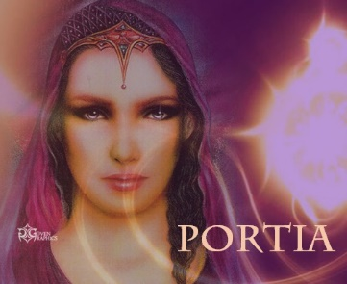
Portrait
A painting, drawing

Slide 18
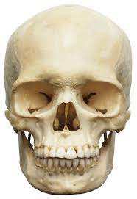
Skull
The skeleton of a person’s or animal’s head

Slide 19
Answer the following questions.
Why did Portia’s father make such a strange plan?
Write what you know of the three caskets.
How many people attempted to choose the right casket?
Who succeeded to marry Portia? Why/ how?

Slide 20
Home work
Write a short notes about the story.

Slide 21
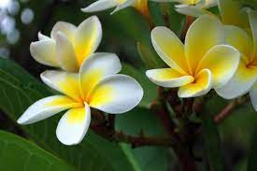
Thank You

