Slide 1
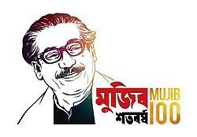
welcome

Slide 2
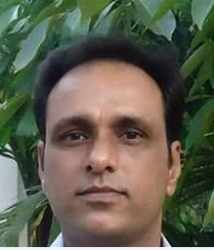
Teacher introduction
Ranadhir Das
Assistant teacher
Dokkhin sangor Govt. Primary School,
Baniachong, Hobiganj.

Slide 3
Class-Four
Subject-English
Unit-40
Lesson:1-2

Slide 4
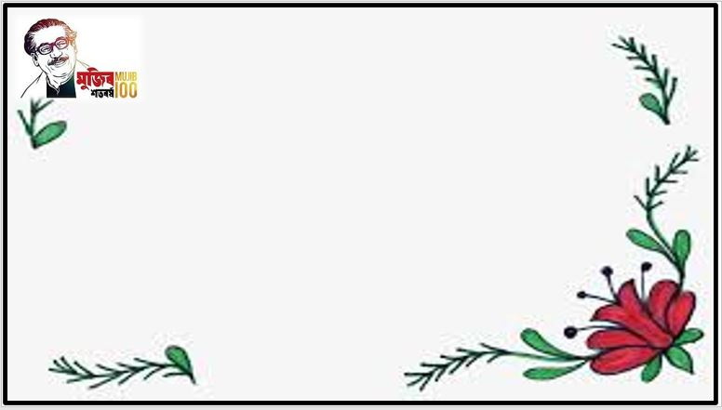
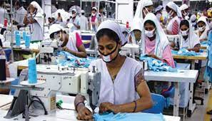
What is this picture?
A garment

Slide 5
Our today’s lesson is--
A garment worker’s day

Slide 6
1.4.1 recognize and use intonation patterns for Wh and Yes/No questions, greetings and statements.
1.1.1 repeat after the teacher and say words phrases and sentences proper sounds and stress.
1.4.1 read words, phrases and sentences in the text.
3.1.1 write words phrases and sentences using non cursive capital and small letters.

Slide 7
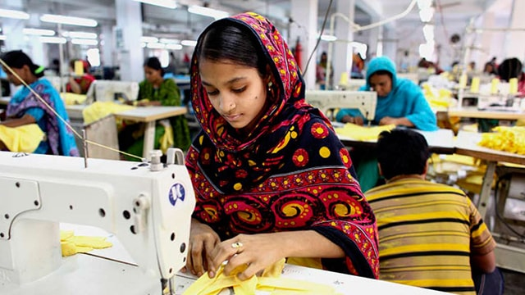
Look at the picture
Q-Who is she?
Ans-She is Reshma.
Q-What does she do?
Ans- She is a garment worker.
Reshma is 18 years old. She is a garment worker in Dhaka.

Slide 8
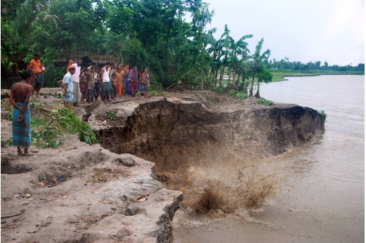
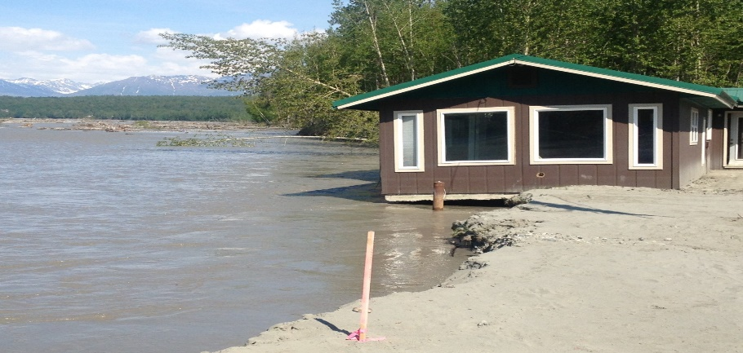
Q-What is this?
Ans-River erosion.
There was river erosion in Reshma’s village.
They lost their home.

Slide 9
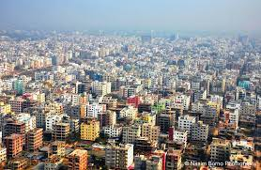
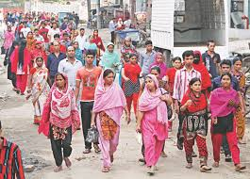
Dhaka city
Dhaka city
So their family came to Dhaka before eight years ago.

Slide 10
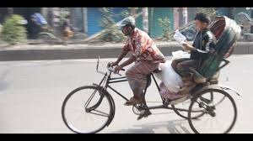
Look at the picture
He is Reshma’s father.
Who is he?
What does he do?
He is a rickshaw driver.

Slide 11
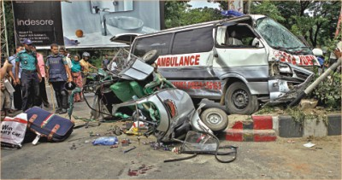
But he died in an accident.

Slide 12
Individual work
1.Who is Reshma?
2. What was Reshma’s father?

Slide 13
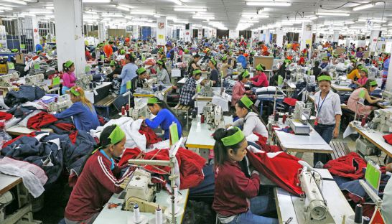
This is Reshma’s workplace.
She works this garment factory in Mirpur.

Slide 14
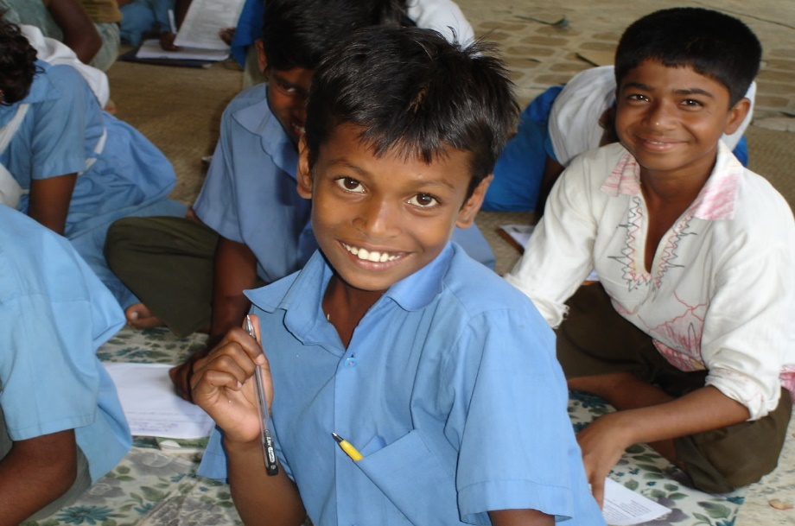
Look at the picture
Q- who is he?
Ans- He is Babul.
Babul is Reshma’s younger brother. He goes to school.
He reads in class v.

Slide 15
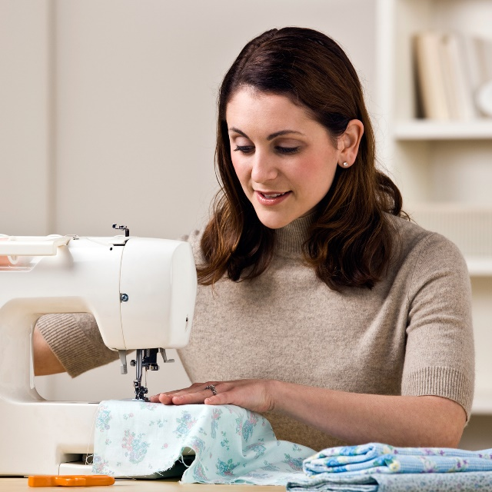
Look at the picture
Q- who is she?
Ans- She is Reshma’s mother.
Reshma’s mother stitches “nakshi kathas” at home and sells them.

Slide 16
Factory
The garment factory is two kilometres from Reshma’s house.

Slide 17
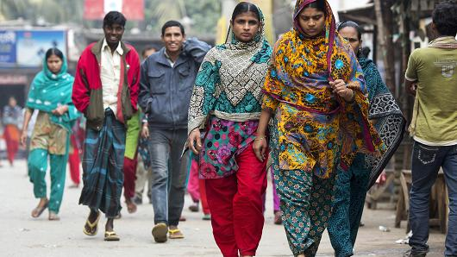
In the morning, Reshma goes to work on foot.

Slide 18
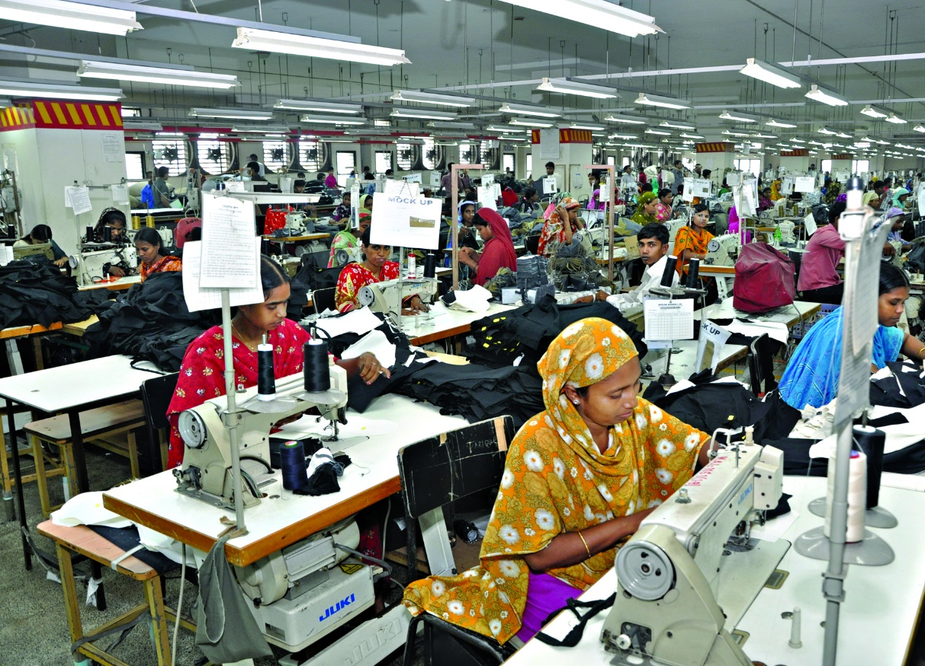
Reshma is working.
She works from 8 a.m to 4 p.m.

Slide 19
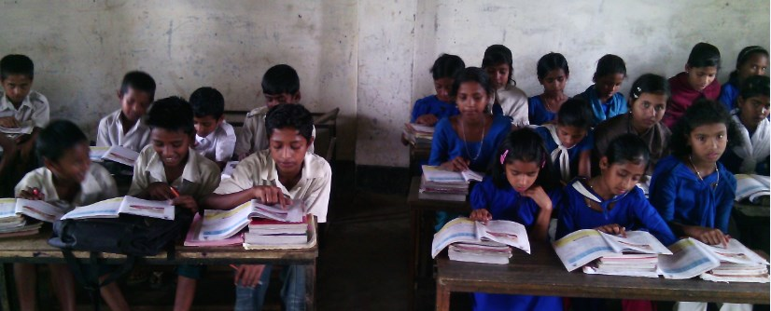
Students reading

Slide 20
Small group work (SGW)
Write new words from the lesson:-
extra
lost
driver
stitch
erosion
accident
like

Slide 21
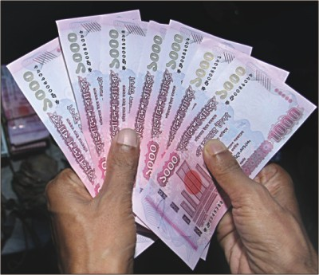
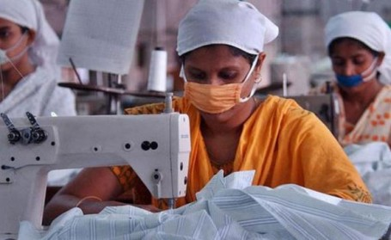
She often works extra hours until 6 p.m. So she can make more money.

Slide 22
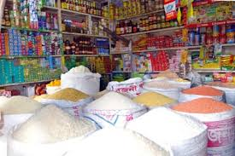
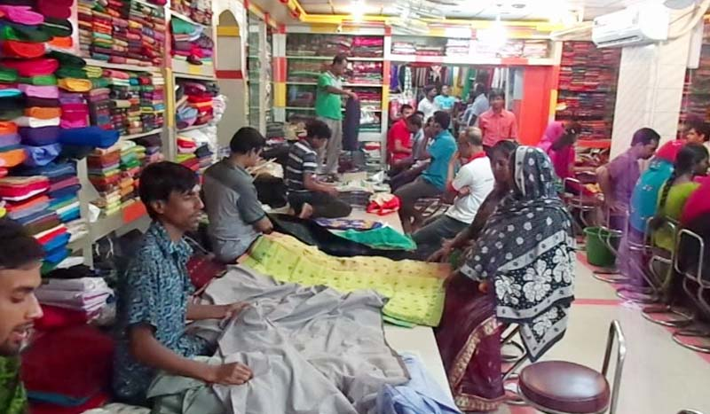
Her family needs this money for food and other things.

Slide 23
Groupwork
* Fill in the blank with suitable word:
1.There was river ……………. in her village.
2. Reshma’s father was ……………… driver.
3. Reshama’s mother stitches ………………… .
4. Babul reads in class …….. .
5. They lost their …………… .

Slide 24
Choose the correct answer
Q- Who is Babul?
Q-Where is the factory?
a) Reshma’s friend
a) In Mirpur
b) Reshma’s brother
b) In Kalyanpur
c) Reshma’s uncle
c) In Gulshan
d) Reshma’s father
d) In Farmgait
Q-Where does Reshma like to go?
Q-When does Reshma go to work?
a) The cinema
a) In the evening
b) The picnic
b) In the morning
c) The market
c) In the afternoon
d) The college
d) At night

Slide 25
1. Why did Reshma’s family come to Dhaka?
2. What does Reshma’s mother do?
3. How does Reshma go to work?

Slide 26
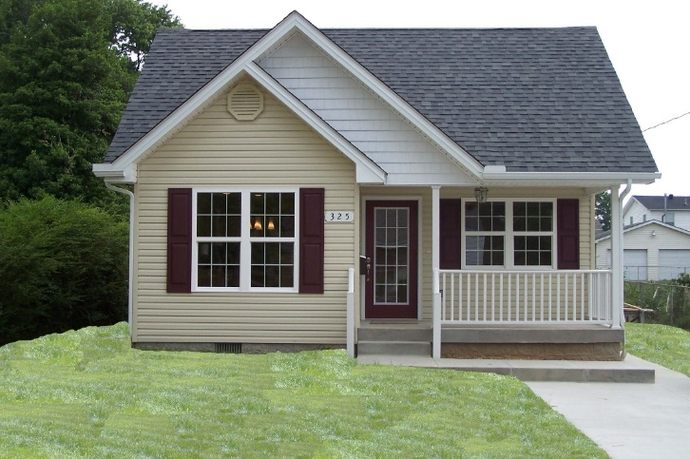
Homework
Suppose, Rohima is a garment worker, You will write five sentences about her.

Slide 27
Good bye

