Slide 3
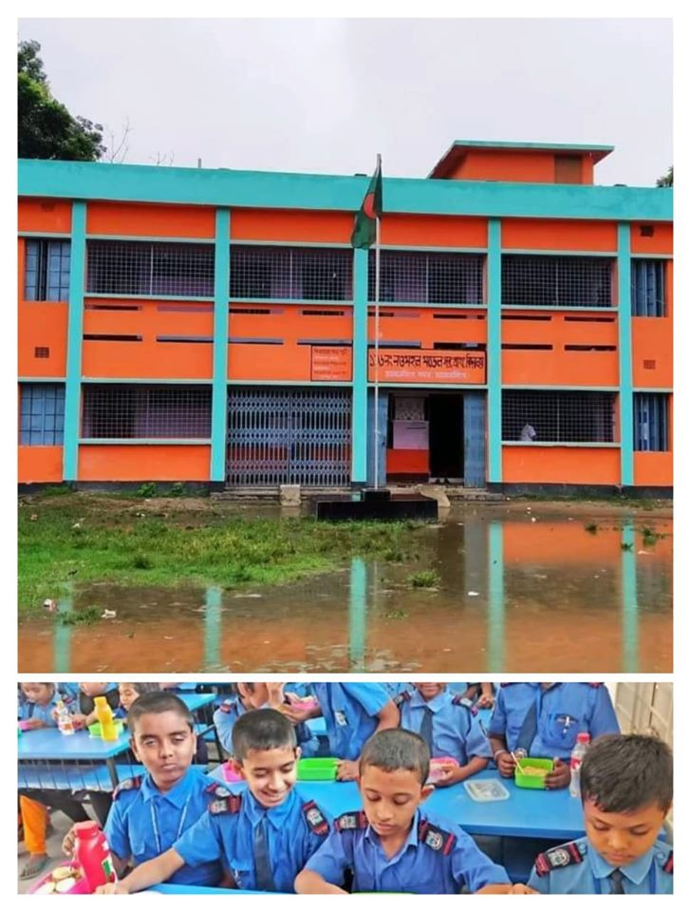
MD.KHALILUR RAHMAN
Assistant Teacher
Jangalia Union Govt. Primary School
Pakundia,Kishoreganj.

Slide 4
Class-two
Subject-English
Unit-14
Lessons 4-6

Slide 5
LEARNING OUTCOMES
Students will be able to-
Say and Write the words
(head,eyes,nose,ear,mouth,shoulder,
knee,toes).
Recite the rhymes “Head and Shoulders”.

Slide 6
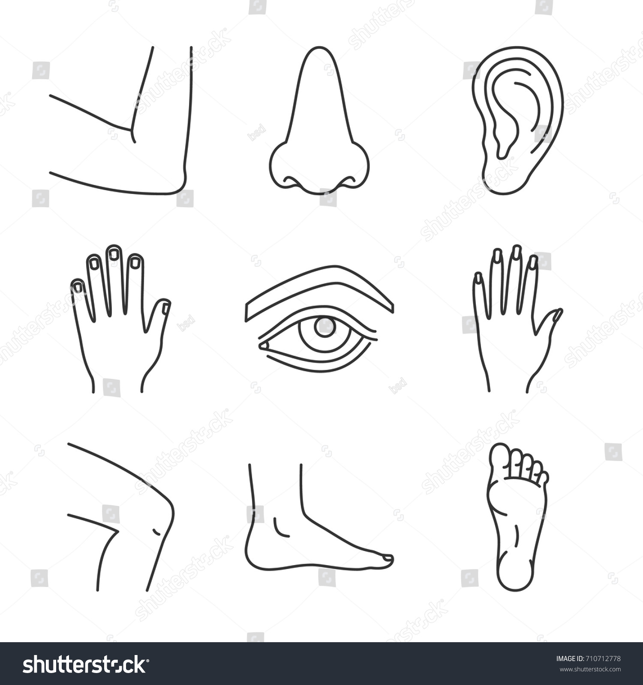

Slide 7
Head and shoulders

Slide 8
Page-22

Slide 10
Write the following words 3 times:
(Head,Eyes,Nose,Ear,Mouth,
Shoulder,Knee,Toes).

Slide 11
Home Work
“Head and shoulders” Rhymes.

Slide 12
Thanks To All

