Slide 1
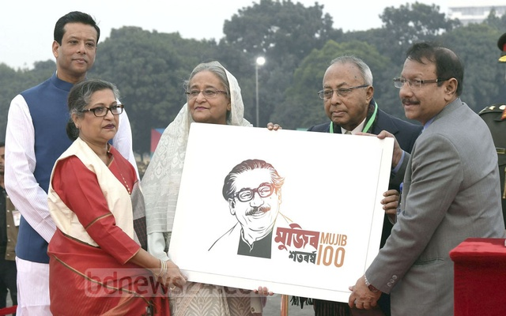
আজকের ক্লাসে
স্বাগতম

Slide 2
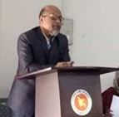
INTRODUCTION
AL ALIMUL RAZI.
Assistant Professor.(Economics).
English Teacher. (Part-time).
Daudpur Girl’s high School and College.
P.O-Daudpur, Upzela - Nawabganj, Dist – Dinajpur.
Class-Eight.
Subject-English.
Time-One Hour.

Slide 3
My dear students, do you have any idea about a dialogue?
Let us follow below.

Slide 4
Our Today’s Lesson is-
A dialogue on “Mobile Phone”

Slide 5
Learning outcomes
After we have studied this lesson we will be able to-
tell the merits and demerits of a mobile phone
the effect of use of a mobile phone
ask and answer questions
write a dialogue.

Slide 6
Mobile phone
Playing mobile game.
Watching something on mobile.
Driving car while using mobile.
Talking with mobile phone .
A baby is watching something on mobile phone.

Slide 7
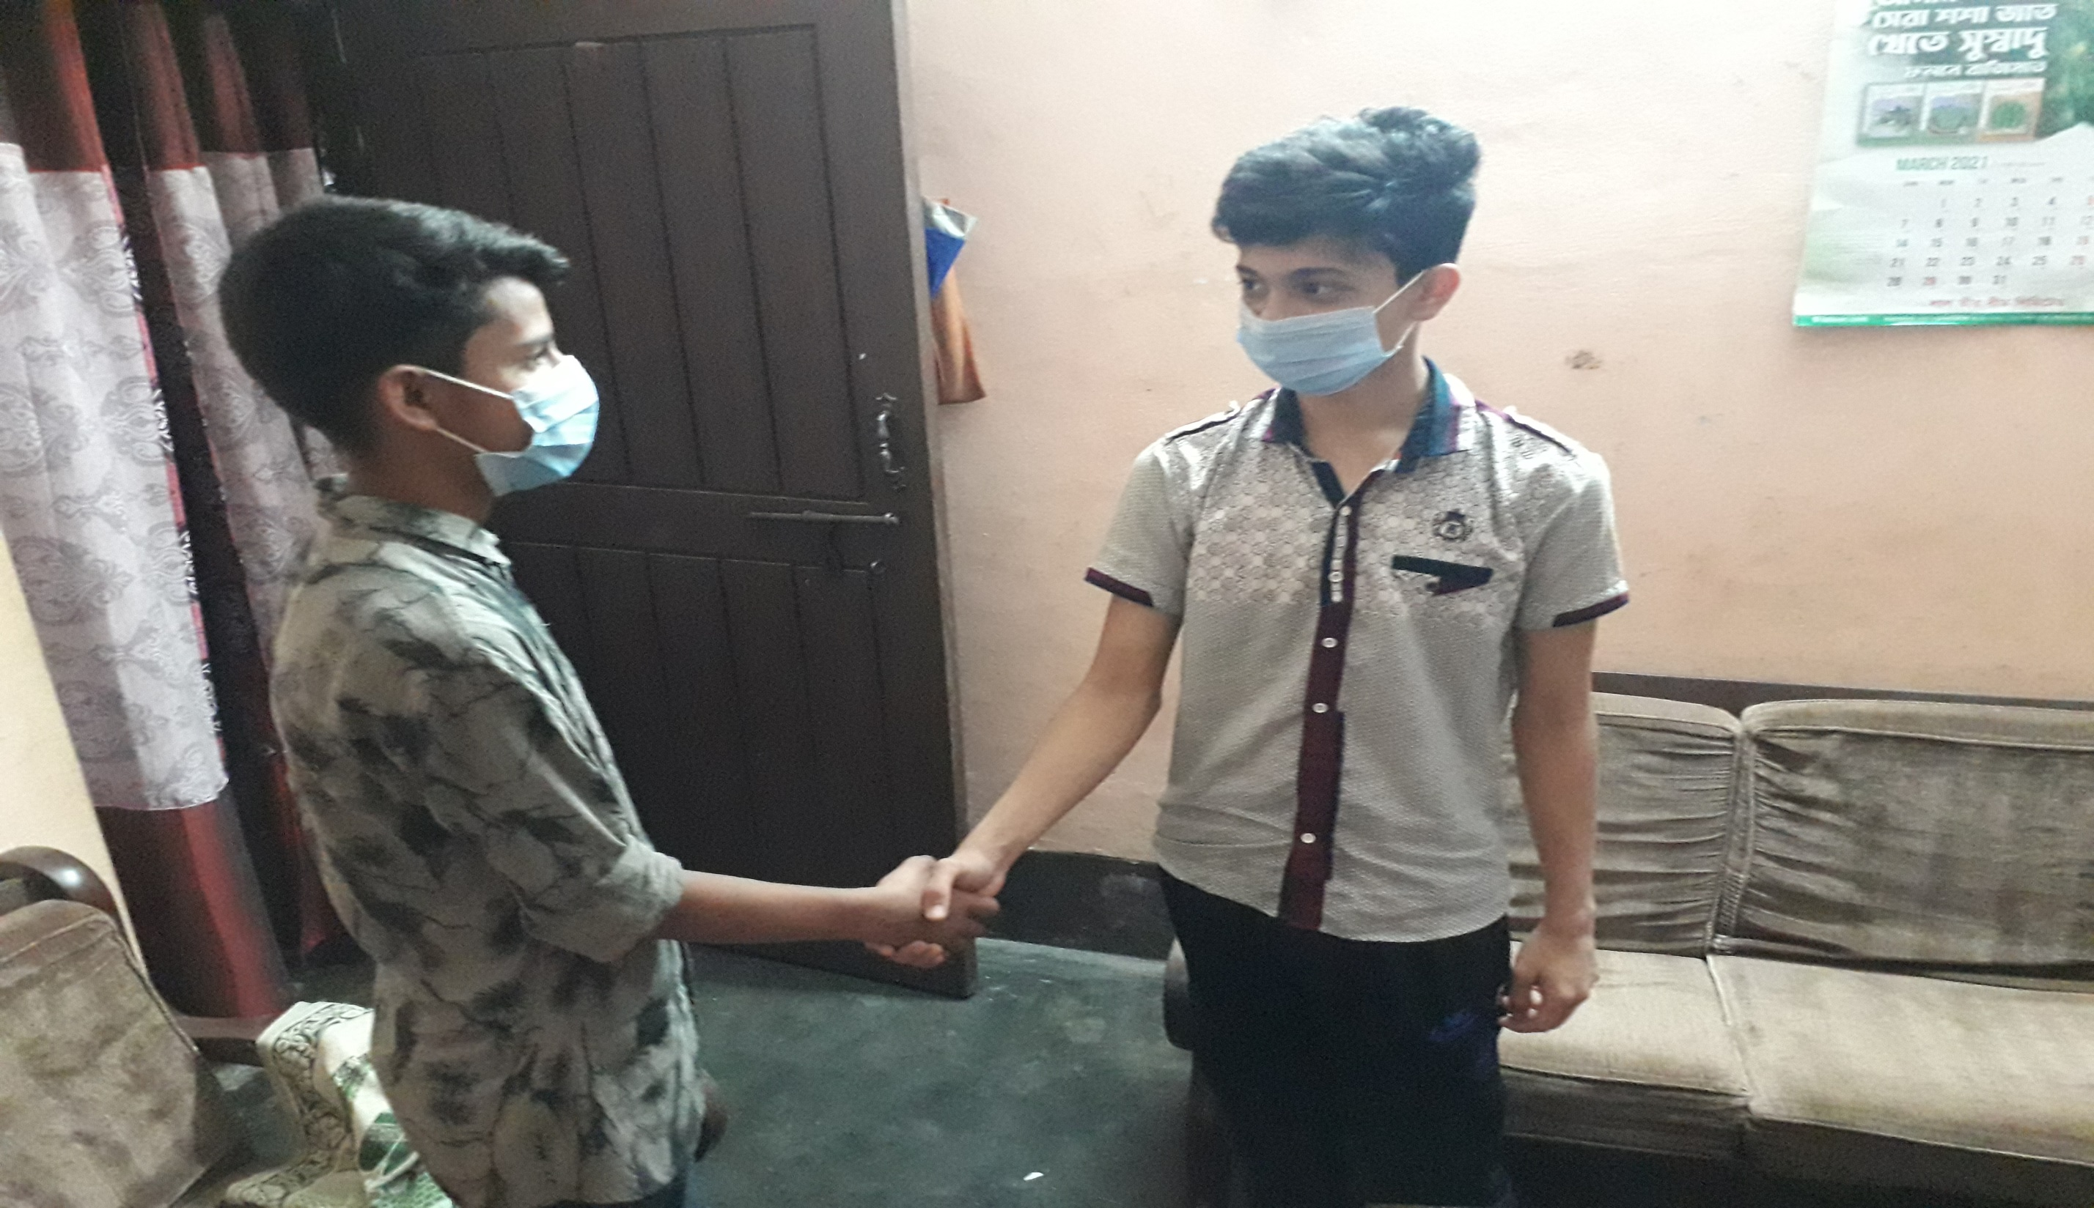
Hello friend! How are you?
Fine, my goodness! You come to my house? I am looking for you.

Slide 8
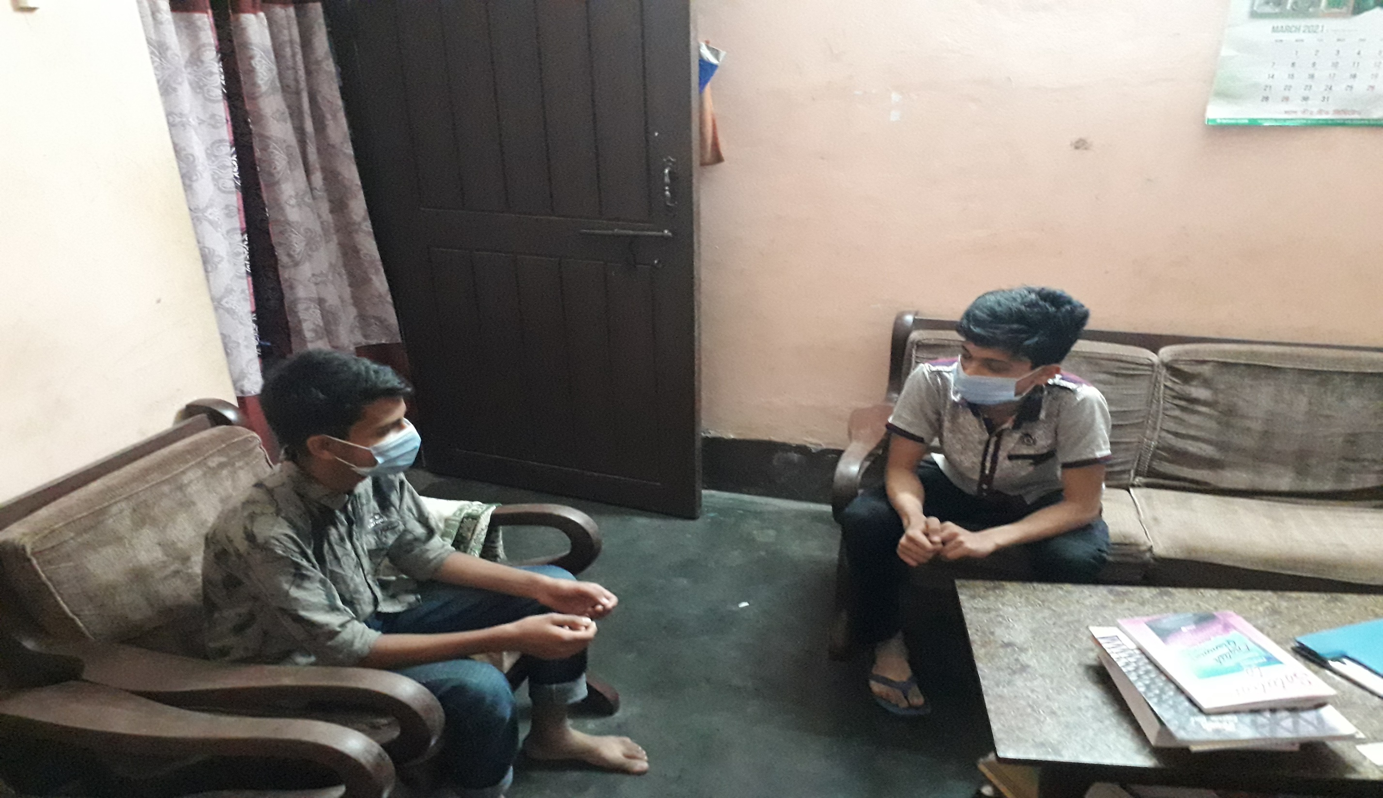
why?
Actually I want to know about the merits and demerits of a mobile phone.

Slide 9
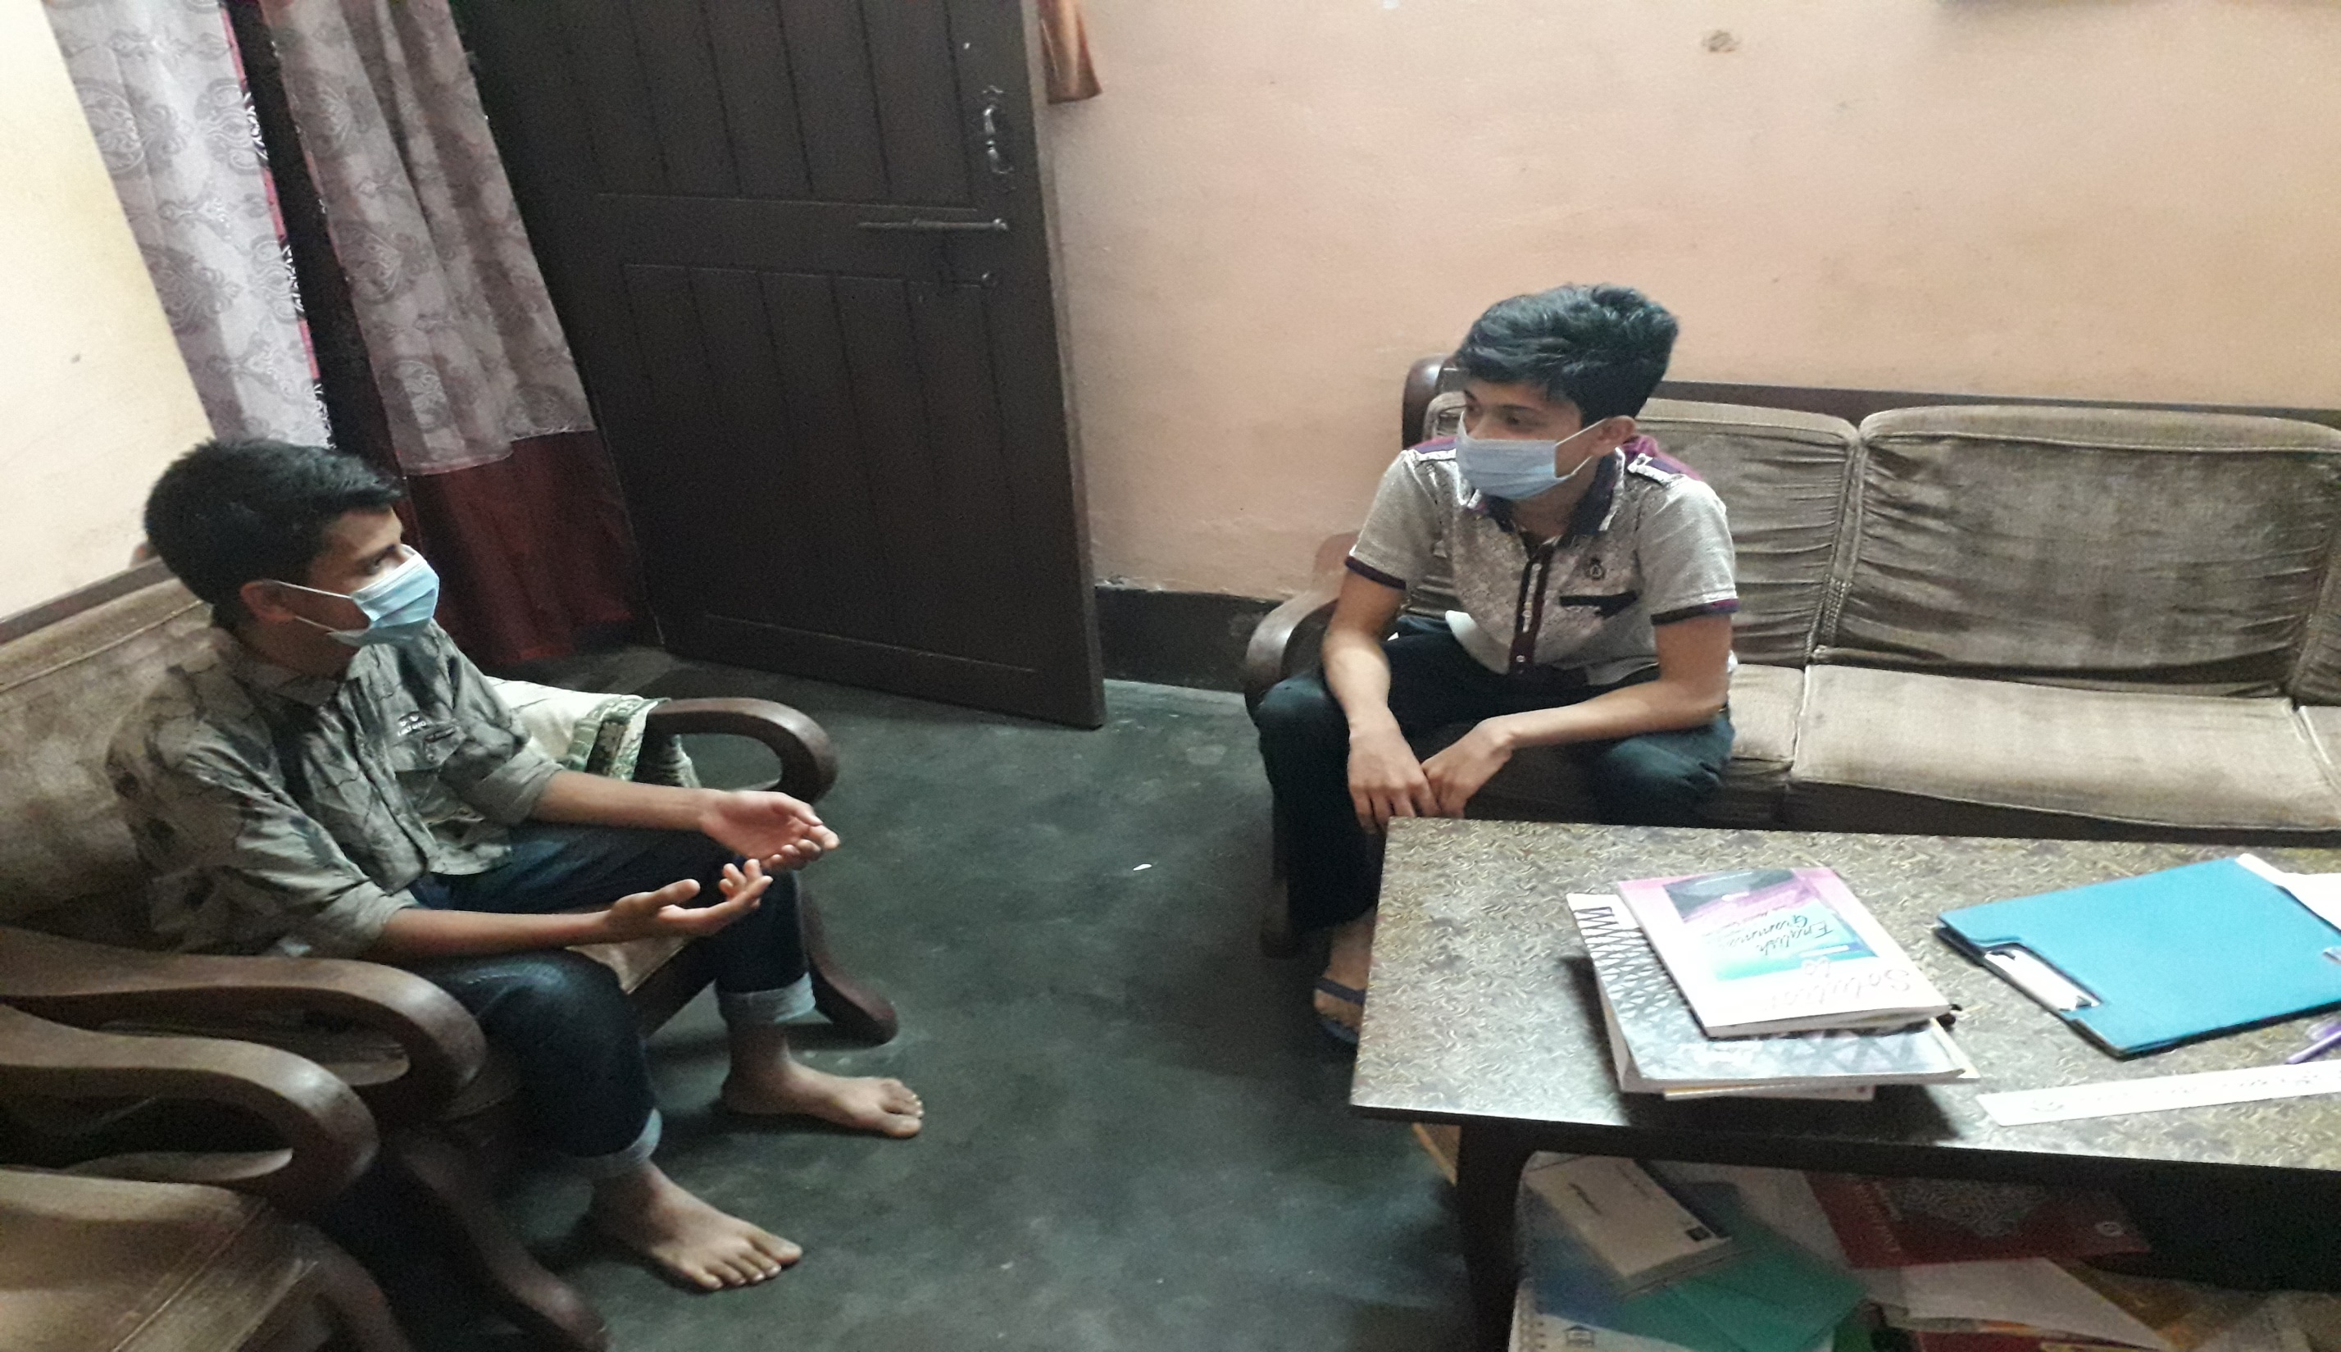
Sure, carry on.
I know, you’re using a mobile phone, then tell me the good sides.

Slide 10
Ok. Through the mobile phone, we can send messages to distant places, use the internet, play games, and sports, know about time, solve the work of calculation, be aware of different kinds of news and views.
But I know, something can be done with this phone that has a bad effect on young people. Such a variety of games, so that our young society becomes addicted. .

Slide 11
There are a lot of fun games on mobile phones that young people have a lot of fun. Due to this young people become addicted to mobile phones.
Due to this negative aspect I thing student should use this phone carefully.

Slide 12
But except these point mobile is grossly required in the age of speedy communication.
We should use this device carefully.

Slide 13
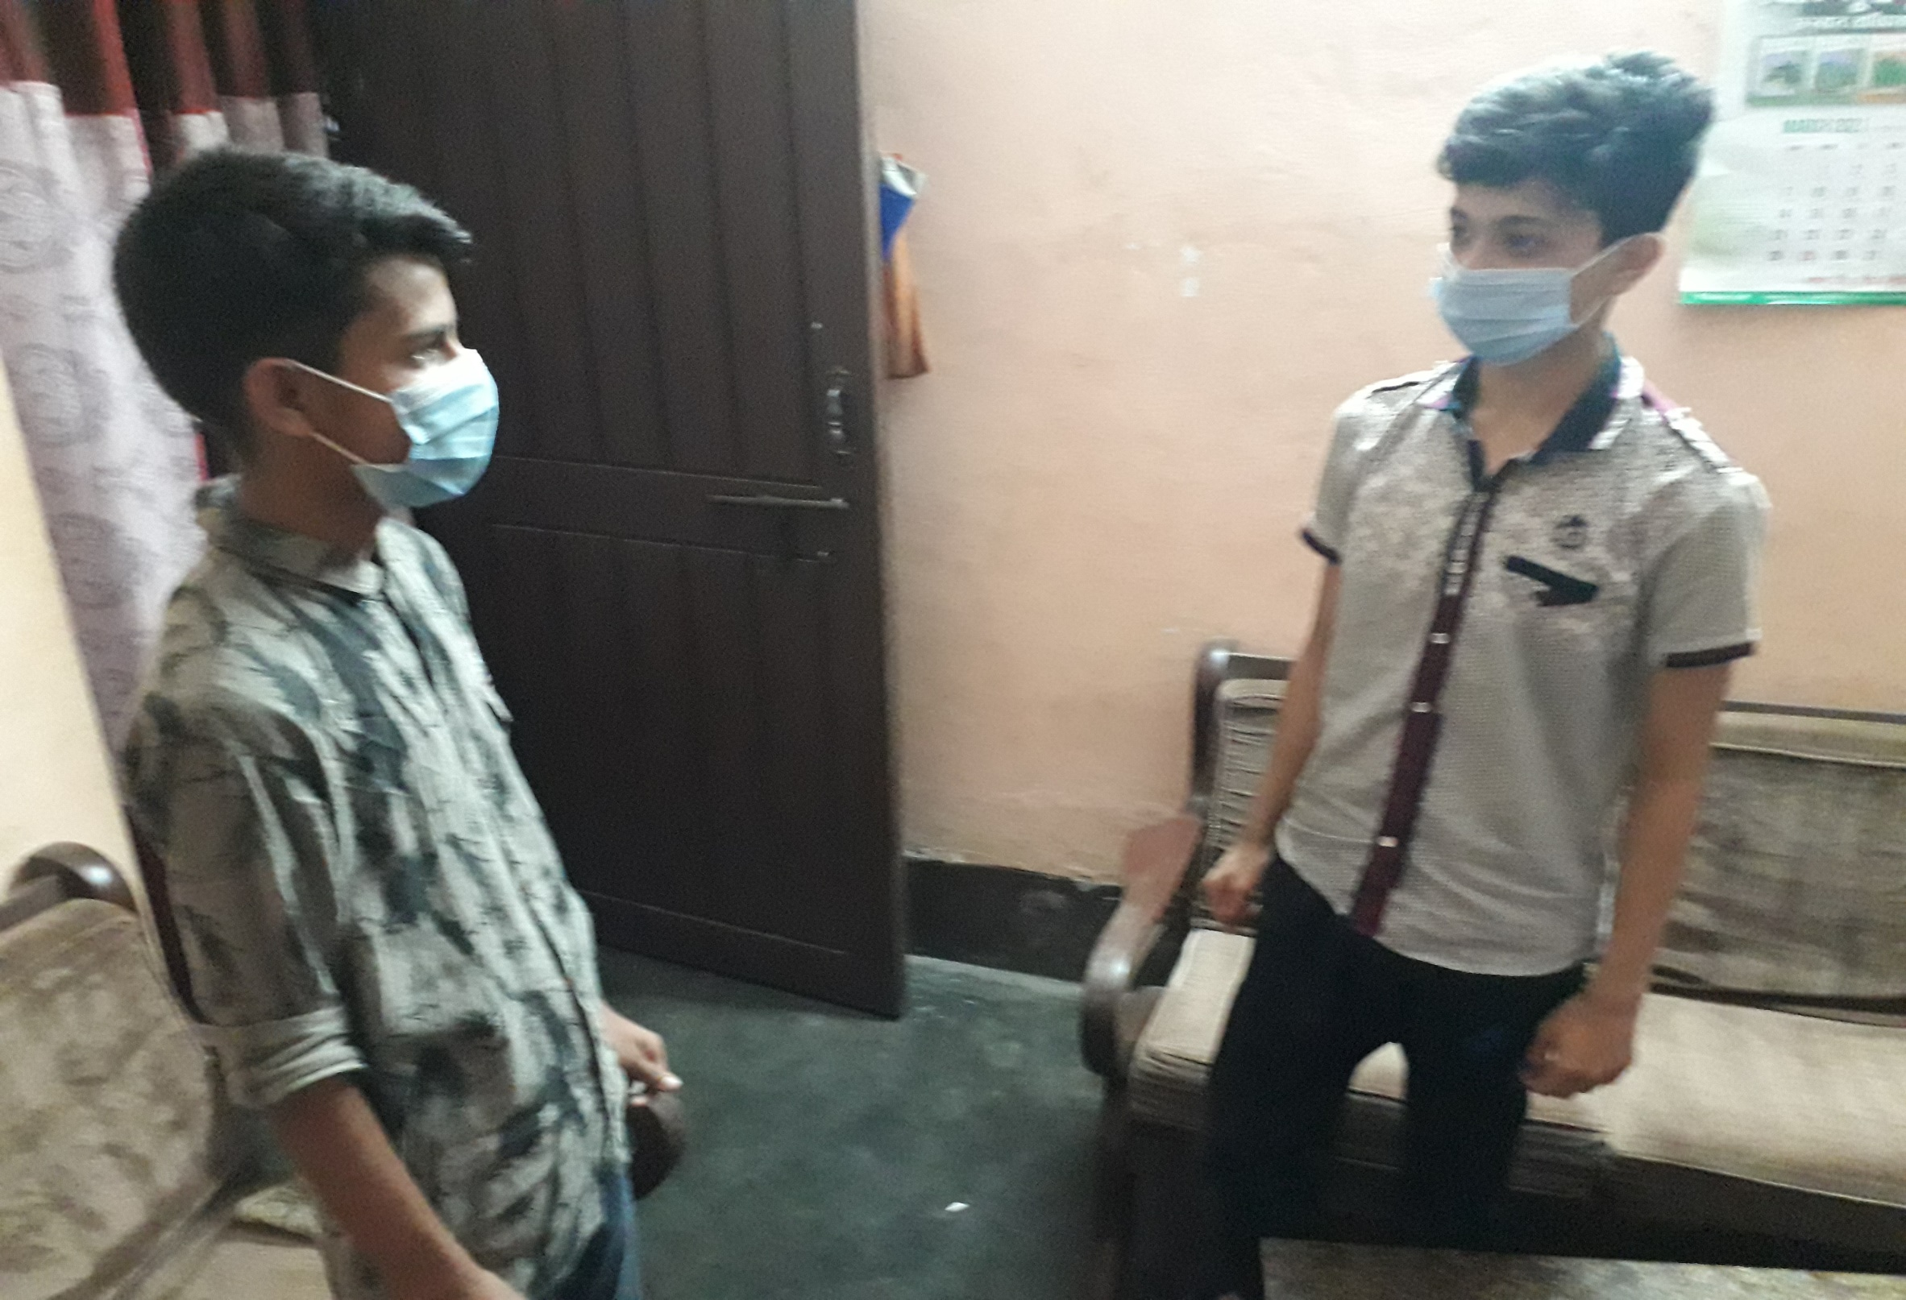
Well, I have to go right now.
Ok, see you again.

Slide 14
Thank you.
Well come.

Slide 15
Pair Work
All of you get involved in two and say two dialogue on mobile phone.

Slide 16
Evaluation
Answer the following questions-
What is mobile phone?
What is the bad effect of mobile phone?
What should we do to use mobile phone?

Slide 17
Homework
Make a dialogue with your friend about
“mobile phone”

Slide 18
Advice

Slide 19
+
Bye bye
Good bye

