Slide 1
WELCOME

Slide 2
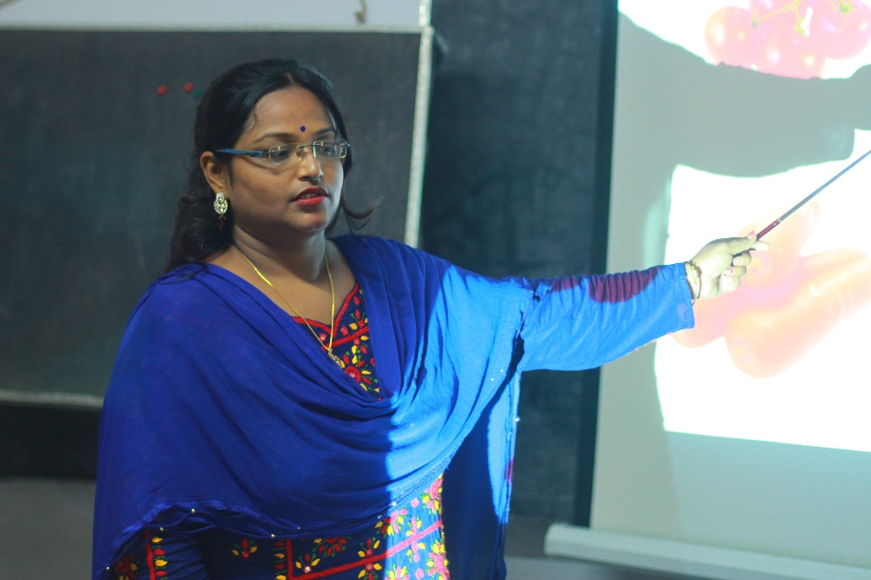
Teacher’s Identity
Labony Saha
Assistant Teacher, 45no.Maddhyapur Govt.Primary School
Abhaynagar,Jashore.

Slide 3
Lesson Identity
Class-5
Sub-English Title-Sagar and His Family,UNIT-15,lesson:1-3
Part-(Sagar………….housewife)

Slide 4
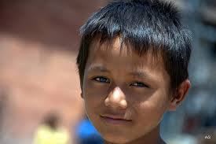
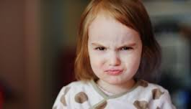
Presentation
Sagor
Sister

Slide 5
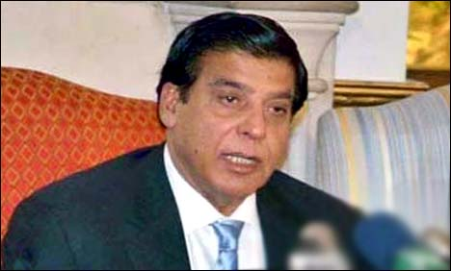
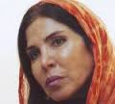
Father
Mother

Slide 6
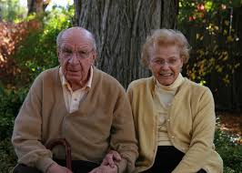
Grandfater
Grandmother

Slide 7
Sagor and His Family

Slide 8
New words Showing
New words
Meaning
Sentences
Students
Little
Housewife
Learner
Small
Who does household works
Sagar is a student
The boy is little.
She is a housewife.

Slide 9
T& SS aloud reading

Slide 10
Group Work
Shapla-Make sentences using words.
Students,housewife.
Golap-Answer the questions.
What class is Sagar in?
What is Sagar’s father?

Slide 11
Evaluation
Make 3 sententences using those words.
student,old,father.
Answer the questions.
What class is Sagar in?
How old is Sagar?
What is his father?

Slide 12
Hometask.
Make 5 sentences about your family.

Slide 13
Thanks all

