Slide 1
Welcome to my online class.
Welcome to my online class.

Slide 2
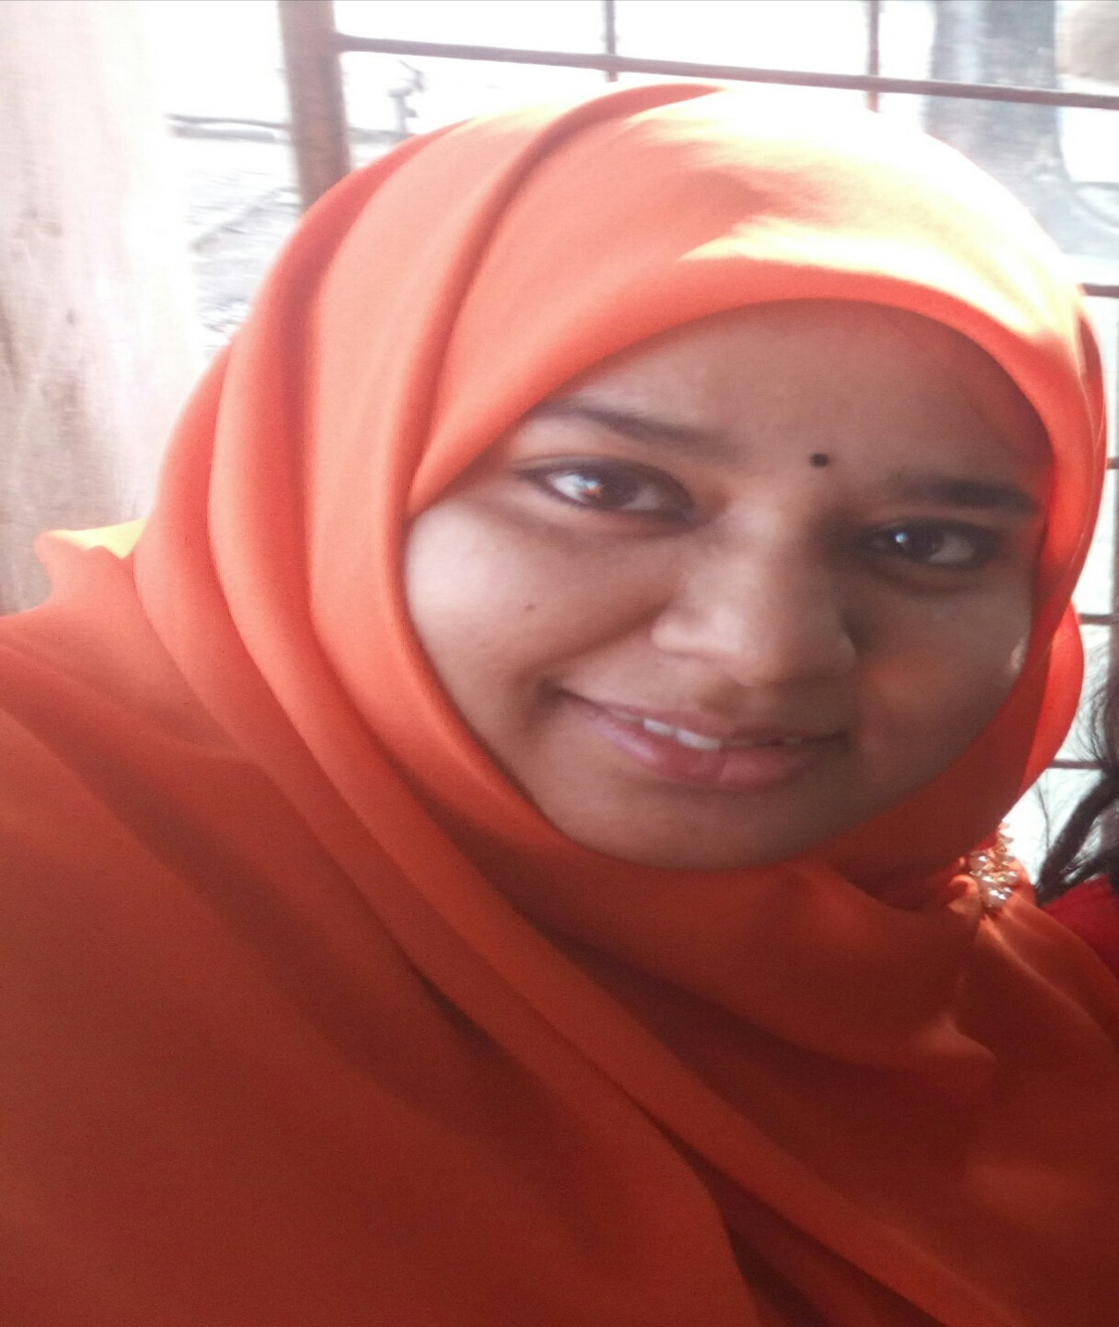
Teacher’s information
Syeda Nusrat Sarmin
Assistant Teacher
Ayjuddin Matubbor Kandi GPS
Faridpur Sadar, Faridpur

Slide 3
Lesson’s information
Class : Five
Subject : English
Unit : 17
Lesson : 1-2
Activity : F & G
Page : 67

Slide 4
Learning outcomes
By the end of the lesson the students will be able to
Listening:
3.4.1 understand statements made by the teacher and students.
Speaking:
1.1.1 say words, phrases and sentences with proper sounds, stress.
Reading:
1.7.1 read words, phrases and sentences in the text with proper pronunciation, stress and intonation .
1.7.1 read paragraphs, dialogues, stories, letters and other texts.
5.1.3 read silently with understanding dialogues.
Writing:
3.1.1 write words, phrases and sentences using non-cursive capital letters.
3.1.2 write words, phrases and sentences using non-cursive small letters.
8.1.1 make sentences using words and phrases given in the textbook.
9.1.1 take dictation of short and simple paragraph.

Slide 5
Teaching aids :
Pictures of cricket, cycling, football.
Word cards
Poster paper
Slide
CD drive/ audio

Slide 6
Answer the following questions.
1. Which games and sports does Arousha play or do?
Answer: Arousha plays badminton. She also does swimming and cycling.
2. Which games and sports does Baichong play or do?
Answer: Baichong plays cricket. He also does weightlifting.

Slide 7
Look at the pictures.

Slide 8
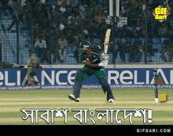
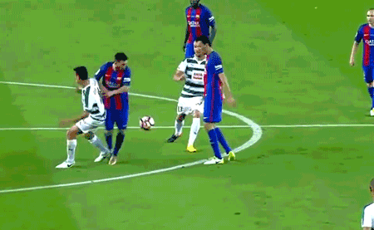
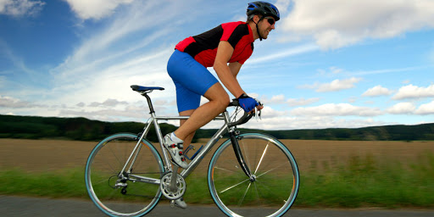
Cricket
Football
Cycling
What do you see in these pictures?
These are very popular sports.

Slide 9
Our today’s lesson is
Sport
Unit: 17, Lesson: 3-4, Activity: F&G;
Page: 67
Notes:
GgG

Slide 10
WCW
Look at the conversation, listen it carefully.

Slide 11
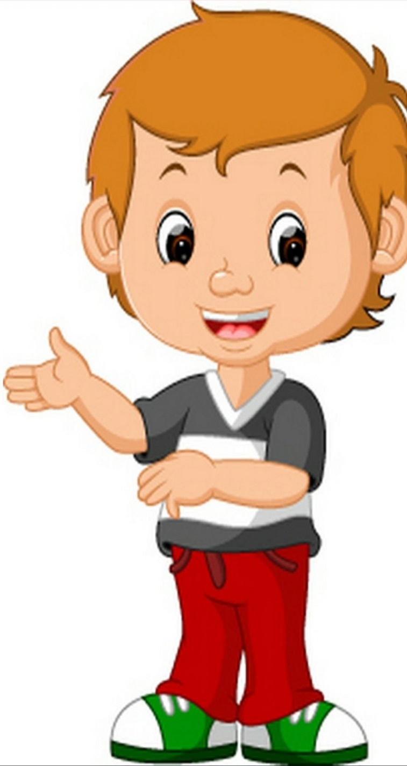
Listen and say.
Do you play or do any sports?
I play cricket, and I do weightlifting.
I love football too, but not as much as cricket. That’s my favourite sport.
I’d like to try kabadi. I’d also like to learn how to play volleyball.
Not very, but I want to get stronger. My brother is very strong.
Weightlifting! Are you strong?
Volleyball is exciting but I like playing football more.
My brother is strong, too. He plays kabadi and volleyball. He’s good at sports.
I love badminton. I play with my family on weekends. I also go swimming and cycling a lot.
Baichong
Anousha
Baichong
Anousha

Slide 12
IW
Open your EFT book at page 66, read and act the activity B with your pair.

Slide 15
Pair Work.
PW > IW
Act the activity B with your pair.

Slide 16
Open your EFT book at page 66, activity B. Find out the words go, play, do & like and circle these words.

Slide 18
IW
Open your EFT book at page 67, read the activity F and do it by yourself.

Slide 20
Play
Play
Play
Go
Go
Play
Play
Do

Slide 21
Write a sentence about each sport.
1. Badminton -
I love to play badminton.
2. Cricket -
I like cricket.
3. Cycling -
I go to cycling everyday.
4. Football -
I want to play football.
5. Kabadi -
I want to learn kabadi.
6. Swimming -
I love swimming.
I watch volleyball on the TV.
7. Volleyball -
8. Weightlifting -
My brother likes weightlifting.

Slide 22
Re-arrange the words.
1. alyp
- play
2. ketcric
- cricket
3. rotherb
- brother

Slide 23
Evaluation
Write ‘True’ for correct statement or ‘False’ for incorrect statement.
Baichong plays kabadi and volleyball.
Baichong’s sister is expert in sport.
Baichong likes to learn how to ride bicycle.
Anousha knows how to swim.
Both Anousha and Baichong like football.
False
False
False
True
True

Slide 24
Home work
Write a paragraph about cricket in Bangladesh.

Slide 25
Where there is a will, there is a way.
Good bye, dear students.

