Slide 1
welcome
welcome
welcome
welcome
welcome
welcome
welcome

Slide 2
Teacher’s Identity
Lesson Identity
Mahfuja Khatun
Class : Five
Subject : English
Unit : 9
Lesson : 5-6 (F&G)
Head Teacher
Sujanagor Govt. Primary School
Pangsha, Rajbari.

Slide 3
Learning Outcomes
Students will be able to :
Listening
1.3.1 recognize which words in a sentence are stressed.
1.4.1 recognize and use intonation patterns for Yes/No and Wh questions.
Speaking
1.1.1 say words, phrases and sentences with proper sounds and stress.
1.1.2 say sentences with proper intonation.
3.1.1 ask and answer Wh questions.
Reading
1.5.1 read words, phrases and sentences in the text with proper pronunciation, stress and intonation.
1.6.1 recognize and read statements, commands, greetings, questions and answers.
Writing
3.1.1 write words, phrases and sentences using non-cursive capital letters.
8.1.1 make sentences using words and phrases given in the textbook.

Slide 4
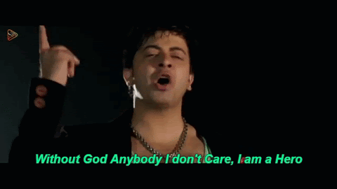
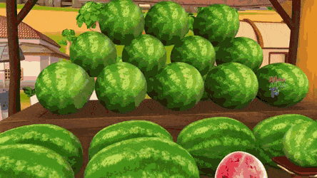
creating
Emotion
Let’s enjoy a video
Watch the video carefully
What do you see in the video? Who is doing what here?
A fruit seller sells fruit.
A dressmaker makes dress.
A film actor acts in the film.

Slide 5
Declear the
lesson
The work that people do to earn a living is his job/occupation.
Occupations

Slide 6
Verb | Noun
Paint
Play
Act
Sing
Dance
Make
Drive
Review of previous lesson
Painter
Player
Actor
Singer
Dancer
Maker
Driver

Slide 7
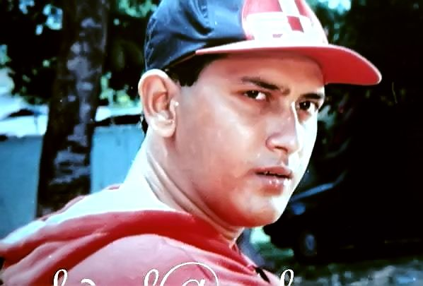
Do you know him?
He acts in the film.
Let’s see some pictures and discuss about them.
What does he do?
He is a film actor.

Slide 8
What does he do?
Who is he?
He is a bus driver.
He drives a bus.

Slide 9
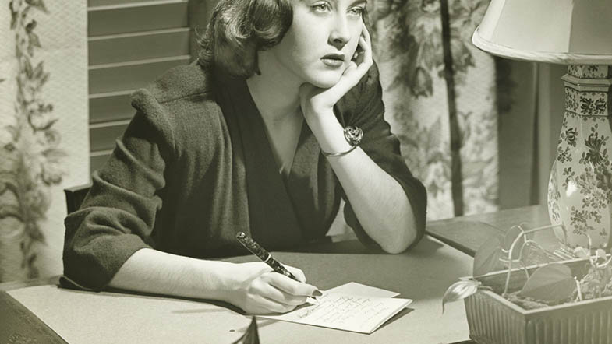
What does she do?
Who is she?
She is a writer.
She writes stories or poems.

Slide 10
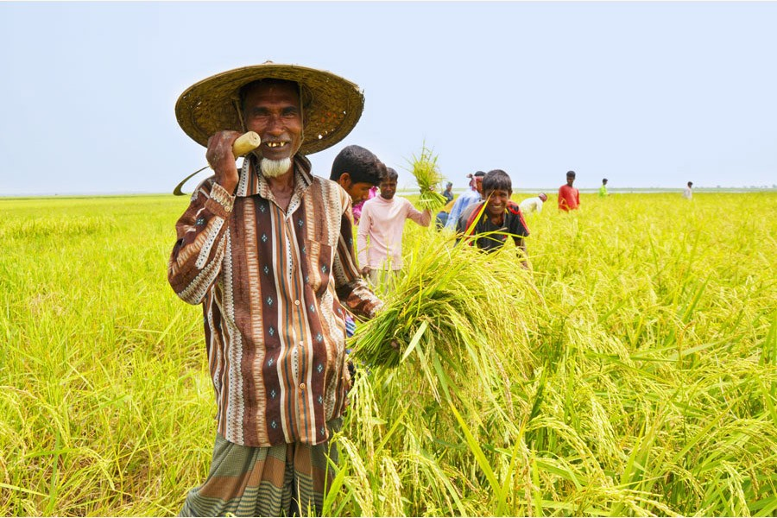
Who is he?
What does he do?
He is a farmer.
He grows crops.

Slide 11
Who is he?
What does he do?
He is a baker.
He bakes bread.

Slide 12
silent reading
Students , please read
the text silently
and try to understand.

Slide 13
Pair work
Write the questions or answers in your exercise book. Ask and answer the questions.
1 What does a film actor do?
Ans: A film actor acts in the film.
2 What does bus driver do?
Ans: A bus driver drives a bus.
3 She writes stories and poems.
Ans: What does a writer do?
4 He grows crops.
Ans: What does a farmer do?
Ans: What does a baker do?
5 He bakes bread.

Slide 14
Group work
Write the other occupations you know in your exercise book.
Teacher, Doctor, Shopkeeper, Cobler, Painter, singer, Dancer.

Slide 15
Evalution
Write 5 sentences about different occupations.

Slide 16
We have learned about different occupations.
What have we learned from this lesson?

Slide 17
Home work
Write 5 sentences about 5 occupationals who live around you.

Slide 18
Thank you

