Slide 1
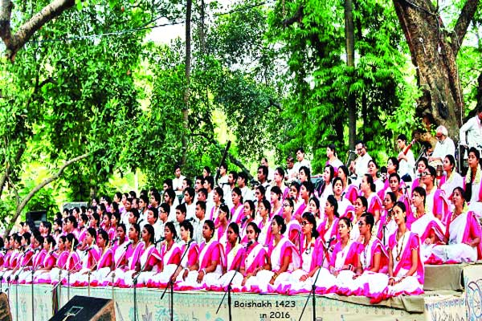
WELCOME

Slide 2
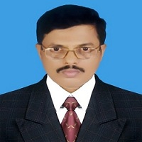
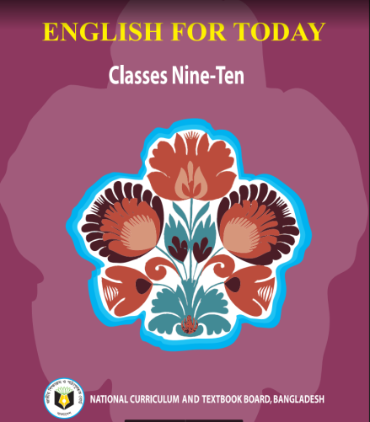
IDENTITY
Md. Saiful Islam Chowdhury
Senior Teacher
C. J. M High School,
Mohara, Chandgaon, Chittagong..
saifulcjm@gmail.com Mob: 01991945882
ENGLISH FOR TODAY
Class : Nine-Ten
Unit- Three , Lesson – six

Slide 3
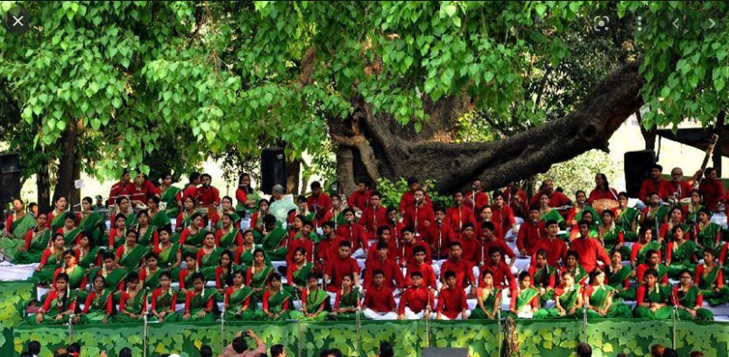
Look at the picture
1. What do you see in the picture?
1. In the picture young people are seen wearing traditional dress .
2. Where do you think the picture was taken?
2. I guess It was taken at the Ramna Batamul in Dhaka.
3. What are the people doing?
3. The people here are performing at a cultural programme.Their traditional Bengali dresses suggest that it is nothing but a Pahela Boishakh celebration

Slide 4
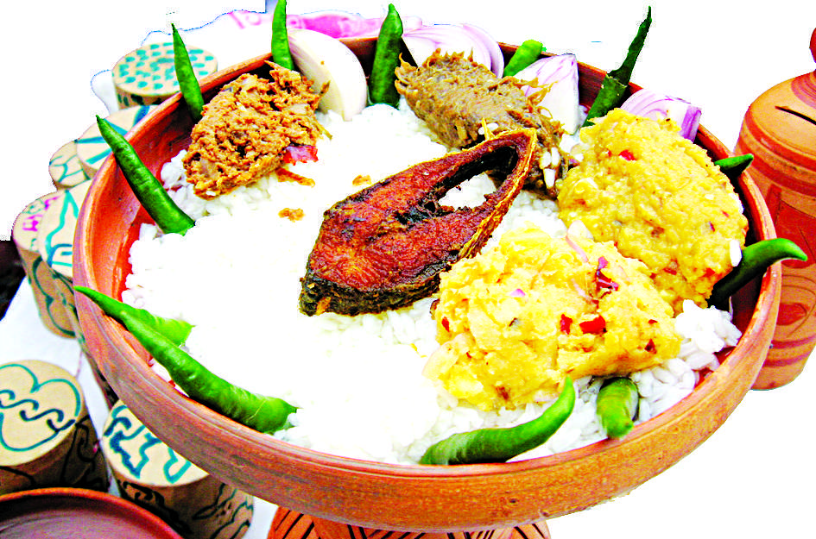
Today our lesson is
Pahela Boishakh
Events and festivals
UNIT: 03 , LESSON: 06

Slide 5
Learning outcomes
After we have studied the lesson we will be able to ..
1.Talk about events and festivals;
2. Ask and answer questions and give opinions in a logical sequence;
3.Infer meaning from the context .

Slide 6
Read the text
Pahela Boishakh’ is the first day of bangla new year. The day is a public holiday. This day has a special significance for us as it forms a part of Bangalee culture and tradition. People from all walks of life, irrespective of their ethnic identity or religious beliefs, celebrate the day with traditional festivities, On this day, the whole of Bangladesh is in a festive mood. The day inspires people to start life with renewed hopes and inspirations. Every year the day is celebrated traditionally. People wake up early in the morning, have a bath and wear their traditional clothes. Women wear white saris with red borders and adorn themselves with colourful churis and flowers, while men dress themselves with pajamas and punjabis. It is a day when people love eating traditional food.

Slide 7
Read the text
The most colourful event of the day is held in Dhaka. Early in the morning, people in hundreds and thousands pour in from all directions to attend the cultural function at Ramna Batamul organised by Chhyanate. The cultural programme begins just with sunrise and and the renowned artists of the country take part in the programme that starts with the famous Tagore-song Esho-he-Boishakh, Esho Esho. Artists also sing traditional folk songs, and display classical dances with the rhythm of musical instruments. People also come to join the colourful processions, the biggest carnival of the country, organised by the Fine Arts strdents of Dhaka University. The procession usually displays the traditional practices of Bangalee Culture. The masks and wreaths worn by the people are so fascinating ! Often they symbolise contemporary worries or happiness in the national life. It attracts an increasing number of foreign tourists every year. The day is also observed all over the country. Different social and cultural organisations and educational institutions celebrate the day with their own cultural programmes.

Slide 8
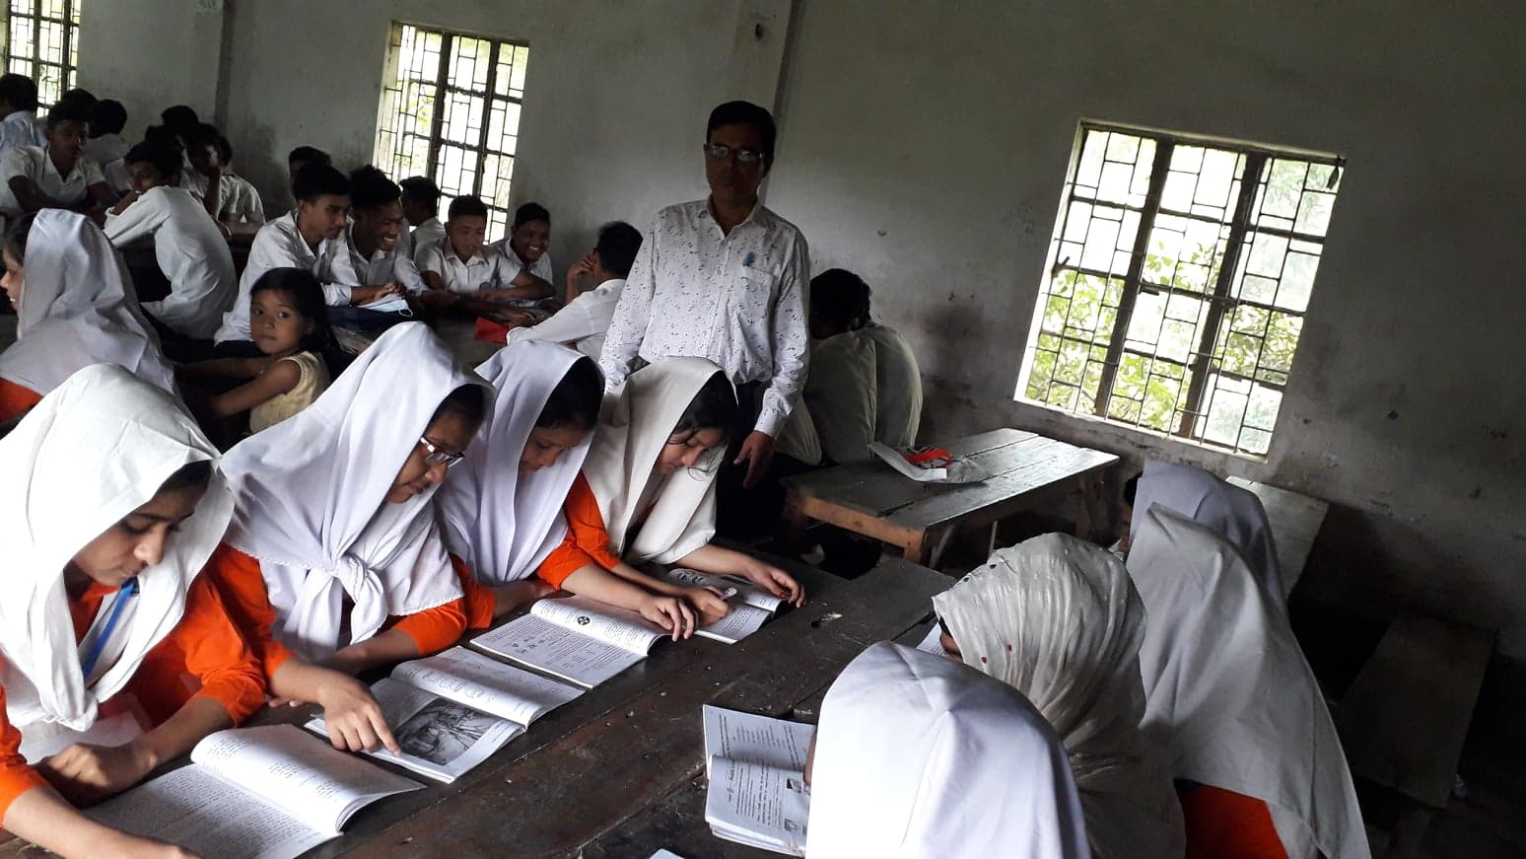
Student’s Model reading.
Go to the section “B” and start silent reading.

Slide 9
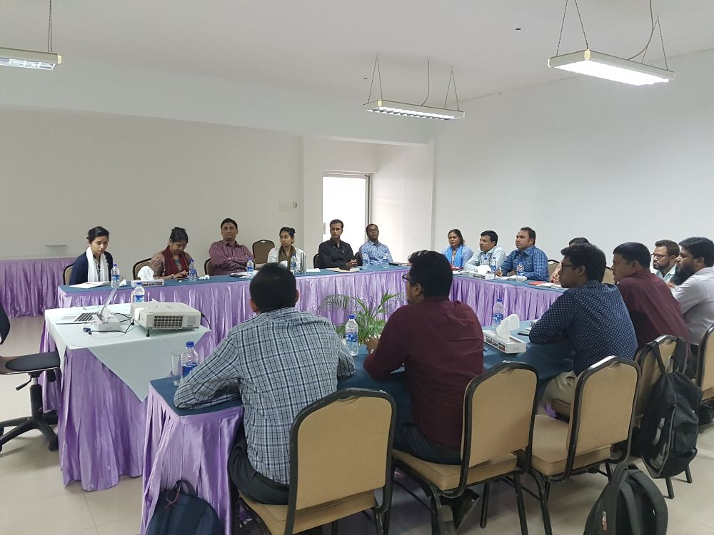
Vocabulary
Key word
Significance
Meaning:
The importance of something
The meeting is of great significance .

Slide 10
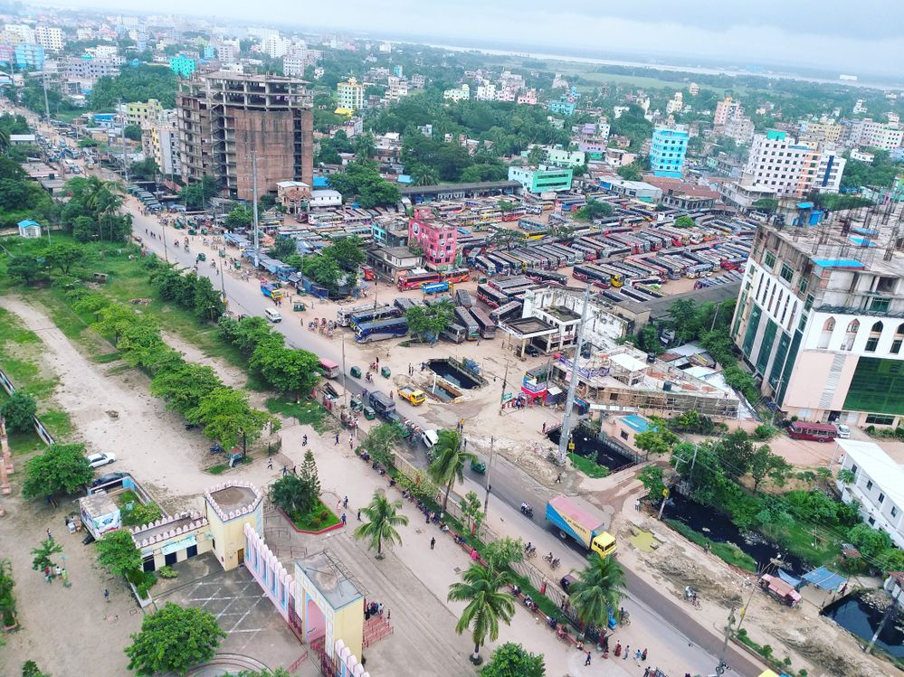
Vocabulary
Key word
Fascinating
Meaning:
Extremely interesting or attractive
Chattogram is a vibrant and Fascinating city.

Slide 11
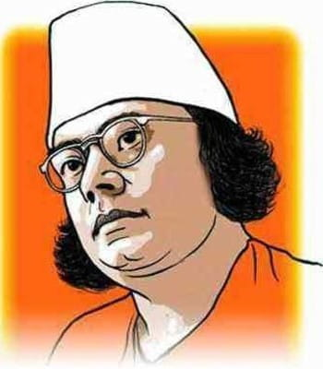
Vocabulary
Key word
Renowned
Meaning:
Famous and respected
Kazi Nazrul Islam is a renowned writer.

Slide 12
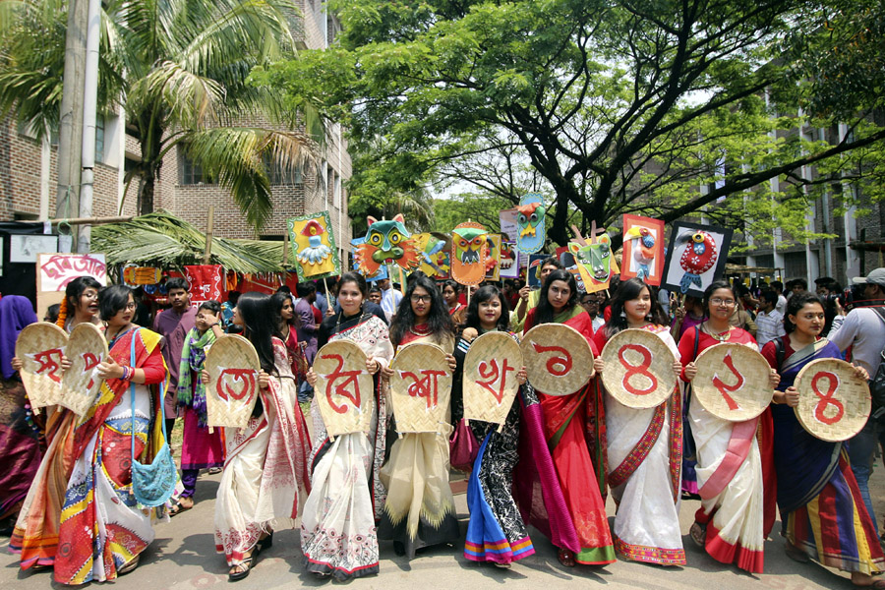
Key word
Carnival
Vocabulary
Meaning:
A public celebration
The biggest carnival of the country is organized by the Fine Arts student of Dhaka University

Slide 13
Vocabulary
Key word
Wreath
Meaning:
Circular arrangement of flowers
They twisted flowers into a wreath .

Slide 14
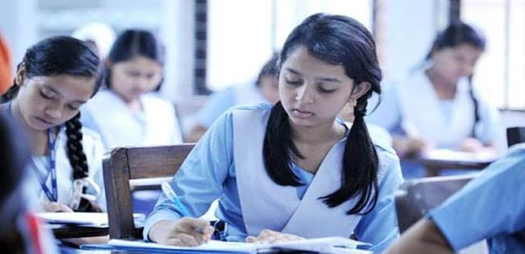
Read the passage attentively then answer the following questions.
1. Do you go out in the morning of Pahela Boishakh? If you do, where do go? If not, what do you do? ?
Individual work
2. What kind of food do you eat in the morning of Pahela Boishakh?
3. Do you wear any special clothes on this occasion?

Slide 15
Compare with your answer
1. Do you go out in the morning of Pahela Boishakh? If you do, where do go? If not, what do you do? ?
Yes, I go to Dhaka university area in the morning , I enjoy cultural programme there.
2. What kind of food do you eat in the morning of Pahela Boishakh?
I eat Hilsha and Panta.
3. Do you wear any special clothes on this occasion?
Yes, I wear Pajama and panjabee.

Slide 16
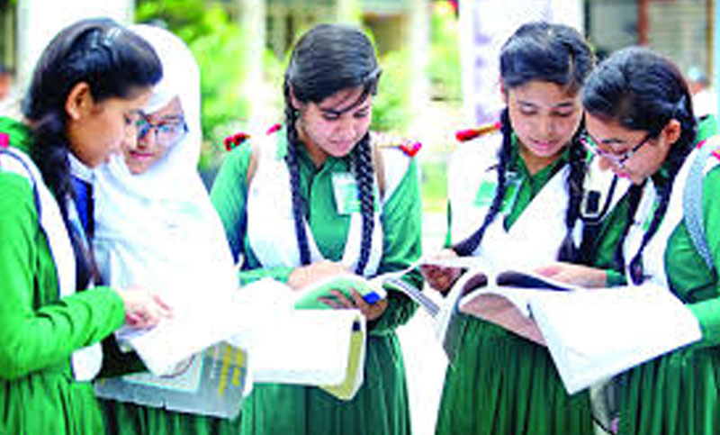
Choose the correct answer from the alternative.
1.Pahela Boishakh denotes –
Group work
(a) the beginning of a year
(b) the and of the Bangla year
(c) the beginning of Bangla new year
(d) the beginning of the Christian era

Slide 17
Choose the correct answer from the alternative.
2. On this occasion people are in a ---- mood.
Festive
(b) Reluctant
(b) Reluctant
(d) Gloomy

Slide 18
Choose the correct answer from the alternative.
3. Pahela Boishakh is the – day of Bangla new year.
Third
(b) Second
First
(d) Last

Slide 19
Choose the correct answer from the alternative.
4. On Pahela Boishakh people eat –food .
Conventional
(b) Junk
Rich
d) Balanced

Slide 20
Choose the correct answer from the alternative.
5. The biggest carnival of the country is organized by the-
Chhayanaut
(b) Bangla Academy
(c) Fine Arts student of Dhaka University
(d) Shilpakala Academy

Slide 21
Choose the correct answer from the alternative.
6.Pahela Boishakh inspires people to start life with –hopes and inspirations
Renewed
(b) Exhausted
(c) Fake
(d) False

Slide 22
Choose the correct answer from the alternative.
7. What does the phrase `Public holiday` mean?
national holiday
(b) yearly holiday
(c) permanent holiday
(d) uncommon workday

Slide 23
Complete the passage with suitable words
first
only
also
celebrated
festival
near
generally
show
largest
Australia
The word Pahela means the first and Boishakh is the -------- - month of Bangla calendar.The day is observed not----------- in Bangladesh but -----------in some other parts of the world. It is celebrated in West Bengal, Assam and Tripura. It is also ------------- in Australia and the UK. In Australia, the largest--------------- for Bangla new year is the Sydney Boishakhi Mela held --------- ----Sydney Olympic Park. In England, the Bangalees ------------- celebrate the day with a street ------------ in London. It is the ---------------Asian festival in Europe, ----------- Bangladesh and West Bengal.

Slide 24
Evaluation
Answer the following questions in your own words:
Why does Pahela Boishakh bear a special significance ?
(b) What does the procession display ?
(c) How do people celebrate the day?
(d) What do people love to eat the day ?
(e) What do women and men wear on Pahela Boishakh ?

Slide 25
Compare with your answer
Pahela Boishakh bear a special significance because it forms a part of Bangalee culture and tradition.
(b) The procession displays the traditional practices of Bangalee culture.
(c) People celebrate the day with traditional festivities.
(d) On this day, people love to eat traditional foods.
(e) Women wear white sarees with red borders and adorn themselves with colourful churis and flowers. Men put on pajamas Punjabis .

Slide 26
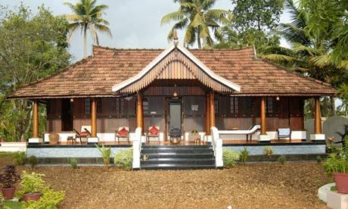
Home Work
Describe your own cultural or religious festival that you celebrate.

Slide 27
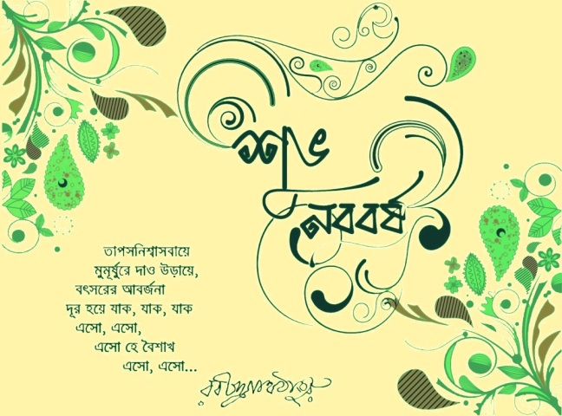
Thank you all

