Slide 1
Learning outcomes
4
At the end of the lesson students will be able to-
Listening- (1.1.1)-become familiar with English sounds by listening to common English words.
Speaking –(1.1.1)-repeat after teacher simple words phrases with proper sounds and stress.
Reading –(3.1.1)-recognize and read the days of the week.

Slide 2
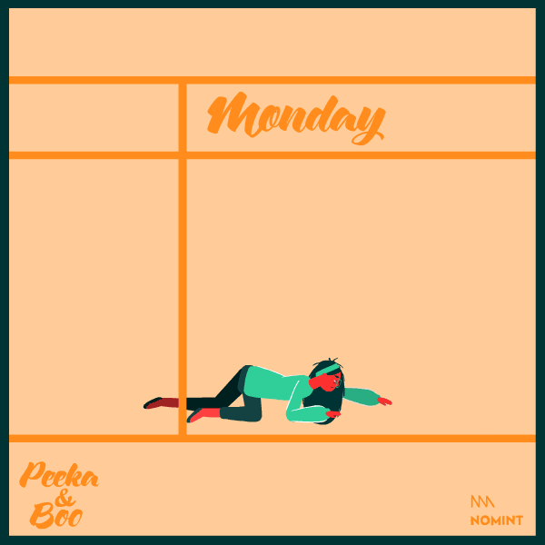
Welcome
1

Slide 3
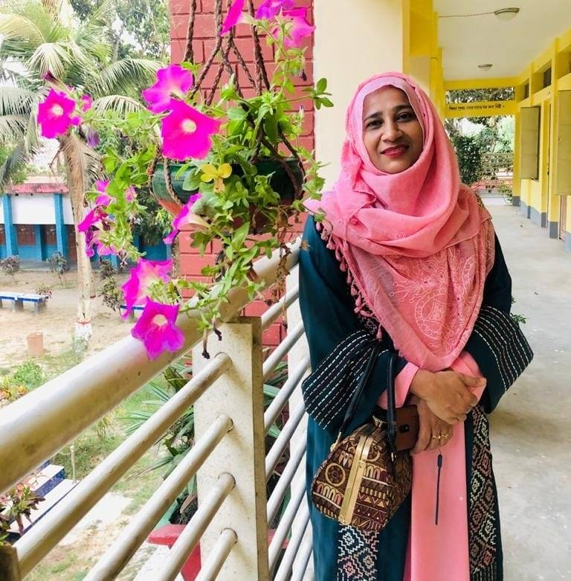
2
Presented by
Maksuda Khatun
Assistant Teacher
S,M Govt Pri School
Meherpur

Slide 4
Lesson identity
3
Class-2
Sub-English
Unit-13, Lessons-1-3
Section-A

Slide 5
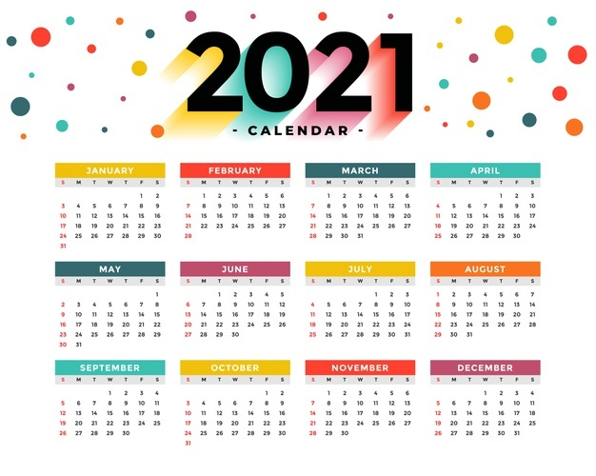
What can you see?
5
Calender

Slide 6
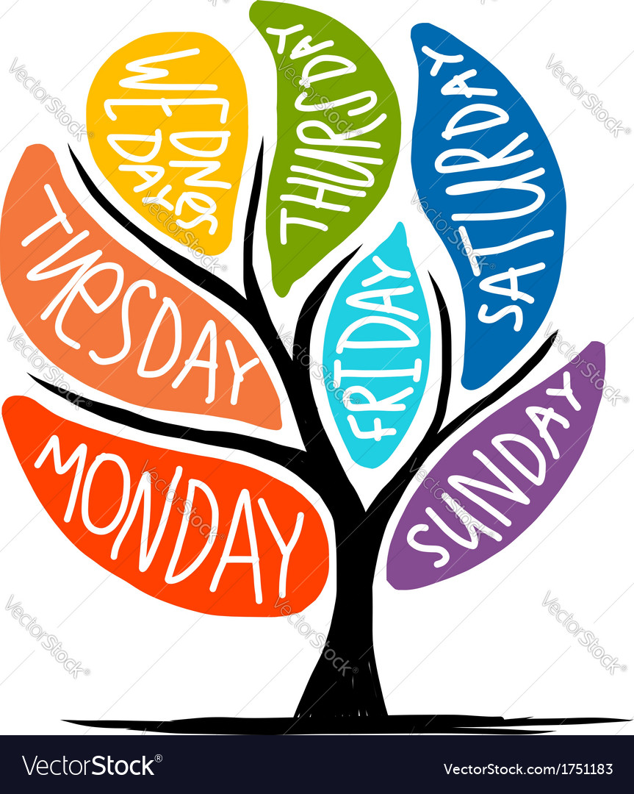
What do you see now?
6
This is a tree of 7 days

Slide 7
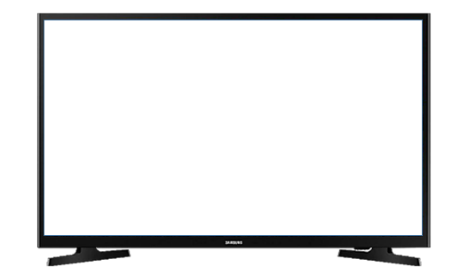
Let’s see a video.
7
https://youtu.be/mXMofxtDPUQ
We were watching a video.
Now tell me what about the video is?

Slide 8
ONE DAY ONE WORD
8
সপ্তাহ
Week
There are 7 days in a week.

Slide 9
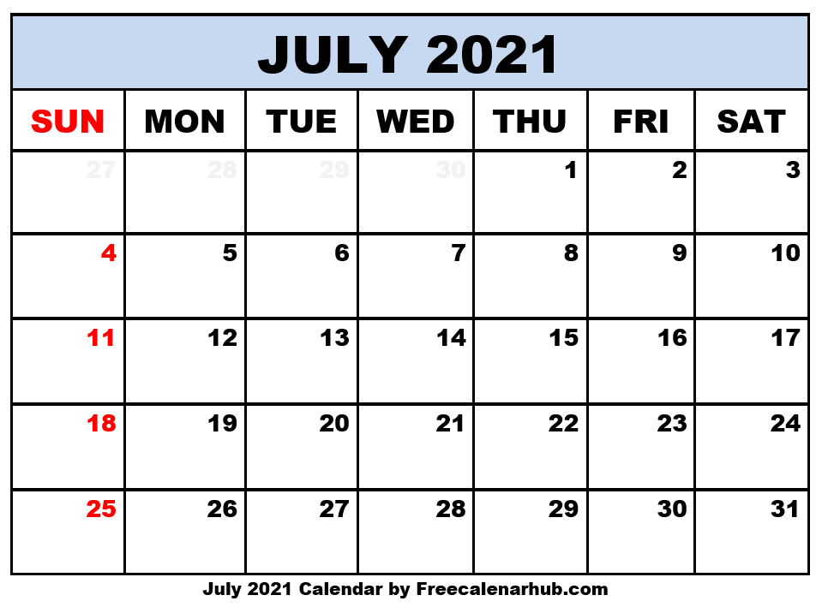
What is this ?
9
Do you know what is this ?
Days of the week
A calendar
Count and say how many days in a week ?
7

Slide 10
10
How many days are in a week?
What day is today?
What is the next day?

Slide 11
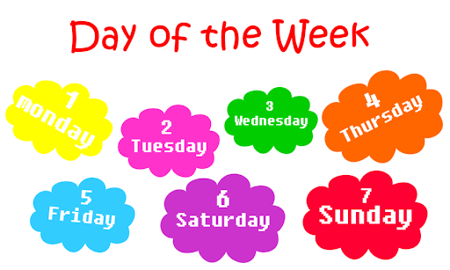
Today’s lesson
11

Slide 12
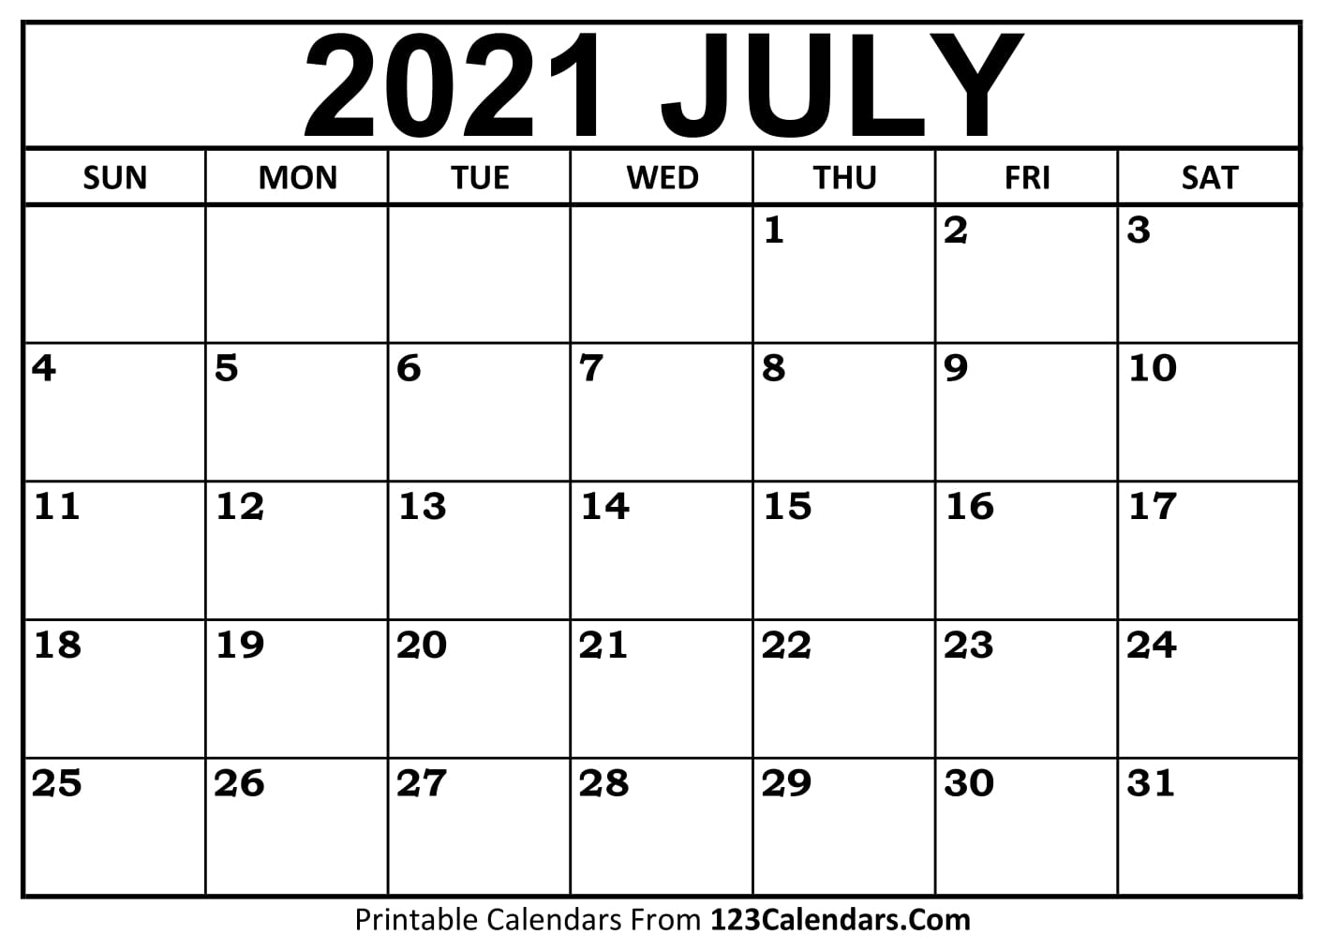
You will see the weekend names are shortened in the calender
12
Saturday
Sunday
Monday
Tuesday
Wednesday
Thusrday
Friday

Slide 13
Look , listen and say
13
Saturday
Sunday
Monday
Sat
Sun
Mon
Tue
Wed
Thu
Fri
Tuesday
Days of the week
Wednesday
Thusrday
Friday

Slide 14
14
Sat
Saturday
Sunday
Sun
Mon
Monday
Practice
Tuesday
Tue
Wed
Wednesday
Thursday
Thu
Fri
Friday

Slide 15
Say with me
15
S
Saturday
S
Sunday
M
Monday
T
Tuesday
W
Wednesday
T
Thursday
F
Friday

Slide 16
Say alone
16
Saturday
Sunday
Monday
Tuesday
Individual work
Wednesday
Thursday
Friday

Slide 17
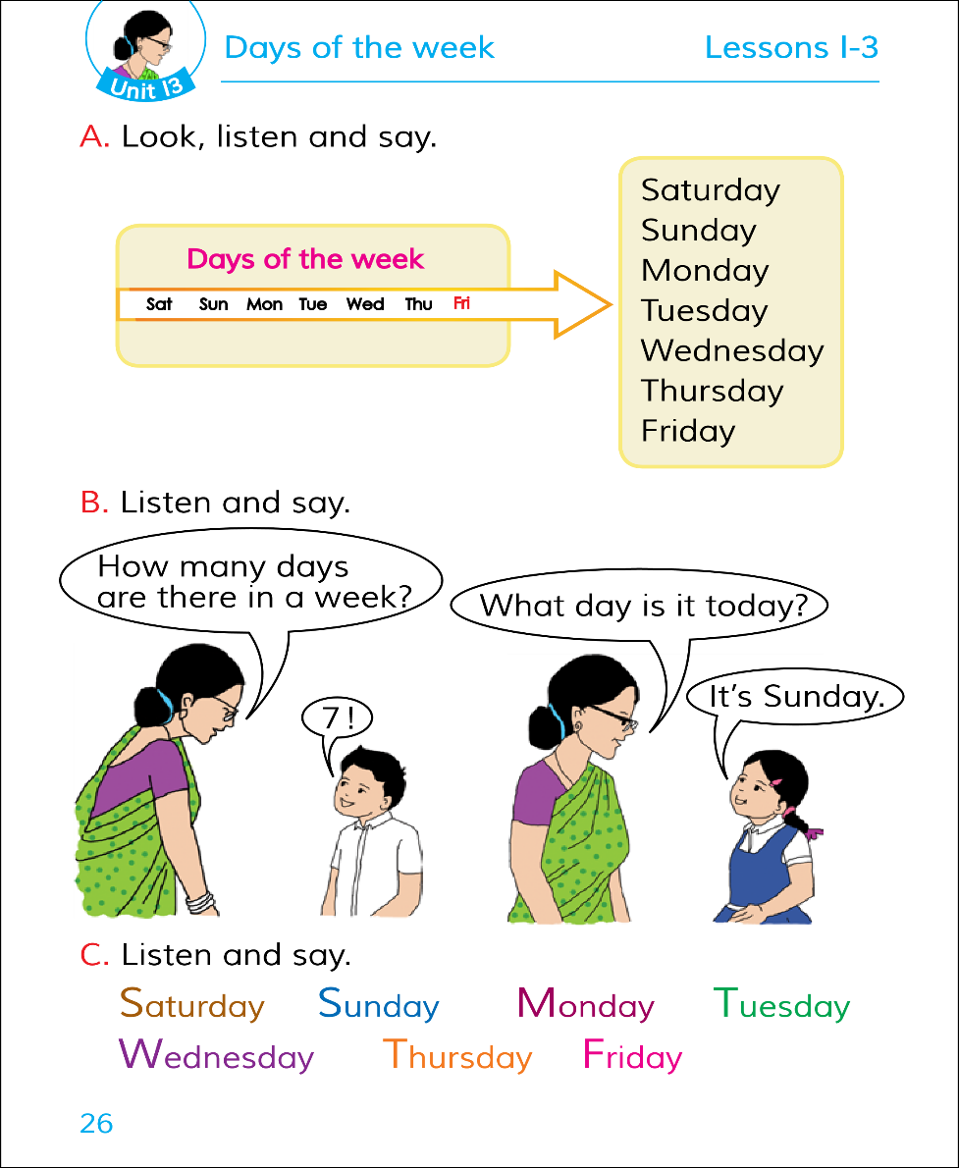
17
Open your book page no- 26
Activity-A

Slide 18
Let’s play a game
18
Saturday
Wednesday
Friday
Sunday
Monday
Thursday
Tuesday
Friday

Slide 19
Match the days name of the week
19
Sat
Wednesday
Tue
Sunday
Wed
Saturday
Evaliatiuon
Tuesday
Sun
Thu
Friday
Fri
Monday
Mon
Thursday

Slide 20
Rearrange the days of the week
20
Monday
Tuesday
Friday
Saturday
Thrusday
Sunday
Wednesday
Evaliatiuon

Slide 21
Answer the Questions
I w
21
Qus - How days are in a week ?
Ans - 7
Qus – What are the days of the week ?
Evaliatiuon
Ans – Saturday ,Sunday, Monday,Tuesday, Wednesday,Thursday, Friday.

Slide 22
22
Home work
Practice 7 days name in your home

Slide 23
23
STAY HOME
STAY SAFE

