Slide 1
Welcome To All

Slide 2
Teacher’s Identity
Md. Reajul Islam
Assistant Teacher
Arajiniamot Govt. Primary School
Gangachara , Rangpur.
E-mail: reajatgps1992@gmail.com

Slide 3
Lesson’s Identity
Subject: English
Class: Five
Unit: 2
Lesson: 1-2
Time: 40 minutes
Date: 09/06/2021

Slide 5
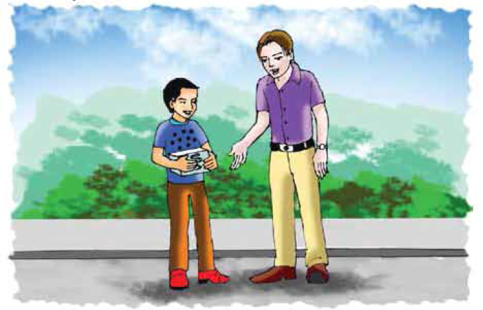
Let’s see the picture

Slide 6
Lesson Declaration
See you!

Slide 7
New words
Fair
মেলা
Bazaar
Great
চমৎকার
Very good
Medicine
ঔষধ
Drug
দুঃখিত
Regretful
Sorry
Exactly
Right
ঠিক

Slide 8
Open your EfT
at page 6

Slide 9
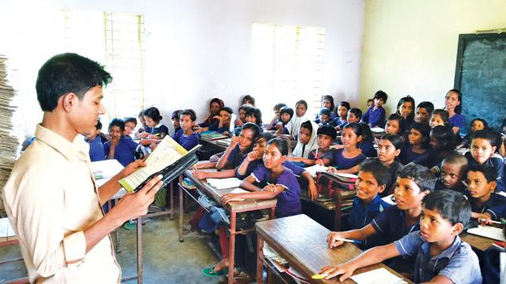
Teacher’s reading

Slide 10
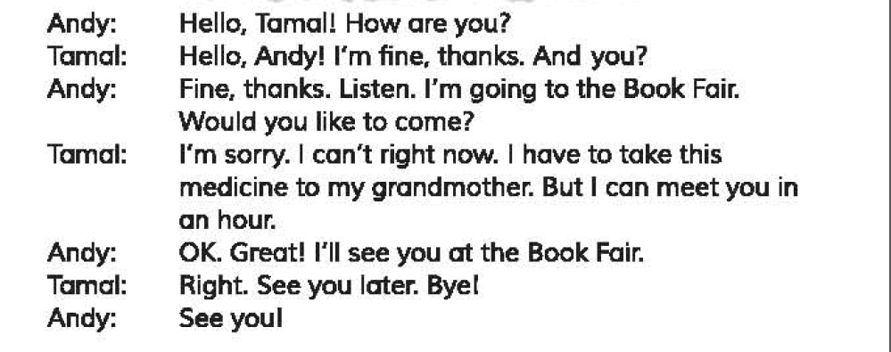

Slide 11
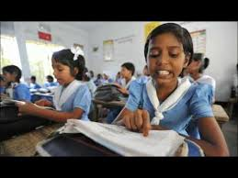
Student’s Reading

Slide 12
Pair work
Answer the following questions:
a. Where is Andy going?
b. When can Tamal meet Andy?
c. Where is Tamal going? Why?
d. How does Andy say goodbye to Tamal?
e. Where will they meet?

Slide 13
Group work
Group: Rose
Write True for correct statement and False for incorrect statement:
a. Tamal is going to the Book Fair.
b. Andy does not like Tamal’s behaviour.
c. Tamal bade Andy bye.
Group: Lily
Fill in the blanks using the right words:
a. I want to ----------- how you are.
b. I -----------you my thanks.
c. Look, I am ---------- to the Book Fair.
d. I shall ---------- you in the Book Fair..
know
False
offer
going
False
meet
True

Slide 14
Assessment
Make Wh questions from the underlined words
a.Tamal can’t Andy with right now.
b.Tamal can meet Andy in an hour.
c.They will meet at the Book Fair.
d.There are 24 hours in a day.
e.Tamal takes medicine for his grandmother.

Slide 15
One day one word
Grandmother
দাদী
I love my grandmother.

Slide 16
Home work
You will write five sentences about ‘Your visit to a Book Fair’.

Slide 17
Good Bye

