Slide 3
Introducing
Masuma
Assistant Teacher
Kishormojlis Government primary school
Barishal Sador
Class One
Subject English
Numbers
Unit 13
Lesson 1-3(A)

Slide 4
Learning outcomes
Students will be able to -
Listening
1.1.1 become familiar with English sounds by listening to common English words.
Speaking
1.1.1 repeat after the teacher simple words and phrases.
1.1.2 say simple words and phrases.

Slide 5
Lets play a Rhyme

Slide 6
Lesson Title
Rhyme

Slide 7
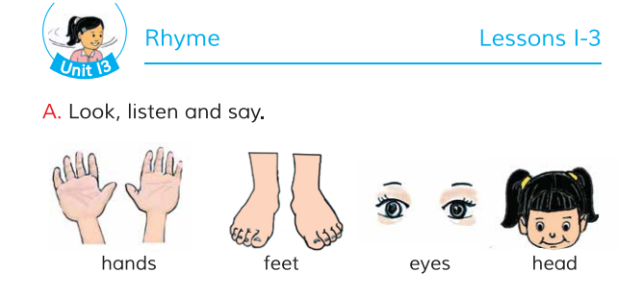
Open your English book page no 26

Slide 8
What do you see in the picture?.
Look listen and say
hands

Slide 9
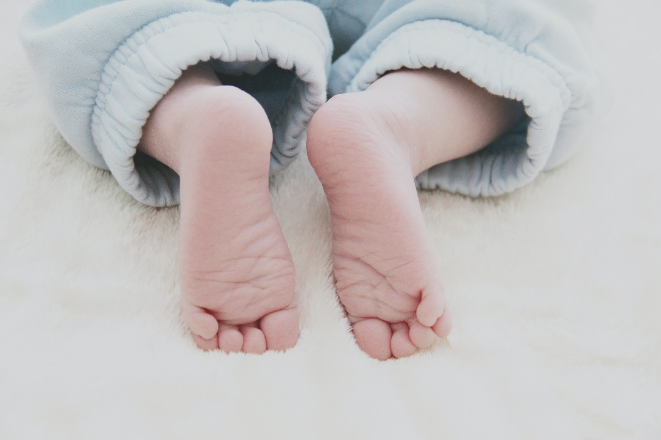
What do you see in the picture?.
Look listen and say
feet

Slide 10
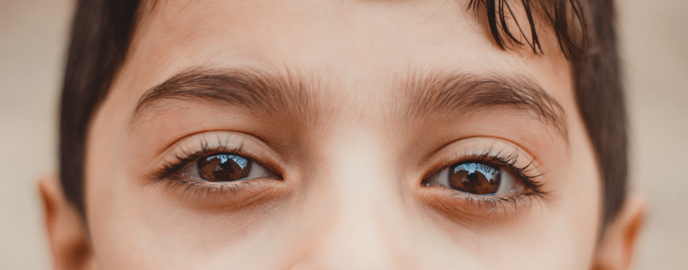
What do you see in the picture?.
Look listen and say
eyes

Slide 11
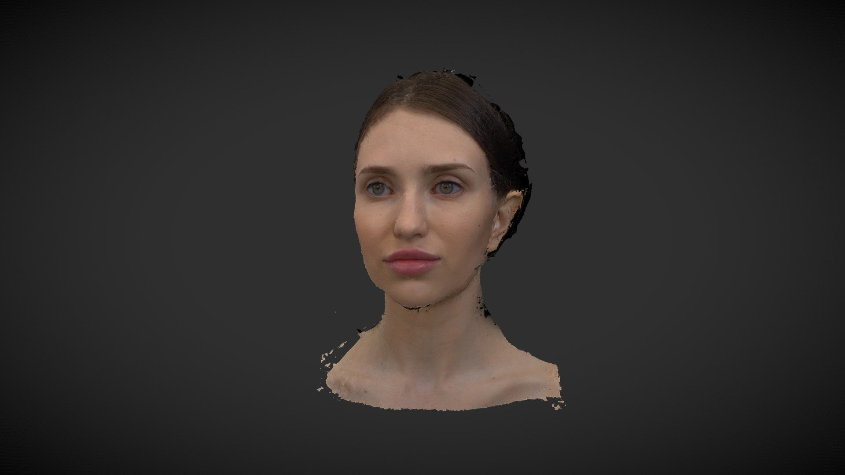
What do you see in the picture?.
Look listen and say
head

Slide 12
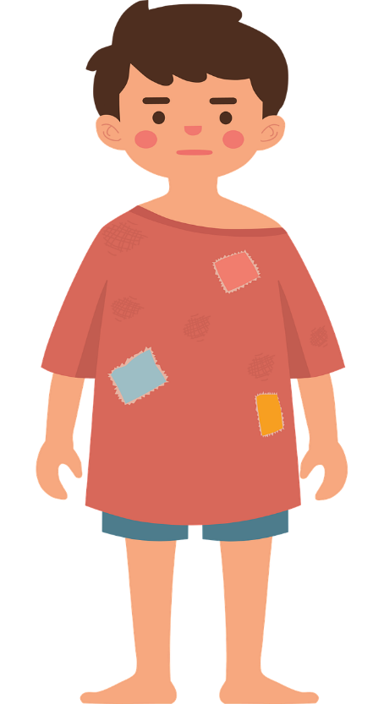
What do you see in the picture?.
Look listen and say
head
eyes
hands
feet

Slide 13
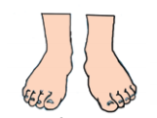
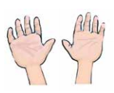
What do you see in the picture?.
Look listen and say?
eyes
feet
head
hands

Slide 14
What do you see in the picture?.
Look listen and say.see again.
hands
head
eyes
feet

Slide 15
What do you see in the picture?.
head
Look listen and say.see again.
eyes
hands
feet

Slide 16
hands
feet
eyes
head

Slide 17
eyes
hands
feet
head

Slide 18
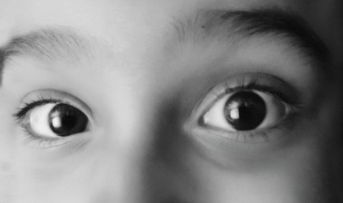
What do you see in the picture?.
head
eyes
feet
hands

Slide 19
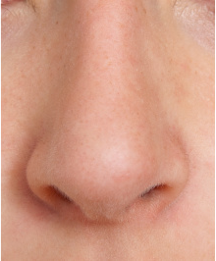
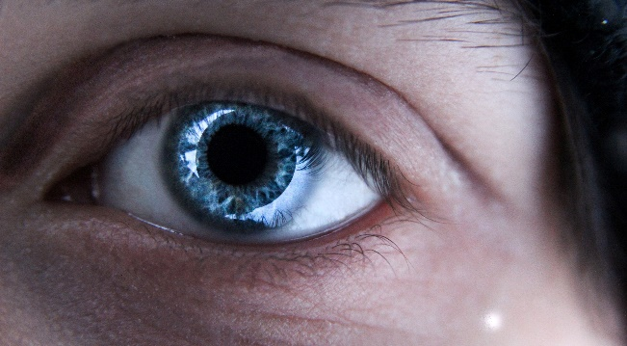
Evaluation

Slide 20
Good bye

