Slide 1
Hi !Every body

Slide 2
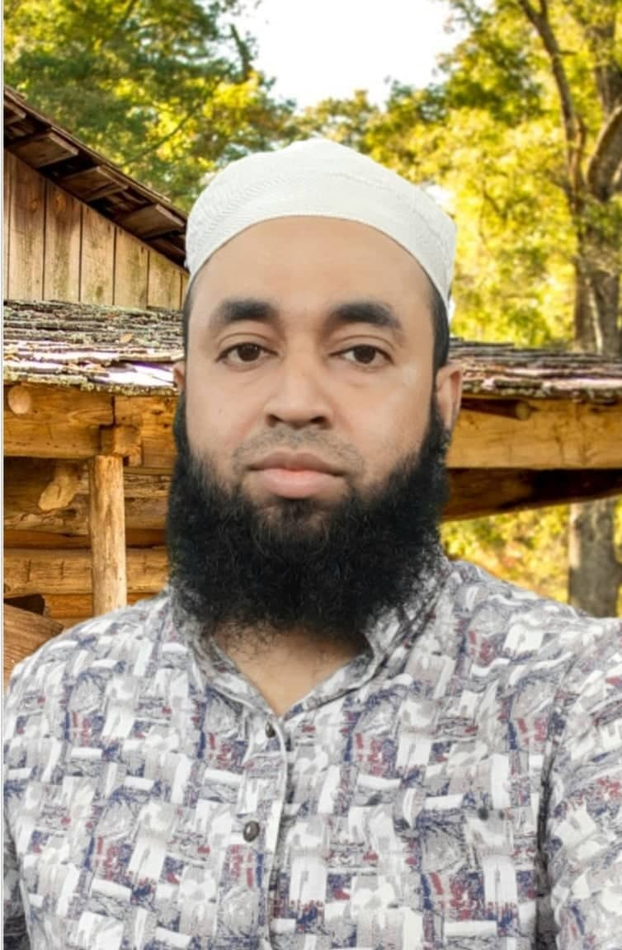
Teacher Introduction
Shahenur Alam shibly
Assistant teacher
Lal md sikdarpara govt primary school
Moheshkhali , Cox,bazar.

Slide 3
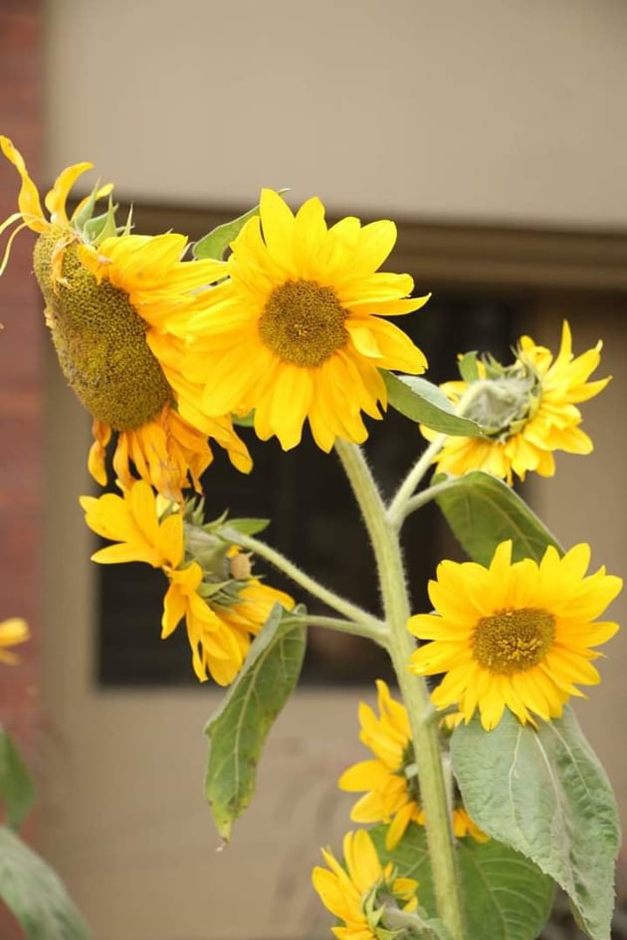
Introduction of lesson
Class: Four.
Subject:English
Time:40 Minutes.

Slide 4
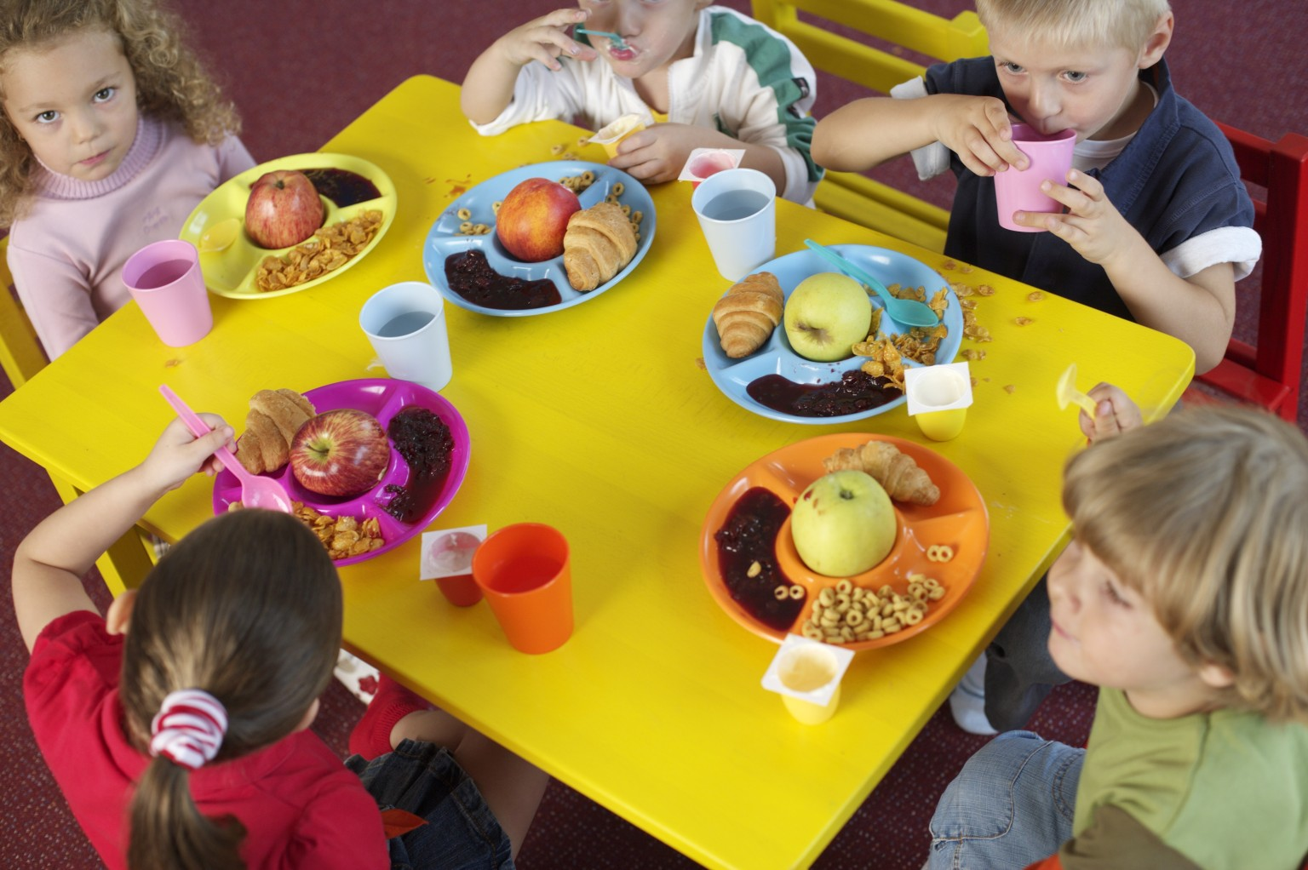
Look at the picture

Slide 5
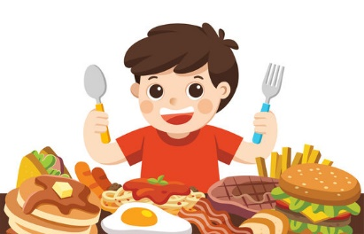
Todays Lesson
Food around the world
Unit : 21
Page : 42

Slide 6
Learning Outcome
Student will be able to :
1.5.1To read words,phrases and sentences in the text with proper pronunciation.
8.1.1To make sentences using words.
1.7.1To write a short simple composition.

Slide 7
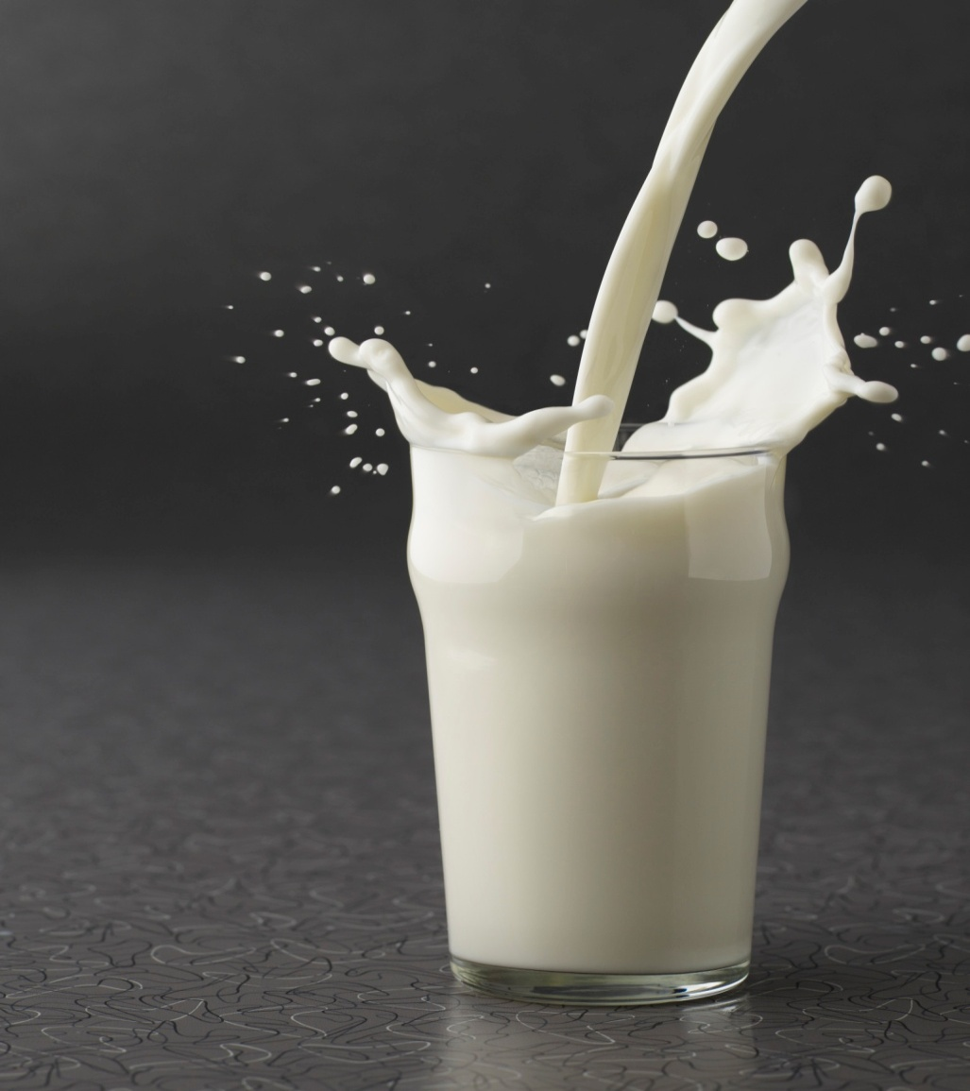
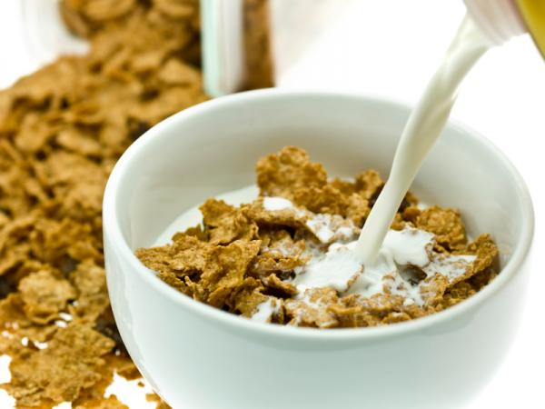
Look at this picture
Milk
Cereal

Slide 8
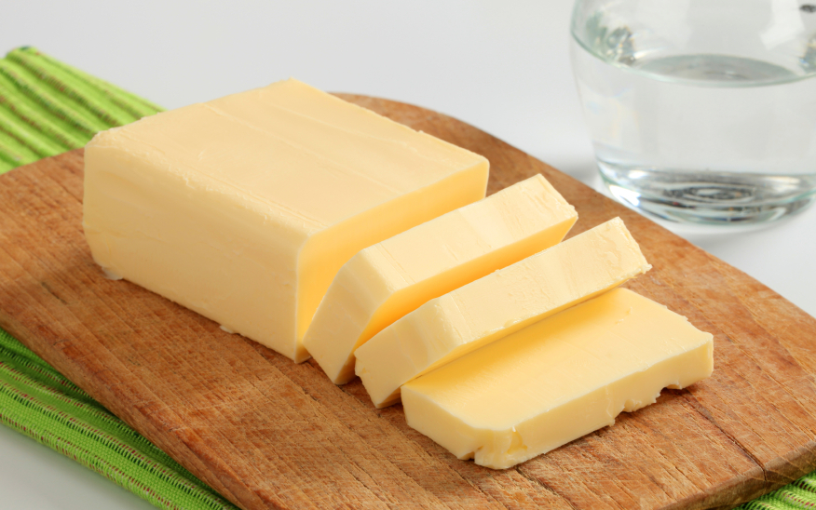
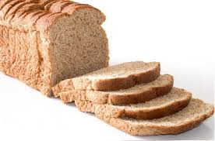
Butter
Bread

Slide 9
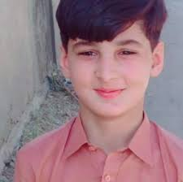
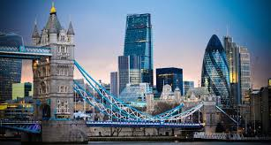
Look at The picture
ALEX
I live in London.I’m British.
Hi! I’m Alex.

Slide 10
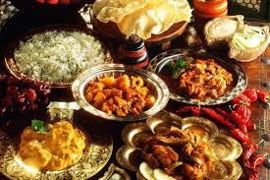
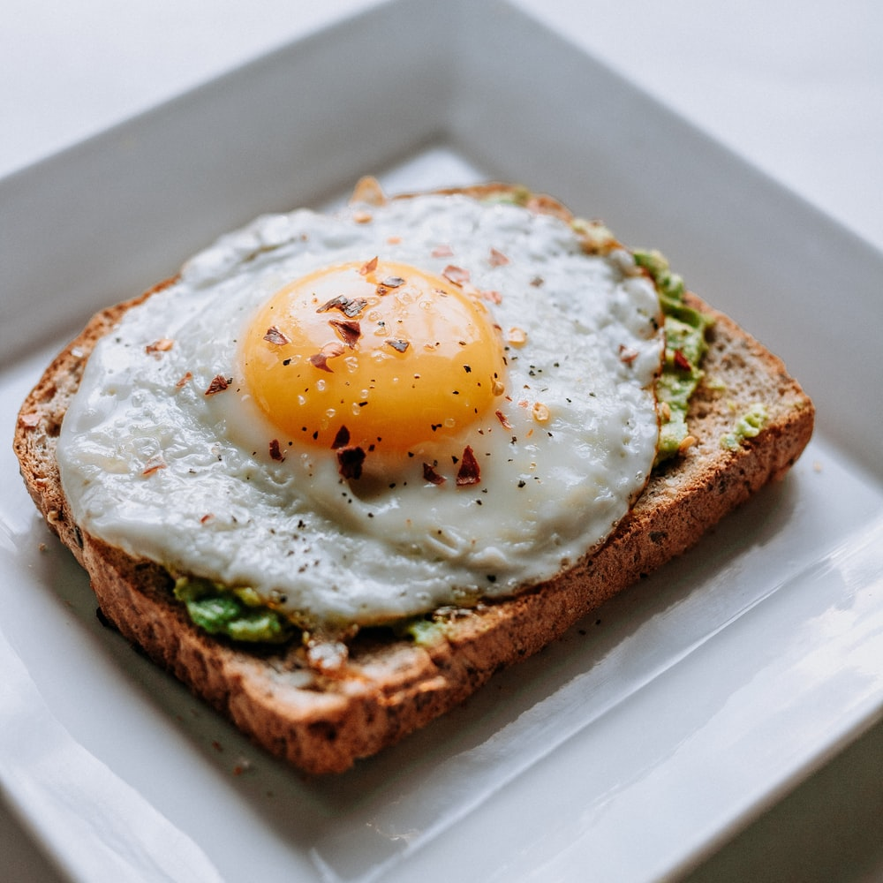
I start my day at 7 a.m and I have breakfast at 8 o’clock.

Slide 11
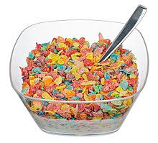
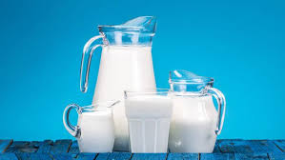
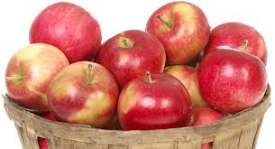
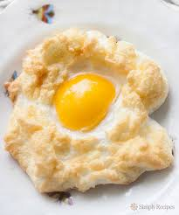
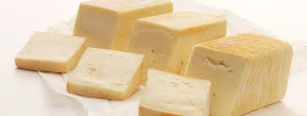
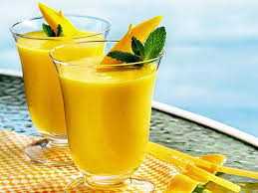
On weekdays,I usually have milk,cereal and an apple.Sometime I have feied eggs with cheese some juice.

Slide 12
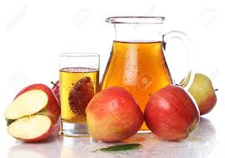
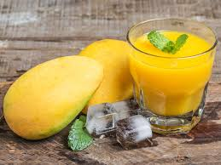
Apple juice is my favourite, but I like mango juice,too.

Slide 13
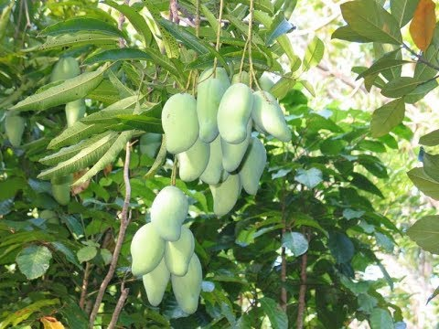
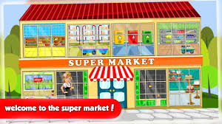
We don’t grow any mangoes in my country, but we can get mango juice at the supermarket.

Slide 14
Individiul work
Find new words in this todays lesion.
Write the name of food, which Alex usually eat or drink.

Slide 15
Teacher’s loud reading and discuss the lession.
Alex is a british boy.
He get,s up at 7 am.
He usually have milk.
Alex like apple juice.
He like mango juce too.
His country have no mango tree.

Slide 16
New words with sentences
Juice – one kind of drinks.
start– to begin anythings.
Food-we eat food to get energy.
Favourite-to like something very much.

Slide 17
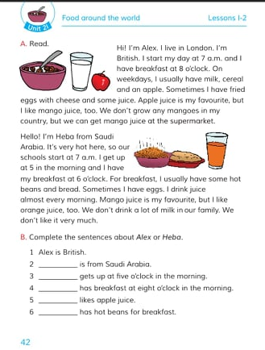
Student’s reading
Open the book at page no: 42

Slide 18
Pair work
8 o’clock
apple
British
breakfast
Alex likes juice.
Alex does not take on weekend.
He takes breakfast at .
Alex is .

Slide 19
Group Work
G-1.When dose Alex take her breakfast?
G-2.Make a list Alex breakfast menu.

Slide 20
Evaluation
When do you get up?
What do you eat in your breakfast?
What’s your favourite drink?
When do you take breakfast?

Slide 21
Home work:
You will write a short composition about your favourite food at lest in five sentences.

Slide 22
See you again

