Slide 1
Welcome

Slide 2
Introduction
Md. Abu Sayed
Lecturer (English)
Indrakul Akbaria Alim Madrsah, Bauphal, Patuakhali.
Class- 11-12
Subject- English 1st paper
Topic- Unit-5, Lessson-3
Time- 40 Minutes

Slide 3
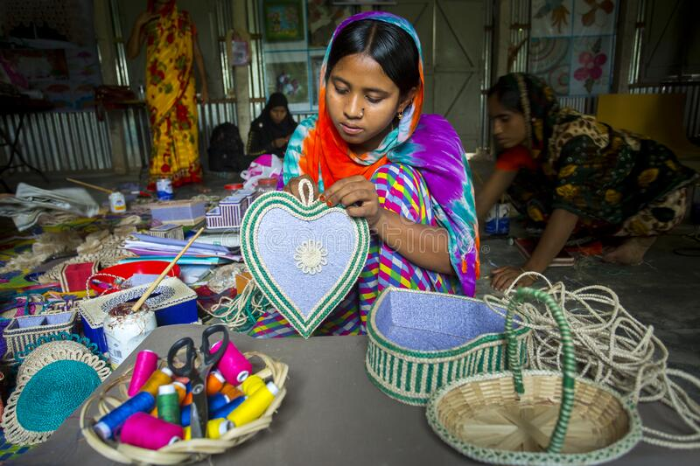
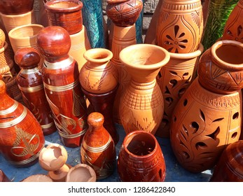
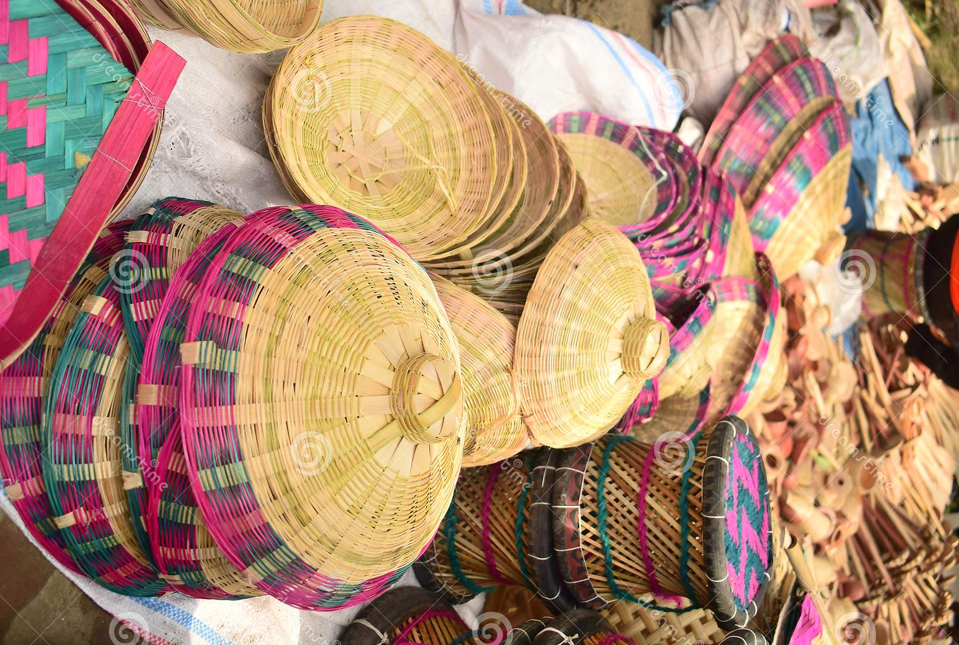
What do you see in these pictures?
What are they about?

Slide 4
The topic we discuss today is…..
Crafts at Our Time

Slide 5
LEARNING OUTCOMES
AFTER COMPLETING THIS LESSON S STUDENTS WILL BE ABLE TO:
talk about craft works.
ask and answer questions.
give opinions about traditional activities.
know about the culture and social activities.

Slide 6
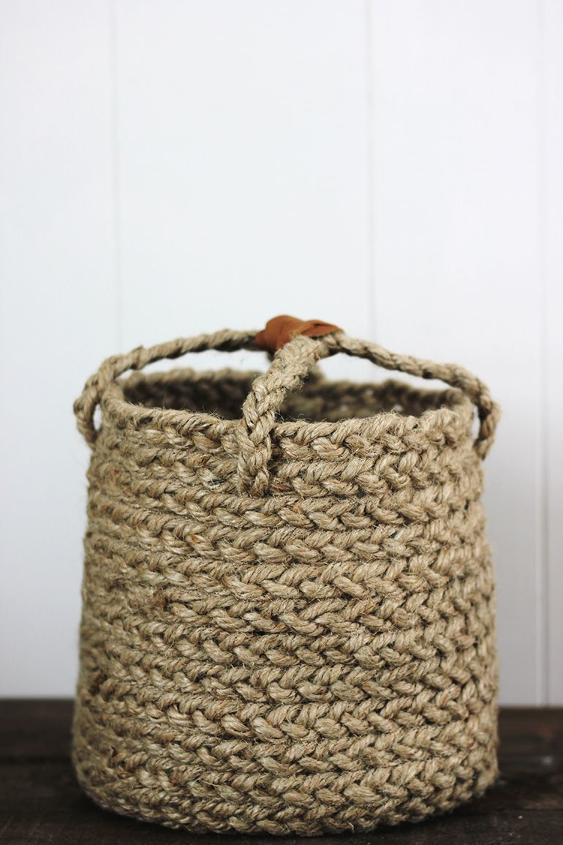
What do you know about craftwork?
Where do you see these?
A craftwork is an applied form of art, a social and cultural product reflecting the inclusive nature of folk imagination. A craftwork, which usually doesn't bear the signature of its maker, retains a personal touch. It also represents a way of life and a cultural flavour.

Slide 7
Now read the text bellow
A craftwork is an applied form of art, a social and cultural product reflecting the inclusive nature of folk imagination. A craftwork, which usually doesn't bear the signature of its maker, retains a personal touch. When we look at a thirty year old ‘nakshikantha’ we wonder at its motifs and designs that point to the artistic ingenuity and the presence of the maker in it. The fact that we don't know her name or any other details about her doesn't take anything away from our appreciation of the artist. Indeed, the intimate nature of the ‘kantha’ and the tactile feeling it generates animate the work and make it very inviting. A craftwork is shaped by the interaction of individual creativity and community aesthetics, utility functions and human values. It is distinguished by its maker's desire to locate himself or herself in the wider and ever-changing cultural aspirations of the community, and subsequently of the market. But even when the market is an important factor, community aesthetics remains the factor determining the form and content of the craftwork. The exquisite terracotta dolls from Dinajpur dating back to early 1940s that form a part of the Bangladesh National Museum's collection were mostly bought from village fairs by some patron. They were no doubt meant to be consumer items, but the dolls reflect community aesthetics in such a manner that the market has not been able to impose its own preferences on them. Different

Slide 8
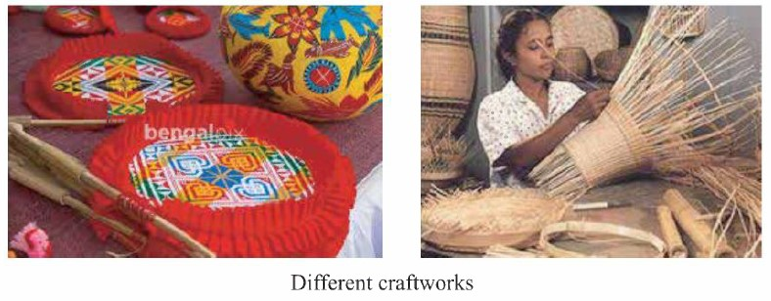

Slide 9
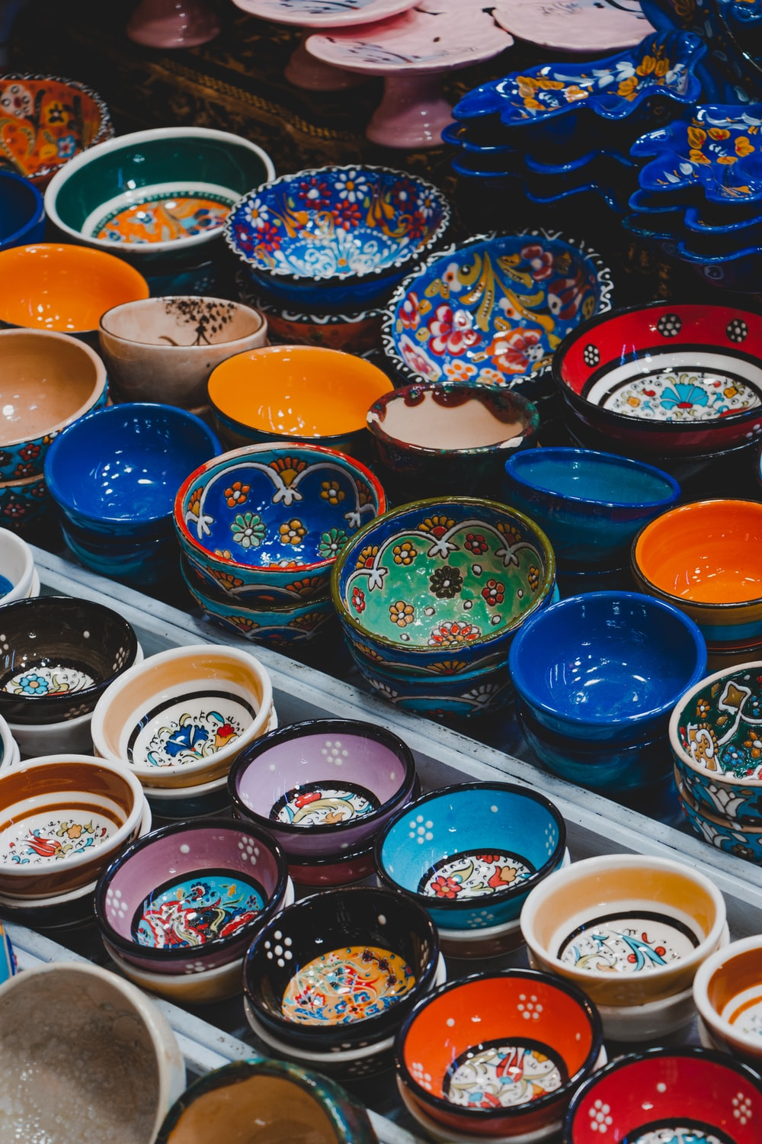
A craftwork thus is a dynamic object-always evolving, and always abreast of changing tastes and preferences. It also represents a way of life and a cultural flavour. Therefore changes in lifestyle and material conditions are expected to have their impact on craftworks and their production. But certain forms, shapes, styles and aesthetic preferences change little over time, suggesting that a craftwork can function as a stable signifier of community values and desires over time. Mechanical and mass production take away this feeling of assurance and stability and the sense of continuity that the handmade craftwork evokes. In the clash between expectations of pure, handmade craftworks and the market need of mechanically produced craftworks, two contesting views emerge: on the one hand, traditionalists contend that the society needs to preserve the authenticity and naturalness of craftworks and their association with domesticity and environment;

Slide 10
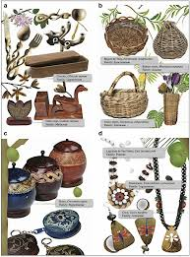
and, on the other, promoters of machine production argue that the machine has helped restore the appeal of the crafts due to their cheaper production costs. There are no easy solutions to the problems that craftworks face in our time. Crafts that are disappearing can and should be revived, even where the machine has made the prospect difficult. And crafts that are still practiced can be safeguarded and made to consolidate their position further. This can be done by providing grants, loans, assistance and other support to the producers, and helping them find a comfortable customer base. But more importantly, craftwork can be branded and successfully marketed throughout the country and beyond as there are always buyers and users of handmade products who feel a strong attraction towards such cultural products.

Slide 11
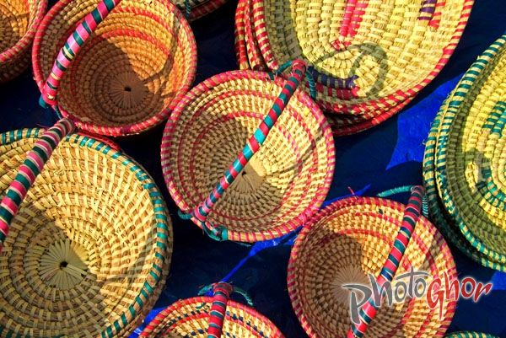
Vocabulary practice
craftwork
inclusive
imagination
motif
ingenuity
appreciation
Noun
Adjective
Noun
Noun
Noun
Noun
হস্তশিল্প
অন্তর্ভুক্ত
কল্পনা
ভাব বা মর্জি
চাতুর্য ও কৌশল
যথাযথ মূল্যায়ন

Slide 12
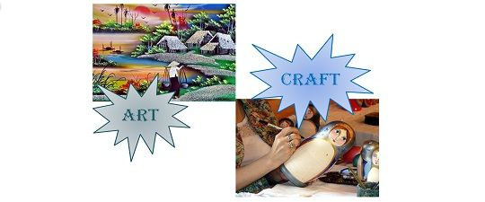
Lets discuss about this question
Q: Can you distinguish between art and craft? How are they different?
Art relies on artistic merit whereas craft is based on learned skills and technique. Art is well known for serving an aesthetic purpose. On the other hand, craft serves human objectives.

Slide 13
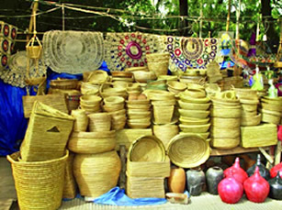
Vocabulary practice
animate
interaction
aesthetic
distinguish
aspiration
Verb
Noun
Adjective
Verb
Noun
প্রান সঞ্চার করা বা সজীব করা
মিথষ্ক্রিয়া
নান্দনিক
পার্থক্য করা
আকাঙ্খা

Slide 14
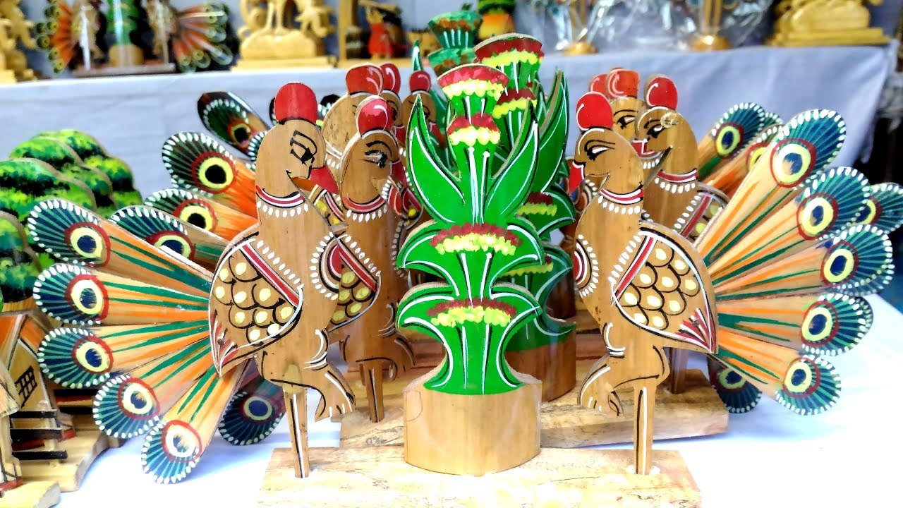
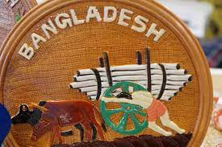
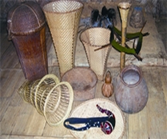
Different types of craft works in Bangladesh.

Slide 15
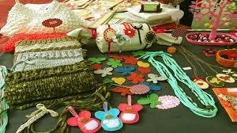
Grammar practice
Find out Parts of speech of the underlined words:
There are no easy solutions to the problems that 1) craftworks face in our time. Crafts that are disappearing can and should be revived, even where the machine has made the
2) prospect difficult. And crafts that are 3) still practiced can be safeguarded and made to 4) consolidate their 5) position further. This can be done by providing grants, loans, 6)assistance and other support to the producers, and helping them find a 7)comfortable customer base. But more importantly, craftwork can be branded and successfully marketed 8) throughout the country and 9) beyond as there are always buyers and users of 10) handmade products who feel a strong attraction towards such cultural products.

Slide 16
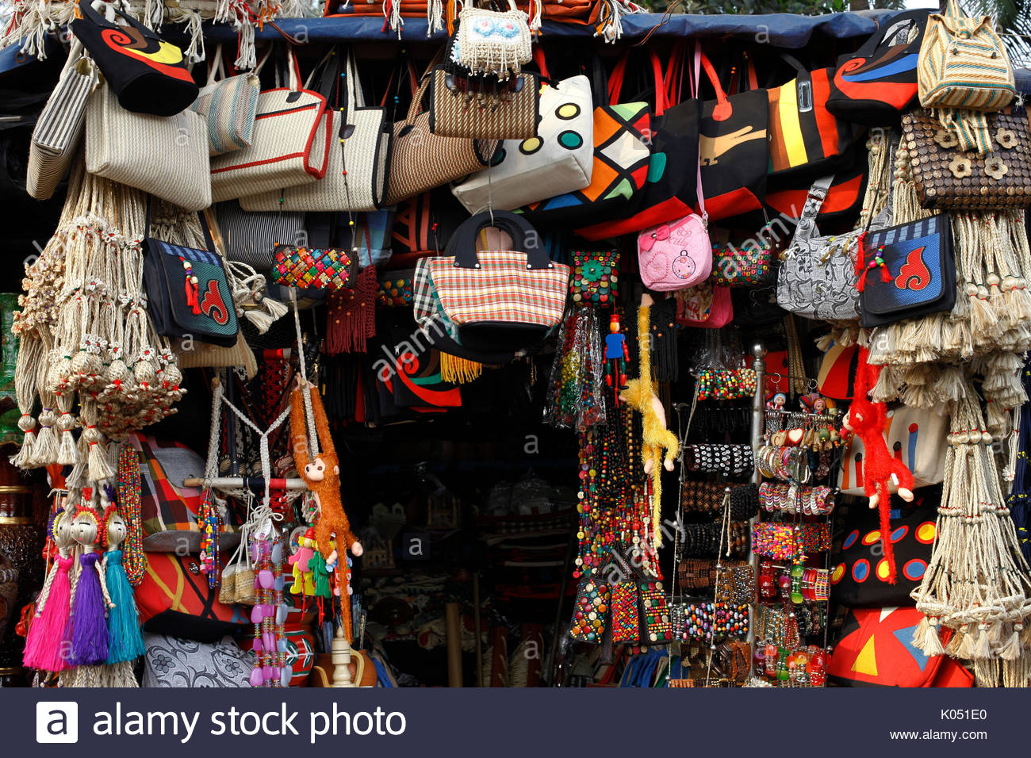
Grammar practice
Craftworks -Noun
Prospect -Noun
Still -Adverb
Consolidate -Verb
Position -Noun
Assistance -Noun
Comfortable -Adjective
Throughout -Adverb
Beyond -Adverb
Handmade -Adjective

Slide 17
Evaluation
In the text above, what are the main ideas presented?
What, according to the text, are the distinctive qualities of a craftwork?
The text considers the mechanical production of craftwork a challenge to the preservation of its authenticity. Do you agree?
What role does the market play in promoting crafts?
How can we successfully use market forces to brand our craftworks both within and outside the country?

Slide 18
Thank you………….

