Slide 1
Welcome

Slide 2
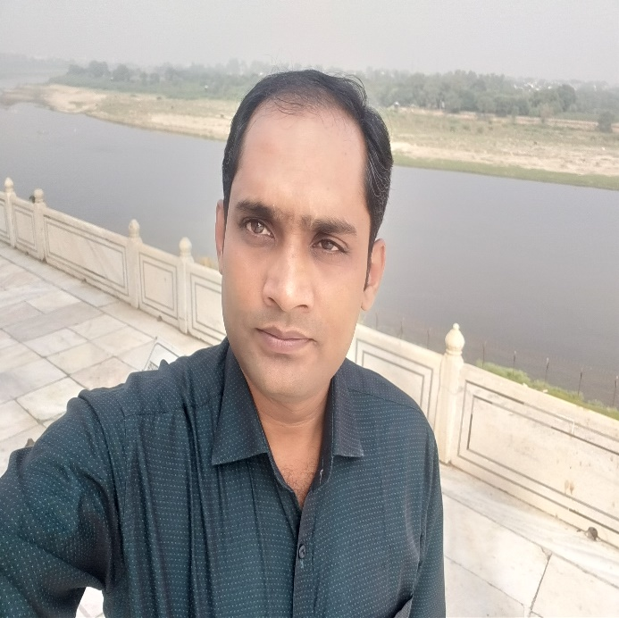
Teachers identity
MD. ABDULLAH AL AHAD REZA
Assistant teacher
Ramchandrapurhat Gov:
Primary School
Sadar, Chapainawabganj

Slide 3
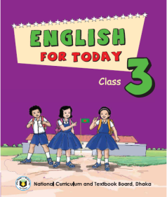
Lessons identity
Class-Three
Subject- English
Unite-39
Lesson 7-9

Slide 4
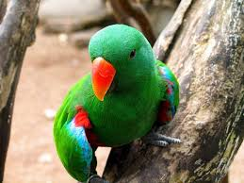
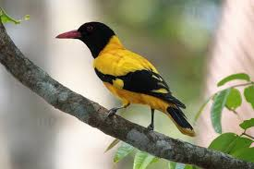
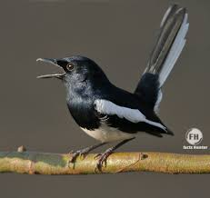
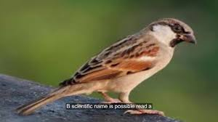
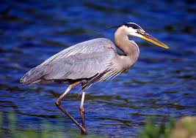
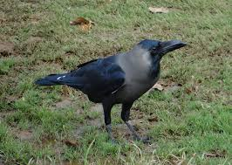
See the following pictures and try to say what is our today’s lesson?
What kind of birds look here?
Many kinds of birds look here.
Which bird is common of our country?
The crow is very common bird in our country.

Slide 5
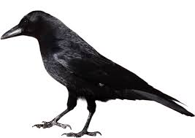
Our today’s lesson is
The crow

Slide 6
Learning outcomes
students will be able---
Listening: 4.3.1 enjoys and understand stories.
Speaking: 1.1.4 say words and sentences with proper sounds and stress.
Reading: 5.1.3 read texts. Writing: text book8.1.1 Write words meaning from the .

Slide 7
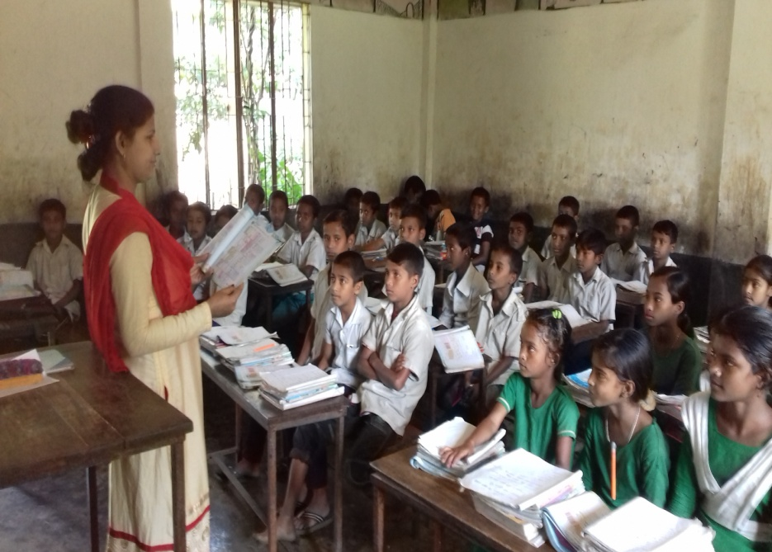
Teacher’s loud reading
Everybody open your book at page 79.

Slide 8
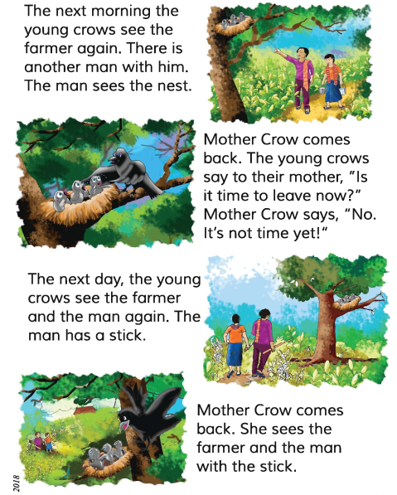

Slide 9
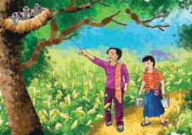
The next morning young crows see the farmer again. There is another man with him. The man sees the nest.

Slide 10
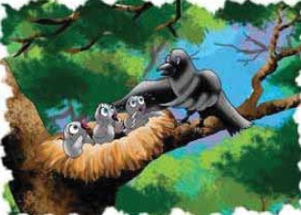
Mother crow comes back. The young crows say to their mother, “Is it time to leave now?” Mother crow says, “No. It’s not time yet!”

Slide 11
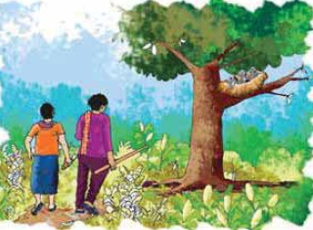
The next day. The young crows see the farmer and the man again. The man has a stick.

Slide 12
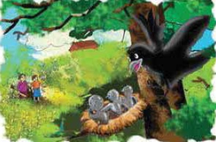
Mother crow comes back. She sees the farmer and the man with the stick.

Slide 13
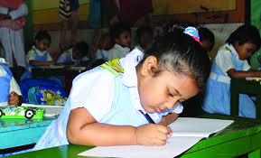
Individual work
Say the words and with proper sound and stress:
Again, Yet, Stick, Farmer, Another.

Slide 14
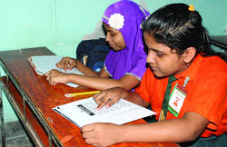
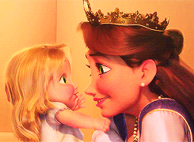
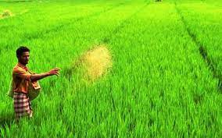
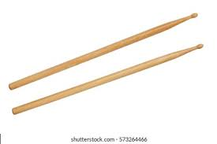
Pair work
Let’s find out new words and meaning them.
Mother
Parent
Farmer
Cultivator
Stick
Rod

Slide 15
Group work
All groups work in same.
1. How many people do the crows see?
2. How many days are there is the story?
Group -1
1. How many people do the crows see?
2. How many days are there is the story?
Group -2
1. How many people do the crows see?
2. How many days are there is the story?
Group -3

Slide 16
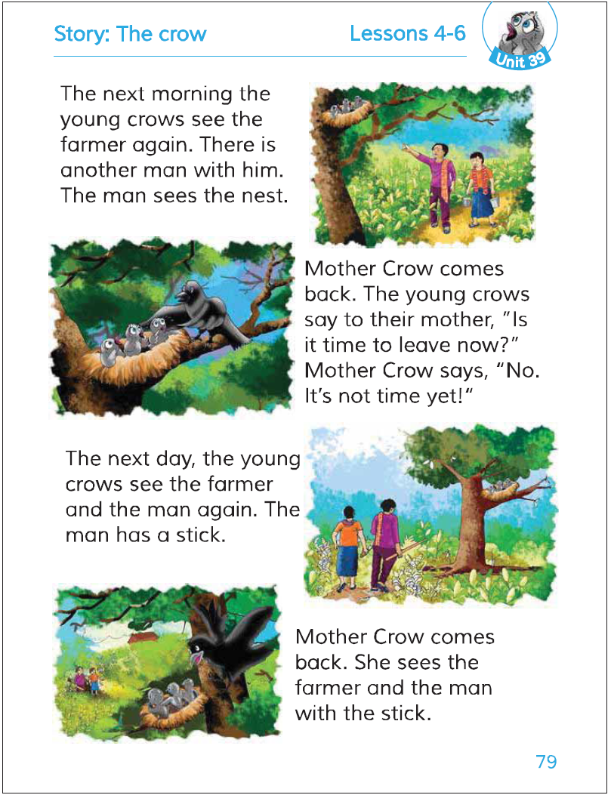
Silent reading

Slide 17
Fill in the blanks:
stick
farmer
nest
crow
another man
1. The man sees the .
2. Mother comes back.
3. The man has a .
4. The young crows see the .
5. There is with him.

Slide 18
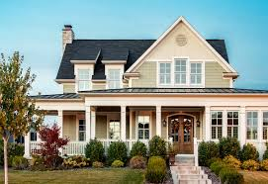
Home work
Write five sentences about the crow.

Slide 19
Thank you

