Slide 1
Welcome to my class:

Slide 2
Introduction:
Mijanur Rahman
Assistant Teacher
Uttar Gopalpur Gov’t Primary School
Durgapur, Netrakona.
Subject: English
Unit: 9
Lesson: 1-3
Time: 40 Minutes

Slide 3
Learning Outcomes:
By the end of the lessons Students will be able to----
Reading:
2.1.1-recognize and read cardinal numbers upto 10
Writing:
2.1.1-write cardinal numbers upto 10 in figures.

Slide 4
Greetings:

Slide 6
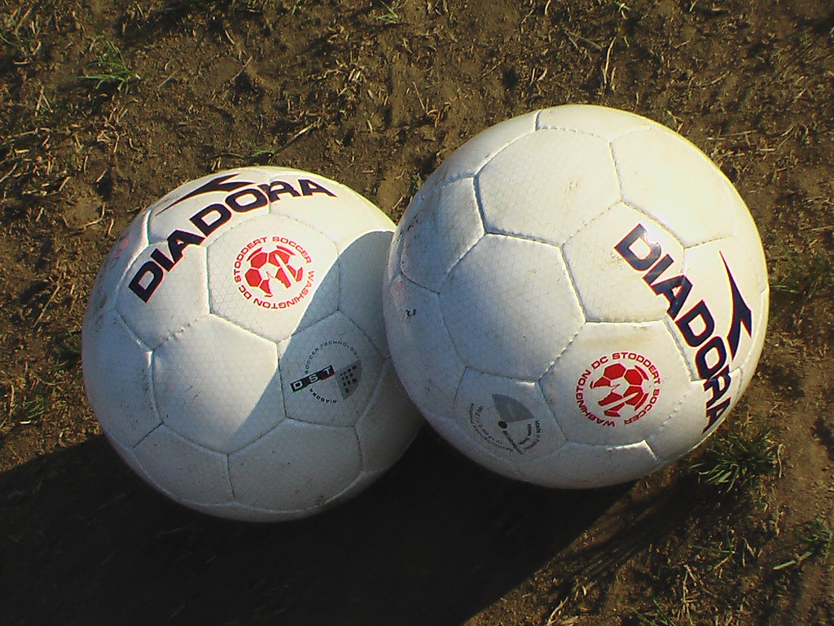
How many balls are there?
2
4

Slide 7
How many bats are there?
3
4

Slide 8
How many eggs are there?
1
4

Slide 9
How many eggs are there ?
2
One

Slide 10
How many eggs are there?
3
One
Two
Three
1
2
3

Slide 11
How many eggs are there?
4
one
two
three
four

Slide 12
Lesson declaration:
Our today’s lesson
Numbers.

Slide 13
Look at the picture and see the page no-18:
Notes:
Part-a

Slide 14
Dear children, listen to the audio carefully:
1
2
3
4
Notes:
Part-a

Slide 15
Notes:
Part-b

Slide 16
4
4
4
4
4
4
1
2
3
4
1 , 2 , 3 , 4 ------ ------- ------- -------

Slide 17
Trace and write these numbers:
1
2
3
4
Notes:
Practice:

Slide 18
Dear children,look at the picture and listen to the audio carefully:
4
3
2
1
4
Notes:
Part-c

Slide 19
What is this?
How many caps are there?

Slide 20
What is this?
Ball.
How many balls are there?
4

Slide 21
Dear learners , write the numbers in the circle:
1
2
3
one
two
three
four
4
Notes:
Evaluation:

Slide 22
Home task:
Practice the numbers 1 to 10.

Slide 23
Bye bye
Good bye.

