Slide 1
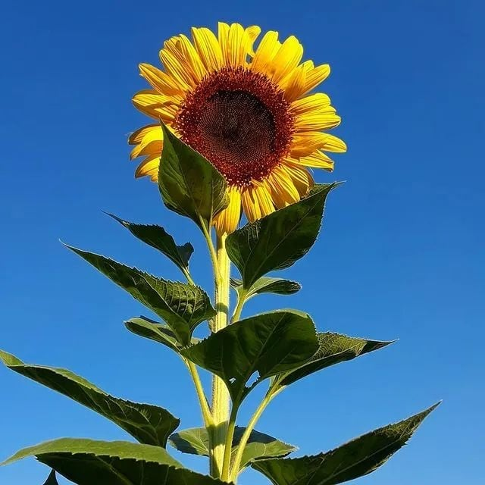
Hi! Everybody

Slide 2
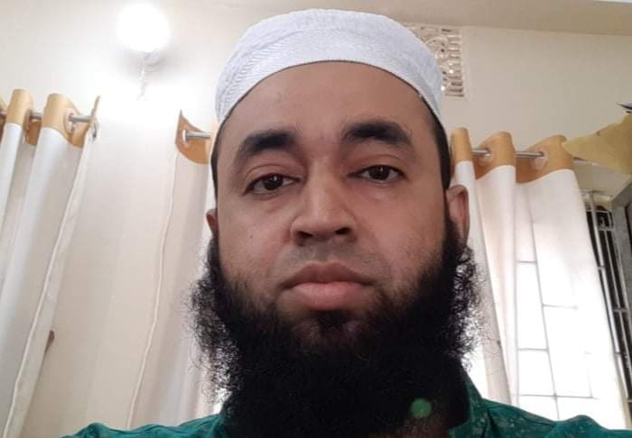
Introducing of the teacher :
SHAHENUR ALAM SHIBLY
ASSISTANT TEACHER
LAL MD. SIKDAR PARA GOVT PRIMARY SCHOOL
MOHESHKHALI, COX,SBAZAR

Slide 3
Identity of the Subject:
Subject: English for Today
Class : One
Time : 40 minutes

Slide 4
Let’s enjoy an Alphabet song

Slide 5
Declaration of the lesson:
Unit : Seven
Lesson : 4-6
Page no: 15

Slide 6
Learning outcomes
The students will able to -
Listen attentively and say correctly and fluently.
Match the pictures with the first letters.
Write Capital and small letters.

Slide 7
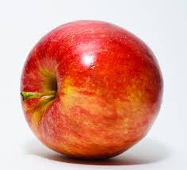
Let’s we watch mindfully:
A
a
A for apple

Slide 8
WATCH MORE
B
b
B for ball

Slide 9
WATCH MORE
C
c
C for cap

Slide 10
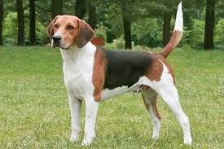
WATCH MORE
D
d
D for dog

Slide 11
WATCH MORE
E
e
E for Egg

Slide 12
Look at the picture and say about them

Slide 13
Look at the Alphabets and say with correct pronunciation:
A
E
b
C
c
d
e
D
B
a

Slide 14
Individul work
Write the capital letters:
A
a________
b________
c________
d________
e________
B
C
D
E

Slide 15
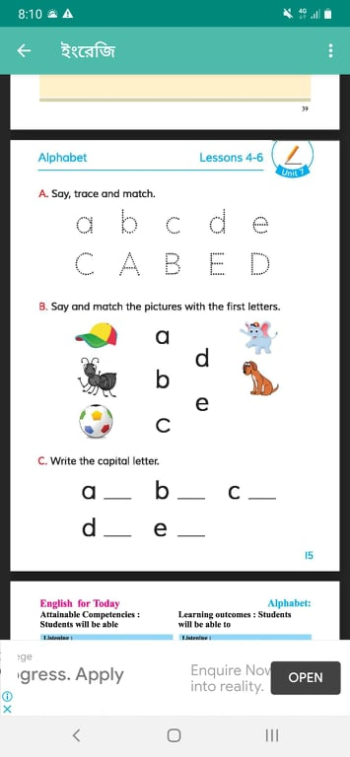
Look at the book at page nong -15

Slide 16
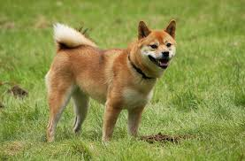
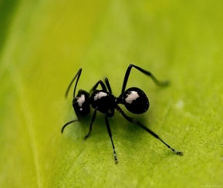
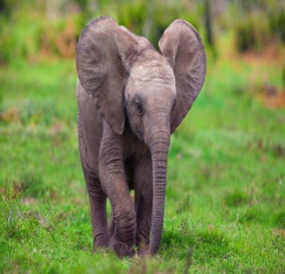
Match the letters with the pictures.
A
B
C
D
E

Slide 17
Pair work

Slide 18
Group work

Slide 19
Assesment :
Say and reply
A/a for
B/b for
C/c for
D/d for
E/e for

Slide 20
Home task:
You will write two words by using A,B,C,D,E

Slide 21
Thank you all

