Slide 1
Welcome to the class

Slide 2
IDENTITY
Mohammad Tofazzal Hossan
senior Teacher
Burischar Ziaul Ulum Kamil Madrasah
Hathazari, Chattagram

Slide 3
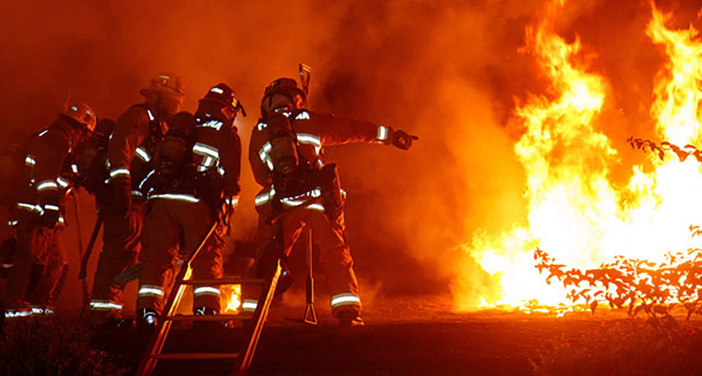
What do you see in this picture?
What are they doing?

Slide 4
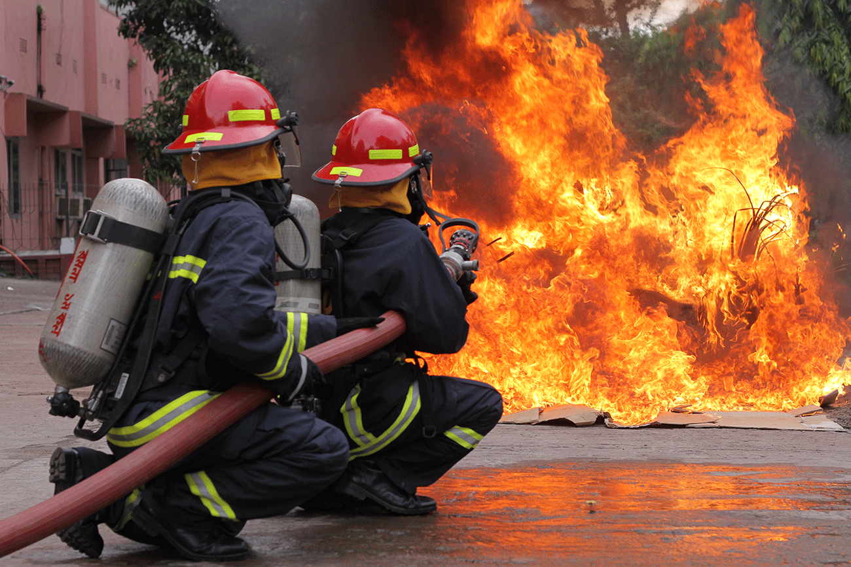
INTRODUCTION
ENGLISH FOR TODAY
CLASS: Five
Unit: 09
Lesson: 1-2

Slide 5
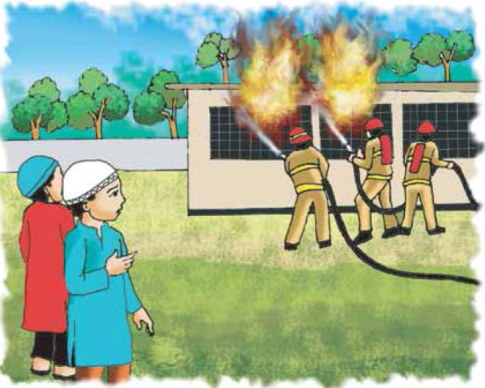
Our Today’s Lesson is
Occupations

Slide 6
Learning outcomes
After we have studied this lesson, the students will be able to
tell synonym of some key words
read, comprehend and summaries texts
choose the best answer
ask and answer questions
fill up blanks

Slide 7
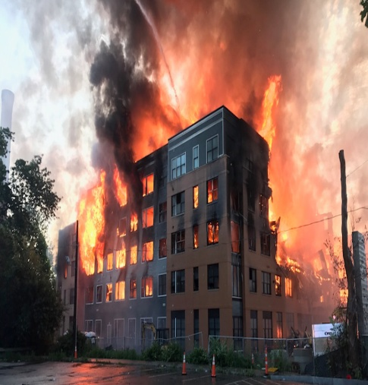
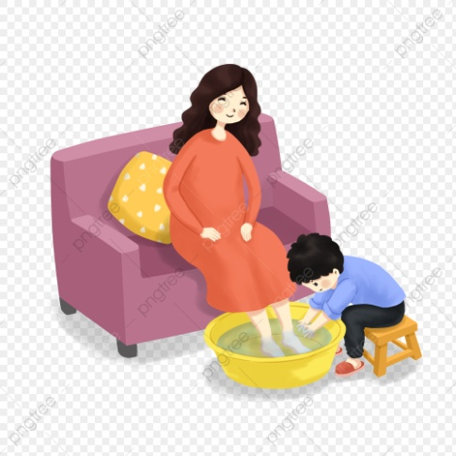
Listen and Read
A long time ago, when Raju was in Class 5, there was a fire in his Madrasah. Everyone was very afraid, but no one panicked. The teachers helped the students to leave the building quietly and safely.
afraid
Fire
panicked
helped

Slide 8
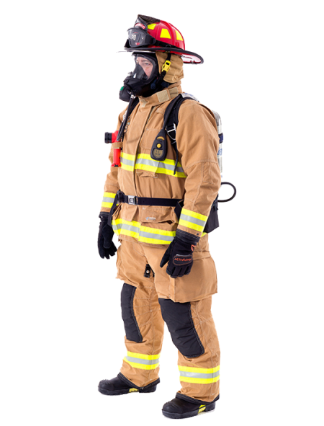
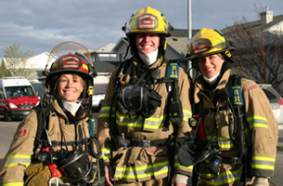
Listen and Read
Soon the firegighters came and put out the fire. Raju Watched the firefighters from the madrasah yard. He thought about the fire and the firefihgters for a long time. After Alim, Raju joined a volunteer fire department.
firefighter
Thought
department

Slide 9
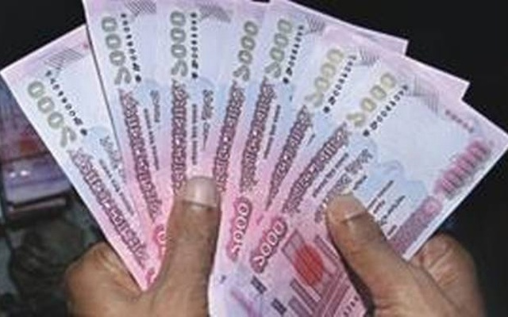
Listen and Read
As a volunteer, he didn’t get any money for his work. But Raju didn’t mind. Now Raju is a full-time firefighter. It is his job, so he earns money for it. Most of the time his work is putting out fires, but he also teaches new firefighters about safety.
earns
job
teach

Slide 10
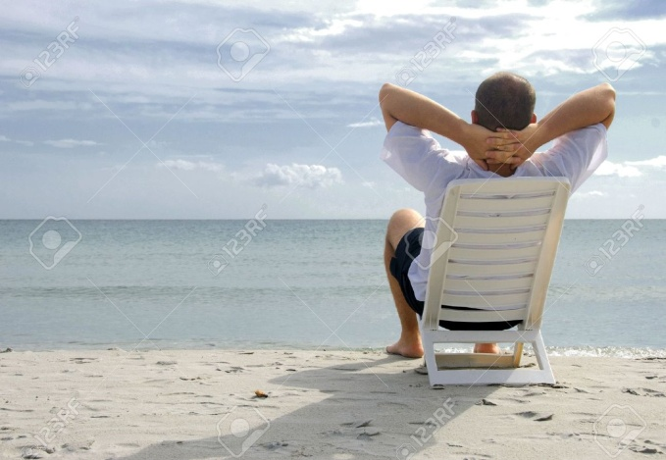
Listen and Read
He likes teaching very much. In his free time, Raju visits Madrasah. He talks to students about fire safety. He tells them what to do if there is a fire. They shouldn’t panic. They should listen to their teachers and leave the building quietly.
free time
listen

Slide 11
Sentence Maknig
Fire
We use fire when we cook food.
Leave
We do not leave you study.
Soon
Soon he will come to our house.
listen
In the class listen to your teachers.
safety
Everybody should know the fire safety.
earn
Everybody earns money for their family.
Notes:
The teacher will show the location of Bhutan with a stick.

Slide 12
Individual work
1. Write 5 senteces about Raju?

Slide 13
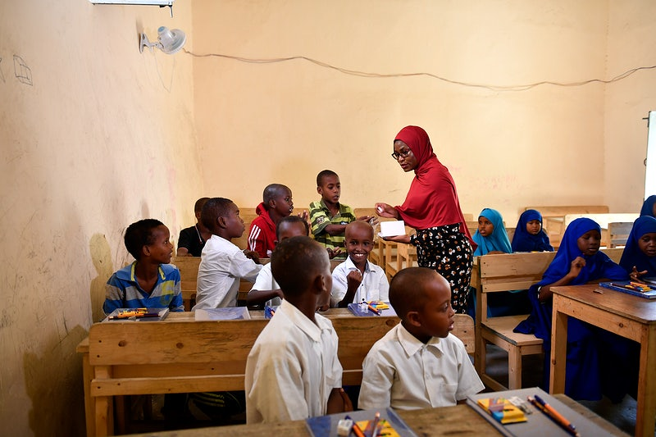
Team work
1. Write about Raju’s work.

Slide 14
1. Write a paragaraph about your future plan.

Slide 15
Thank you all

