Slide 1
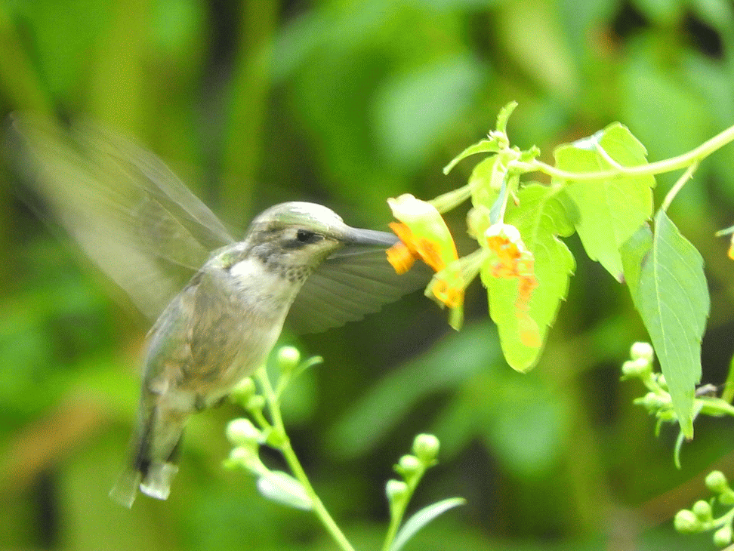
Welcome
Thanks

Slide 2
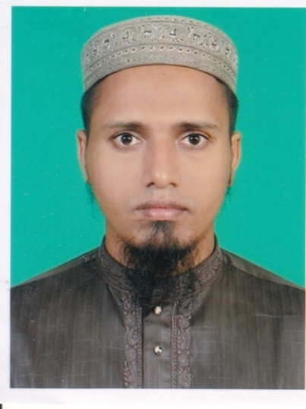
Introduction
Md.Mehedy Hasan
Lecturer in English
Bandar Islamia Fazil Madrasah
Bandar, Narayanganj.
Mob: 01745866460
Email:mehedypakdal@gmail.com
Class: xi-xii
Sub:English 1st Paper

Slide 3
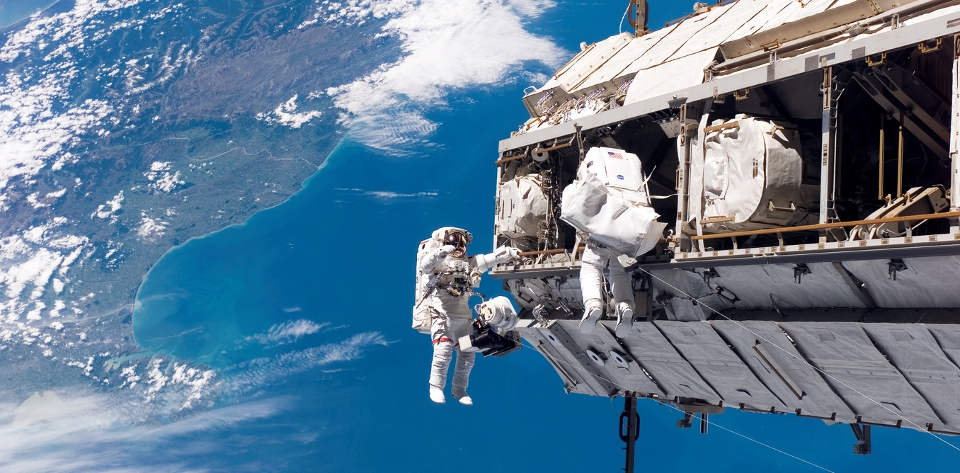
Look at the picture below? What do you see ?
Can you say what is spacecraft ?
Has Bangladesh any spacecraft?
Can you say among women of South Asia who travelled to space first ?

Slide 4
Let us enjoy a short video .

Slide 5
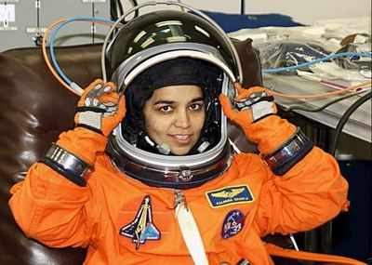
Our today’s lesson is
(Kalpana Chawla)
Unit : 1 Lesson : 3 (b)

Slide 6
Learning outcomes
By the end of the lesson the students will be able to..
. talk about pictures
. ask and answer questions
. infer the word meaning from the text
. complete the questions
. choose the best answers
. write a paragraph.
Learning outcomes

Slide 7
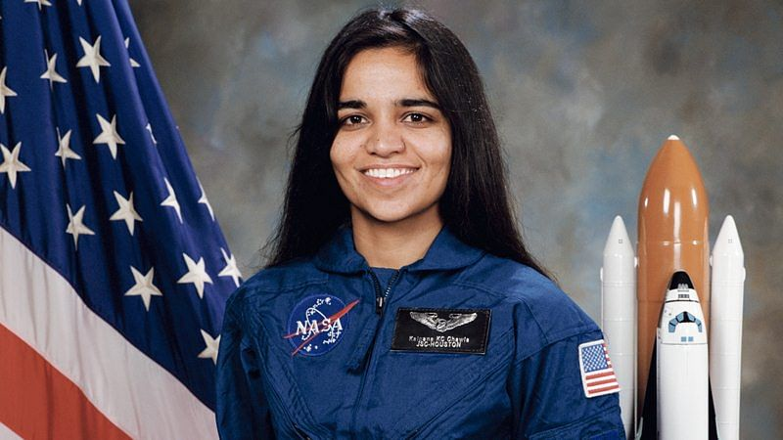
1. Born on 17 March 1962 in India.
4. Moved to USA in 1982.
5. Completed masters from University ofTexus in 1984.
6. Did her Ph.D from University of Colorada in 1988.
2. S he started school at Tagore Baal Niketon.
3. Completed Aeronautical Engineering from Punjab Engineering College.
Early life of Kalpana Chawla

Slide 8
Her life in NASA
She joined NASA in 1988.
She bega as a Vice President and did Computational Fluid Dynamics research on vertical take-off and landing.
She got American citizenship in 1991 and started her carrier as a NASA astronaut in 1995.
She was selected for her first flight in 1996 and travelled 10.67 million miles as many as 252 times around the earth.

Slide 9
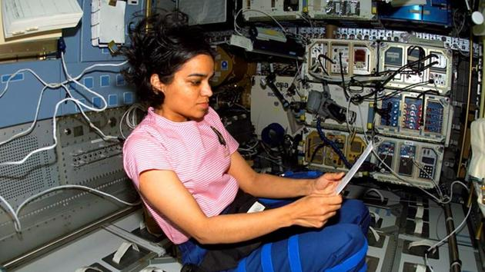
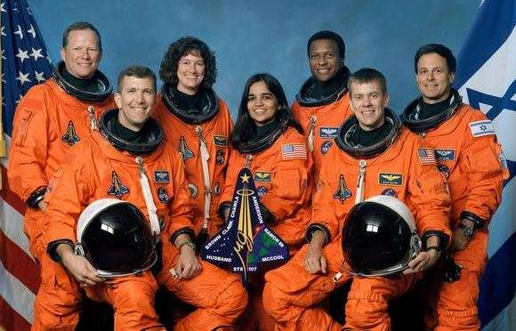
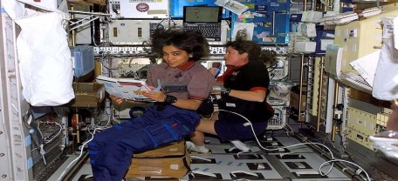
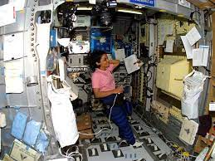
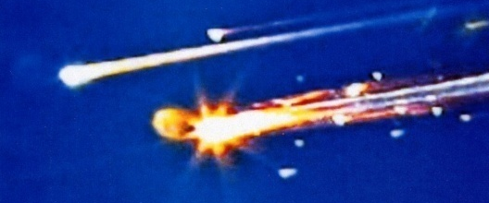
Her journey to space
1. Her first space mission began on 19/11/199 with six other astronauts .
4. On January 2003 she started her last mission with six other space crew.
5. She did 80 experiments.
2. She spent 15 days 16 hours,34 minutes and 4 seconds in space and travelled 6.5 million miles.
6. On 1 February 2003 her space destroyed before 16 minutes prior to their scheduled landing.
3. In 2003 she was selected for second space mission but cancelled for technical problems.

Slide 10
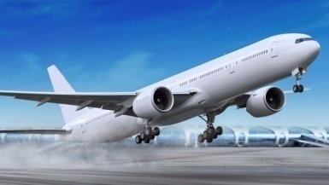
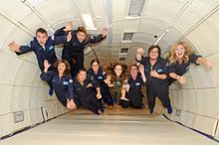
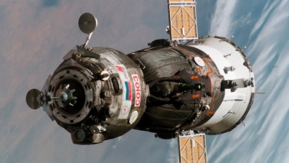
Word meaning
The moment when an aircraft leaves the ground and begins to fly.
Take off
Weightlessness
The state of having no weight
Malfunction
Inability to work or operate correctly
Retrieve
To find and bring back something.
Microgravity
Very week gravity

Slide 11
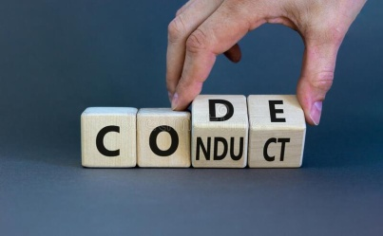
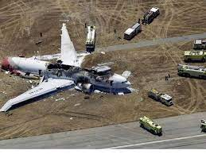
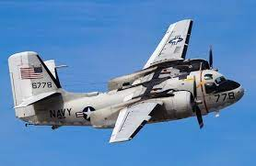
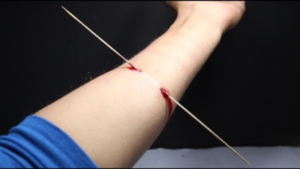
Word meaning
Conduct
To organized a particular activity.
Disintigrate
To become much worse
Rell off
To leave a group of vehicles,aircraft.
Penetrate
To move into something.
Vertical
Not horizontal.

Slide 12
Individual work [Reading& Writing Test]
( Read the text and answer the following questions)
Where was Kalpana Chawla born ?
When did she do her Ph.D ?
When did she get US citizenship ?

Slide 13
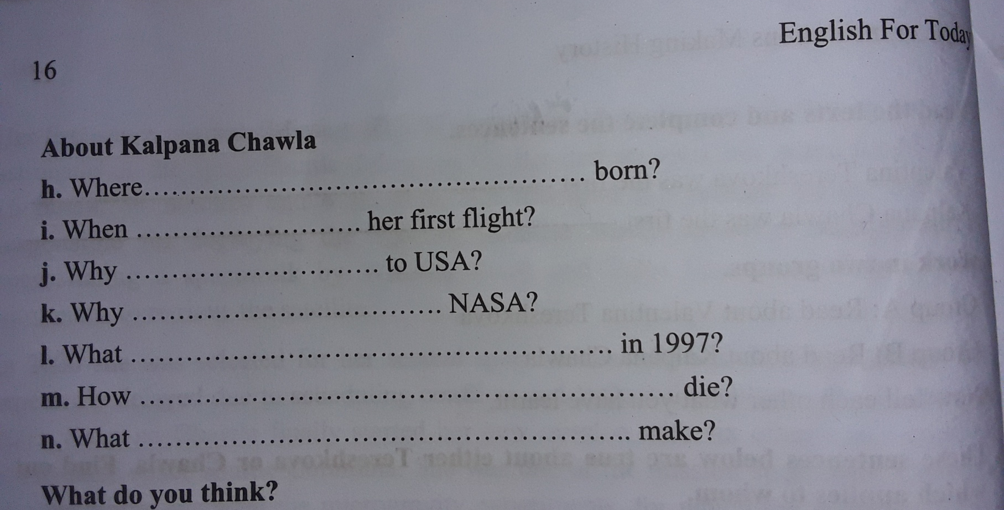
Individual Work [Reading and Speaking Test ]
Connection with mainbook
(Pair Work) [Listening & Speaking]
Connection with main book
Open your textbook and answer the following questions
Was Kalpana Chawla
She she was selected for
did she go
did she join
happened
Did she
Did she

Slide 14
Evaluation [Listening & Speaking Test]
a) Kalpana Chaola was born in------------
1. 1960 2. 1961 3. 1962 4. 1963
b) She gratuated in Aeronatical Engineering in---
1. 1980 2.1981 3. 1982 4. 1983
c) She obtained her masters from the university of--.
1. Texus 2. California 3. Colombia
d) She joined NASA in------
1. 1988 2. 1989 3. 1990 4. 1991
e) She spent almost----------days in space
1. 12 2. 14 3. 16 4. 18

Slide 15
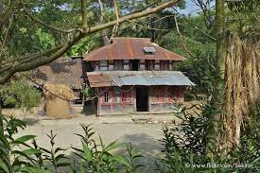
Homework [Writing Test]
Write a paragraph on “A Moonlit Night” that you have enjoyed recently.

Slide 16
Thank you very much

