Slide 1
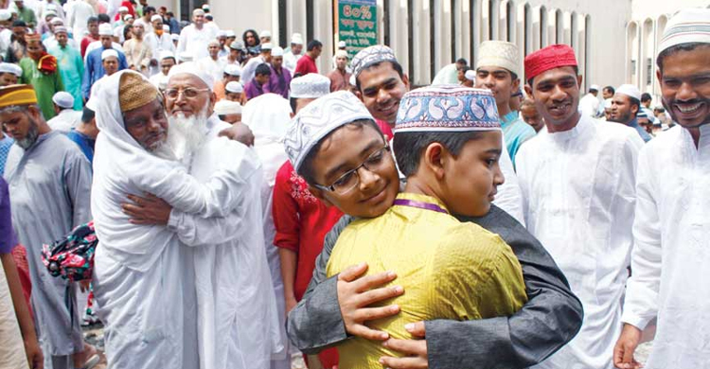
Good moorning everybody

Slide 2
Teachers Identity
Fatema khatun , Head Teacher, Hatisha Government Primary School. Kaharole,Dinajpur.

Slide 3
Subject Identity
Subject:English, Class:Five, Lesson-Unseen text ( For question no:5, 6 & 7)

Slide 4
Lets sing a Eid day song
Eid mubarak, eid mubarak,
Eid mubarak , Eid;
Today is Eidday,
Eid mubarak ,Eid.

Slide 5
Learning outcomes:
By the end of the lesson student will be able to--
4.2.1 understand and enjoy simple text.
5.1.1 read silently with understanding paragraph .
6.2.1talk about people.
10.1.1 write a short piece of composition by answering a set of question.

Slide 6
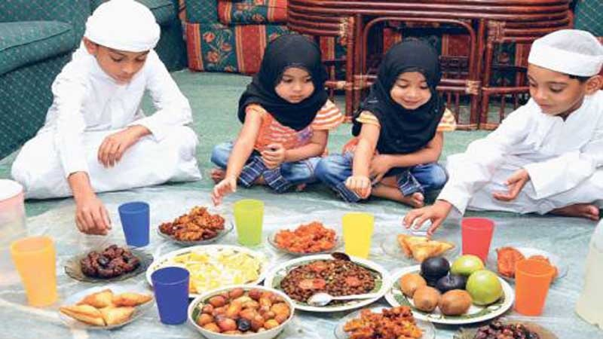
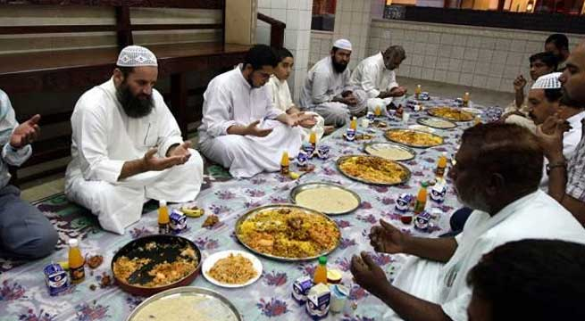
Look at the pictures
They ready to iftar.

Slide 7
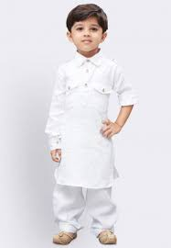
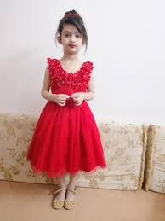
Look at the pictures
Shihab wears new payjamas and panjabi.
Nafisa wears a red frock

Slide 8
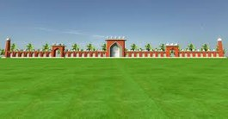
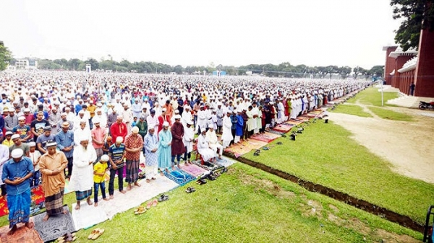
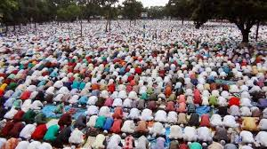
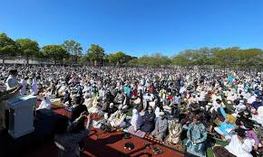
Look at the pictures
Eidgah
Eid prayer

Slide 9
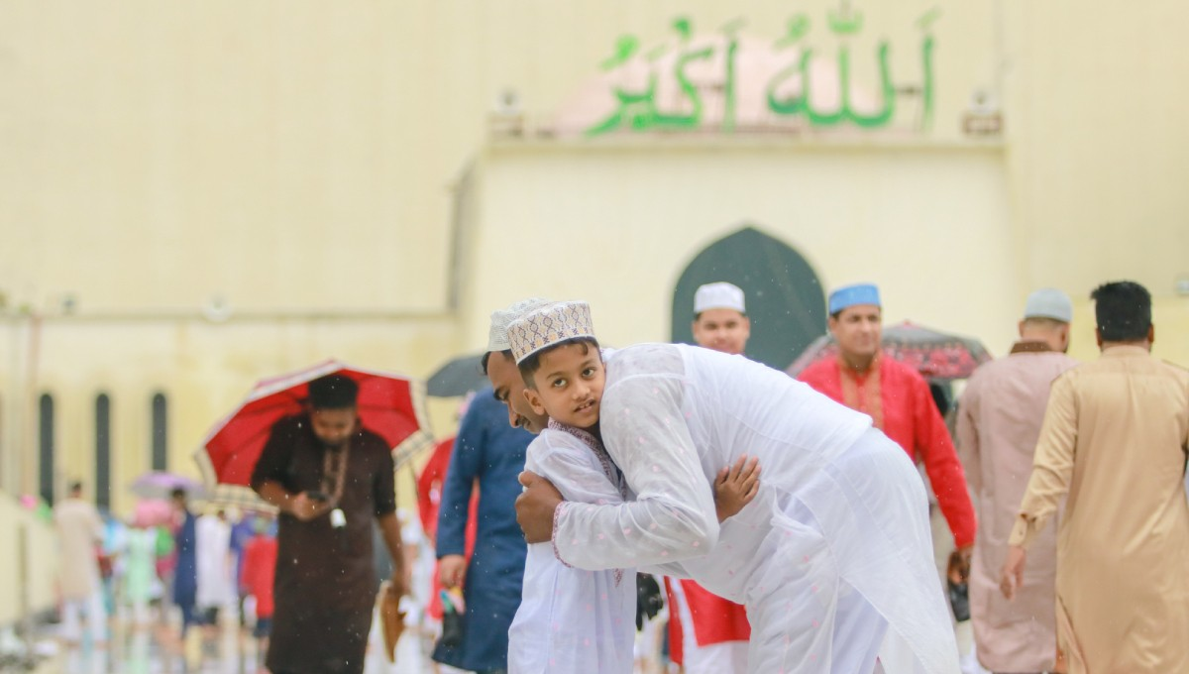
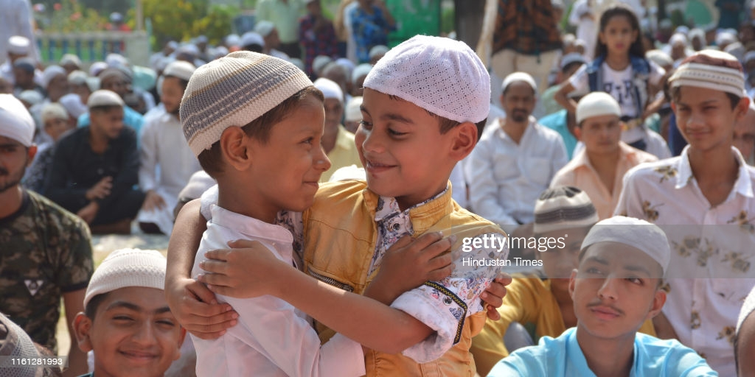
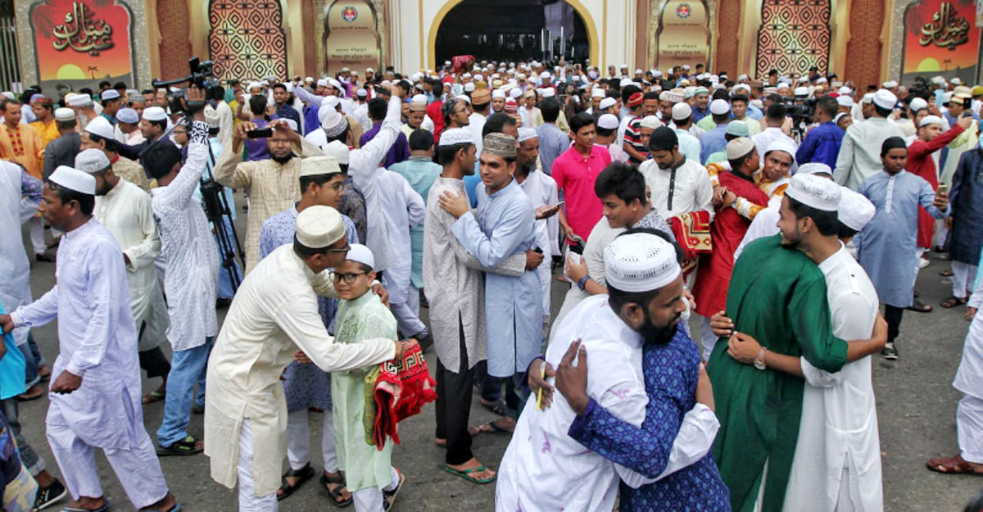
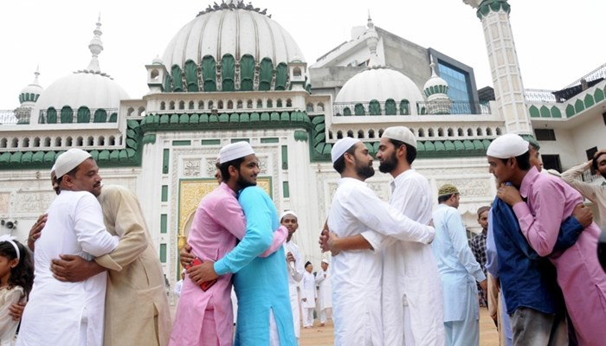
Loook at the pictures
After the prayer they embraced each other

Slide 10
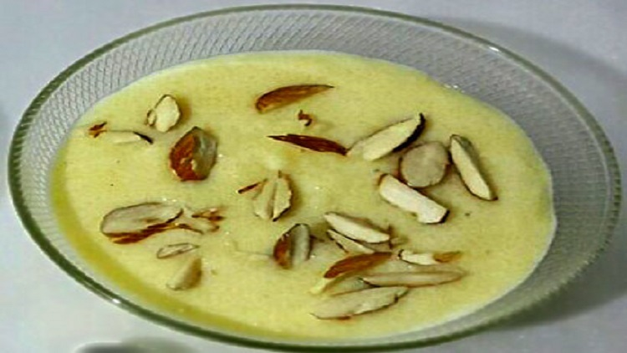
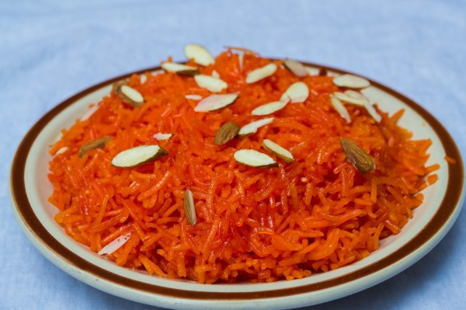
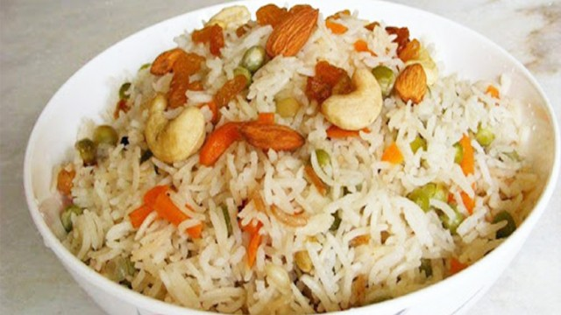
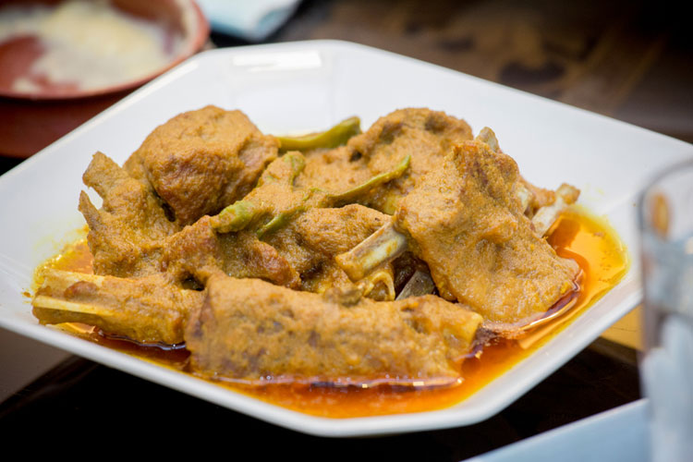
Special dishes for Eid
Firni
Jarda
Polao
Korma

Slide 11
Read the passage carefully
After a month’s fasting Eid-Ul-Fitre is celebrated. Today is Eid. Shihab is wearing new payjamas and a panjabi . Asif has come to shihab’s house . The boys will go to Eidgah for Eid prayer . Asif is also wearing new clothes.The boys are happy. Shihab has fasted 15 days and Asif for 17 days.Shihab’s sister Nafisa has fasted for 20 days. Nafisa has come out to greet Asif. The children say Eid Mubarak’ too each other. Nafisa is wearing a read frock. She looks happy too. Shihab’s mother Ms Fatema Banu has prepared many special dishes for Eid. She has made firni, jarda, polao, korma and many other items. Shihab and Nafisa’s favourite dish is firni.

Slide 12
5.Fill in the blanks with the given words: cooked, happy, 15, fasted, greet, wearing, come
a.Nafisa has come out to……..Asif.
b.Shihab has fasted for …....days.
c.The boys are ……….
d.Asif has ……to Shihab’s house.
e.Ms Fatema Banu has…..many dishes.
Match the answers:
a. greet, b. 15, c. happy, d. come, e. cooked.

Slide 13
6. Write true or false.
a.Shihab is wearing a shirt and trousers.
b.Asif is wearing new clothes.
c.Ms Fatema Banu has cooked many dishes.
d.Nafisa’s favourite dish is jarda.
e.The boys will go to Eidgah for Eid prayer.
Match the answers:
a. false, b. true, c. true, d.false, e. true.

Slide 14
Answer the following questions:-
(a) When is Eid-ul-Fitre celebrated ?
(b) What is Shihab wearing ?
(c) How many days has Nafisa fasted?
(d) Who are prepared special dishes ?
(e) What are the special dishes ?
.

Slide 15
Match the answers:
a. After a month’s fasting Eid-ul-Fitre is celebrated.
b.Shihab is wearing new payjamas and a panjabi.
c.Nafisa has fasted for 20 days.
d.Shihab’s mother Ms Fatema Banu prepared special dishes.
e.The special dishes are firni,jarda,polao,korma and many other items.

Slide 16
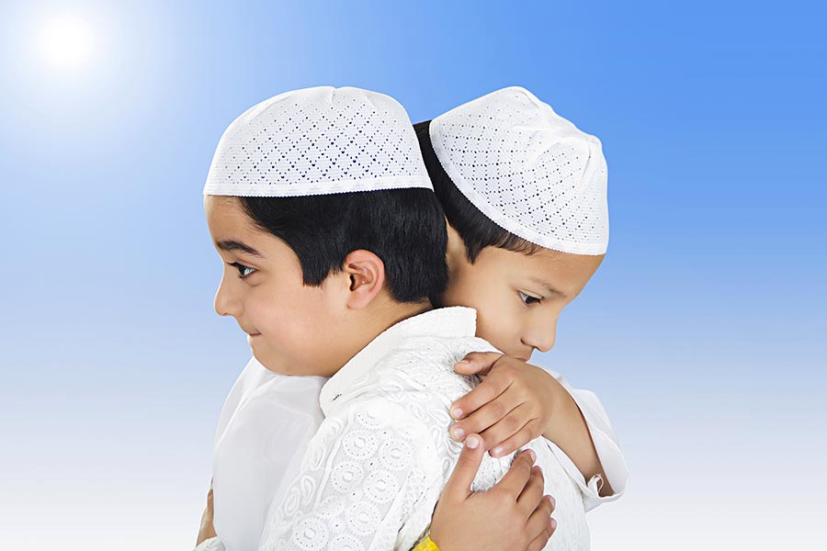
Thank you.

