Slide 2
Welcome to my class.

Slide 3
Introduction to the teacher
Maleka Mokerrama Moly
Assistant Teacher
171 No Dhandogaon Government Primary School
Thakurgaon Sadar,Thakurgaon.
Mobile: 01737822846
Email: molyictb120@gmail.com

Slide 4
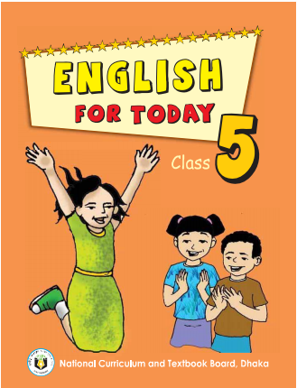
Introduction to the lesson
Class:Five
Subject:English
Title:How far is Saint Martin’s?
Unit: 12
Lessons: 1
Page: 46

Slide 5
Learning outcomes
Listening:
3.4.1 understand statements made by the teacher and students.
4.2.1 understand and enjoy simple stories.
Speaking:
1.1.1 say words ,phrases and sentences with proper sounds and stress.
1.1.2: say sentences with proper intonation.
Reading:
1.5.1:read words,phrases and sentences in the text with proper pronunciation,stress and intonation.
1.6.1: recognize and read statements,commands,greetings,questions and answer.

Slide 6
Let’s see a video and enjoy this my little learners.
https://www.youtube.com/watch?v=9SdBZoqHxB8&list=WL&index=2&t=31s

Slide 7
How was the video?
What is the name of the spot?
Do you want to visit there ?
Can you guess our today’s lesson?

Slide 8
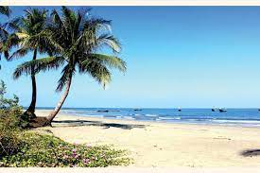
Todays Lesson
is
How far is Sain Martin’s?

Slide 9
Dear students,let’s see some beautiful pictures and enjoy it.

Slide 10
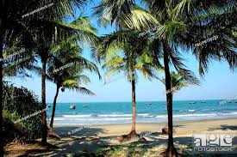
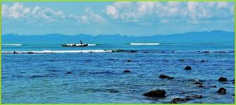
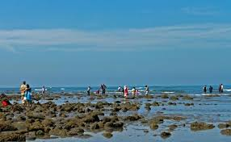
Saint Martin’s Island

Slide 11
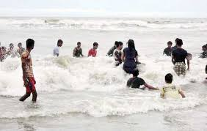
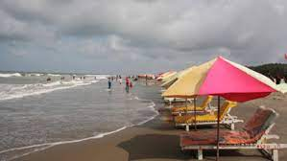
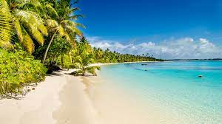
Cox’s Bazar
The most popular tourist spot

Slide 12
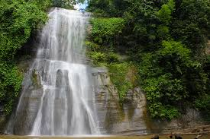
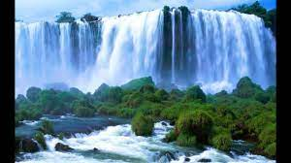
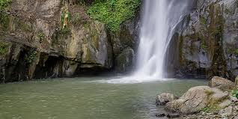
Madhabkundu
Wanderful waterfall

Slide 13
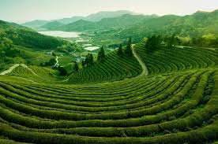
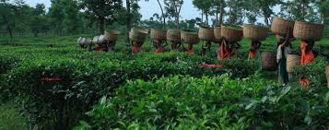
Sreemangal
Beauty of the tea garden

Slide 14
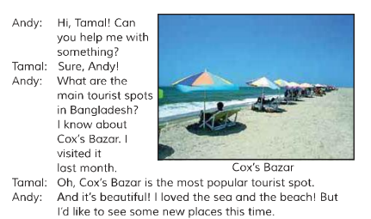
Teacher’s loud reading

Slide 15
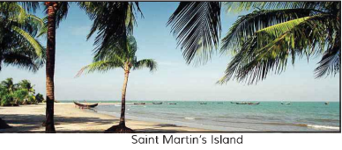
Tamal:
There are many places to see
In our country.You can go to Sreemangal.You can enjoy the beauty of the tea gardens thera.From there you can go to Madhabkundu.There are some wonderful waterfalls there.You can also go to Saint Martin’s Island.It’s a special place.

Slide 16
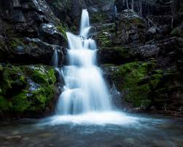
Summary of the dialogue
The dialogue is between Andy and Tamal.Andy asked for Tamal’s help to know about main tourist spots in Bangladesh?Andy visited Cox’s Bazar last month .Now he wants to know about some new places to visit.Tomal told Andy to visit Srimangal tea gardens,Madhobkundu waterfalls and Saint Martin’s Island.

Slide 17
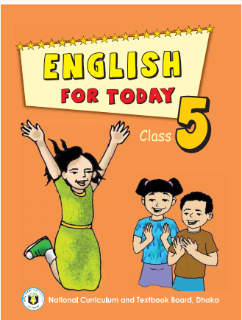
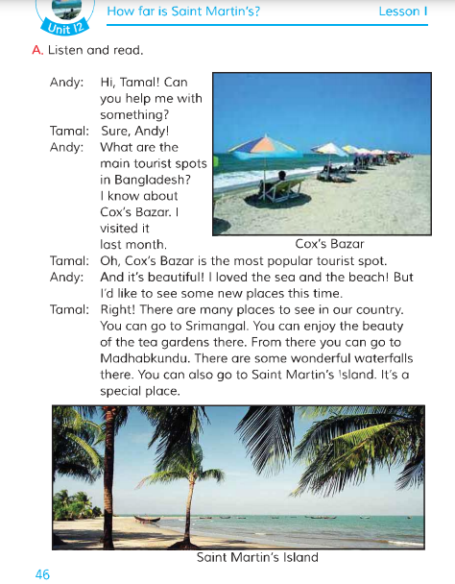
Now open your English book at page no 46.

Slide 18
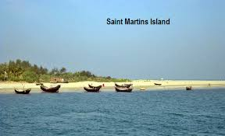
New words and that’s meaning
Tourists spot
A place where people travels for pleasure.
Beach
The seashore
Water dropping from a higher to a lower point.
Waterfall
Island
A mass of land surrounded by water.

Slide 19
Student’s individual reading

Slide 20
Pair work
Practise the dialogue in pair.One will act as Andy and other will act as Tamal.

Slide 21
Group Work
Group 1
What is the most popular tourist spot in Bangladesh?
Group 2
Write the name of 4 popular tourist spots of Bangladesh.

Slide 22
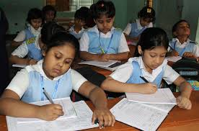
Evaluation
Answer the questions
1.Who are in the dialogue?
Ans:Andy and Tamal are in the dialogue.
2.Who is asking about the main tourist spots in Bangladesh?
Ans:Andy is asking about the main tourist spots in Bangladesh.
3.Who visited Cox’s Bazar last month?
Ans:Andy visited Cox’s Bazar last month.
4.What is the most popular tourist spot in Bangladesh?
Ans:Cox’s Bazar is the most popular tourist spot in Bangladesh.
5.Write the name of tourist spots of Bangladesh.
Ans: The name of tourist spots of Bangladesh are Cox’s Bazar,Sreemangal’s tea garden,Madhobkundu waterfalls and Sain Martin’s Island .

Slide 23
Homework
Write a short composition about ‘Tourist spot in Bangladesh.’You have to write it at least 5 sentences.

Slide 24
Learning from todays lesson.
Today we learnt about different tourist spots in Bangladesh.

Slide 25
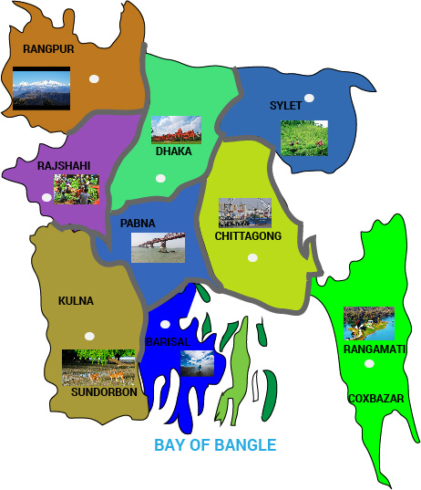
THANK YOU

