Slide 1
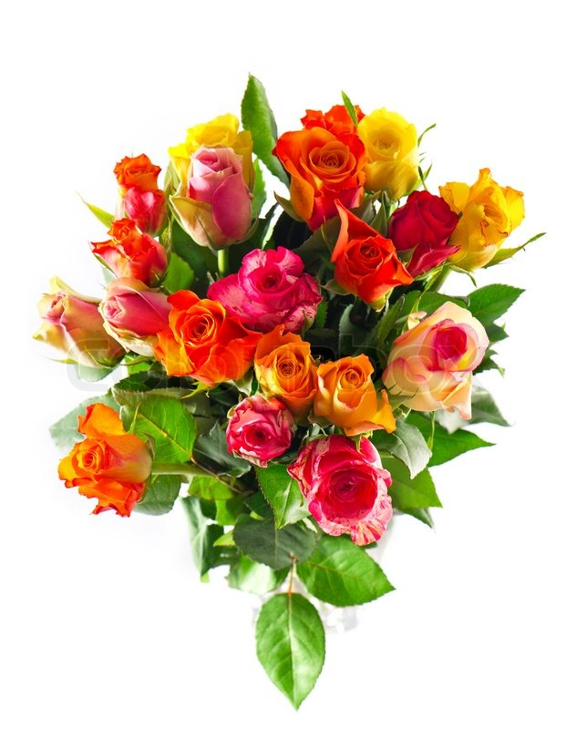
Welcome to my class

Slide 2
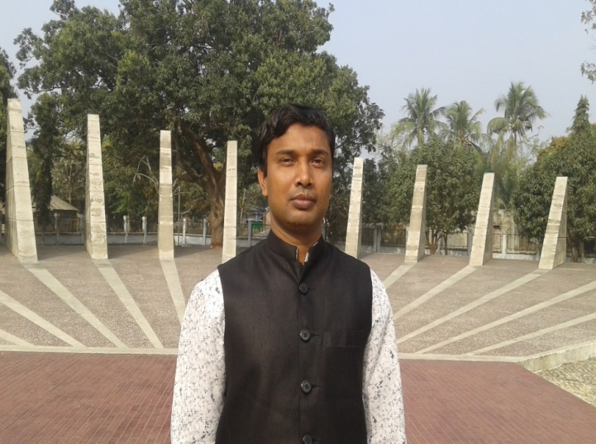
Introduction
Md. Faruq Hossain
Assistant teacher
Anandabash Govt. primary school.
Mujibnagar, Meherpur.
Mobile no- 01717406029
E-mail- faruqbd01@gmail.com
Class: Five
Subject: English
Caption of the lesson: Sport.
Today`s Lesson: Lessons 1-2

Slide 3
Let`s watch a video clip.
What did you watch?
https://www.youtube.com/watch?v=v3m_DlYSJOA&ab_channel=SporDelisiHD
Sport

Slide 4
Today`s lesson
Lesson 1-2

Slide 5
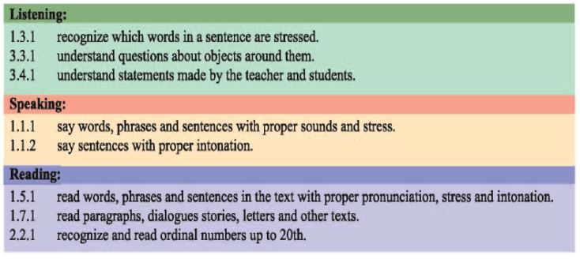
LEARNING OUTCOMES
Students will be able to-------

Slide 6
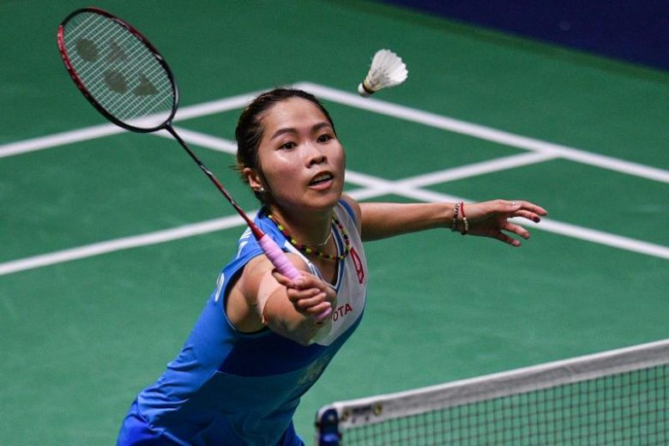
How many players can take part in a badminton team?
What is the name of the game?
Think about the picture.
Badminton
One or two players.

Slide 7
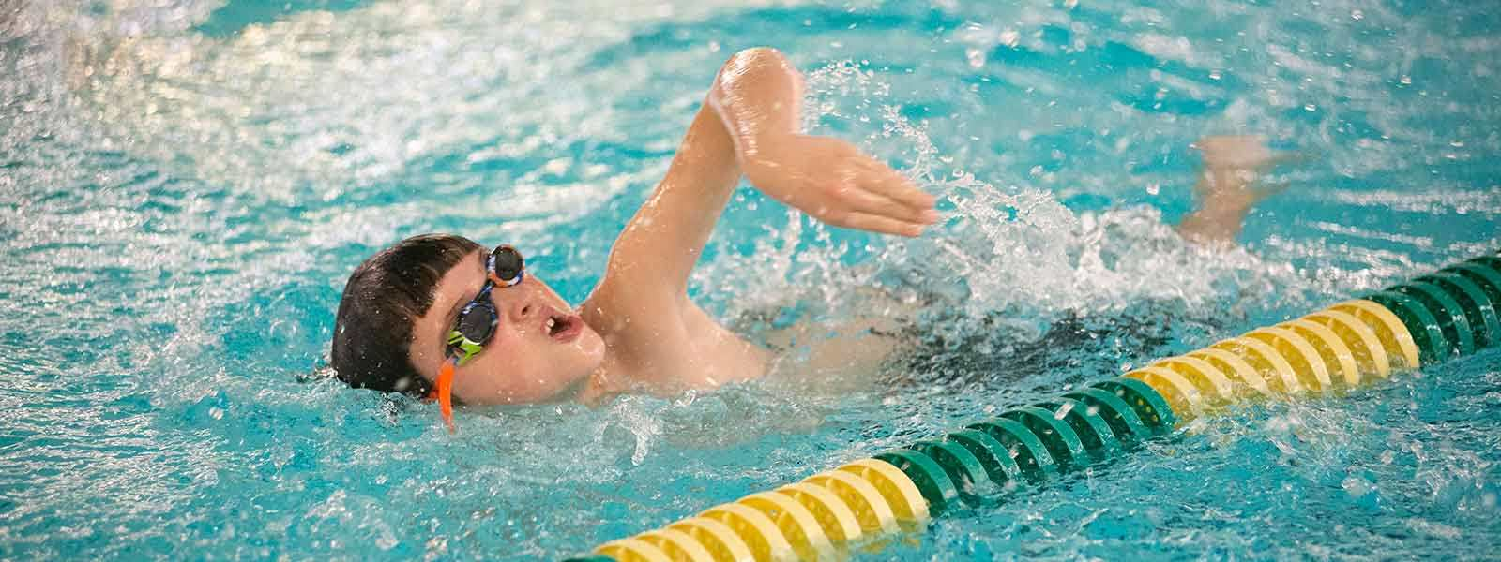
What`s the name of this game?
Think about the picture.
Swimming
Butterfly and Breststrok are the name of two kinds of swimming.

Slide 8
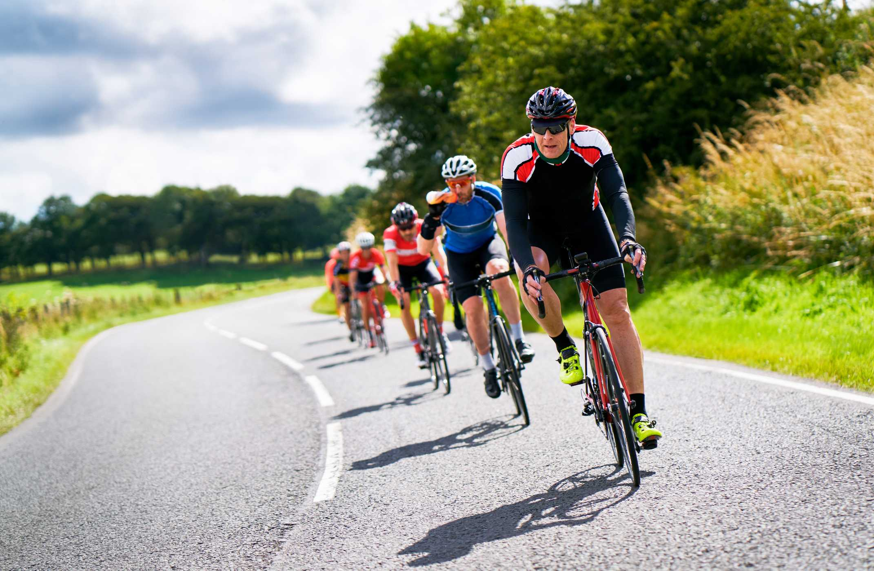
What`s the name of this game?
Think about the picture.
Cycling

Slide 9
Group work
Answer the following questions.
Group-A: How many players can take part in a badminton team?
Group-B: Write the name of two kinds of swimming?
Ans: One or two players.
Ans: Butterfly and Breststroke.

Slide 10
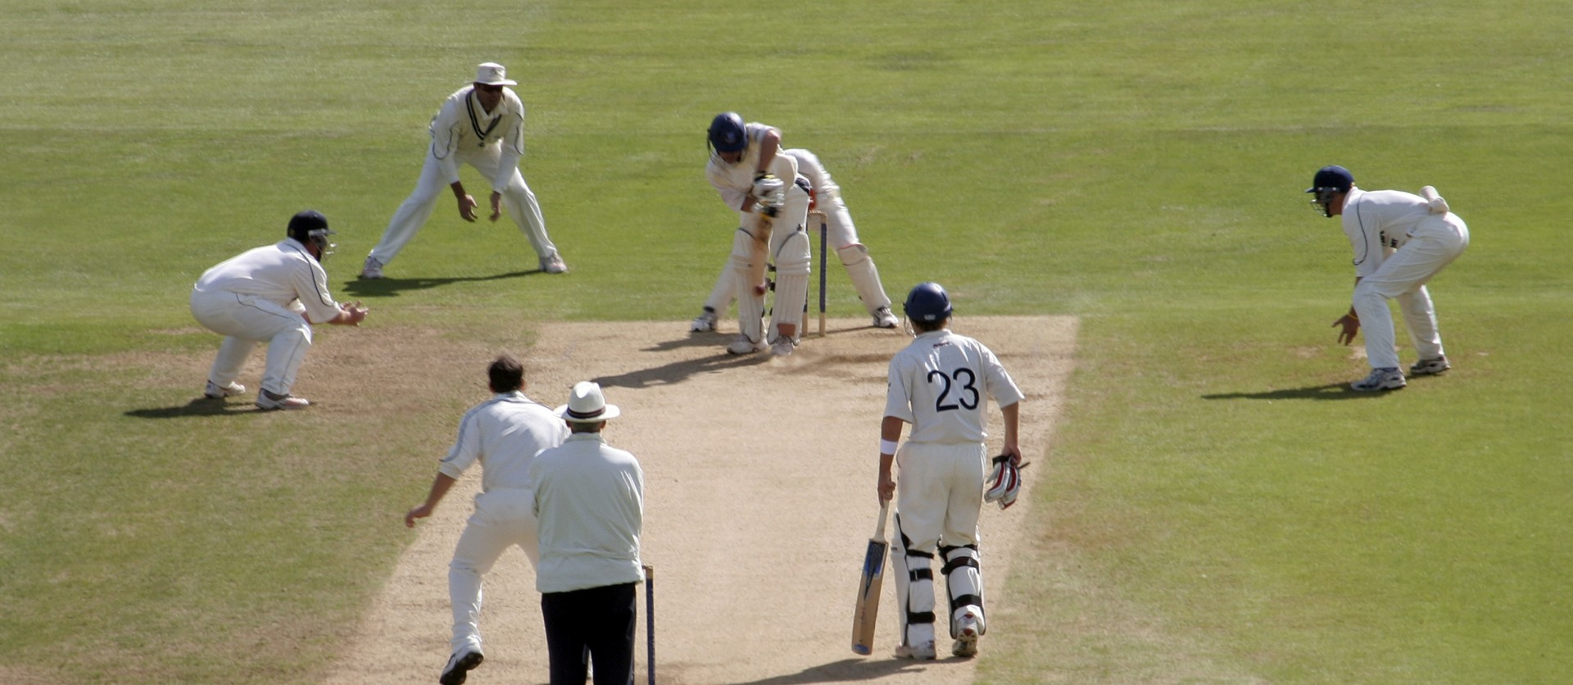
What`s the name of this game?
Think about the picture.
Cricket

Slide 11
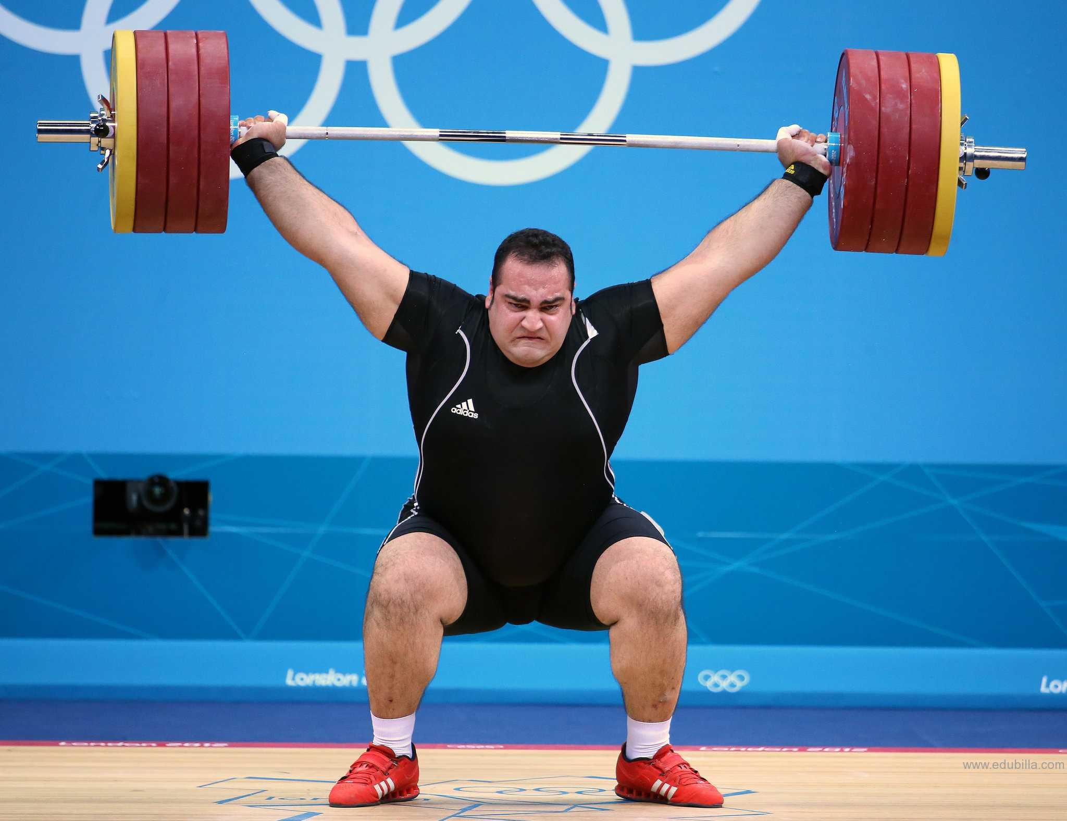
What`s the name of this game?
Think about the picture.
Weightlifting

Slide 12
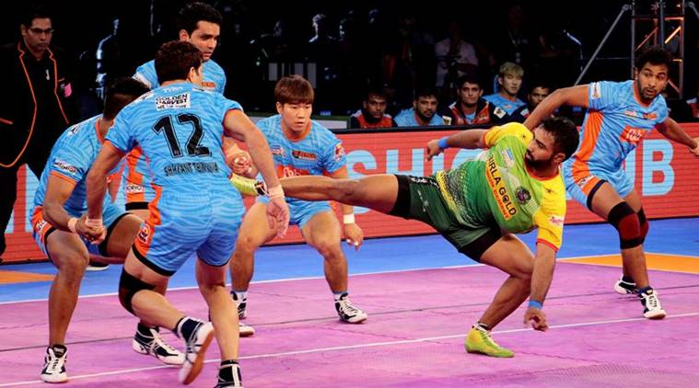
Think about the picture.
What`s the name of this game?
Kabadi
is our national game

Slide 13
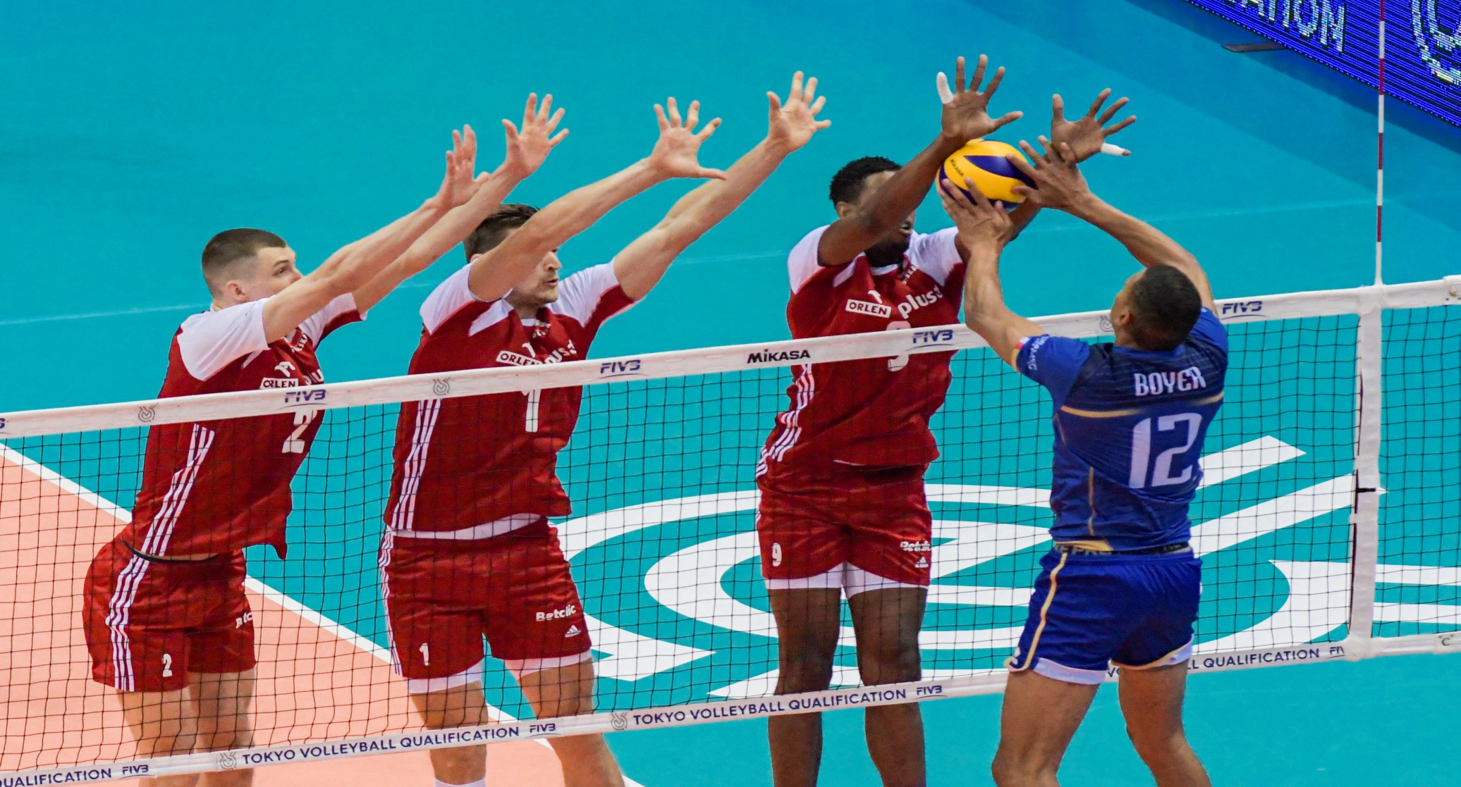
What`s the name of this game?
Look at the picture.
Volleyball

Slide 14
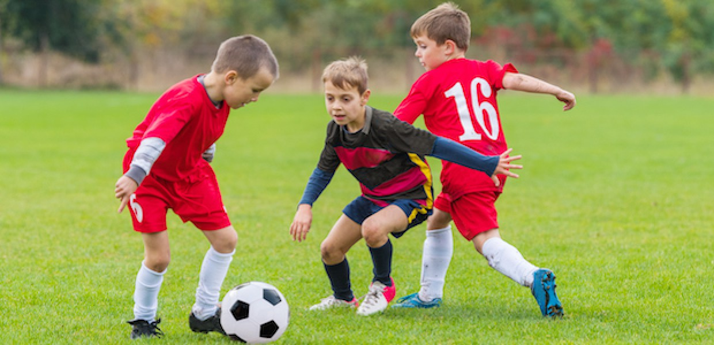
What`s the name of this game?
Look at the picture.
Football

Slide 15
Pair work
Answer the following questions.
1. What is our national game?
Ans: Kabadi.

Slide 16
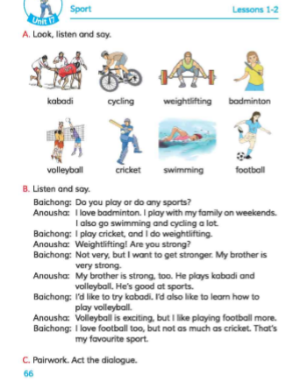
Open your english book at the page no-66

Slide 17
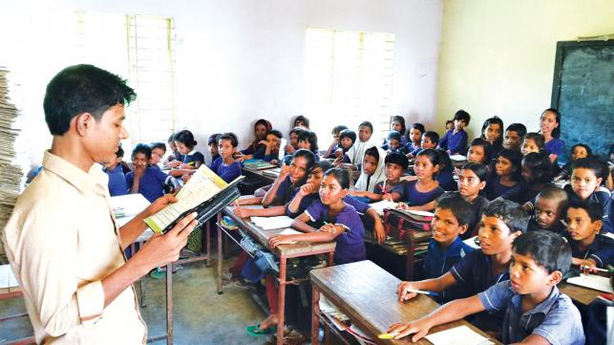
Loud reading

Slide 18
Some word meanings
Sport
Swim
Weightlifting
Weekends
Strong
Exciting
Favourite
ক্রীড়া
সাতাঁর কাটা
ভারোত্তোলন
সাপ্তাহিক ছুটির দিন
শক্তিশালী
মনোমুগ্ধকর
প্রিয়

Slide 19
EVALUATION
Write “T” for correct statement or “F” for false statement.
1. Anousa plays badminton on weekdays.
2. Baichong hates weightlifting.
B. Answer the following questions.
1. What is Baichong`s favourite sport?
2. Who goes swimming and cyling a lot?
T
F
Ans: Cricket.
Ans: Anousha.

Slide 20
Home work
Write a short composition about “your favourite sport” by answering the following questions.
1. What games or sports do you like?
2. How often do you play or watch that sport?
3. When do you play or watch it?
4. Who do you play or watch the sport with?

