Slide 1
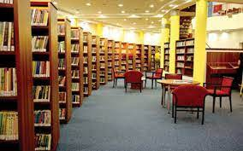
Welcome to my class

Slide 2
Identity of Teacher
Fatema Khatun
Head Teacher
Hatisha Government Primary School
Kaharole,Dinajpur .

Slide 3
Class:Five
Sub:English
Lesson unit : Form Fill up (For question no : 13
Time : 40 Minutes
Identity of Lesson

Slide 4
Learning Outcomes:
After the lesson students will be able to-
4.2.1 understand and enjoy simple texts.
4.1.1 Fill in simple form about oneself and others.

Slide 5
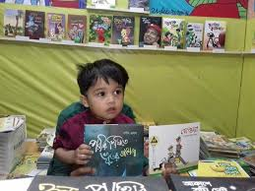
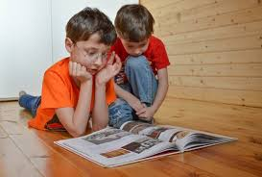
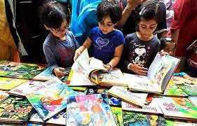
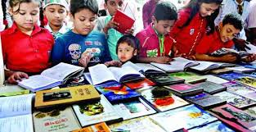
What are they doing?

Slide 6
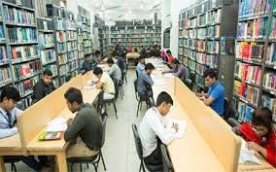
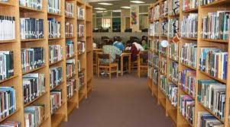
Look at the pictures
What are they doing ?
They are reading at library.

Slide 7
Read the text carefully(Small group work)
Imagine,Najmul Haque reads in class five. in Sonapur Government Primary School.He lives with his parents Sajedul Haque and Rina Haque.His home address is station road,Sadar,dinajpur. He likes to play football.He enjoys reading. So,he wants to be a member of District Public Library.

Slide 8
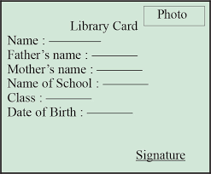
Look at the library card
Now,fill up the form by using Najmul’s information.(Pair Work)

Slide 9
Complete the following form by usuing your own information.
English Language Club
1.Name :
2.Father’s Name :
3.School’s Name :
4.Date of birth :
5.Home address :
Date: Signature
Photo

Slide 10
Thank You

