Slide 1
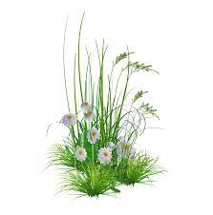
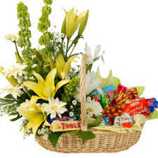
WELCOME ON MY CLASS

Slide 2
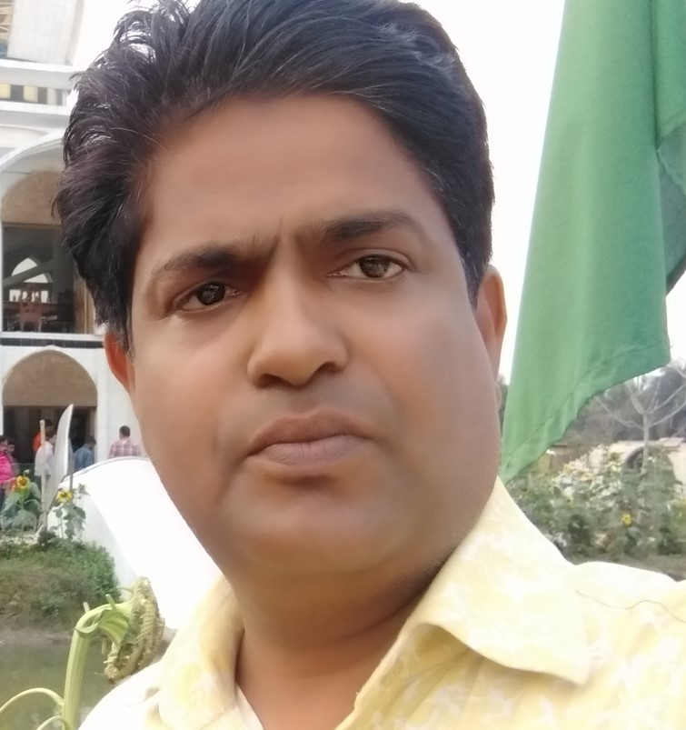
Teacher’s Identity
Md Jahid Hossen Khan
Headteacher
Rajihar Government Primary School.
Agailjhara , Barishal .

Slide 3
Class: Three
Subject: English

Slide 4
Learning outcomes: Students will be able to
Listening:
4.3.1- enjoy and understand simple stories.
Reading:
5.1.2- read simple stories.

Slide 5
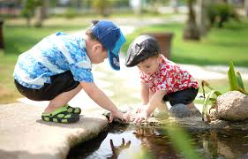
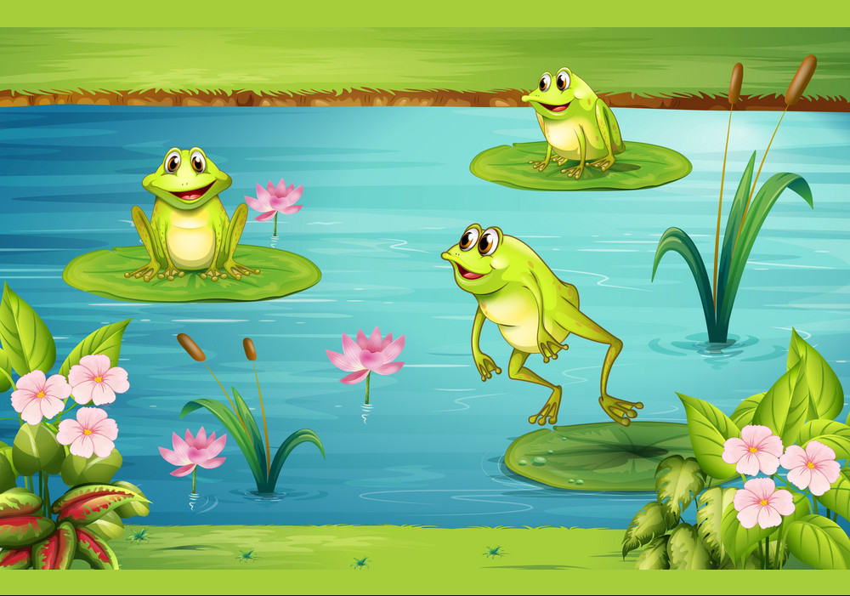
Let’s see the pictures
What do you see in the picture?

Slide 6
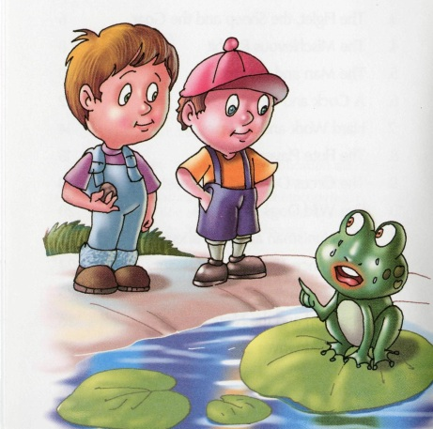
Our Today’s Topic Is
Unit: 33
Lesson: 1-2
Topic: The boys and the frogs
Activity: A .

Slide 7
Let’s know some new words and pronounce with me
pond
tank
flow of water

Slide 8
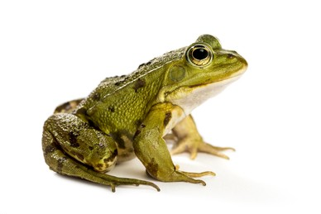
frog
toad
paddock

Slide 9
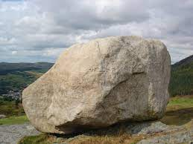
stone
rock
gem

Slide 10
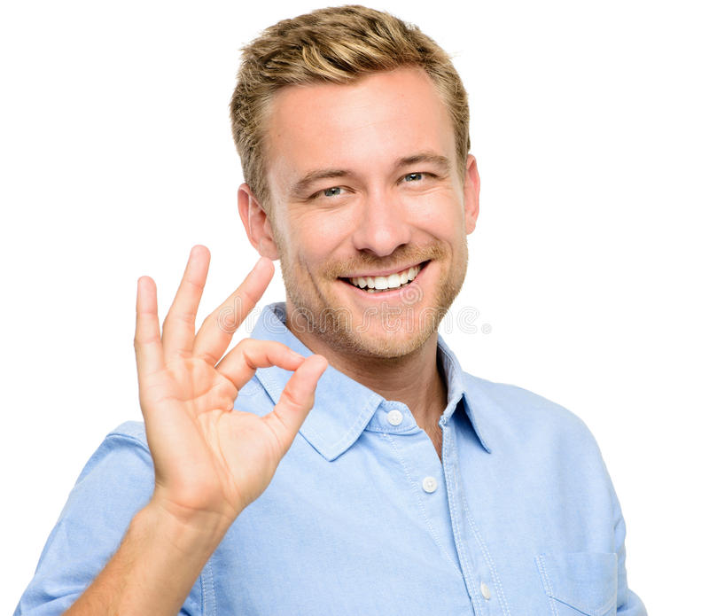
happy
glad
feeling good

Slide 11
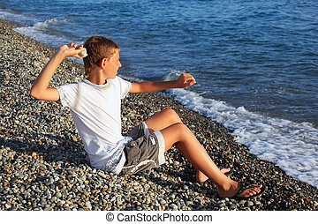
throw
cast
volley

Slide 12
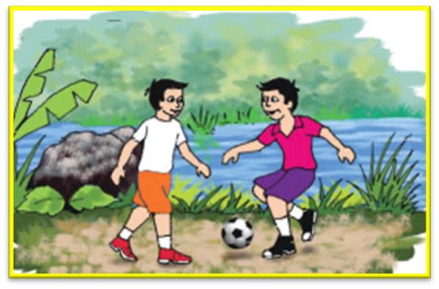
Let’s see the pictures.
What are the boys doing ?
The boys are playing near the pond .

Slide 13
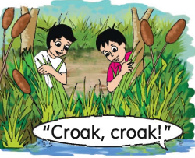
What are the boys doing ?
The boys are looking for frogs.

Slide 14
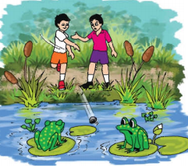
What are the boys doing ?
The boys are throwing a stone.

Slide 15
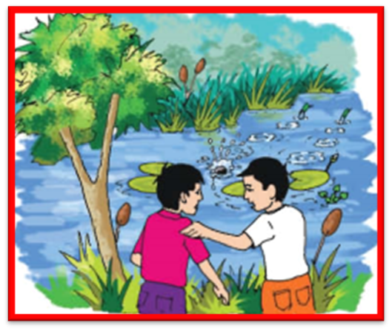
What is happening here ?
The frogs are swimming away.

Slide 16
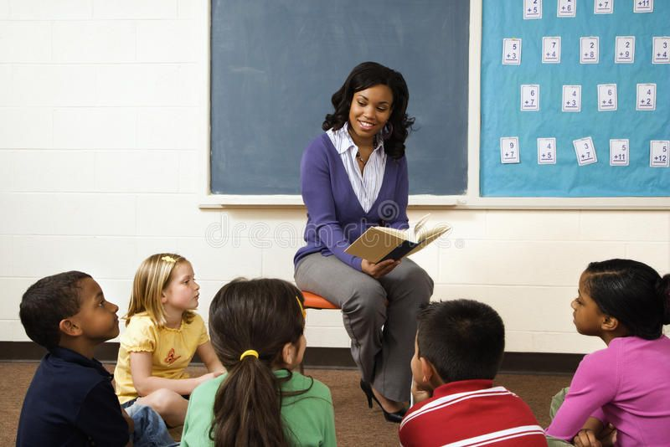
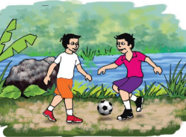
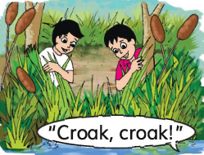
Teacher’s Model Reading
Fazle and Saiful are playing near the pond
Fazle says , ” Listen Saiful .There are frogs here ! Let’s see them !” Fazle is happy .

Slide 17
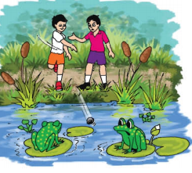
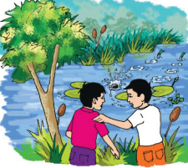
“ I have an idea ,” Saiful says .He throws a stone .” Stop! “ Fazle says .
The frogs swim away .”Sorry ! “ Saiful says.

Slide 18
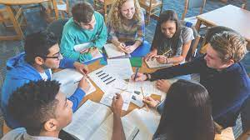
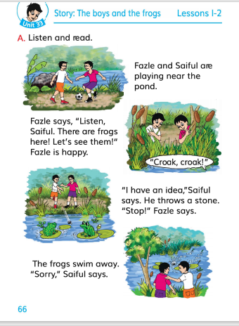
Group work
Read the text
Group
Group
Apple
Banana
Open your book at page at 66

Slide 19
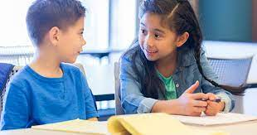
Pair work
Read the text
Open your book at page at 66

Slide 20
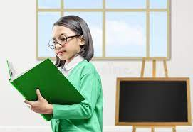
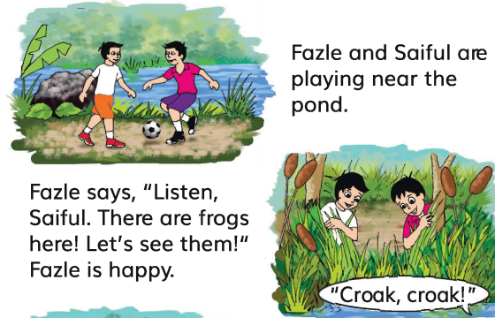
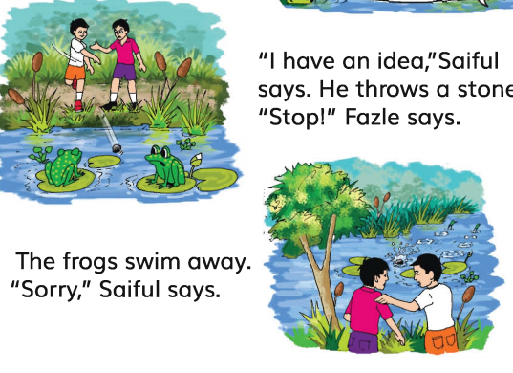
Individual Work
Read the text
Checking Learning & Evaluation

Slide 21
Home Work
Read the text

