Slide 2
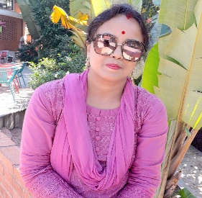
Teacher Identification
SHAMPA RANI DAS
ASSISTANT TEACHER
SATKORAKANDI GOVT.PRIMARY SCHOOL
BOROLEKHA ,MOULVIBAZAR.

Slide 3
Lesson Identification
Subject : English
Class : Two
Topic : Shapes
Unit:19
Lesson:1-3
Page:38
Class Duration:40 minutes.

Slide 4
Lets watch a video clip
What have you watched?
Could you guess?
Yes , Shapes

Slide 5
Lessons declarations
Todays lesson is our ….
Shapes

Slide 6
At the end of the lesson learners will be able to …….
1.1.1. become familiar with English sounds by listening to common English words.
1.1.2. say simple words and phrases with proper sounds and stress.
1.4.1. read words and phrases with the help of visual clues .

Slide 7
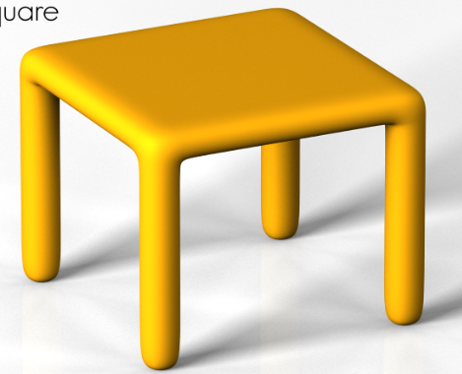
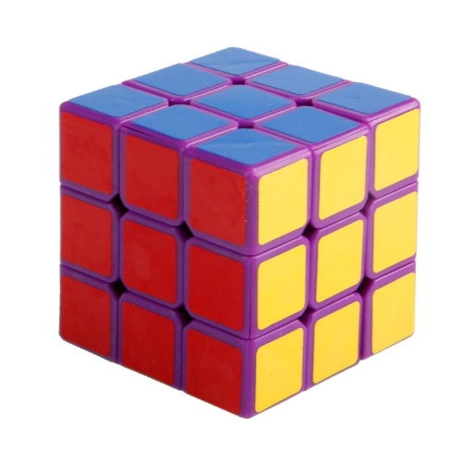
Square
These objects has four sides

Slide 8
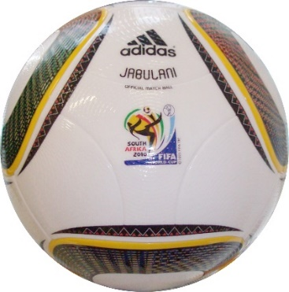
Circle
These objects are round

Slide 9
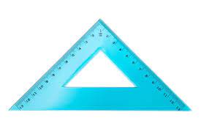
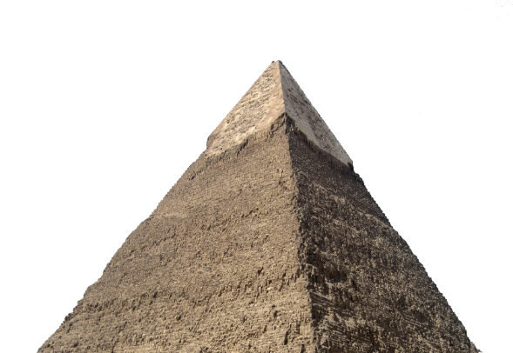
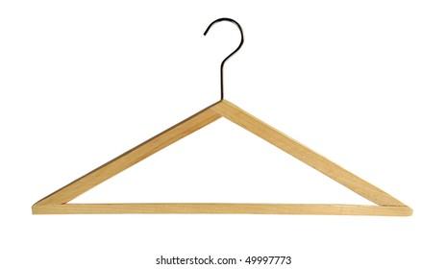
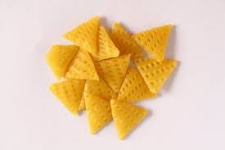
Lets see some objects
Triangle
These objects has three sides.

Slide 10
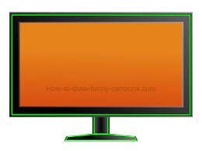
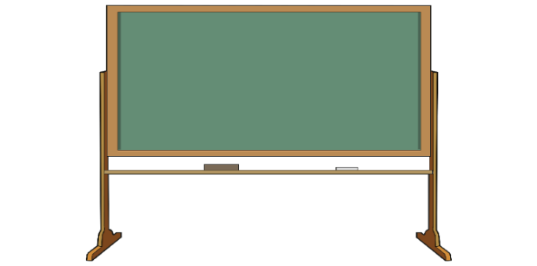
Rectangle
These objects has also four sides
But two are long and two are short

Slide 11
INDIVIDUAL WORK
1.What is this?
It is a marble.
2.What is this?
It is a cradler.
3.What is this?
It is a pazzle.
4.What is this?
It is a door.

Slide 12
Look, listen and say
square
circle
triangle
rectangle

Slide 13
Look and say
Pair work
square
circle
triangle
rectangle

Slide 14
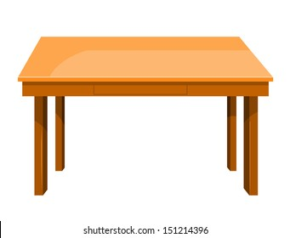
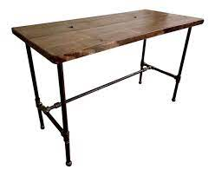
Look and say
1.What shape it is?
It’s look like a square.
2.What shape it is?
It’s look like a rectangle.
3.What shape it is?
It’s look like a triangle.
4.What shape it is?
It’s look like a circle.

Slide 15
Group work
Open your book at page-38
Say, read and match
square
triangle
triangle
rectangle
circle
square
rectangle
circle

Slide 16
Evaluations
Answers the questions orally?
What shape has three sides?
triangle
What shape is round?
circle
What shape has four sides?
square
What shape has straight sides?
rectangle

Slide 17
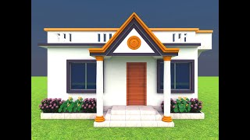
Home work
Draw a rectangle and color it.

