Slide 1
Welcome to all

Slide 2
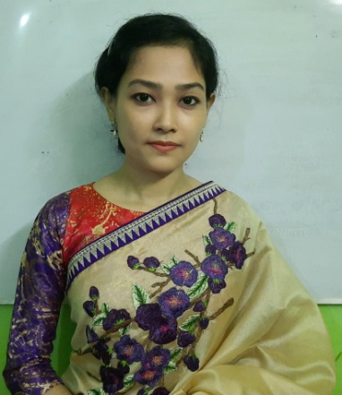
Introduction
Nipa Chatterjee
Assistant Teacher
Abdul Hamid Govt. Primary School, Sylhet Sadar, Sylhet.
Class : Five
Subject: English
Lesson: 1-2
Unit: 2, Page no-6
Time: 35 minutes

Slide 3
Learning Outcomes:
Students will be able to-
Listening:
1.4.1– recognize and use intonation patterns for Yes/ No and Wh questions.
1.4.2– recognize and use intonation pattern for greetings and statements.
3.2.1– understand questions about family and friends of students.
3.4.1– understand statements made by the teacher and students.
Speaking:
1.1.1– say words, phrases and sentences with proper sounds and stress.
1.1.2– say sentences with proper intonation.
2.1.1– exchange greetings and farewells.
3.1.1– ask and answer Wh questions.

Slide 4
Learning Outcomes:
Students will be able to-
Reading:
1.5.1– read words, phrases and sentences in the text with proper pronunciation, stress and intonation.
1.6.1– recognize and read statements, commands, greetings, questions and answers.
5.1.3– read silently with understanding dialogues.

Slide 5
Let’s enjoy a video

Slide 7
Recalling Previous Lesson:
Tamal, who came to the Town Hall Language Club to practise speaking English.
There he met with Andy Smith, who is working with an NGO in that language club and Tamal started to practise speaking English with him.

Slide 8
Today's lesson
See you!

Slide 9
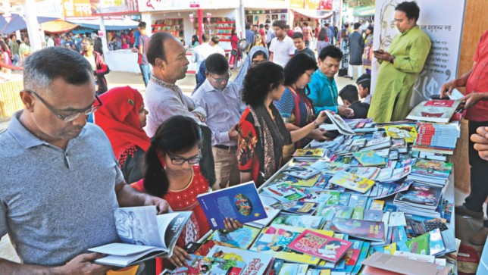
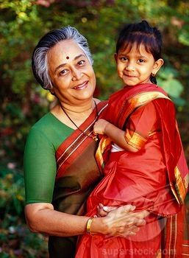
Let’s introduce with some new words--
Book fair--
Medicine--
Grandmother--
Great--

Slide 10
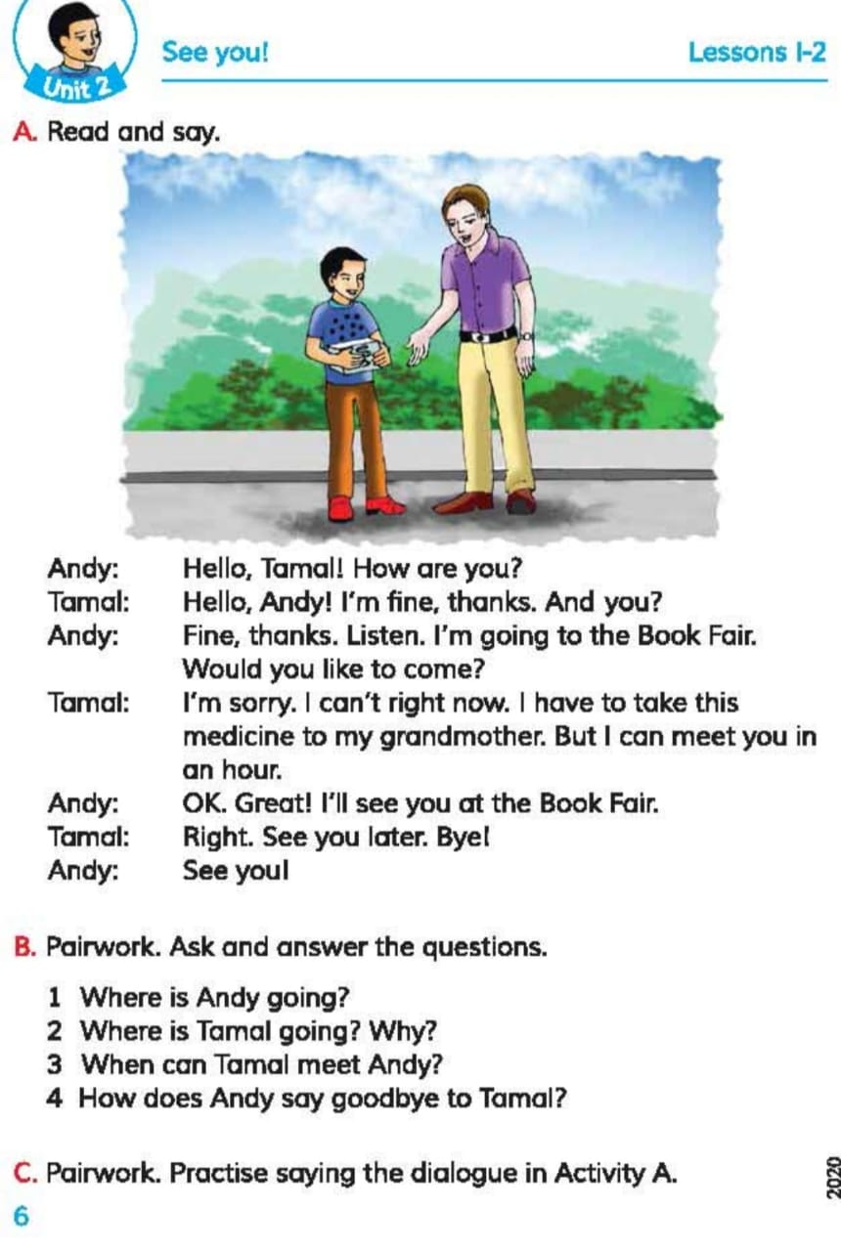
Open your book at Page No- 6

Slide 11
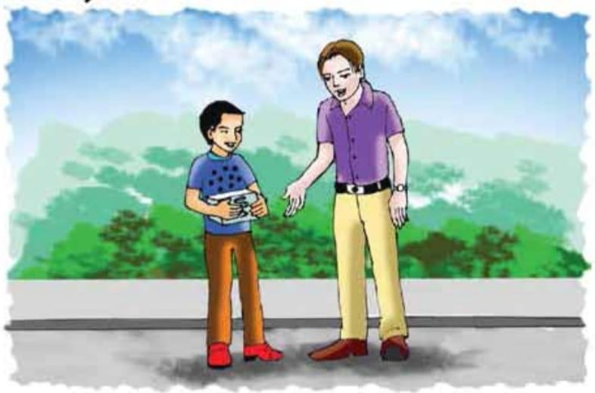
Look at the picture-

Slide 12
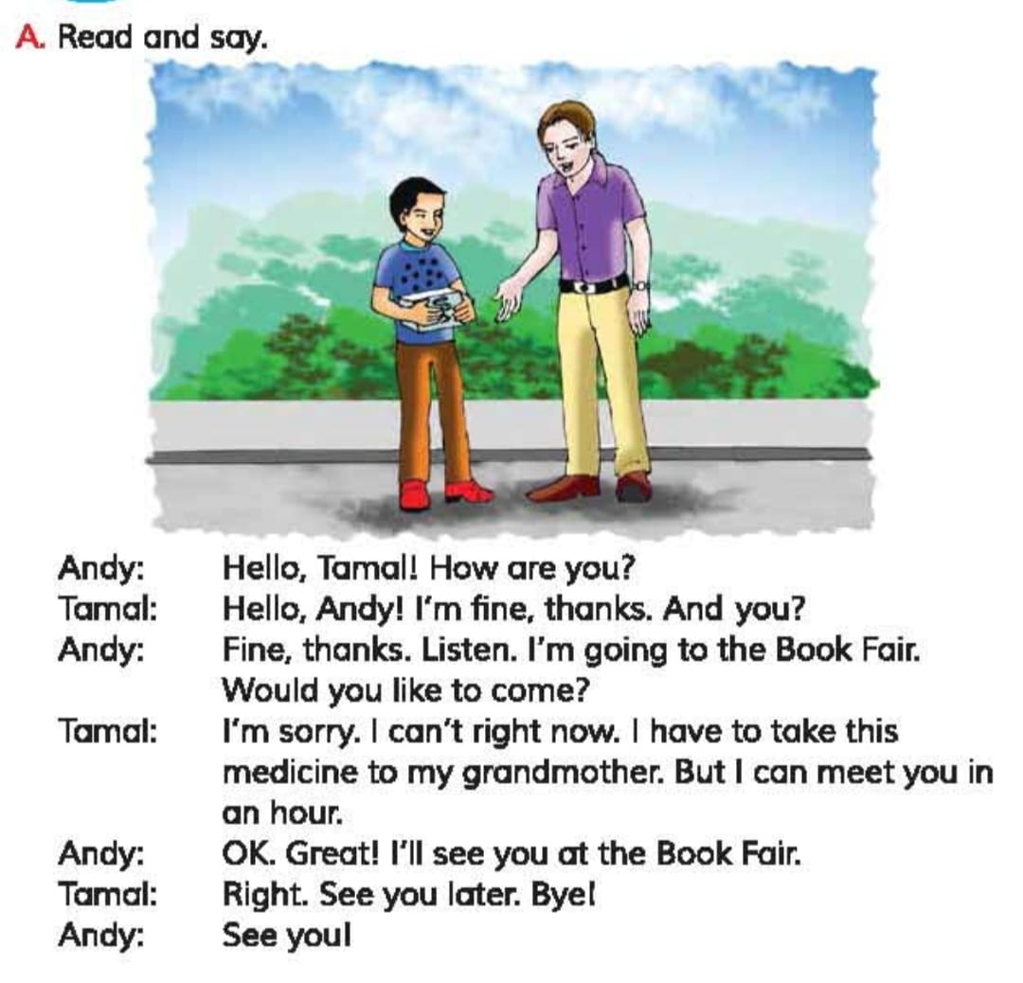
Listen very attentively

Slide 13
New word meaning--
Book fair–
A fair or Bazar at which books are sold.
(বই মেলা)
Medicine–
which is taken for the treatment or prevention of disease.
(ঔষধ)
Grandmother–
Mother of one’s mother or father.
(দাদি)
Meet–
To see and talk with someone.
(সাক্ষাৎ / দেখা হওয়া)
Great–
Very well.
(খুব ভালো)
Right now–
Immediately.
(এখনি)

Slide 14
Again , listen very attentively.....

Slide 15
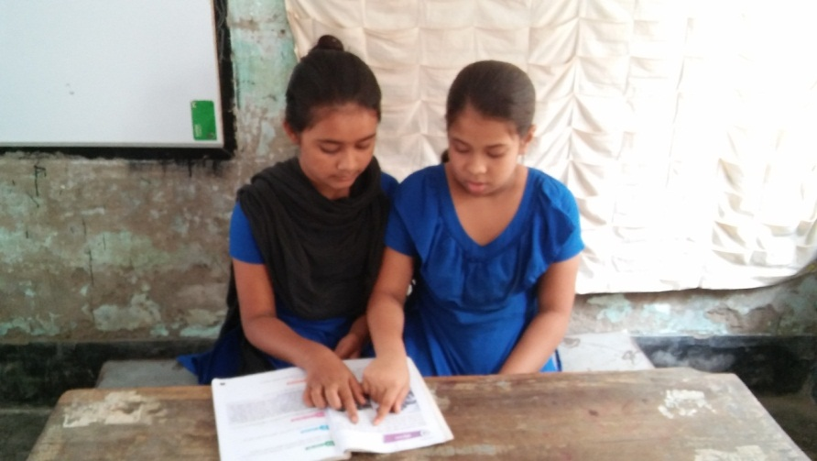
Pair reading....

Slide 16
Evaluation:
Who is going to the book fair?
Who needs medicine?
How did Andy and Tamal take leave of each other?

Slide 17
Home Work

