Slide 1
WELL COME

Slide 2
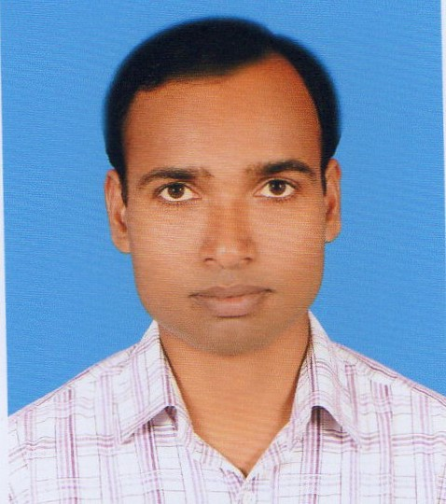
Sujoy Bain (ICT4E, Bagerhat).
Assistant Head Master
Mongla Girls’ high School
Mongla, Bagerhat.
01913241921
sujoygirlsschool@gmail.com

Slide 3
Class: Eight English 2nd Paper Chapter:9, Question No:9 Suffixes and Prefixes.

Slide 14
Thanks a lot

