Slide 1
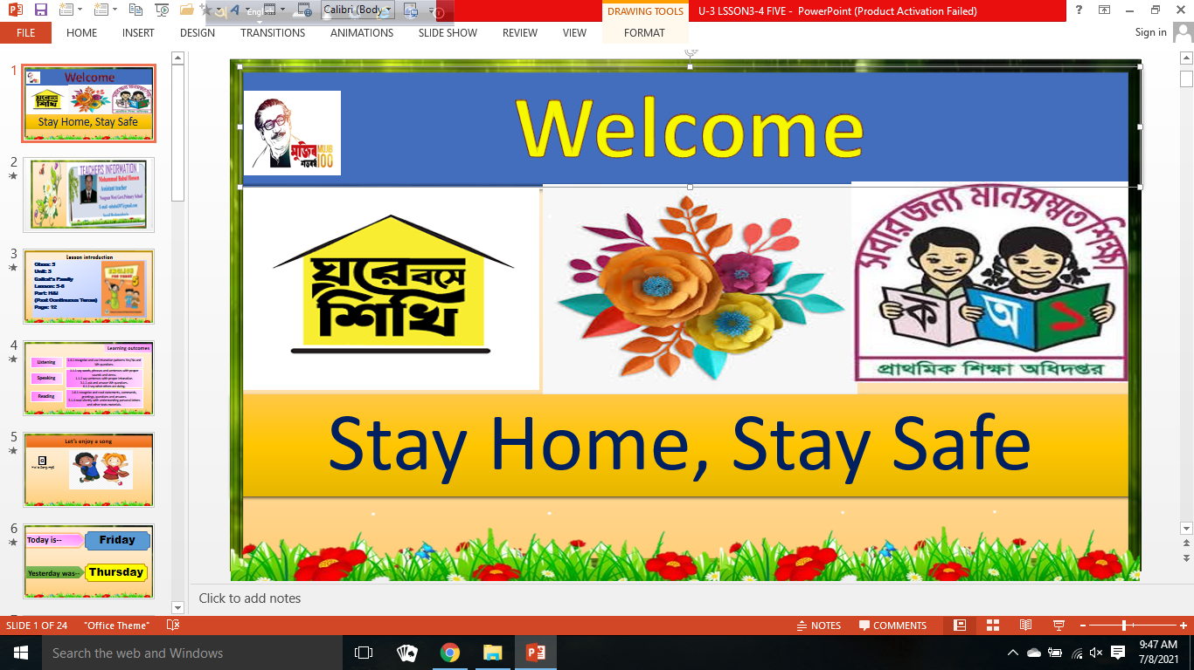

Slide 2
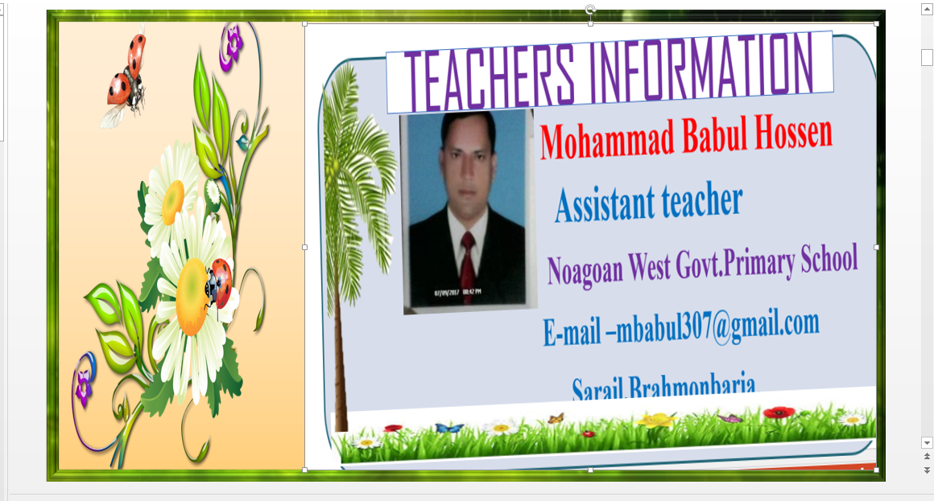

Slide 3

Lesson introduction
Class: 5
Unit: 3
Saikat’s Family
Lesson: 5-6
Part: H&I
(Past Continuous Tense)
Page: 12

Slide 4
Learning outcomes
Listening
1.4.1 recognize and use intonation patterns Yes/No and Wh questions.
1.1.1 say words, phrases and sentences with proper sounds and stress.
1.1.2 say sentences with proper intonation.
3.1.1 ask and answer Wh questions.
6.1.2 say what others are doing.
Speaking
1.6.1 recognize and read statements, commands, greetings, questions and answers.
5.1.4 read silently with understanding personal letters and other texts materials.
Reading

Slide 5

Let’s enjoy a song

Slide 6
Friday
Today is--
Yesterday was--
Thursday

Slide 7

Look and say…
What is she doing?
Today
She is reading…

Slide 8
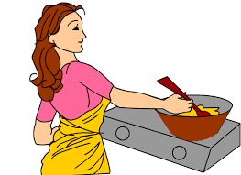
Look and say…
What was she doing?
Yesterday
She was cooking…

Slide 9


Look and say…
What were they doing?
Yesterday
They were dancing…

Slide 10

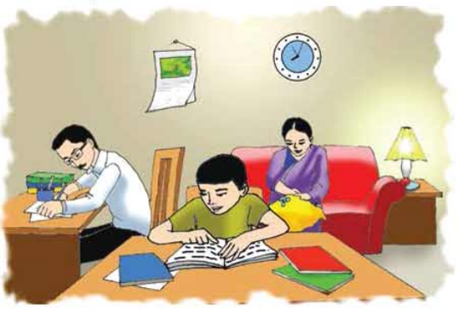
Our Todays topic is……
Saikat’s family (H and I)
Past Continuous Tense

Slide 11

Look and say…
Yesterday’s Activities
What was Saikat doing at 6 o’ clock yesterday?
Saikat was studying at 6 o’ clock yesterday.

Slide 12

Look and say…
Yesterday’s Activities
Who was reading at 6 o’ clock yesterday?
Saikat’s father was reading at 6 o’ clock yesterday.

Slide 13
Look and say…
Yesterday’s Activities
What were Saikat and his father doing at 8 o’ clock yesterday?
Saikat and his father were watching TV at 8 o’ clock yesterday.

Slide 14
Look and say…
Yesterday’s Activities
Who was helping his mother at 10 o’ clock yesterday?
Saikat was helping his mother at 10 o’ clock yesterday.

Slide 15
Look and say…
Yesterday’s Activities
Who was watching TV at 11 o’ clock yesterday?
Saikat’s mother was watching TV at 11 o’ clock yesterday.

Slide 16
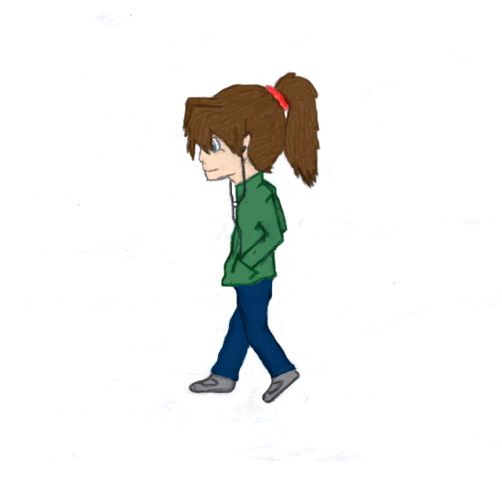
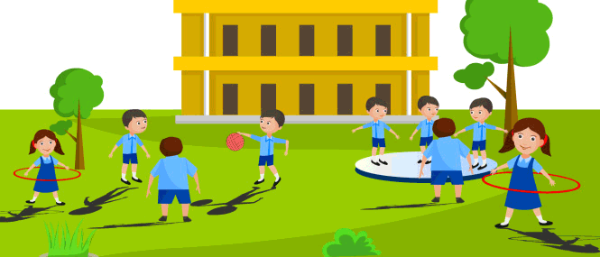
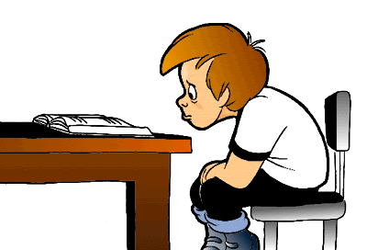
THURSDAY
Past continuous sentence
What can you see in these picture?
She was walking.
They were playing.
He was reading.
We use past continuous tense to expresses an action going on past.

Slide 17
Structure of past continuous sentence
Subject
was/were
Verb + ing
Extension
Sima was reading a book
Remember
Singlular Person/thing - Was
Plural Person/things & you - Were

Slide 18
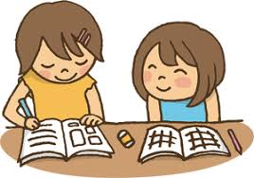
Lets try….
Find out past continuous sentences and give mark.
1. Saikat was watching TV.
2. His mother was cooking.
3. He plays football.
4. Mr. Islam enjoys sewing.
5. They were eating rice.

Slide 19
Try again---
Fill in the blank with was/were to make past continuous sentences .
1. Saikat ------- reading book.
was
were
2. Fishes ---------swimming in the water.
3. Yesterday 8 o’clock, I -------drawing a picture.
was
4. They -------- reading newspaper.
were
was
5. Last Sunday, tamal----------playing football.

Slide 20
Evaluation
1.What were you doing at 10 pm yesterday evening?
2.What were your mother doing at 9am today?
3.What were you doing at 3 pm last wednesday?

Slide 21
One day one word
Yesterday
The day before today
গতকাল
Yesterday at 2 o’clock, It was shining.

Slide 22


Home work
Write 3 sentences about what were you doing at 7 a.m., 9 a.m. and 10 p.m. yesterday.

Slide 23

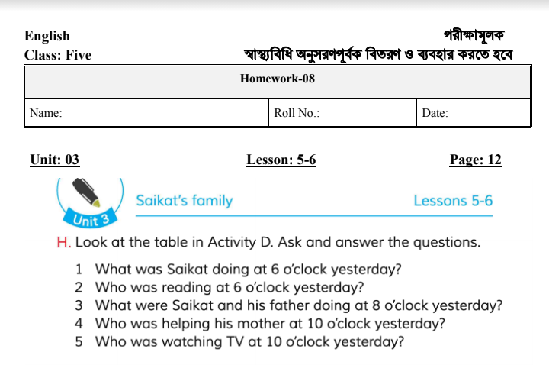

Slide 24
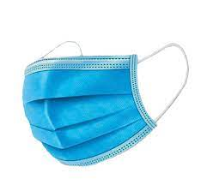
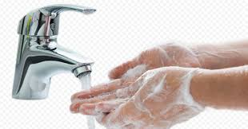
Good bye
Be safe

