Slide 1
Welcome to
Multimedia class

Slide 2
Identity
Mosammat Nelufa Afrose Bithi
Lecturer in English
Khilbaisa Rahmania Fazil Madrasah
Sadar, Lakshmipur
E-mail:nelufa.afrose@gmail.com
Class- Alim/ xi/xii
Subject-English 1st paper

Slide 3
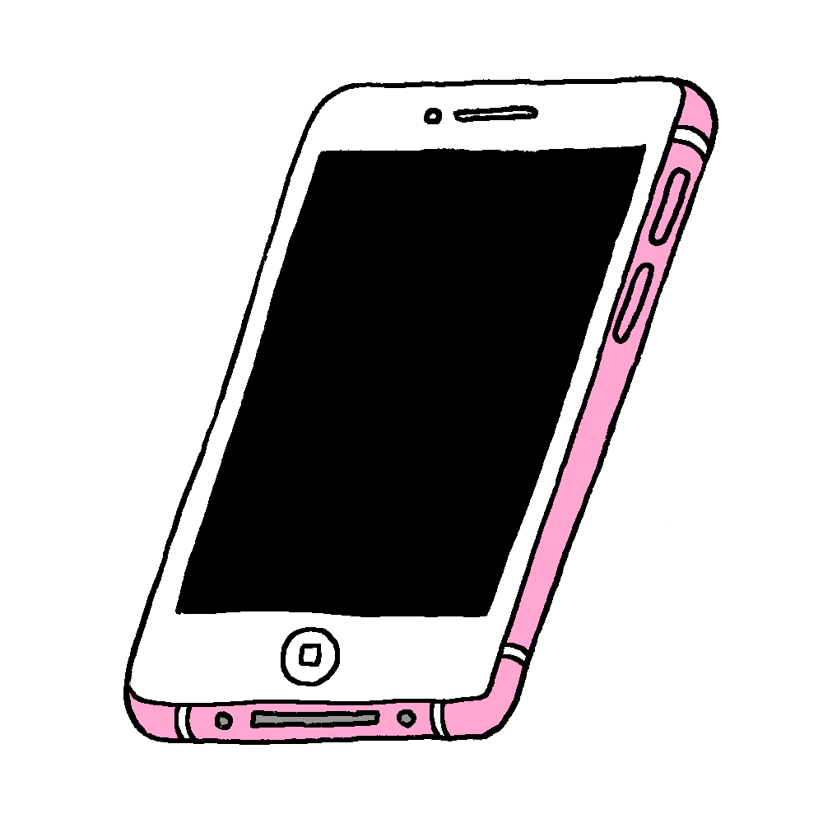
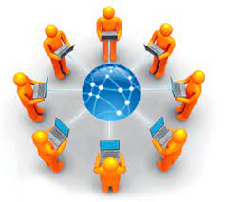
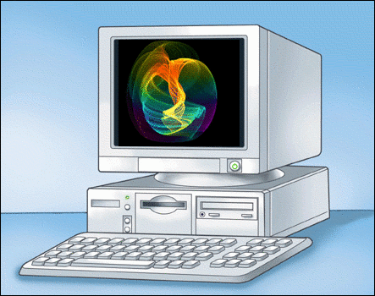
Warm up activity
We Live in the age of science.
Can you tell some important scientific inventions?
Mobile Phone
Internet etc.
Computer

Slide 4
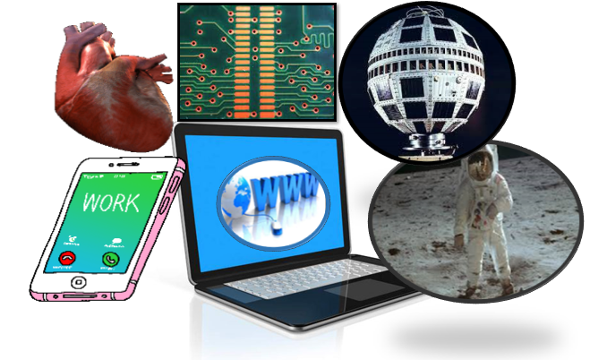
Our today’s topic is-
Some of the Greatest Scientific Achievements of the Last 50 Years.
Unit-Two: Greatest Scientific Achievements
Lesson: One (Part-2)

Slide 5
Learning Outcomes
After finishing the lesson, the students will be able to -
Learn new words from the text.
Know about some of the greatest achievements.
Understand the text.
Practice questions for exam preparation.

Slide 6
New Words
Amazing -
Astonishing/remarkable.
Extraordinary -
Special/exceptional.
Surveillance -
Observation.
Strata -
Layer/level.
Productive -
Beneficial/ fruitful.
Revolutionize -
Reform/transform.

Slide 7
Innovations-
The introduction of new things/ ideas.
Exploration-
Investigation/survey.
Fantastic -
Unreal/ incredible.
Resistant-
Preventive/obstructing.
Feat-
Investigation/survey
Performance/ Attainment.
GPS-
The Global Positioning System.

Slide 8
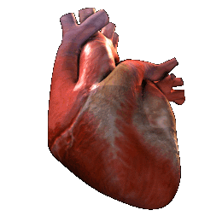
Some of the greatest achievements.
The Artificial heart
Implanting an artificial heart ,the Jarvik-7 in 1982 was an extraordinary step towards increasing human lifespan. One day, more advanced versions of artificial organs will likely allow us to live much longer and more productive lives.

Slide 9
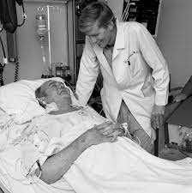
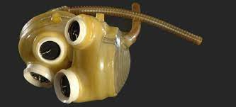
Robert Jarvik and first implanted patient , Dr Barney Clark.
Jarvik-7,the artificial Heart.
The Jarvik-7 was designed by Robert Jarvik. Dr. Barney was the first person implanted with Jarvik-7.
The Artificial heart

Slide 10
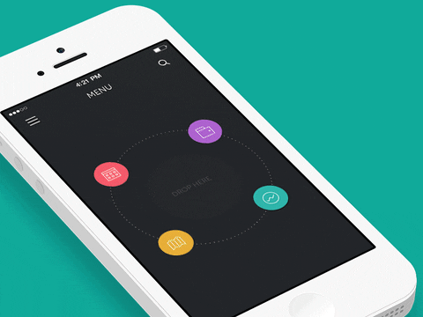
Cell phone
Cell phone/Mobile phone made appearance in the 1990s. Today, more than 100 million people in Bangladesh and more than 4.6 billion people worldwide have mobiles.

Slide 11
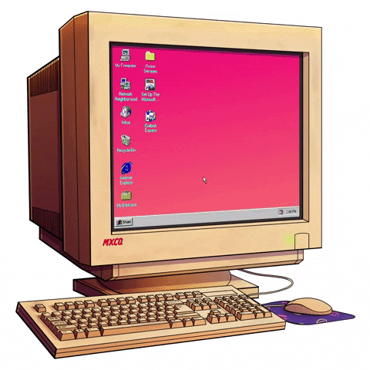
Personal Computer:
Personal Computer: The personal computer only became available to consumers in 1974. It allows us to access the internet , do word processing , use a calculator, watch TV, play games and do a host of other things.

Slide 12
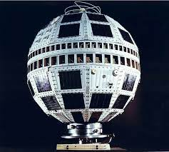
First Communication Satellite
1o July 1962 marked the birth of satellite communications. On this day Telstar satellite commenced its journey into space. Today, we use satellites for GPS , TV, radio, weather tracking, space exploration and global communications, among other things.

Slide 13
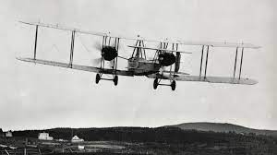
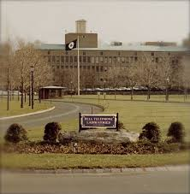
Trans-Atlantic TV
Bell Telephone Laboratories
Telstar satellite carried the first trans-Atlantic TV broadcasts.
Telstar was built by a team at Bell Telephone Laboratories in USA.
First Communication Satellite

Slide 14
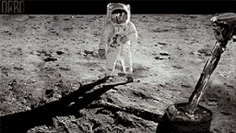
The Moon Landing
Putting a man on the moon is perhaps man’s most inspiring accomplishment. It opened the door to future space travel and led to a number of spin-off inventions.

Slide 15
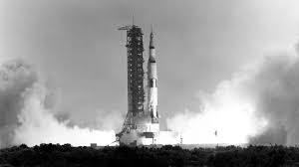
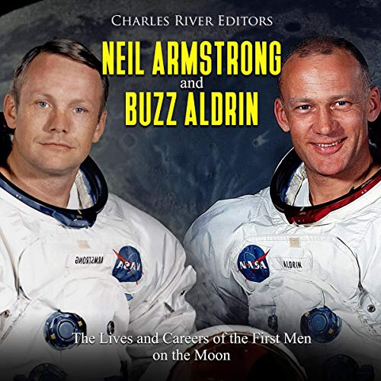
Appolo-11
Neil Armstrong and Buzz Aldrin
In 1969, as a part of the Apollo 11 mission, Neil Armstrong became the first person to accomplish that dream, followed only minutes later by Buzz Aldrin.
The Moon Landing

Slide 16
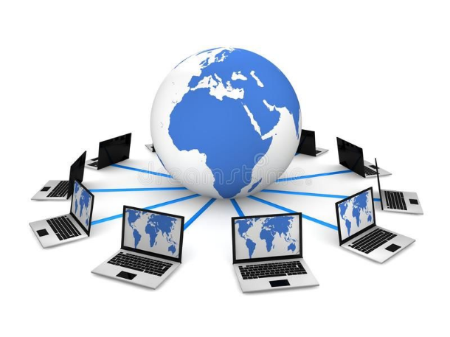
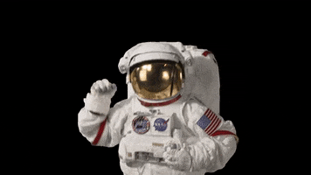
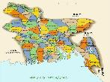
Internet/Wide World Web
The ARPANET ,The first Internet , was invented in1969 .The public had access to the World Wide Web starting in 1993. The web has revolutionized the dissemination of information.

Slide 17
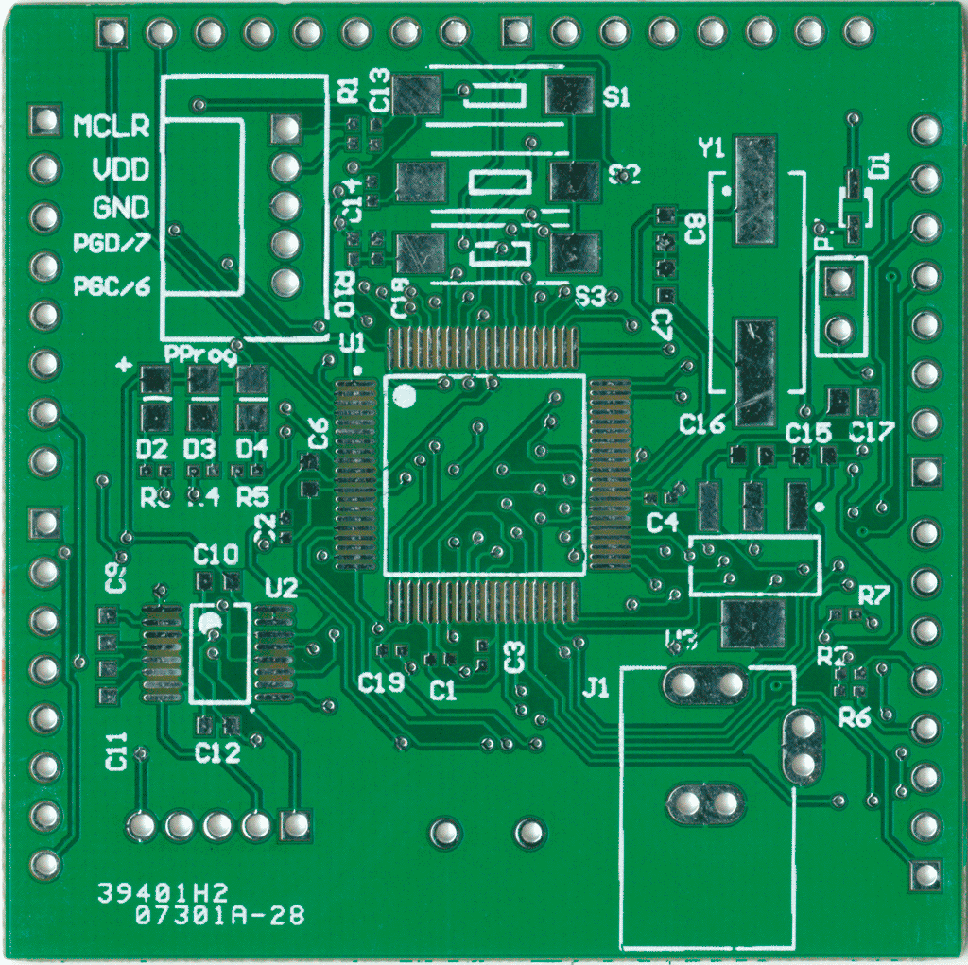
The Microchip
A microchip is a set of electronic on one small plate. It is used in virtually all electronic equipment today. The forerunner to the microchip was invented back in 1959.

Slide 18
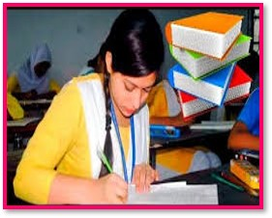
Individual work
You have read about seven amazing achievements of science in the last fifty years. In your view which of the achievements has strongest influence on human beings. Explain why?

Slide 19
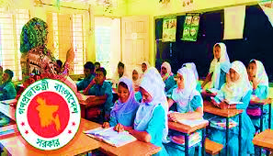
Read from the textbook.
Open the textbook at page-164
&
Read Silently.

Slide 20
Read the following text and fill in the blanks with suitable words.
Human (a)________ to put steps on the (b)_____. They desired to (c)_________ the moon. This (d)______ dream came (e)________ when Apollo 11 was (f)________ in 1962. The moon landing is a (g)__________in the history of (h)______ exploration. It (i)________ a new horizon for the (j)_______.
dream
moon
capture
very
true
Evaluation
launched
milestone
space
has opened
people

Slide 21
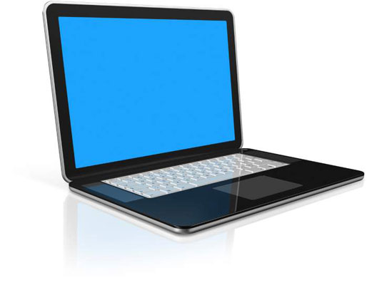
Let’s Understand the information
What is computer?
Computer is an electronic device for storing and processing data, typically in binary form, according to instructions given to it in a variable program.

Slide 22
What is WWW?
WWW means World Wide Web, commonly known as the Web, is an information system where documents and other web resources are identified by Uniform Resource Locators,
Understanding information

Slide 23
Pair work
Answer the following questions
(According to board Question no-1.B)
1.Who was First implanted with the Jarvik-7?
2.What do you mean by amazing scientific advances?
3.What is Telstar?
4.How are Microchips used?
5.Why the moon landing is significance in human life?

Slide 24
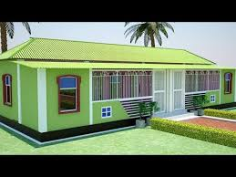
Home work
Make flow-chart showing the influence/effect of World Wide Web. (One is done for you.)
1.Dissemination of information
2
3
4
5
6

Slide 25
Thank you.
See you again.

