Slide 2
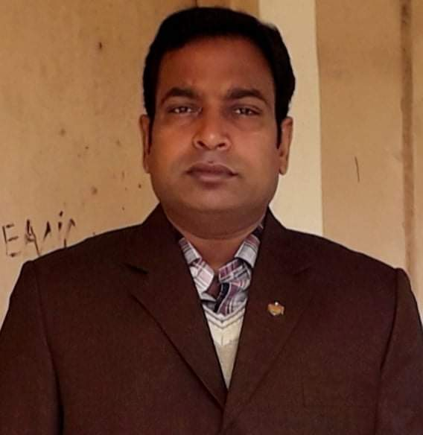
TEACHER’S IDENTITY
Mr. Moslem Uddin
Act: Head-Teacher Nishchintapur GPS ,Singra ,Natore.

Slide 3
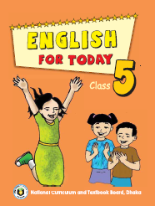
Class: Five
English For Today
Lesson unit: 17
Lesson: (L:4-6) Sports Birthday. Page – 68

Slide 4
Learning outcomes
By the end of the lesson the students will be able to
Listening:
3.4.1 understand statements made by the teacher and students.
Speaking:
1.1.1 say words, phrases and sentences with proper sounds, stress.
Reading:
1.7.1 read words, phrases and sentences in the text with proper pronunciation, stress and intonation .
1.7.1 read paragraphs, dialogues, stories, letters and other texts.
5.1.3 read silently with understanding dialogues.
Writing:
3.1.1 write words, phrases and sentences using non-cursive capital letters.
3.1.2 write words, phrases and sentences using non-cursive small letters.
8.1.1 make sentences using words and phrases given in the textbook.
9.1.1 take dictation of short and simple paragraph.

Slide 5
LET’S WATCH A VIDEO

Slide 6
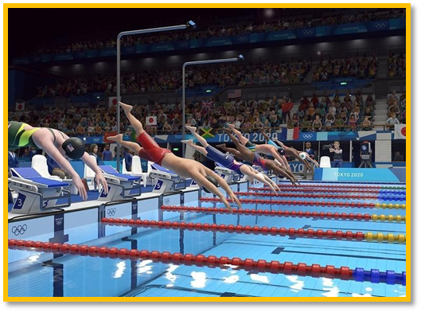
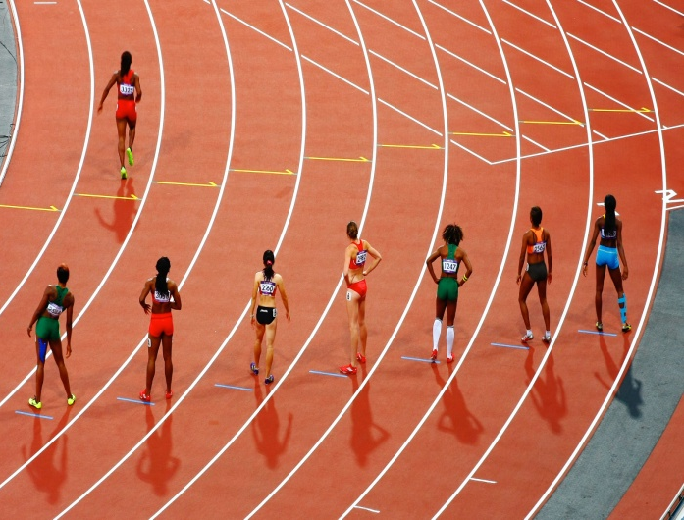
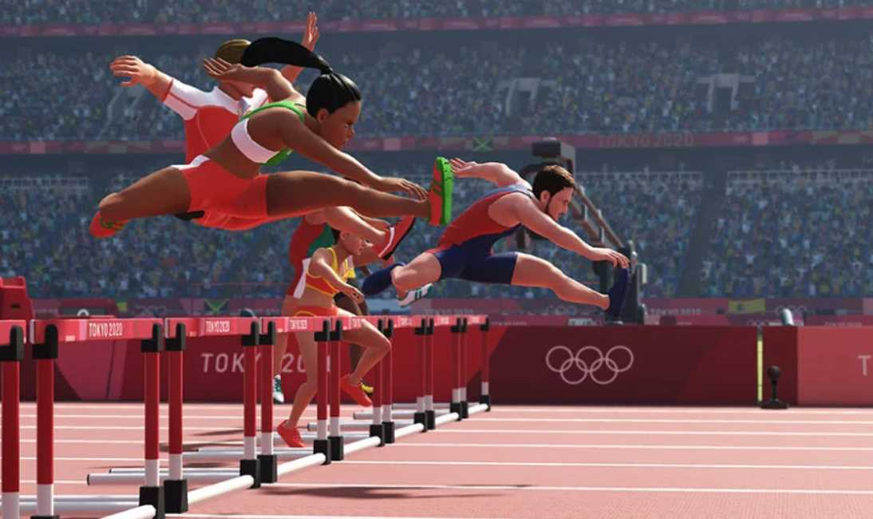
Look at the pictures:
Can you guess, what are the pictures about?
Yes, the pictures are about ‘Sports’.

Slide 7
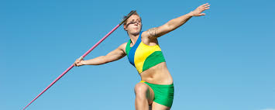
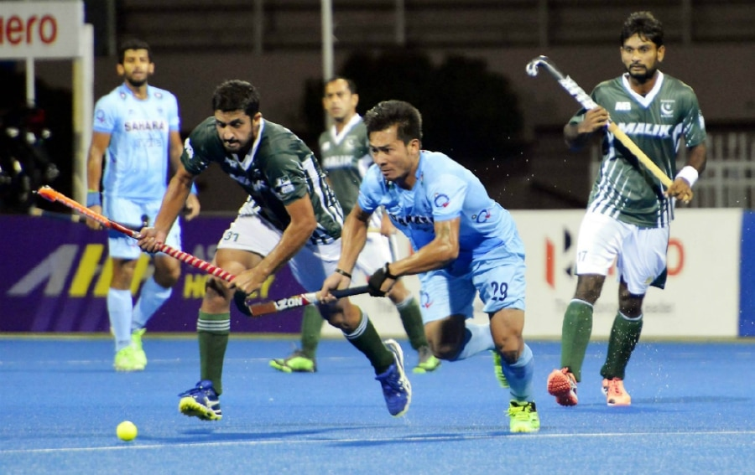
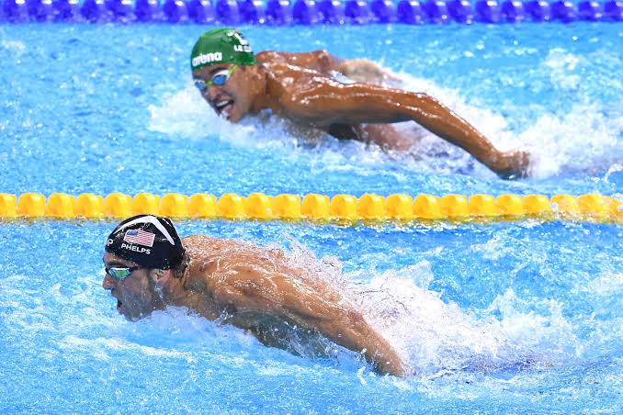

Slide 8
Lesson Declaration
Today we learn-
Unit:17
Lesson:5-6
Topic: Sport ( The Olympic.
…….since then).

Slide 9
Open page no.-68 and follow teacher
The Olympic games is the biggest sports competition in
The world. The Olympics are held every four years in a
different host city. More than 200 nations send a total of
about 13,000 athletes to compete in more than 30
different sports.

Slide 10
The first Olympic Games were held in Greece almost
3,000 years ago. The modern Olympic Games started
in 1896, and there have been 31 Olympic competition
since then.

Slide 11
Word meaning:
New word
meaning
Similar word
Competition
প্রতিযোগীতা
a contest
Different
ভিন্ন/আলাদা
not same
Athlete
ক্রীড়াবিদ
Sports man
Nation
জাতি
the people of a country
Game
খেলা
Sport

Slide 12
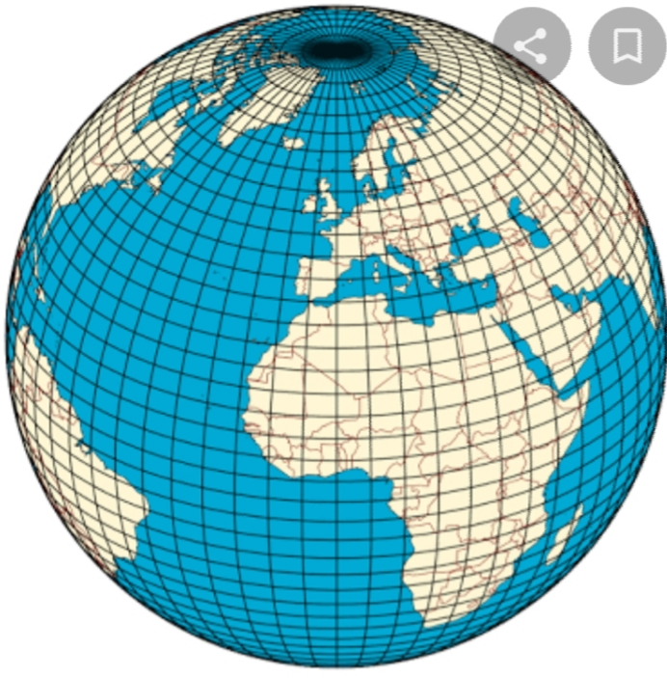
Today’s new word:
World
পৃথিবী
The Olympic game is the biggest sport in the world.

Slide 13
Make sentence with the following words
word | sentence
biggest
modern
athlete
competition

Slide 14
Make sentence with the following words
word | sentence
biggest | The Padma is the biggest river.
modern | Computer is a modern technology.
athlete | Usine bolt is a great athlete.
competition | The Olympic games is a popular sports competition.

Slide 15
Group works
Answer the following question:
How often are the Olympics held ?
2) How many countries compete in the Olympics ?
3)How many athletes compete in the
Olympics ?
4) How many sports are there in theOlympics ?
5) Where was the first Olympics games held?

Slide 16
Match the answers:
1)The Olympics are held every four years.
2) More than 200 countries compete in the Olympics.
3) There are 13000 athletes compete in the Olympics.
4)There are more than 30 sports in the Olympics.
5)The first Olympic games were held in greece.

Slide 17
Now read the text silently:
The Olympic games is the biggest sports competition in
The world. The Olympics are held every four years in a
different host city. More than 200 nations send a total of
about 13,000 athletes to compete in more than 30
different sports.

Slide 18
Match the words:
Match the words in column A with their meaning in column B
Column A | Column B
Games | Earth
Biggest | Sportsman
World | Sports
Athlete | Before
Ago | Largest

Slide 19
Evaluation
Write a short composition about “The Olympic Games” by answering the following questions:
What is the biggest sports competition in the world ?
b)How often are the Olympics held ?
c) How many countries and athletes compete in the Olympics ?
d) How many athletes compete in the Olympics ?

Slide 20
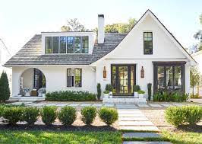
Write a short composition about “Olympic game ” at least five sentences.

Slide 21
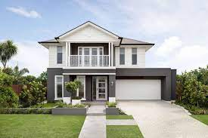
Dear student, please stay safe at home and use musk.
See with you next class. Bye !

