Slide 2
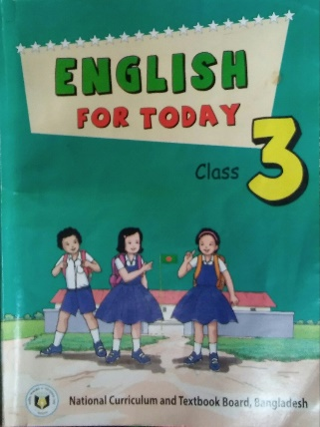
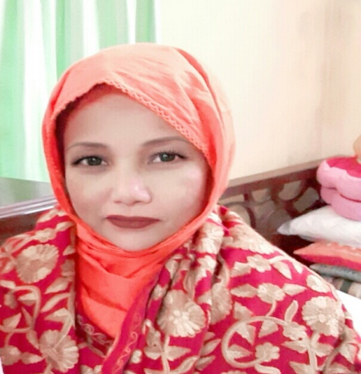
Identity
English For Today
Class: three
Unit: 39
Lesson: 1-3
Mst. Lucky Akhter Parveen
Assistant teacher
Bihari Govt Primary school
Pirgachha, Rangpur

Slide 3
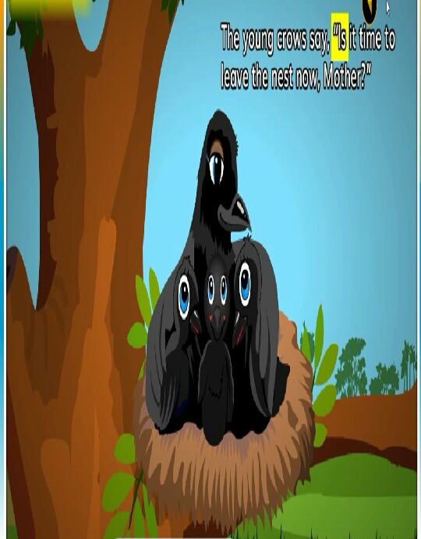
Let’s see the picture.

Slide 4
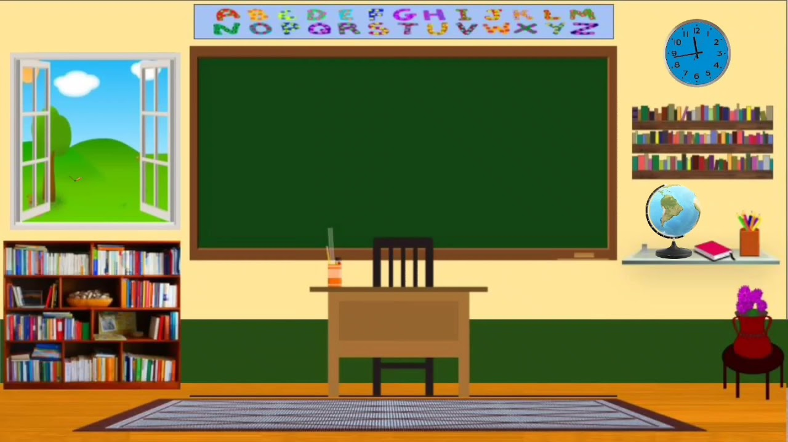
The crow
One morning---------- are afraid.

Slide 5
Learning Outcome
Students will be able to
Listening-4.3.1 enjoy and understand simple stories.
Speaking-3.1.1 ask and answer Wh question
Reading- 5.1.2 read simple stories.

Slide 6
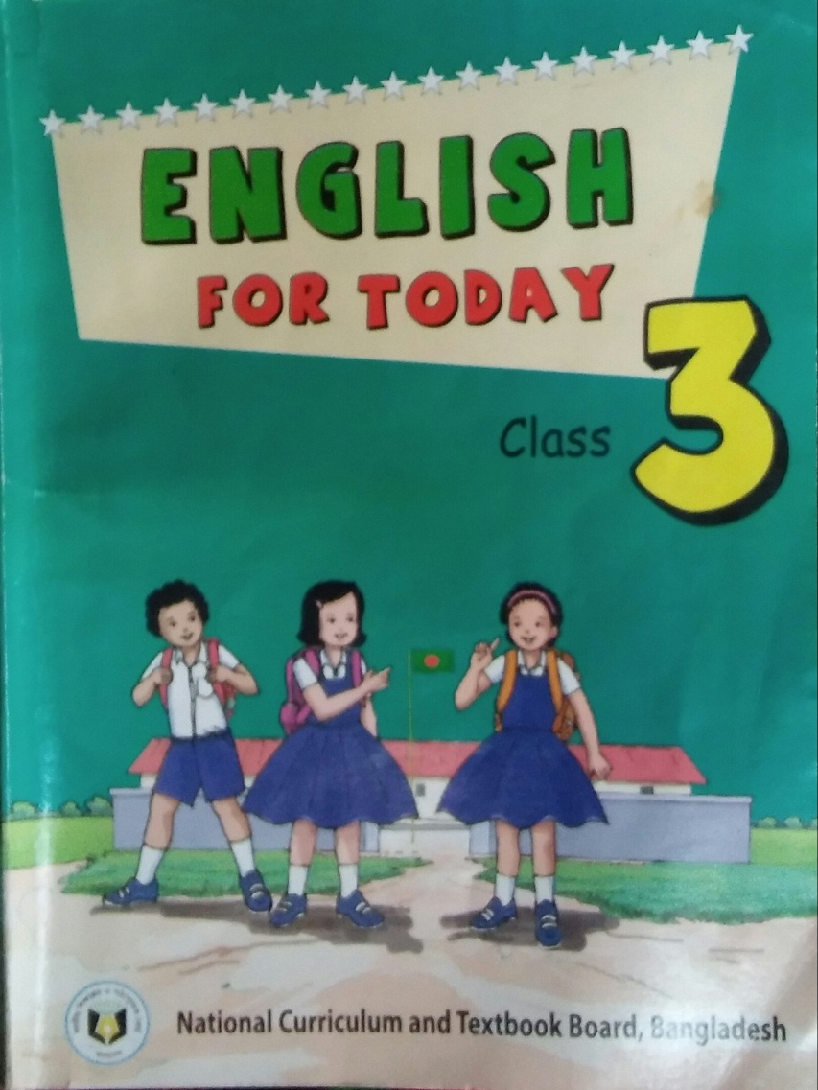
Open your book at page 78

Slide 7
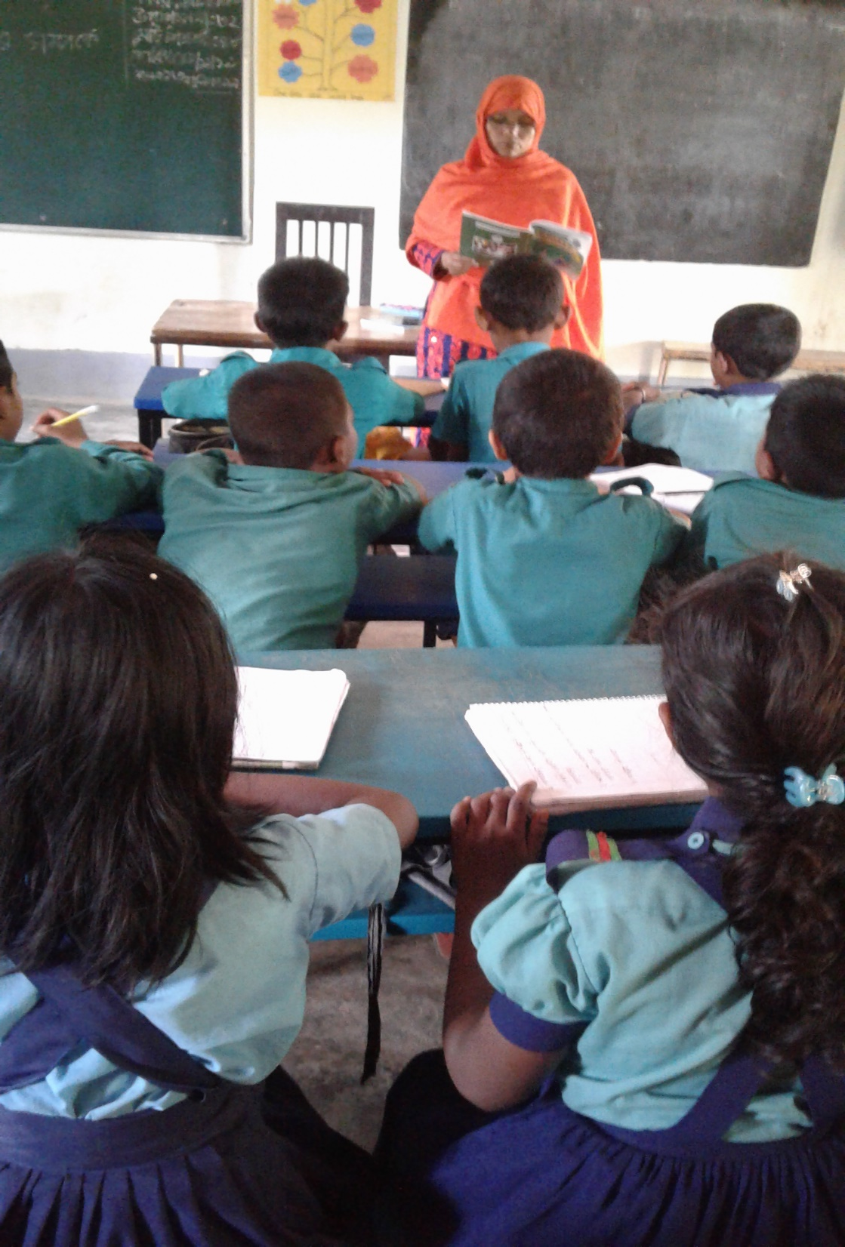
Teacher’s reading.

Slide 8
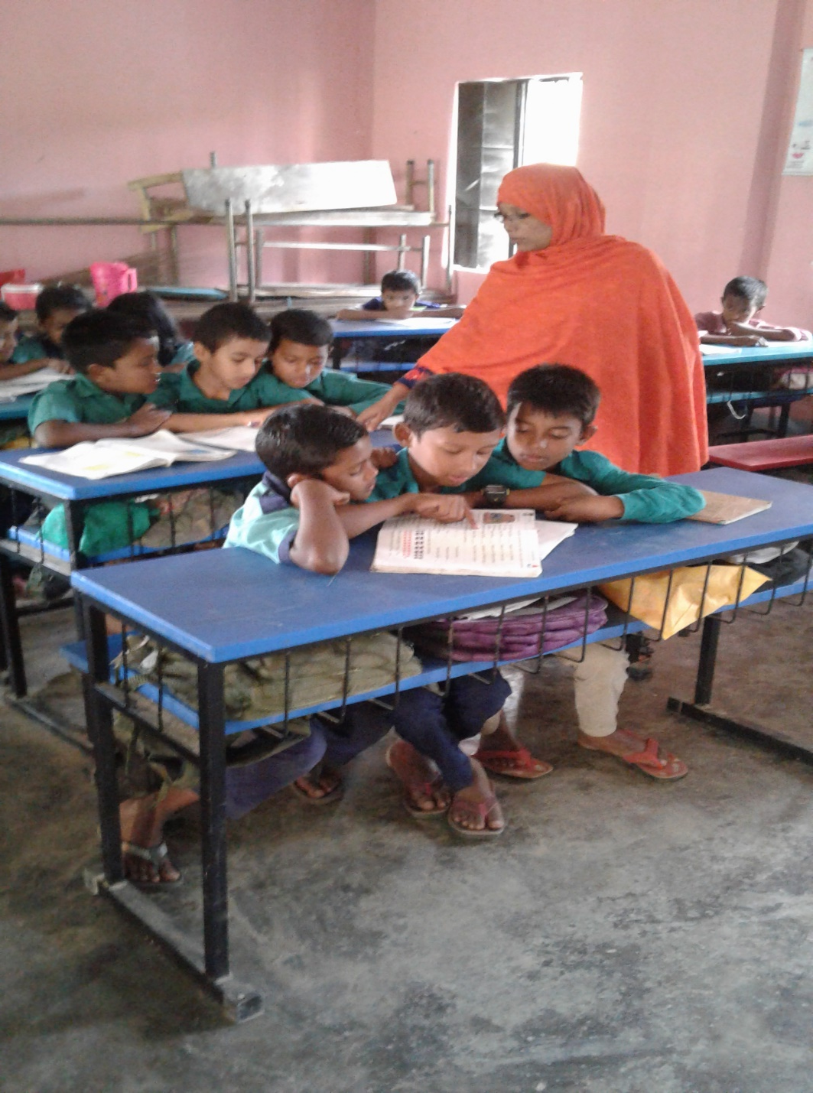
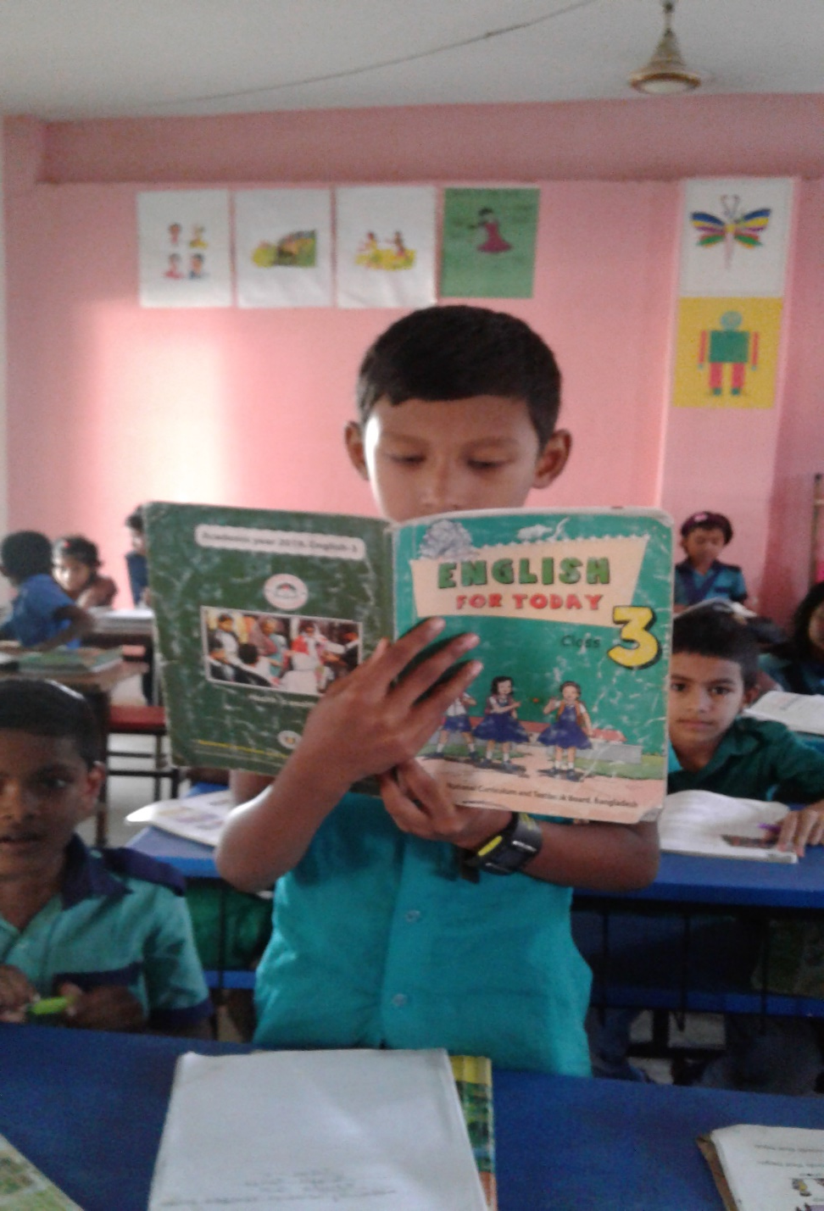
Student’s reading.

Slide 9
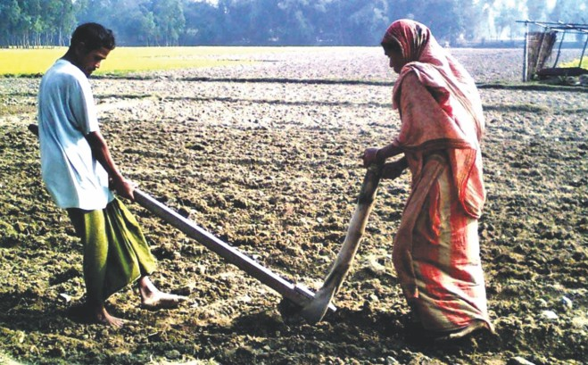
Word meaning
morning
the beginning part of the day.
farmer
who grows crops.

Slide 10
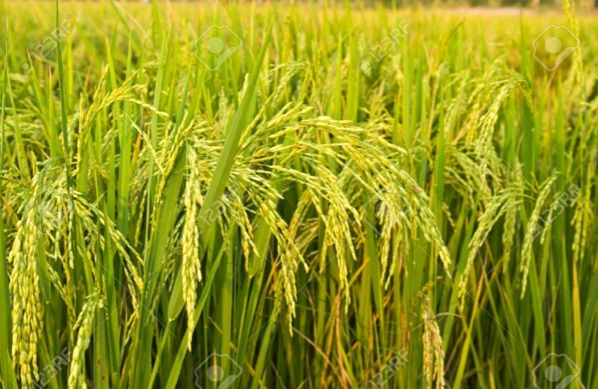
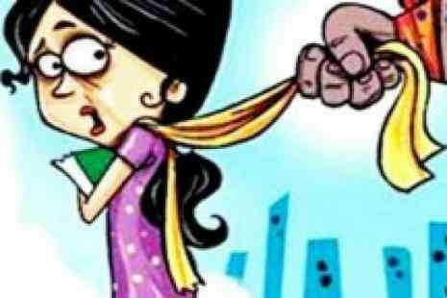
Word meaning
one type of food.
corn
feeling fear.
afraid

Slide 11
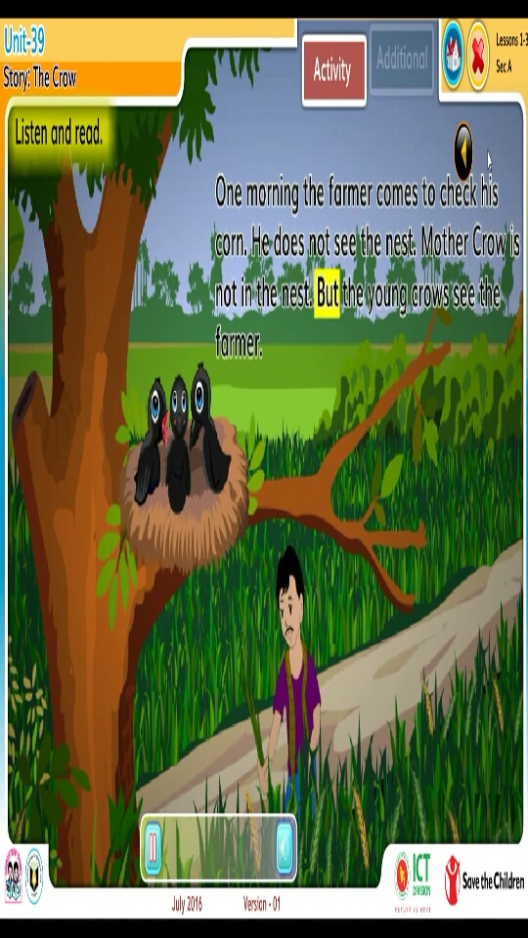
One morning the farmer comes to check his corn. He does not see the nest. Mother Crow is not in the nest. But the young crows see the farmer. They are afraid.

Slide 12
Choose the best answer:
Who comes to check his corn?
farmer b. nurse
c. teacher d. driver
2. Who are afraid?
mother crow b. father crow
c. young crow d. sister crow
3. Who leaves the young crows?
brother Crow b. mother Crow
c. sister Crow d. father Crow
Pair work.

Slide 13
Pair work.
Match the words in of the column ‘A’ with their meaning in column ‘B’.
Column ‘A’ | Column ‘B’
a. morning | i. feeling fear
b. afraid | ii. the place where birds live
c nest | iii. The begging part of the day.
d. farmer | iv. not old
e. young | v. developing first
 | vi. a person who grows crops

Slide 14
Group work.
Answer the following question:
1.How many crows leave in the nest?
2.Who are afraid?
3. Who comes to check his corn?
4. When does the farmer come to check his corn?

Slide 15
Evaluation
Fill in the blanks:
The farmer _______ to check his corn.
Mother Crow is not in the ______.
They are _______.
comes
nest
afraid

Slide 16
Home work.
Write a short composition about “ crow” at least five sentences.

