Slide 2
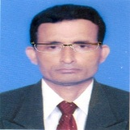
Identity
Manik Chandra Majumder
Senior Teacher
Gazirhat High School
Senbag, Noakhali.
Mobile No: 01717155169
Email: manikmajumder01@gmail.com
Class : Eight
Subject : English 1st paper
Time : 50 Minutes
Date : 00/00/2021

Slide 3
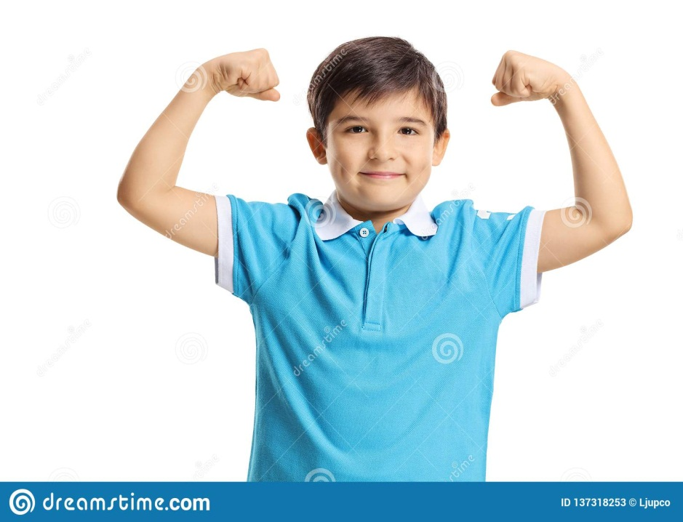
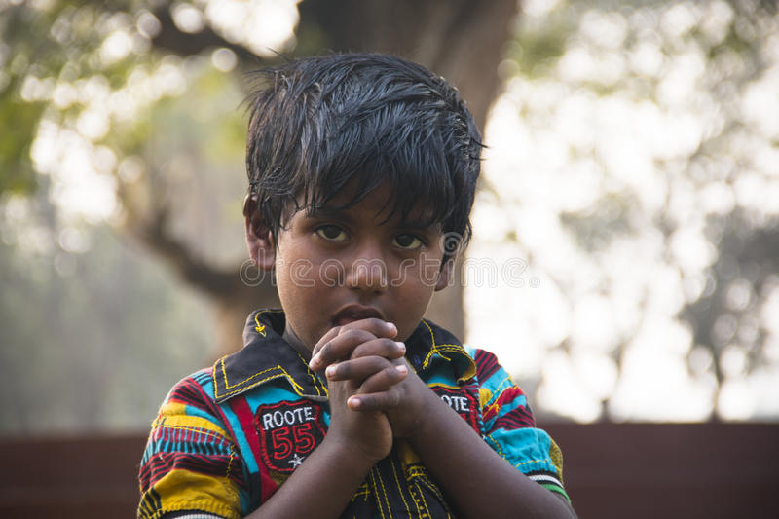
Look at and talk about the pictures
Healthy boy
Unhealthy boy
Which boy looks healthy?
Which boy is unhealthy?
Can you guess why they are so?

Slide 4
Our today’s Lesson is -----
Health
Unit-3, Lesson-1

Slide 5
Learning outcomes
After end the lesson, students will be able to …..
a) read and understand texts through silent reading,
b)listen for information,
c)ask and answer questions,
d)write the answers to questions,
e) write a short paragraph.

Slide 6
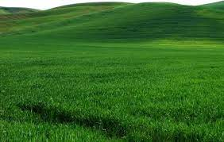
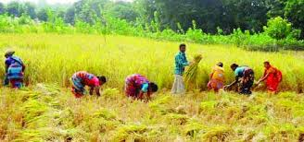
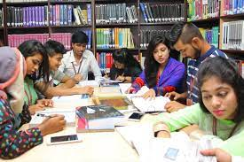
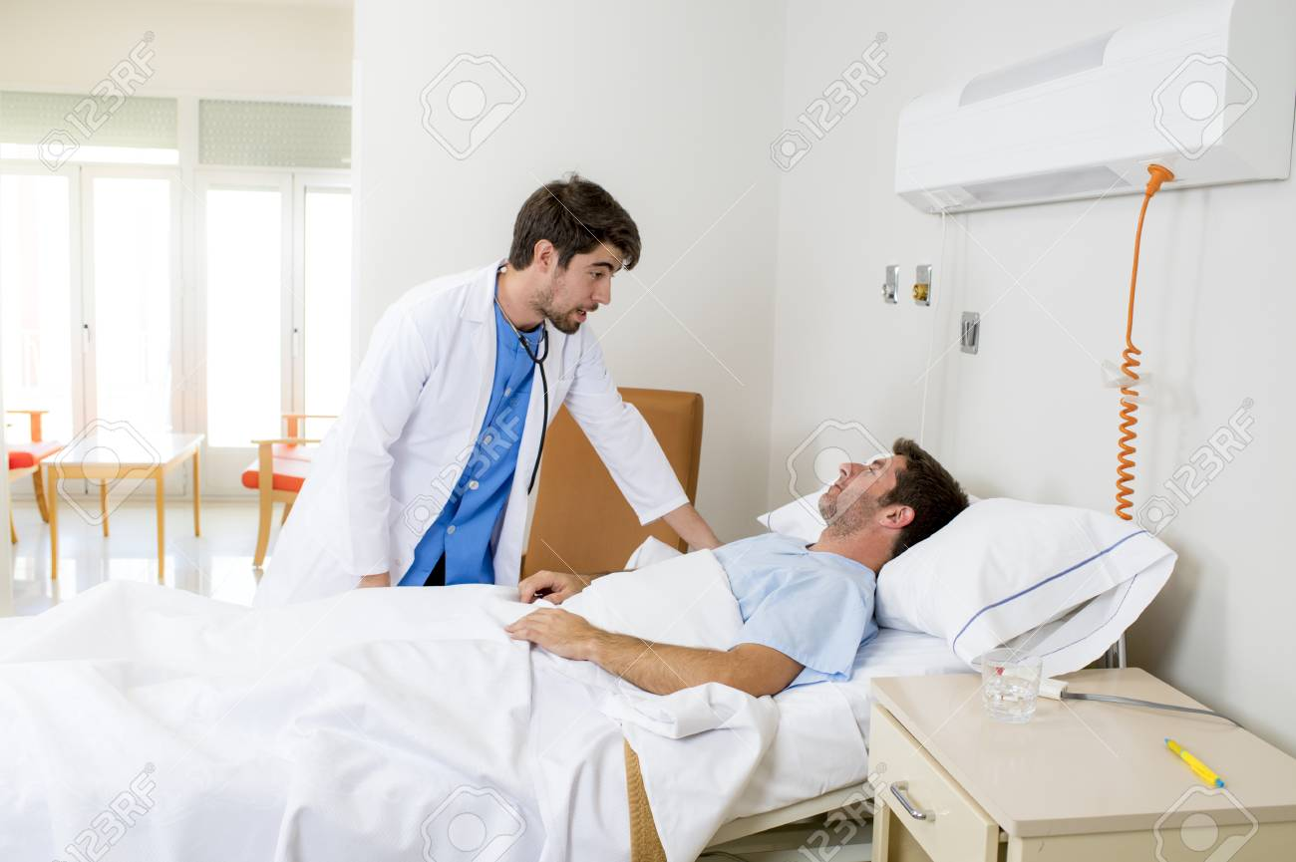
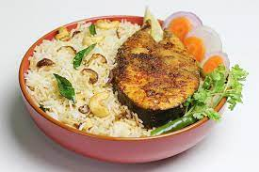
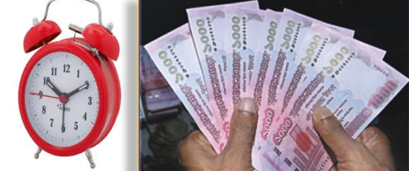
Vocabulary
Click word
Meaning : Illness, Sickness
Meaning : Necessary, Important, Vital
Meaning : Maxim, Saying
Meaning : Huge, Gigantic
Meaning : Ownership, Properties
Meaning : Action, Function
Disease
Meaning : Attention, Devotion
Essential
Concentrate
Possession
Proverb
Vast
Activity
Sentence: A proverb goes, time is money.
Sentence: Vast green land looks endless.
Sentence: Farmers activities increase during harvesting .
Sentence: Food is essential to life.
Sentence: We should concentrate on our studies.
Sentence: The man is suffering from disease.
Sentence: Happiness does not lie in possession or money.

Slide 7
Read the following passage
Health is the condition of our body and mind. It may be good or bad. Good health means healthy body free from diseases. It is essential for everyone to lead a happy life. If we are not in good health, we cannot concentrate on any activity in our life.
A proverb goes, "Health is Wealth" It means health is equally valuable as gold or any other personal possessions. We may have vast wealth and property, but if we are not healthy we cannot enjoy them.

Slide 8
To keep ourselves healthy, we have to do certain things. We have to take a balanced diet. We must exercise regularly to keep our body fit for work.
There is an old saying : 'Early to bed and early to rise Makes a man healthy, wealthy and wise.' So we should not keep late hours. We should go to bed early at night and rise early in the morning. Peace of mind is another condition for good health. So we must not worry over small things of life.

Slide 9
Choose the correct answer from the alternative.
Q: 1.Health means the condition of-------
Ans:
a. our body.
b. our mind.
Ans:
c. our body and mind.
d. our environment.
c. our body and mind.
Ans:
Q: 2. A healthy person is one who -
Ans:
a. is physically and mentally sound.
b. Eats good food.
a. is physically and mentally sound.
c. has a lot of wealth.
d. is overweight.

Slide 10
Q: 3. We need to eat -------
a. rich food.
b. balanced food.
Ans:
b. balanced food.
Ans:
c. little food.
b. lot of food.
Q: 4. The phrase ‘to keep late hours’ means-
a. to go to bed late
Ans:
a. to go to bed late
b. to wake up late
Ans:
c. to do things late
d. to be late in class

Slide 11
Q: 5. What is another condition for good health?
b. peace of mind
Ans:
a. vast property
b. peace of mind
Ans:
c. money and power
d. rich food
Q:6. The word ‘certain’ in the text means---------.
Ans:
a. positive
b. particular
Ans:
c. several
b. particular
d. negative

Slide 12
Now answer the following questions
5. What is the advice in the old saying mentioned in the passage?
1. Why is good health essential for us?
3.What does good health mean?
4. What is a balanced diet?
2. Why is physical exercise necessary?
Ans: A balanced diet means the diet consisting of right amount of food from all six groups of foods.
Ans: The advice in the old saying is that we should go to bed early and rise early.
Ans: Physical exercise is necessary to keep our body fit for work.
Ans: Good health is essential for us to lead a happy life.
Ans: Good health means healthy body free from diseases.

Slide 13
Evaluation
a) balanced
b) exercise
c) sound
Read the following text and fill in the gaps with appropriate words.
d) that
e) cleanliness
Food is one of the basic human needs , We can keep good health if we eat a)------------ food and take b)--------------regularly. If the body is c)------------, the mind is also sound, We should bear in mind d)------------we have to follow the rules of e)-----------------------.

Slide 14
Home Work
Write a paragraph about ‘Good health’

