Slide 1
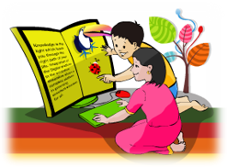

Slide 2
Class Two
Sub: English For Today
Unit:14, Lesson: 1-2. Activity: A
Story: Rima and the seed

Slide 3
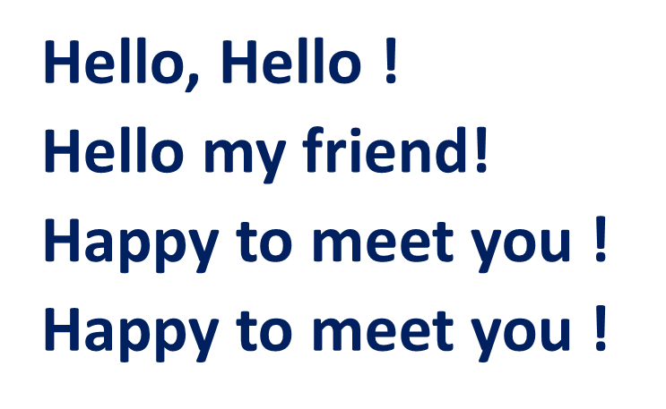
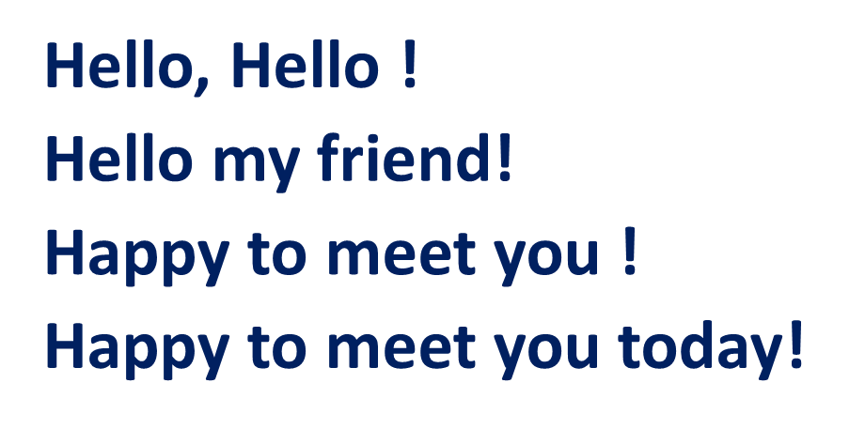
Let us sing a Greeting Song.

Slide 4
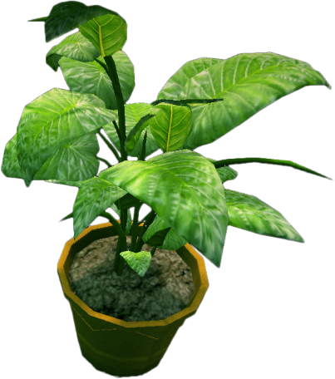
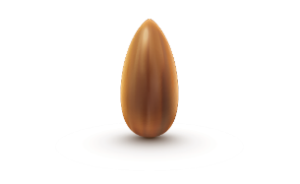
See the picture
Say what do you see?

Slide 5
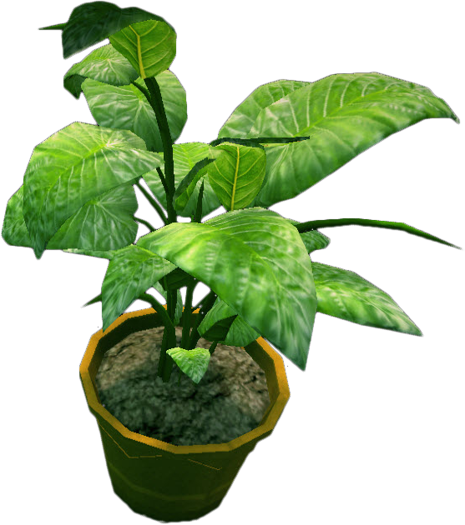
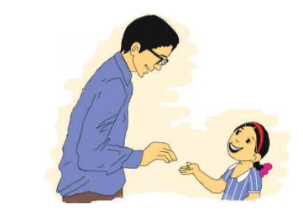
(Activity A)

Slide 7
Look, listen and say.
seed
tub
sun
plant

Slide 8
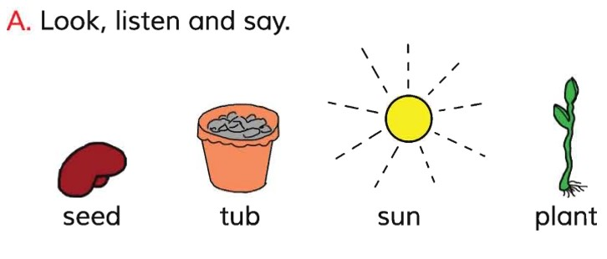
Open your English book at page-29
See the Activity-A.

Slide 9
( Pair Work)
What is this?

Slide 10
Say the word after the Audio
Repeat it.
seed
tub
sun
plant

Slide 11
Spell out the words and ask to say peer
seed
s/e/e/d
tub
t/u/b
sun
s/u/n
plant
p/l/a/n/t

Slide 12
Make the correct word on your exercise book
sede
seed
utb
tub
nus
sun
lantp
plant

Slide 13
Write down the words on your exercise book

Slide 14
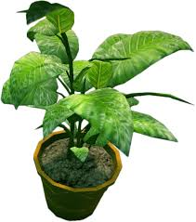
That’s for all today

