Slide 1
welcome

Slide 2
Teacher’s Identity
Lesson Identity
Class : Five
Subject : English
Unit : 12
Lesson : 1 (A)
Page : 46
Mahfuja Khatun
Head Teacher
Sujanagor Govt. Primary School
Pangsha, Rajbari.

Slide 3
Learning Outcomes
Students will be able to :
Listening
1.3.1 recognize which words in a sentence are stressed?
3.4.1 understand statements made by the teachers and students.
Speaking
1.1.1 say words, phrases and sentences with proper sounds and stress.
1.1.2 say sentences with proper intonation.
6.2.1 talk about people, objects, events etc.
8.1.1 take part in conversation on appropriate topics.
Reading
1.5.1 read words, phrases and sentences in text with proper pronunciation, stress and intonation.
1.7.1 read paragraphs, dialogues stories, letters other texts.

Slide 4
Let’s enjoy a video attentively.
I’ll ask you some questions from this video.
Saint Martin’s is about 25 kilometers south of Teknaf.
About what we watched the video?
We watched the video about Saint Martin’s Island.
How far is Saint Martin’s from Teknaf?

Slide 5
Title
How far is Saint Martin’s?

Slide 6
Cox’s Bazar
Saint Martin’s Island

Slide 7
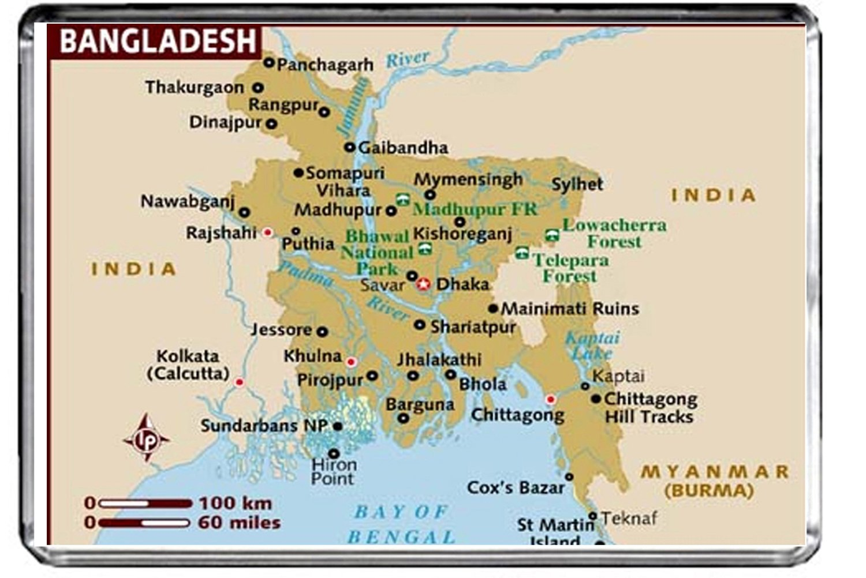
Let’s get acquainted with Cox’s Bazar and Saint Martin’s Island with the help of maps.

Slide 8
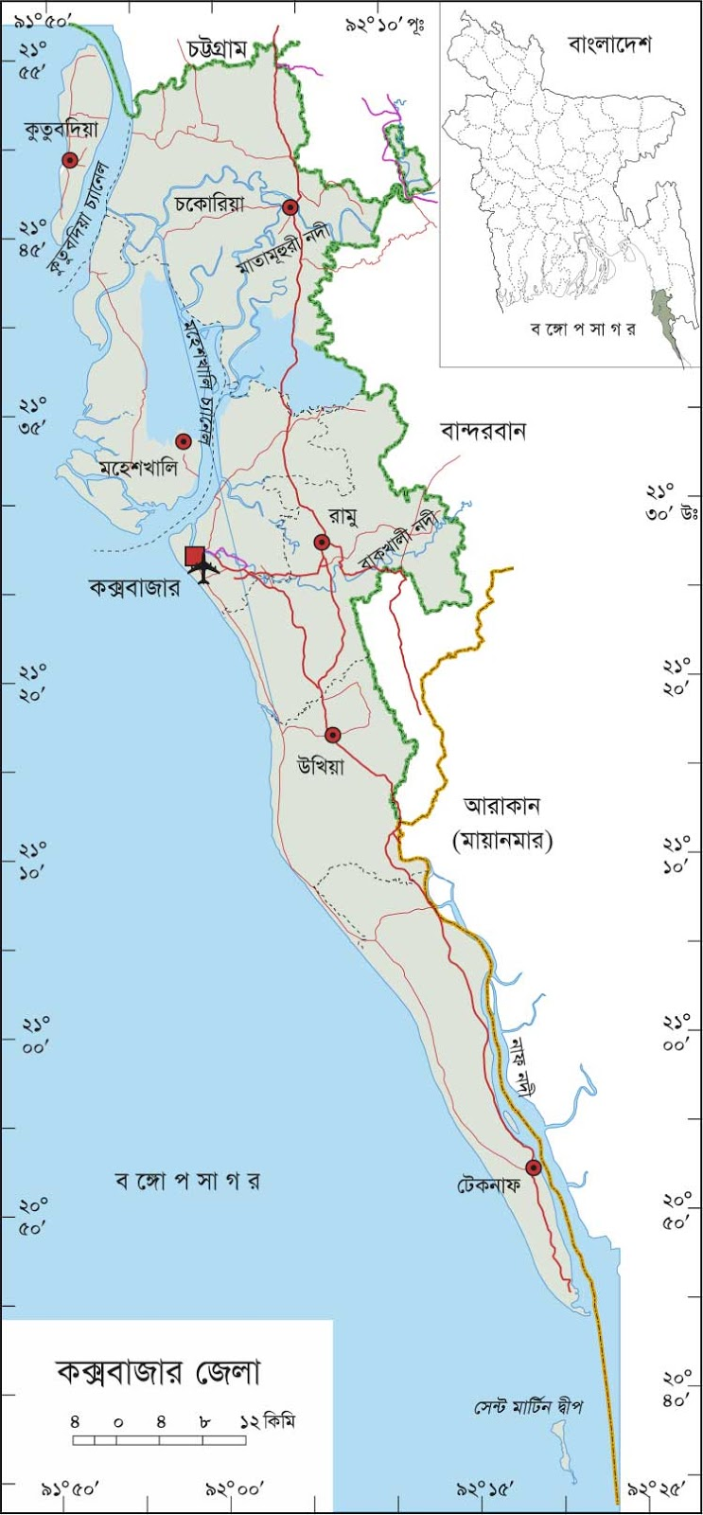

Slide 9
New words
Island- দ্বীপ
Tourist spot– পর্যটন এলাকা।
visited-পরিদর্শন, দেখতে যাওয়া ।
popular-জনপ্রিয় ।
beach-সৈকত ।
Wonderful-বিষ্ময়কর ।
Waterfall-ঝর্ণা।

Slide 10
Open your book at page 46

Slide 11
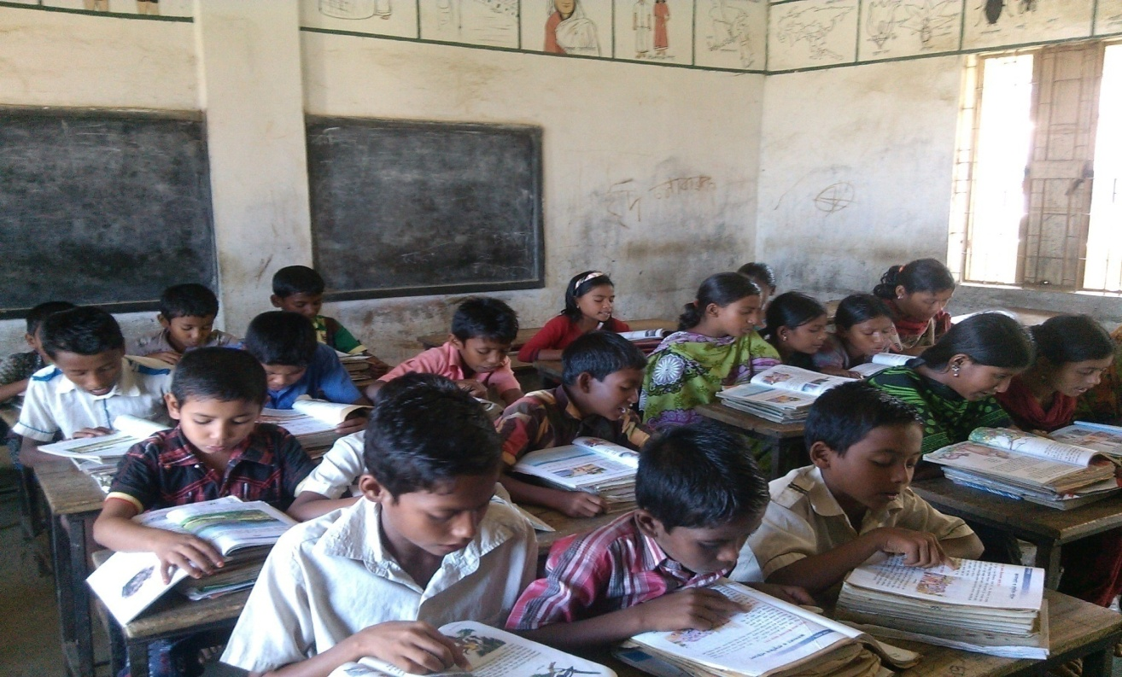
Put your finger under the text and read with me silently

Slide 12
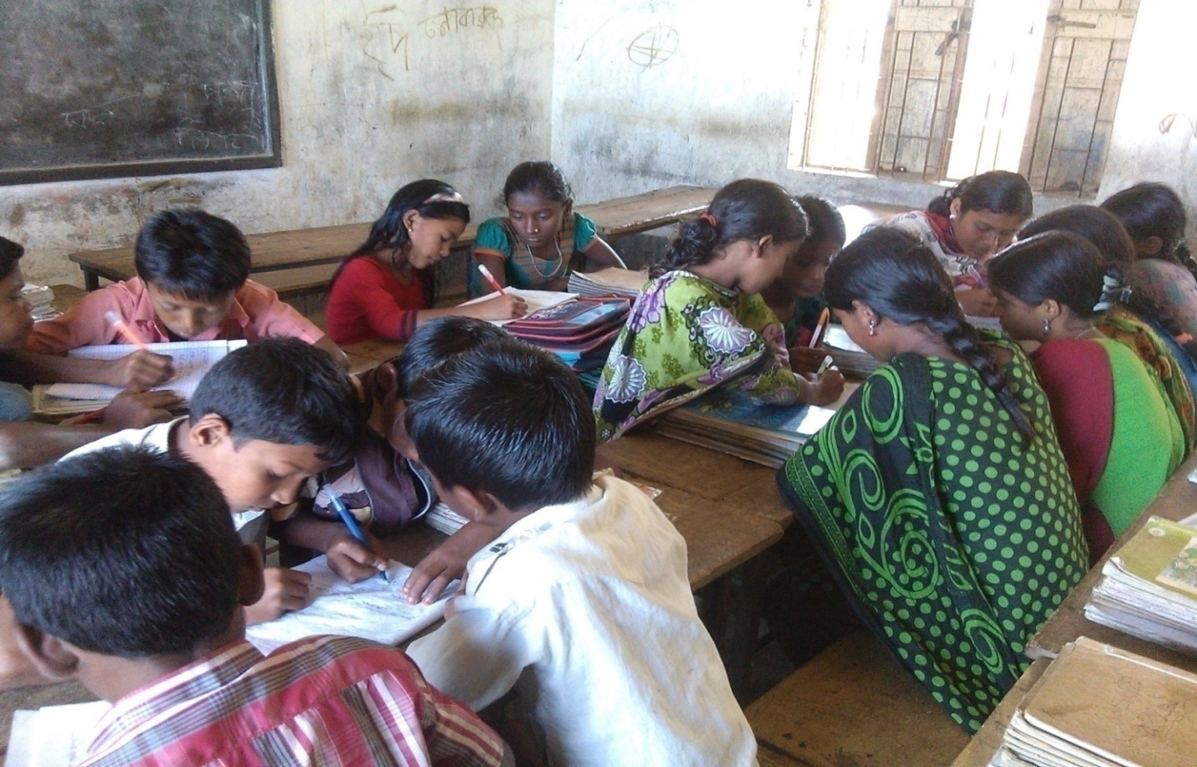
Group works
Each group read the text book silently

Slide 13
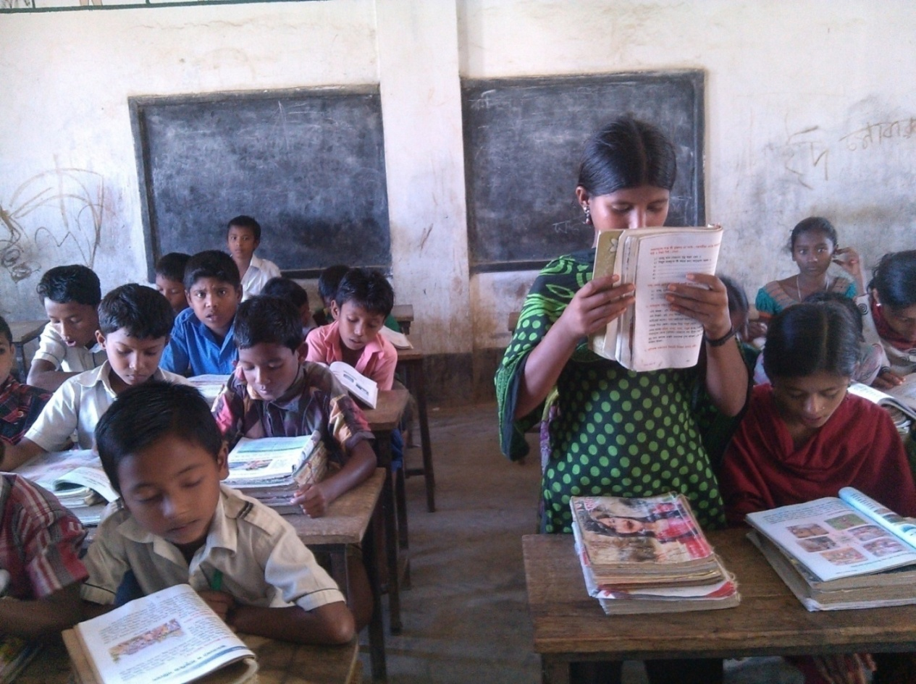
Individual work
Read the text loudly

Slide 14
Pair work
1. What is the name of the Island ?
A. beach
B. Sreemangal
C. Saint mortins
D. Madhabkundu
2.What is the most popular tourist spot ?
A. Saint mortins
B. Cox’s Bazar
C. Tea garden
D. Dhaka
3 .Where are the wonderful waterfall?
A .Sreemangal
B. Madhabkundu
C. khulna
D. Bogra

Slide 15
Assesment
Make sentences with the following words:
Island
Cox’s Bazar
Tourist spot

Slide 16
Home work
Write five sentences about Saint Martin’s Island.

Slide 17
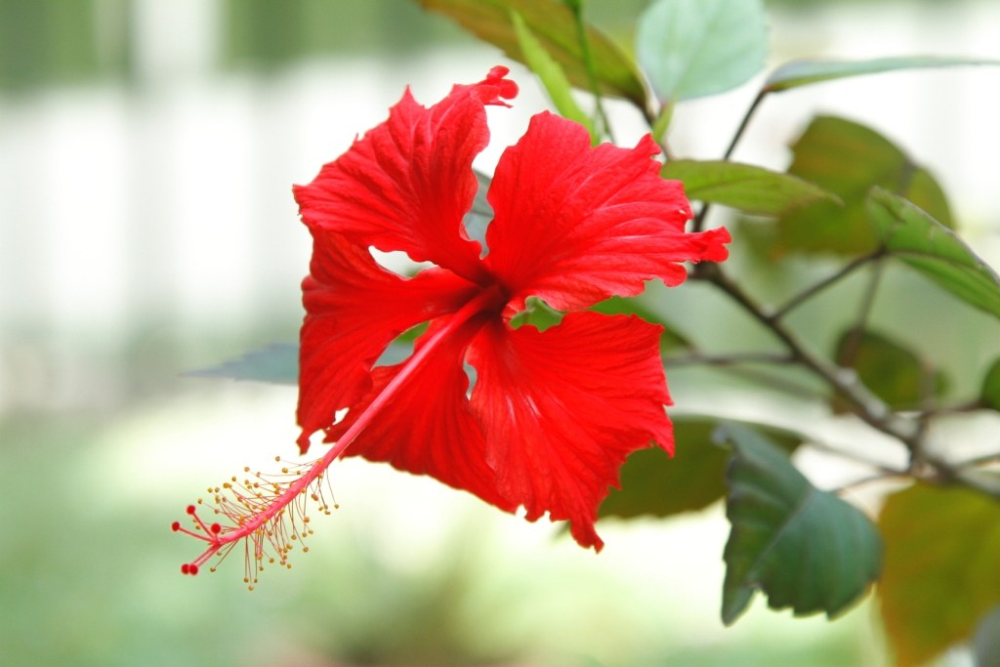
Thank you

