Slide 1
WELCOME

Slide 2
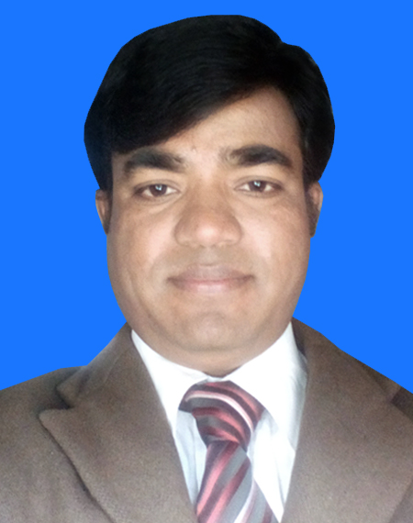
Introduction
Md.Nazmul Islam (M.A&B.ed)
Assistant teacher(English)
Bhair hat girls high school
Kaunia ,Rangpur.
Mobill no: 01716589545
Gmail : nazmulis178@gmail.com

Slide 3
Classes:9-10
Subject: English 1st paper
Unit:7
Lesson: 6

Slide 4
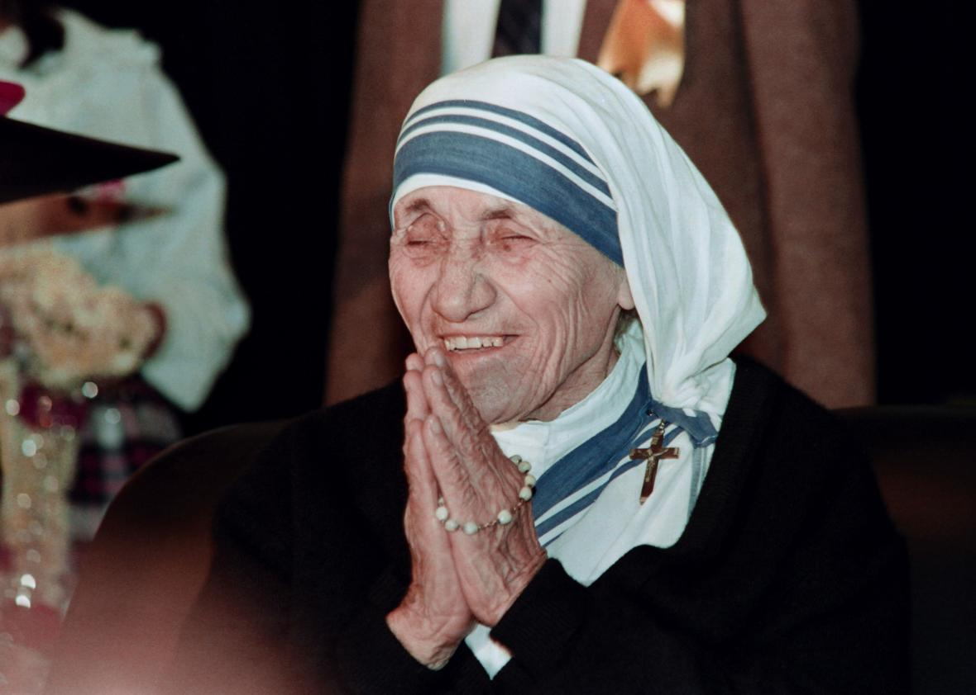
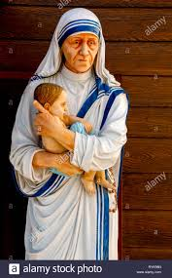
What do you see in these picture ?

Slide 5
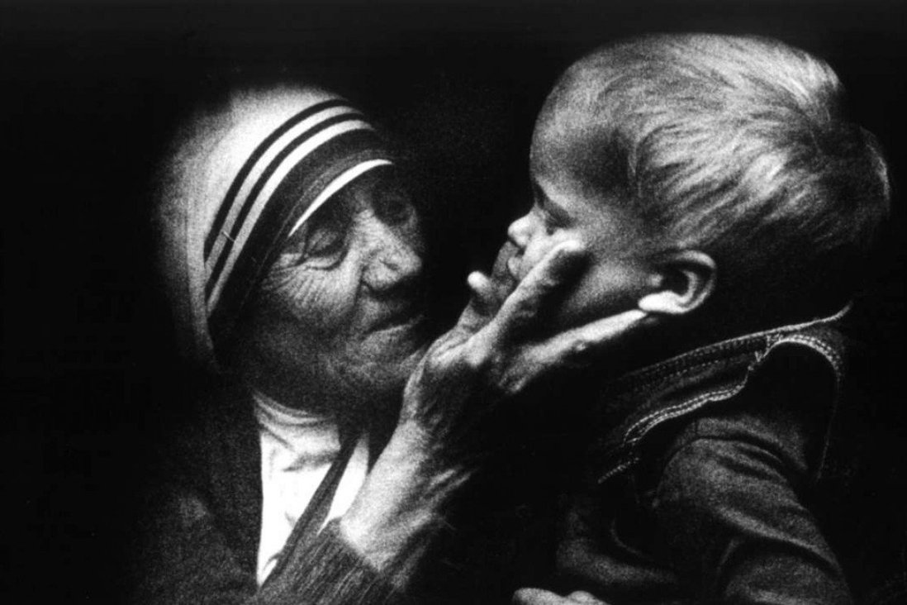
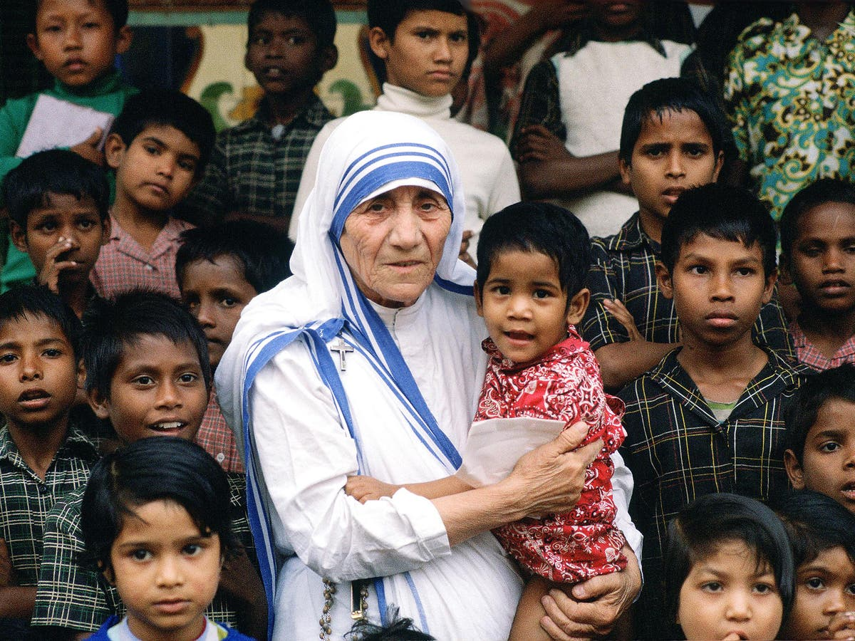
1.What do you think about these children ?
2. What does mother Teresa do with them ?

Slide 6
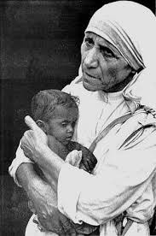
What will be our todays lesson.
Love for humanity

Slide 7
Learning outcomes
By end of the lesson , students will be able to………………………..
1.Talk about the picture
2.Use new words.
3. Ask and answer the question

Slide 8
Look the following words and make sentences with them.
Humanity
kindness
Devote
Dedicate
poor
Destitute
She was the mother of humanity.
She devoted herself to serve the poor.
She worked for destitute people.

Slide 9
Read more about Mother Teresa.
Mother teresa was moved by the sight of the sick and dying on the streets of kolkata. She founded a home for the dying destitute and named it “Nirmal Hriday”, meaning Pure Heart. She and her fellow nuns brought the dying people off the streets of Kolkata to this home. They were lovingly looked after and cared for. Since then many men, women and children have been taken from the streets and carried to Nirmal Hriday .

Slide 10
These unloved and uncared for people get an opportunity to die in an environment of kindness and love. I n there last hours they get human and divine love ,and can feel they are also children of God. The Missionaries of Charity try to find jobs for those who survive , or send them to homes where they can live happily for some more years in a caring environment.

Slide 11
Regarding commitment to family ,Mother Teresa said “May be in our own family, we have somebody ,who is feeling lonely, who is feeling sick, who is feeling worried. Are we there? Are we willing to give until it hurts in order to be with our families ,or do we put our interest first ? We must remember that love begins at home and we must also remember that future of humanity passes through the family”.

Slide 12
Now say whether the following statement are true or false. If false ,give the correct information .
Mother teresa was moved to see the diseasies that spread in the streets of Kolkata .
2. She opened a home for the orphans .
3. She and her group brought in the dying people from the streets of Kolkata.
4. Mother teresa said that humanity passes through charitable organizations.

Slide 13
Answer
False , corr.info. Mother teresa was moved to see the sick and dying people on the streets of Kolkata.
2. False, corr.info. She opened a home for the dying destitute.
3. True
4.False .Corr. Info. Mother teresa said that humanity passes through the family.

Slide 14
Home task
Write five sentences ,What are the things that you have learn from Mother teresa.

Slide 15
Dear students, please stay safe and use musk.

