Slide 1
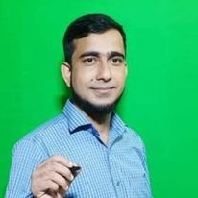
Welcome to my class

Slide 2
Introduction
Md. Ariful Islam
Lecturer in English
Shaistagonj Kamil Madrasah
Shaistagonj, Hobigonj.

Slide 3
Claass: 11 & 12
Date: 12/08/2021
Sub: English 1st Paper
Unit Two: Traffic Education
Lesson: 1
Number of students: 50

Slide 4
How are you my dear students
Hope all of you are well by the grace of Almighty Allah.

Slide 5
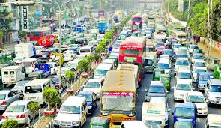
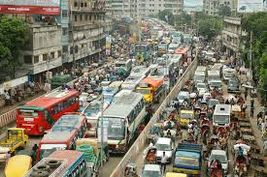
Look at the picture
Tell me what the pictures about.

Slide 6
Yes, all of you are right.
Both the pictures are about the traffic condition of Dhaka city.

Slide 7
Learning Outcome
After the lesson the students will be able to:
Identify the trules of traffic in Dhaka city
Cross the roads carefully
Tell how the vehicles goes

Slide 8
Today’s Lesson
Unit Two: Traffic Education
Lesson 1
How Your Brain Negotiates Traffic

Slide 9
Warm up activity:
Discuss in a small group the following questions.
_ What do you mean by traffic?
_ Who controls the traffic?
_ What are the challenges of traffic control?

Slide 10
Group Work
2. Do you ride a bicycle? If yes, how do you negotiate the traffic? Speak in a
group. If you don't know how to ride a bicycle, ask a friend who does.

Slide 11
Individual Work
Read the passage below and complete the activities mentioned at the end of the passage.

Slide 12
Silently Read
When you are in the driving seat of a car, you have the steering and the horn in your hands, the brake and accelerator under your feet, eyes open looking ahead, left and right. The same can be said about a motorcycle rider, with some modifications.

Slide 13
Read Individually
These are all very visible. But, behind all, there is something that keeps working unseen. And that is the Central Processing Unit (CPU), your brain. CPUs are artificially intelligent
machines that are programmed to do specific jobs under fixed conditions and judgements. But the human brain is intelligent by nature. It is the most sophisticated machine that is able to operate on ever-changing conditions and standards of judgement.

Slide 14
Read SIlently
As conditions in the traffic keep invariably changing, this virtue of sophistication of your brain must be at work when you are driving. The difference between traffic in the roads and highways and racing circuit must not be blurring inside you. Never imagine yourself to be a Michael Schumacher driving an F-1 at 300 mph. Leave no room for fantasy.

Slide 15
Read Silently
You must always be ready to encounter unexpected behavior from any vehicle or pedestrian. ÔKeep your coolÕ is easy to advice but difficult to maintain.
Still you must always restrain yourself because, at the end of the day, you don't want to be regarded as a killer. Now you see, the last thing that differentiates you from a computer is your conscience.

Slide 16
Group Work
Read the following questions. Each question has a word in italics with four alternative meanings. Choose the word which is the closest in meaning:

Slide 17
Group-A
A. What is a steering used for?
i. speeding
ii. stopping
iii. changing speed
iv. directing

Slide 18
Group-B
B. What is the function of the accelerator?
i. charging battery
ii. enhancing speed
iii. stopping
iv. controlling

Slide 19
Group-C
C. Which organ is the word visible associated with?
i. ear
ii. nose
iii. eyes
iv. hands

Slide 20
Group-D
D. The word sophisticated in line 15 meansi.
complex
ii. primitive
iii. modern
iv. refined

Slide 21
Group-E
E. Michael Schumacher is ai.
Hollywood hero.
ii. German racing driver.
iii. English footballer.
iv. Australian cricketer.

Slide 22
Pair Work
5. Answer the following questions:
a. Where do you see the difference between other human organs and the brain?
b. What is the difference between a computer and the human brain?
c. What is a CPU? What are its functions?
d. What are the main challenges facing a driver?
e. What is a racing circuit?
f. How is a racing circuit different from a public road?

Slide 23
Pair Work
6. Do you think the bus and truck drivers of our highways maintain traffic discipline? What are the reasons of road accidents in our country? Write your answer within 500 words.

Slide 24
Individual Work
7. Make sentences with the following words and phrases:
a. sophisticated
b. invariably c. fantasy
d. pedestrain e. convince
f. driving seat g. unseen

Slide 25
Homework
Do you think our towns and cities are pedestrian friendly? If your answer is
''no'', how can you make them so?

Slide 26
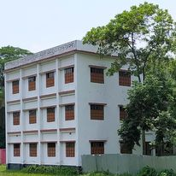
Thank you very much for joining with me in this class.

