Slide 1
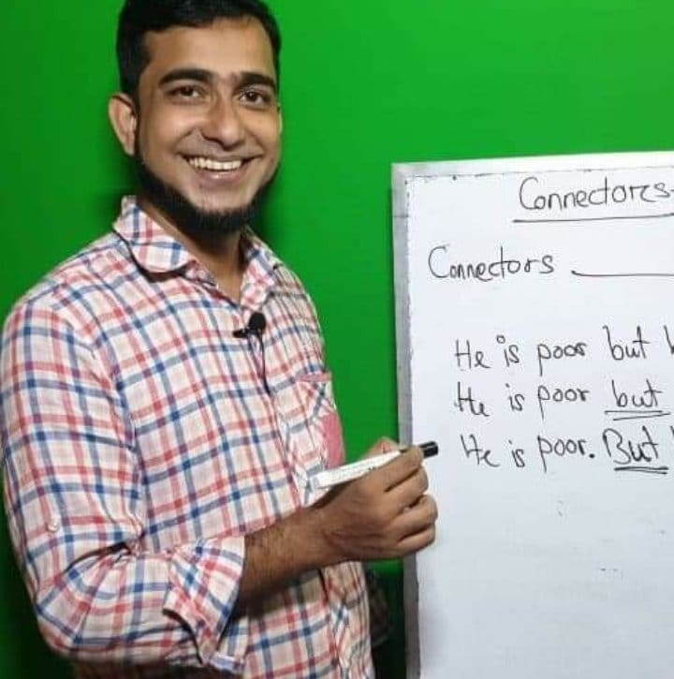
How are you my lovely students

Slide 2
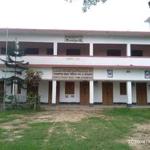
Welcome to my new class

Slide 3
About myself
Name: Md. Ariful Islam
Senior Lecturer in English
Shaistagonj Kamil Madrasah
Shaistagonj, Habiganj
Email: arif046980@gmail.com
Con: 01711857580

Slide 4
About my class
Class: Twelve
Unit: Five
Lesson: Five
Part: Two
Alexandra ‘alex’ Scott
Date: 12/08/2021
Number of students: 50

Slide 5
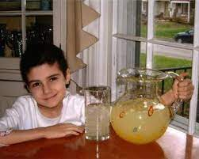
Look at the picture very carefully and tell whom you can see

Slide 6
Yes, all of you are right . She is Alexandra ‘Alex’ Scott
So our today’s topic is
Alexandra ‘Alex’ Scott
Unit-5
Lesson – 5
Part-2

Slide 7
Lesson outcome
After the lesson the students will be able to:
Tell about Alexandra ‘Alex’ Scott
Write a paragraph about Alexandra ‘Alex’ Scott
Answer the question about Alexandra ‘Alex’ Scott

Slide 8
Warm up activity:_
Find examples of young people in our country who have done something exceptional like the boy who stopped a train running on a track with missing fishplates and speak to your friends about them. _ Now share the following introduction with a friend.

Slide 9
Pre-reading activities
It’s an adults’ world. They make the decisions, create the laws, make the money, and have all of the freedoms. But there have been exceptions. Take for example, these child visionaries-boys and girls who have changed our world through their good actions or examples. Some have mobilized millions for a good cause; others have moved us simply by their generous and hopeful view of humanity. LetÕs read about some of these amazing young people.

Slide 10
Read silently my lovely students
Alexandra ‘Alex’ Scott was born in Connecticut in 1996, and was diagnosed with neuroblastoma, a type of childhood cancer, shortly before she turned one. In 2000, just after turning four, she informed her mother that she wanted to start a lemonade stand to raise money for doctors to help children. Her first lemonade stand raised 2,000 dollars and led to the creation of the AlexÕs Lemonade Stand Foundation.

Slide 11
Read silently
Alex continued her lemonade stands throughout her life, ultimately raising over one million dollars toward cancer research. She passed away in August 2004 at the age of eight. Today, AlexÕs Lemonade Stand sponsors a national fundraising weekend in the United States which is popularly known as Lemonade Days. Each year, as many as 10,000 volunteers at more than 2,000 AlexÕs Lemonade Stands make a difference for children with cancer.

Slide 12
Group Work
My dear students, you have to devide in five groups and every group will have five members from A-E

Slide 13
Group-A
Write meaningful sentences with the folowing words:
diagnosed
Neuroblastoma
type
shortly
turned

Slide 14
Group-B
Write meaningful sentences with the folowing words:
informed
lemonade
raise
Stand
5. Collected

Slide 15
Group-C
changed
actions
3. mobilized
4.Cause
5. generous

Slide 16
Group-D
adults
decisions
freedoms
exceptions
visionaries.

Slide 17
Group-E
ultimately
passed away
sponsors
popularly
difference

Slide 18
Evaluation
Write a paragraph on Alexandra ‘Alex’ Scott you can take the help of internet but the paragraph should be less than 150 words.

Slide 19
Homework
Find the meaning of the following words and make sentences with them:
a. empowerment
b. mobilize
c. fundraising
d. betray
e. grace
f. holocaust

Slide 20
Thank you very much for attending my class, see you in the next class.

