Slide 1
Welcome
Welcome

Slide 2
Identity
Class-All class
Subject-English 1st paper.
Writing part.
Md Tazul Islam
Asst Teacher
Andiura u.n High School.
Andiura ,madhabpur.

Slide 3
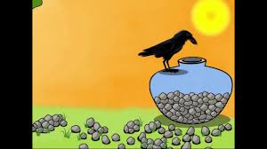
What can see the picture?

Slide 4
Our today’s lesson is a story
A thirsty crow

Slide 5
Learning outcomes
After We have studied this lesson
We will be able to---------------
1.Lesson information?
2.Ask and answer questions?
3.Write a story?

Slide 6
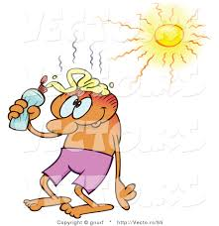
It was a hot summer day.

Slide 7
Once a crow was very thirsty.

Slide 8
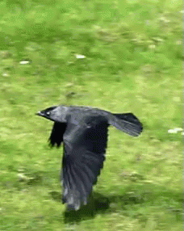
It flew about here and there looking for water.

Slide 9
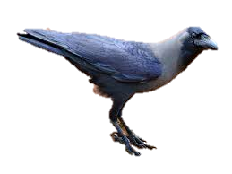
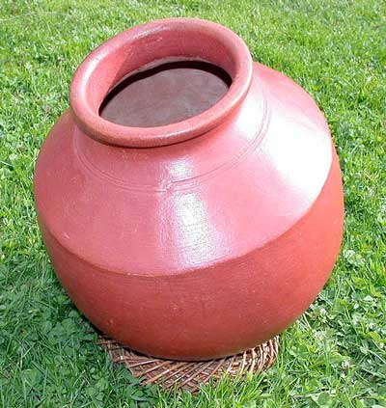
The crow saw a pot of a water.

Slide 10
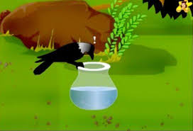
He saw that there was a very little water in the pot.

Slide 11
He could not reach the water.

Slide 12
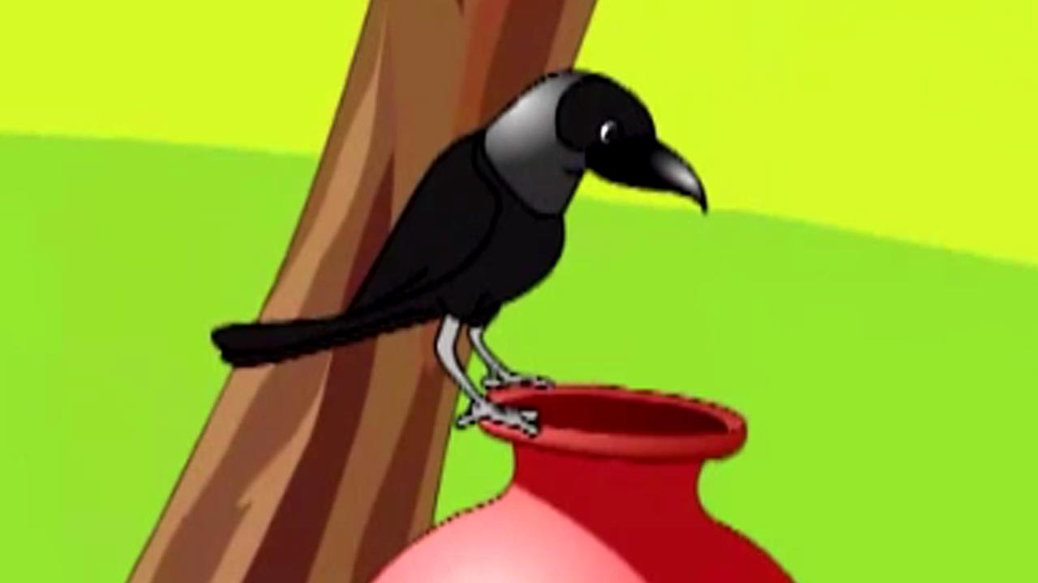
What can I do,I am very thirsty said the crow myself.

Slide 13
He looked around.

Slide 14
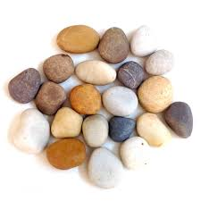
He saw some pebbles

Slide 15
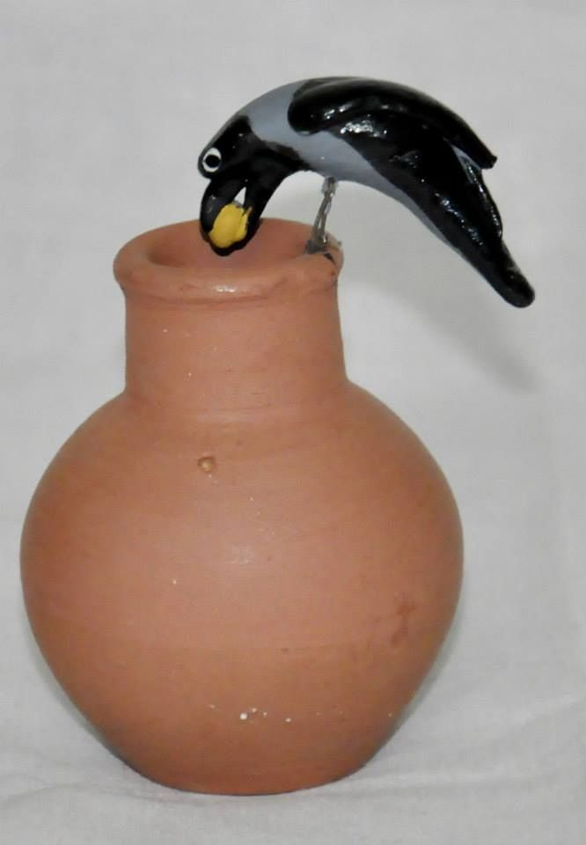
He picked up the pebbles one by one and dropped into the pot.

Slide 16
After a while water came up.

Slide 17
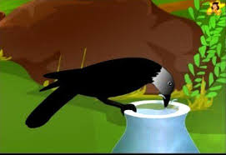
He drank water.

Slide 18
He flew away happily.

Slide 19
Group work
Discusses about the story your partner.

Slide 20
Evaluation
1.What is the story about?
2.Why was the crow flying here and there?
3.Who did he meet up his thirst?

Slide 21
Home work
Write a story?
A thirsty crow.

