Slide 1
Welcome

Slide 2
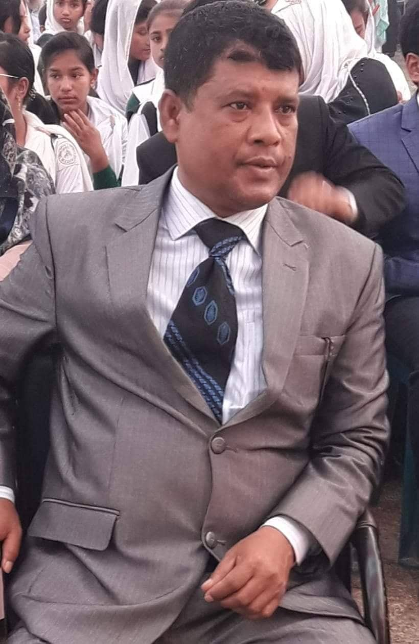
TEACHER’S IDENTITY
Md.Rafiqul Islam
Senior Teacher
Sureswar High School and college
Naria, Shariatpur.
Email: rafiq91269@gmail.com

Slide 3
PRESENTATION
English 2nd paper
Grammar item
Made for class eight

Slide 4
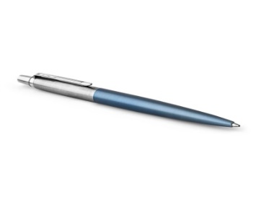
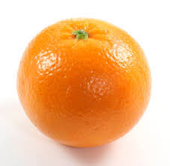
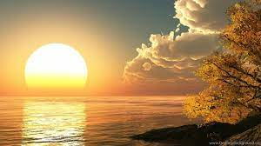
Look at the picture
A pen
An orange
The Sun

Slide 5
What do you think about these words…
A, An, The
Articles…?

Slide 6
Yes, today’s lesson is….
Article

Slide 7
TARGET
At the end of the lesson the students will be able to know
Kinds of article
Identify articles.
Fill the gapes with appropriate articles.

Slide 8
At first we have to know about English letters .
Total English letter is 26
They are Vowel – 5 , Consonant – 21

Slide 9
Kinds of Article
Two kinds of Article:
Indefinite Article- a,an
Definite Article - The

Slide 10
If there is a vowel at the beginning of a word. It is usually preceded by An.
If there is a consonant at the beginning of a word. It is usually preceded by A.

Slide 11
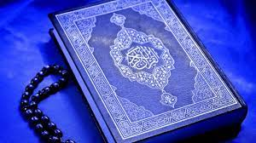
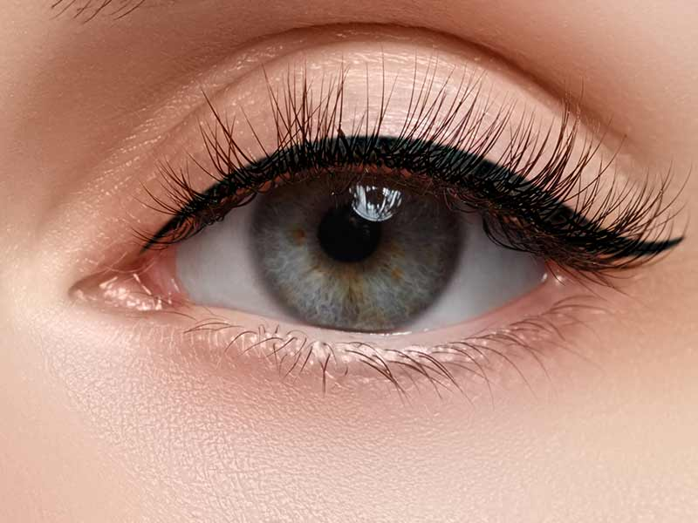
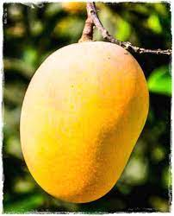
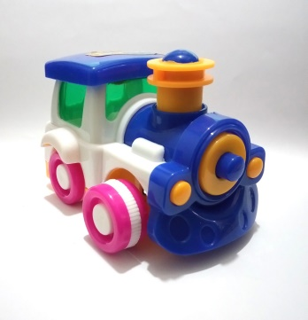
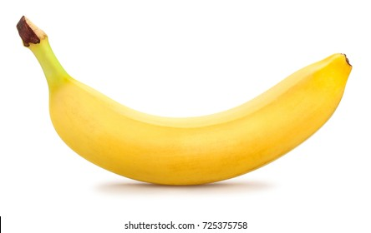
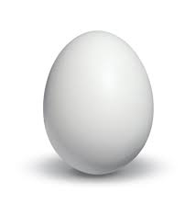
eye
mango
toy
Quran
banana
egg
houses
Pen

Slide 12
Solution :
The Quran
An eye
A mango
A toy
A banana
An egg
A Pen
A houses

Slide 13
H
A house
An honest
n
A
A horse
A house
An honest man
An honorable

Slide 14
U
A university
An umbrella
BD
Av
A union leader
An ugly bird

Slide 15
O
An orange
A one eyed man
Iqv
O
An oil cake
An old man
A one taka note
A one lagged man

Slide 16
E
An egg
A European
BD

Slide 17
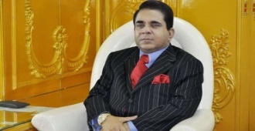
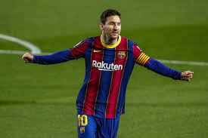
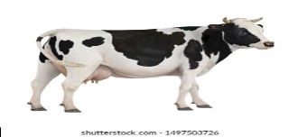
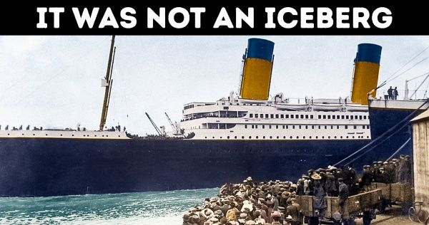
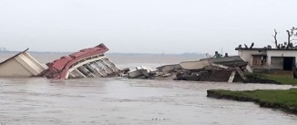
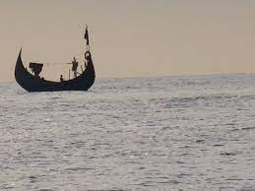
The words that precede the
The Quran
The Sun
The Moon
The rich man
The best player
The cow
The Titanic
The Padma
The Bay of Bengal
The Ittafaq
etc.

Slide 18
Exercise
English is …. International Language b) He is
….. teacher. c) …. Bay of Bengal. D) Dhaka stands on …. Buriganga. e) Jamal is .…best boy in the class. f) …. Rich are not always happy. g) There is …. University in Dhaka. h) He is …. M.A i) …. Prime Minister. J) My father is …. B.A

Slide 19
Solution
a) English is an International Language b) He is
a teacher. c) The Bay of Bengal. D) Dhaka stands on the Buriganga. e) Jamal is the best boy in the class. f) The Rich are not always happy. g) There is a University in Dhaka. h) He is an M.A i) The Prime Minister. J) My father is a B.A

