Slide 1
Good morning
Welcome to my English for today class

Slide 2
IDENTITY
Mazada akther
Lecture in English
Barabor Alim Madrasha
Phone:01798003534
mazadakter3@gmail.com

Slide 3
Lesson
Subject :
English first paper
English for Today
H.S.C/Alim
Duration:45m

Slide 4
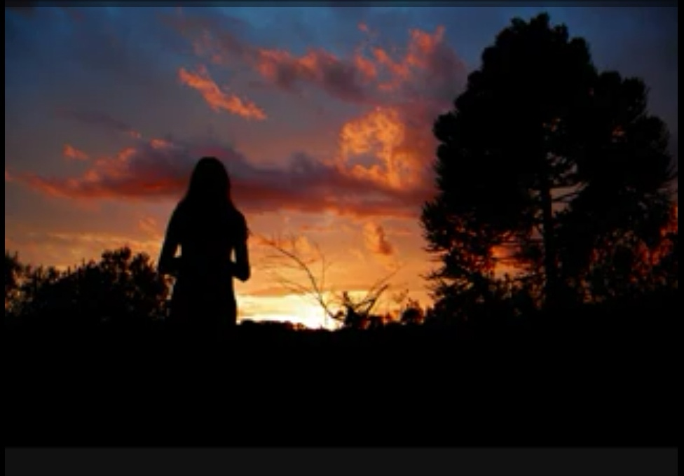

Slide 5
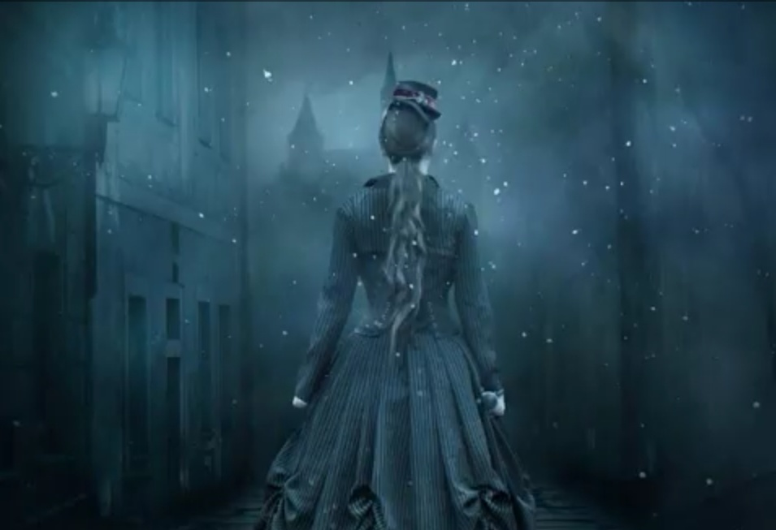
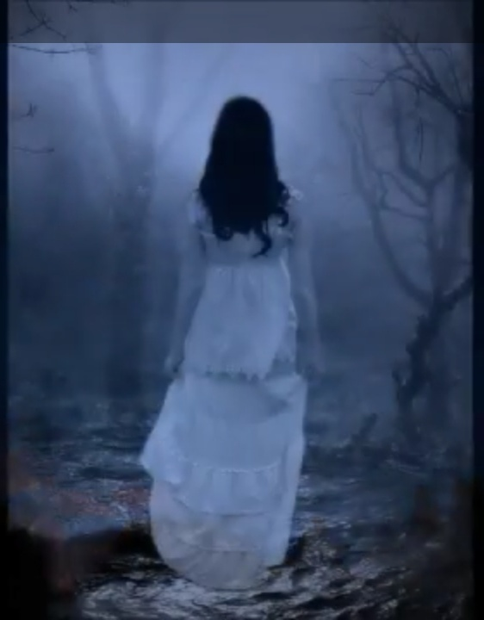

Slide 6
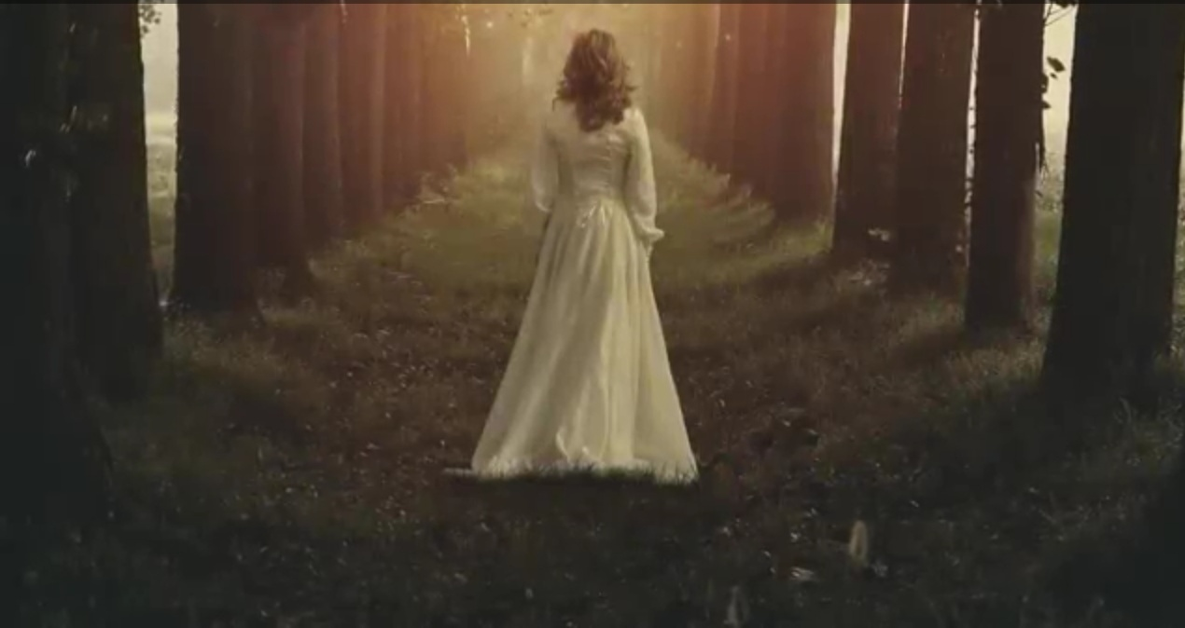

Slide 7
Today's Lesson :
Unit - 14
Lesson - 1

Slide 8
Learning Outcomes
After the end of the lesson the students will be learn
about -
★The poet
★The poem
★Poem analysis
★Interpretation

Slide 9
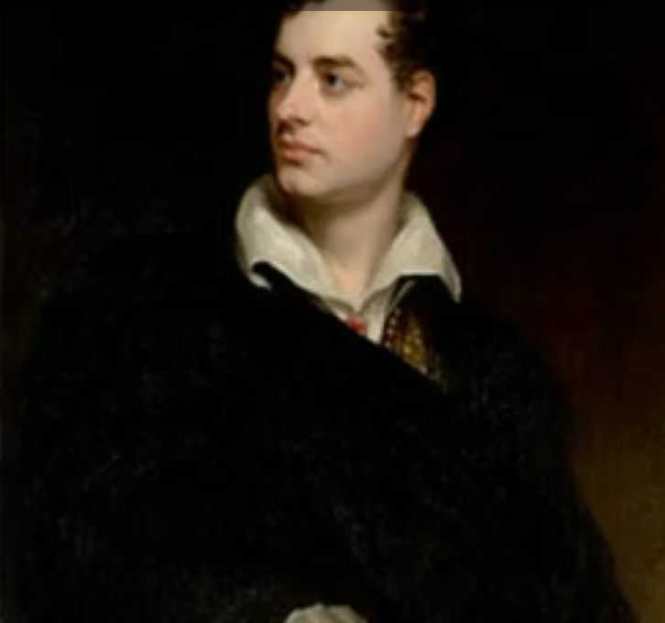

Slide 10
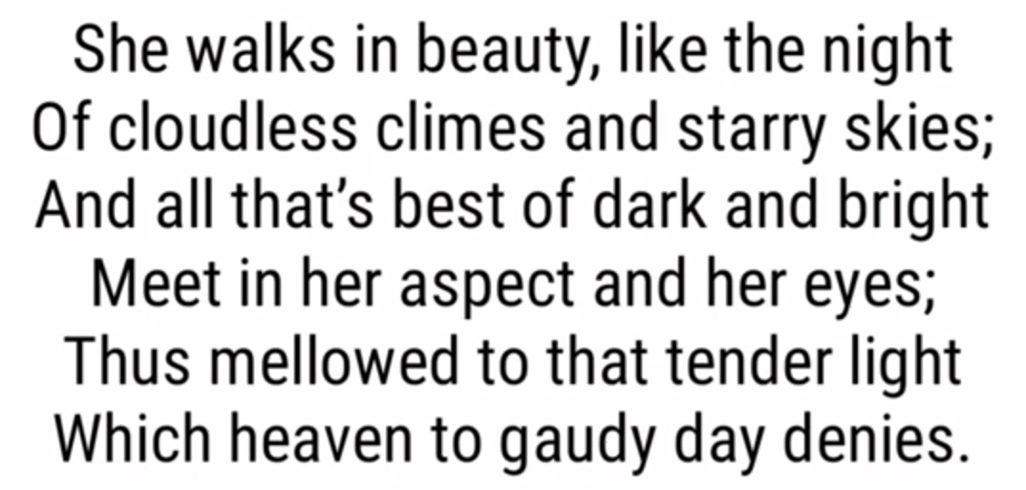

Slide 11
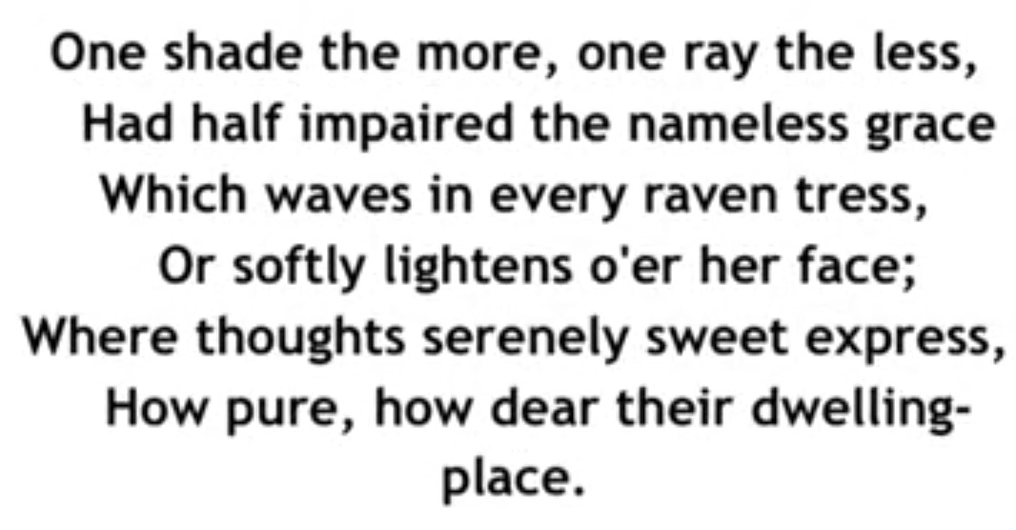

Slide 12
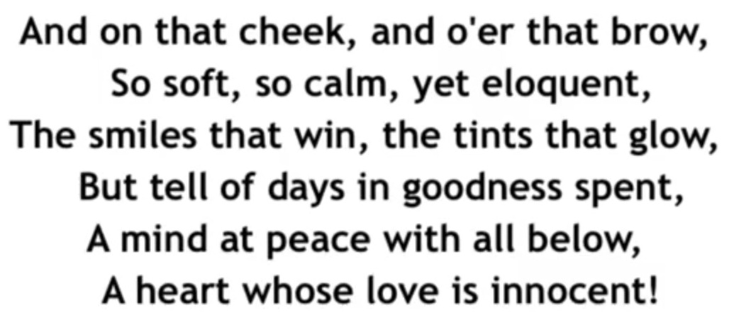

Slide 16
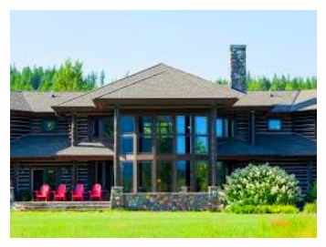
Home Work
★Learn appreciation of the poem.
★Write a theme of the poem in your own words.

Slide 17
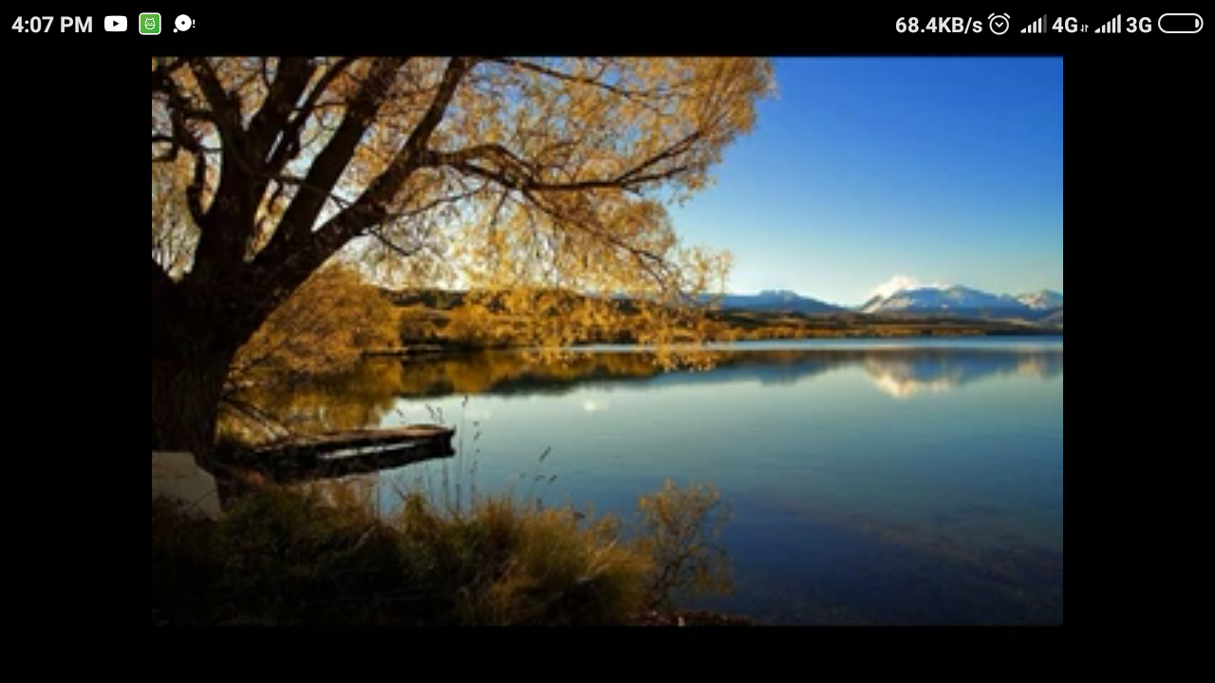
THANK YOU

