Slide 1
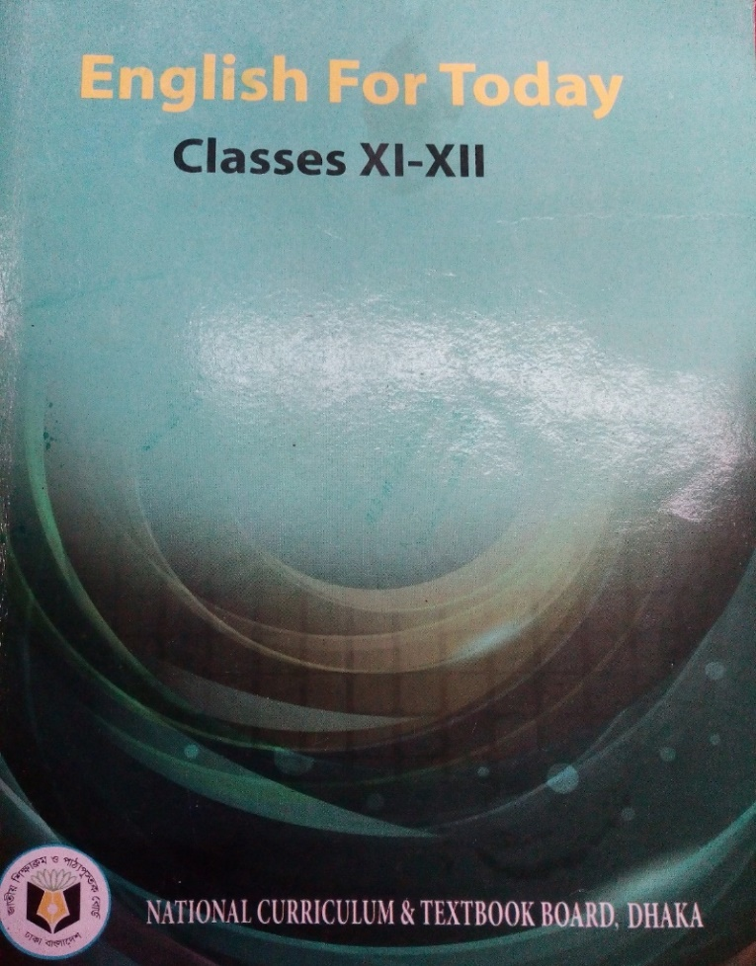
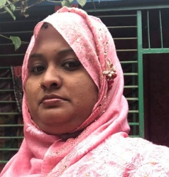
Teachers information
Mazada Akter
Lecturer (English)
Barabor alim Madrasha
Class : 1x
Subject : English 1st paper

Slide 2
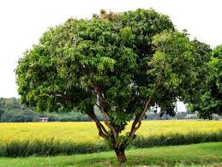
Introduction of Lesson
English First Paper
English for Today
Alim 1st Year
Time: 40m

Slide 3
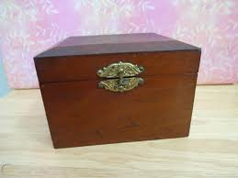
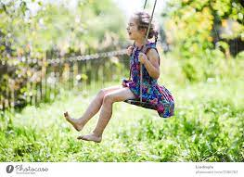

Slide 4
Unit : 4
Lesson : 3
Photograph

Slide 5
Learning Outcomes
Students will be able to learn about-
the meaning/synonym of the hard words
The story
summary / theme

Slide 6
Silence-shut up
Warmth-temparature
Bow-rainbow
Knitting-texture
Word meaning
Wallop-bang
Wrinkle-curling
Common-general
Fade-turn pale
Trouble-sorrow
Exception-departure

Slide 7
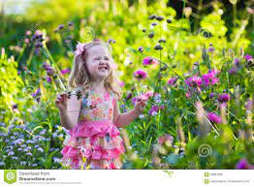
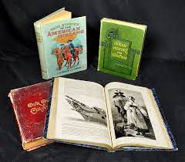
Story & Summary Discussion

Slide 8
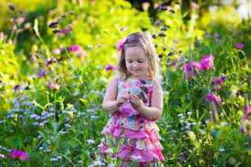
Class Work
Write the name of the flowers which were at the girl’s feet.
Describe about the grandmother and the boy in your own words.

Slide 9
Evaluation
When was the cool breeze blowing?
What flowers were at girl’s feet?
How was the girl in the photograph?
Who has been referred to by cold lady?

Slide 10
Home Work
Write synonyms of the following words:
String, warm, fade, granny, shout, wind.
Write a theme of the story.

