Slide 1
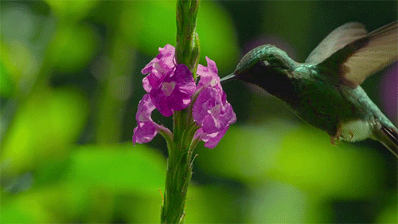
Welcome

Slide 2
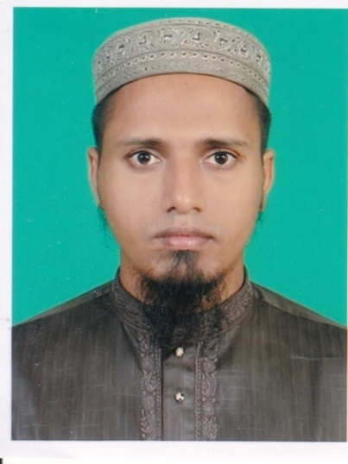
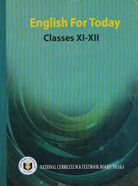
Introduction
Md.Mehedy Hasan
Lecturer in English
Bandar Islamia Fazil Madrasah
Bandar, Narayanganj.
Mob: 01745866460
Email:mehedypakdal@gmail.com
Class: xi-xii
Sub:English 1st Paper

Slide 3
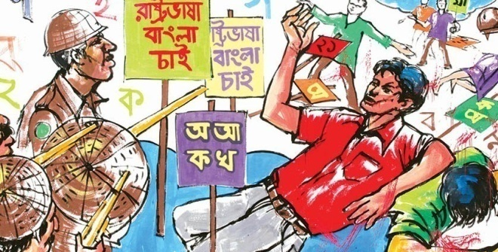
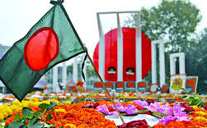
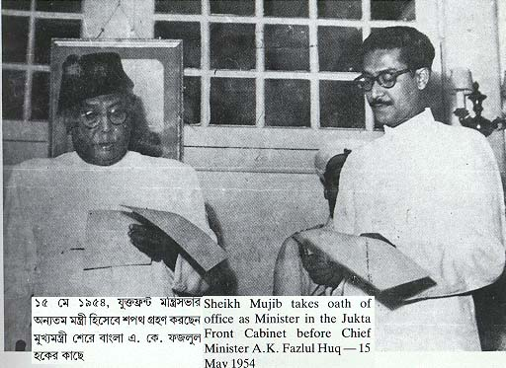
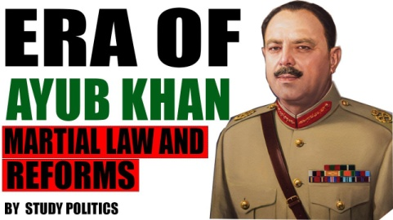
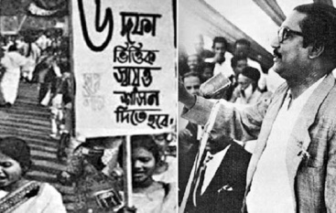
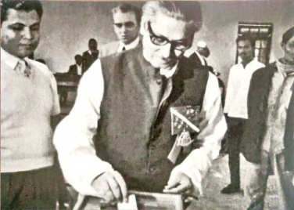
What do you see in the pictures below ?

Slide 4
Let us watch a short video .

Slide 5
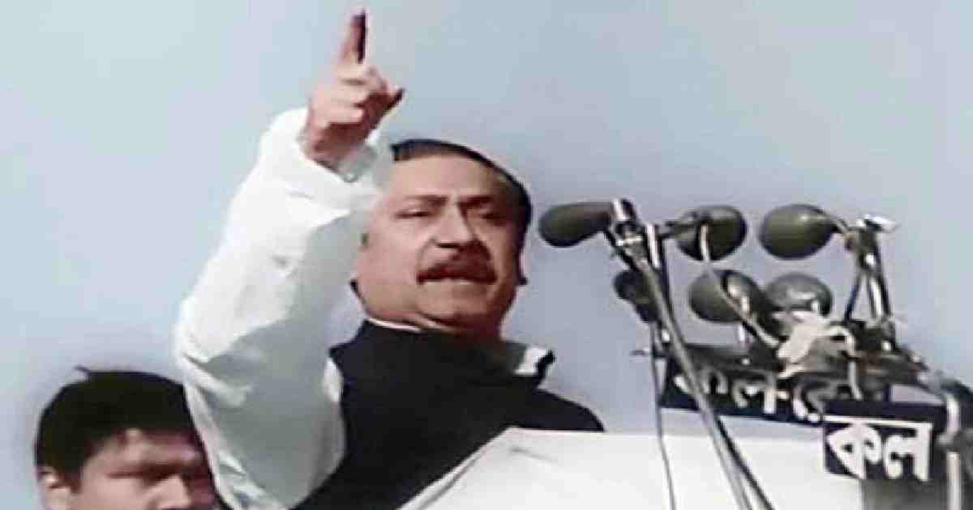
Our today’s lesson is
(The Unforgettable History)
Unit : 1 Lesson : 1 (a)

Slide 6
Learning outcomes
By the end of the lesson the students will be able to..
. talk about pictures
. ask and answer questions
. infer the word meaning from the text
. describe a flaw chart
. choose the best answers
. write a paragraph.

Slide 7
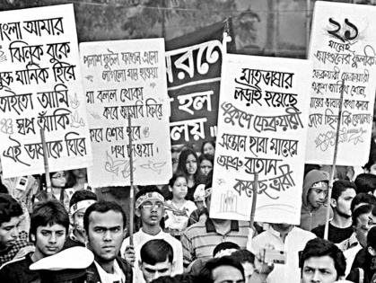
Some significant events before 7th march.
The people of Bengal shed blood in 1952 for their mother lanuage.
Muslim league won the election in 1954. But did not form the govenrment.
Ayub khan declared Martial Law in 1958.

Slide 8
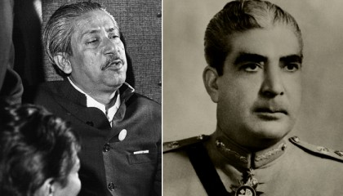
Some significant events before 7th march.
Sheikh Mujib launched six point in 1966.
Yahya Khan came into power in 1969.
Awami League won the election of 1970.

Slide 9
1. We shed blood in 1952 .
4. In 1966 we launched the six point movement.
5. In 1969 Ayub Khan fell from the power nd Yahya Khan assumed the reins.
6. Awami League won the election of 1970.
2. We were the victors in the election in 1954 .
3. In 1958 Ayub Khan declared Martial Law.
7th march speech

Slide 10
Group Work
a) Who launched the six points ?
b) When did the six points launch ?
c) Who declared the Martial Law ?
d) What was the result of the election of 1970 ?
e) How many seat did Awami League get in 1970 ?

Slide 11
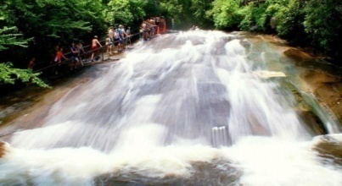
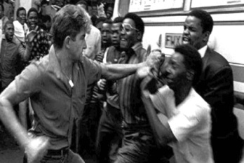
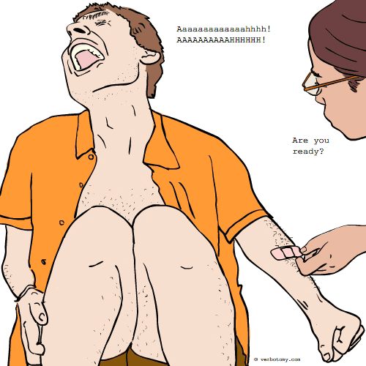
Word meaning
Import
The implicit meaning of something.
Awash
Containing a large amount of something.
Inflict
To make someone suffer by doing something unpleasent.
Agony
Intense mental or physical or mental suffering.
Crimson
A rich deep red colour.

Slide 12
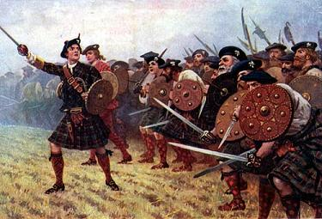
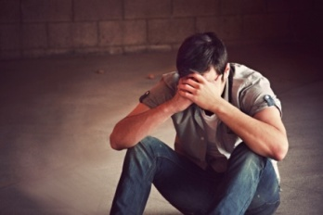
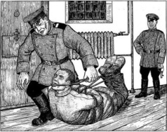
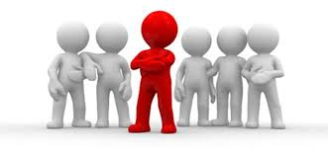
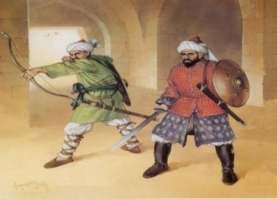
Word meaning
Defend
Resist an attack made on someone
Wretch
An unfortunate or unhappy person
Downtroden
Treated badly by people in power.
Apparently
As far as one knows or can see.
Confront
Deal with something unpleasent.

Slide 13
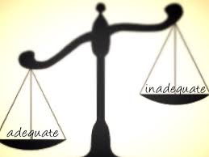
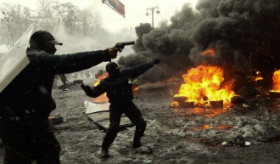
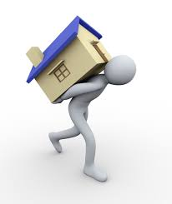
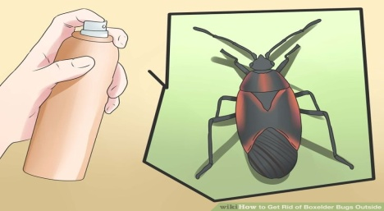
Word meaning
Suppress
Forcibly put an end to something.
Directive
An official or authoriative instruction.
Anarchy
A state of disorder due to absence of controlling systems.
Transmit
Broadcast or send outan electrical signal.
Exterminate
Destroy completely.

Slide 14
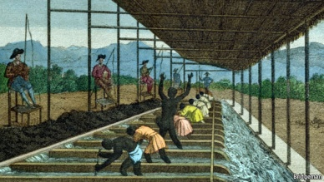
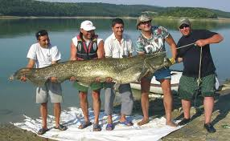
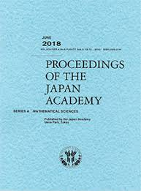
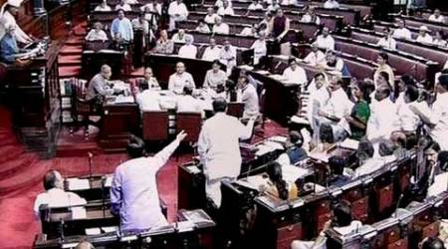
Word meaning
Enslave
To control someone and keep them in a bad situation.
Assume
to take a position.
Proceedings
A series of activities involving a formal procedure.
Dissolve
Disappear .
Discontinue a session of a parliament.
Prorogue

Slide 15
(Individual work) [Reading& Writing Test]
( Read the text and answer the meaning of following words)
b) Containing a large amount of something
What is the meaning of “Awash”?
What is the meaning of “ Crimson” ?
What is the meaning of “Dissolve” ?
a) A rich deep red colour
c) disappear

Slide 16
Connection with mainbook
(Pair Work) [Listening & Speaking]
Open your textbook and answer the following questions no:5

Slide 17
Evaluation [Listening & Speaking Test]
a) The Language Movement tookplace in ---------
1. 1950 2. 1951 3. 1952 4. 1953
b) The six point was launched in----------------
1. 1960 2.1962 3. 1964 4. 1966
c) Ayub Khan fell from power in -------------
1. 1963 2. 1966 3. 1969 4. 1972
d) Ayub Khan declared Martial Law in----------
1. 1954 2. 1956 3. 1958 4. 1960
e) What is the closest meaning of “Agony”
1. painful 2. anguish 3. miserable 4. suffering

Slide 18
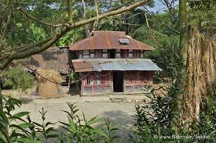
Homework [Writing Test]
Write a paragraph on “Languagr Movement of 1952” .

Slide 19
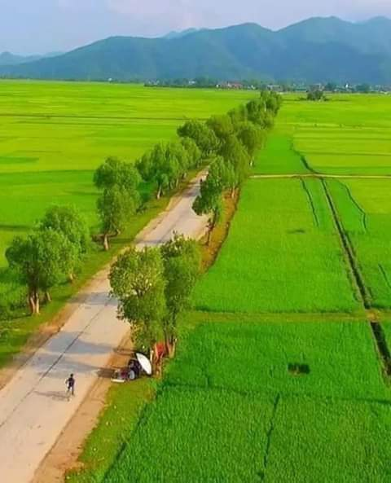
Thank you very much

