Slide 1
Welcome
1
Greetings

Slide 2
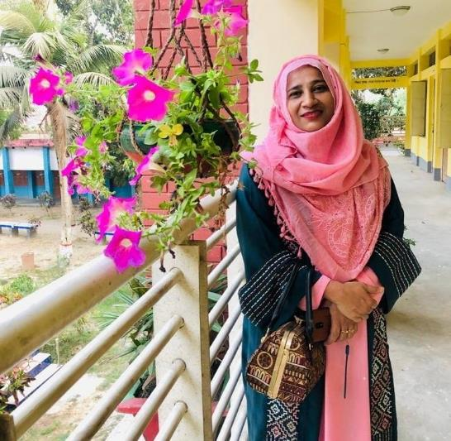
2
Presented by
Maksuda khatun
Assistant Teacher
S.M Govt. Primary School
Meherpur Sadar
Teacher’s Identity

Slide 3
3
COLOURS
Unit-16
Section A
Page- 33
Lesson’s Identity
Lessons-4-6

Slide 4
4
By the end of the lesson students will be able to -
L: 1.1.1 Become familiar with English sounds by listening to common English word.
S: 1.1.1 repeat after the teacher simple words and phrases with proper sounds and stress.
S: 1.1.2 say words and phrases sentences with the help of visual clues and simple sentences.
R:1.4.1 read words and phrases with the of visual clues (about 3 new words)and simple sentences.
Learning outcomes:

Slide 5
What can you see?
5
Think and tell me.
Look at the picture
Rainbow.
7 Colours
How many colours are there in Rainbow?

Slide 6
Everybody listen the rhyme carefully
6
Let’s watch a video
https://youtu.be/NfeZXQbkRYk

Slide 7
Today’s lesson is-
7
Lesson declaration
COLOURS

Slide 8
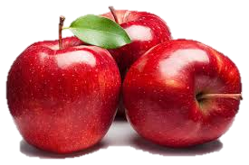
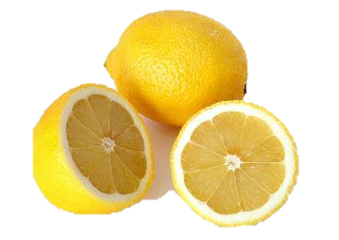
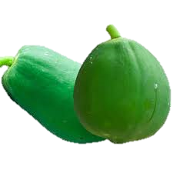
What colour is these?
8
Look, listen and say.
Red
Orange
Yellow
Green

Slide 9
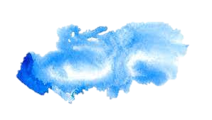
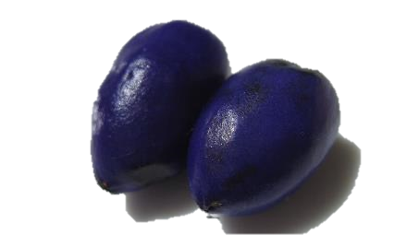
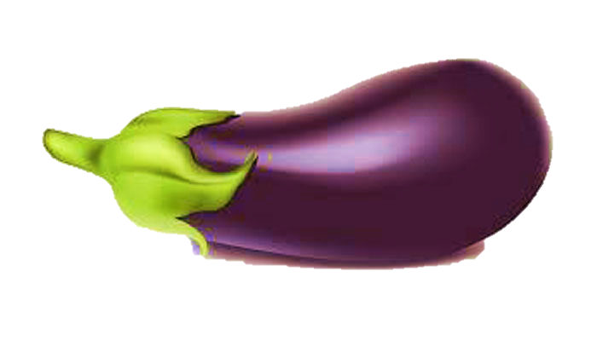
9
What colour is these?
Look, listen and say.
Blue
Indigo
Violet

Slide 10
10
Look and say the colours name.
Red
Orange
What colour is it?
What colour is it?

Slide 11
11
Look and say the colour name.
Yellow
Green
What colour is it?
What colour is it?

Slide 12
12
Look and say the colours name.
Blue
Indigo
What colour is it?
What colour is it?

Slide 13
13
Look and say the colour name
Violet
What colour is it?

Slide 14
Now you will tell yourself.
14
red
orange
yellow
green
blue
violet
indigo

Slide 15
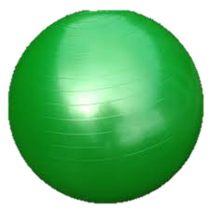
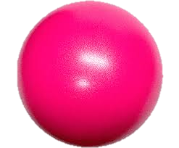
Find out the red ball
15
Find out the green ball
Individual Work

Slide 16
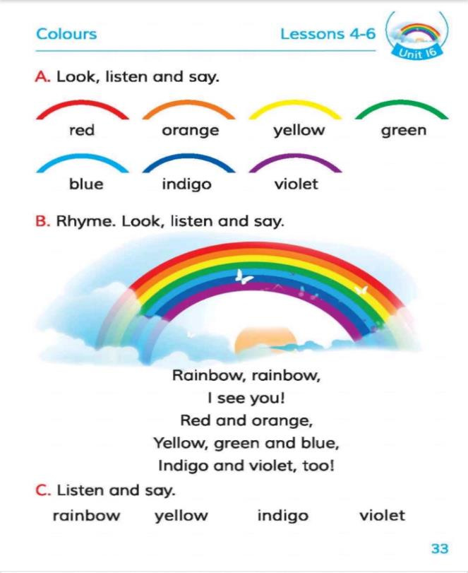
Open your book
16
Connect With Studybook
Page no- 33
Activity-A

Slide 17
17
Lets play a colour game.
Pair work
What colour ball did he throw?
What colour ball did he get?
What colour ball did he throw?
Only for classroom

Slide 18
18
Match the pictures with the colours name.
violet
Evaluation
blue
orange
yellow

Slide 19
19
Write the colour’s name below the pictures.
Evaluation
________________
________________
________________
________________

Slide 20
20
Home work
Draw a picture of Rainbow with 7 colours.

Slide 21
21
Thanks to all
Good
STAY HOME
STAY SAFE

