Slide 1
WELCOME

Slide 2
PRESENTED BY
Lakshan Chandra Paul
Assistant Teacher (English)
Barura Haji Nowab Ali Pilot High School
Barura, Cumilla

Slide 3
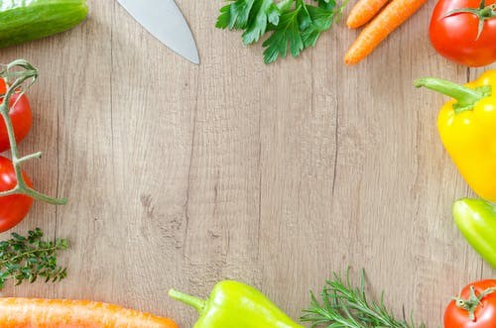
Class : Three
Subject : English
Lesson : What food should we eat? (L 1-3)
Page : 74
Time : 40 minutes

Slide 4
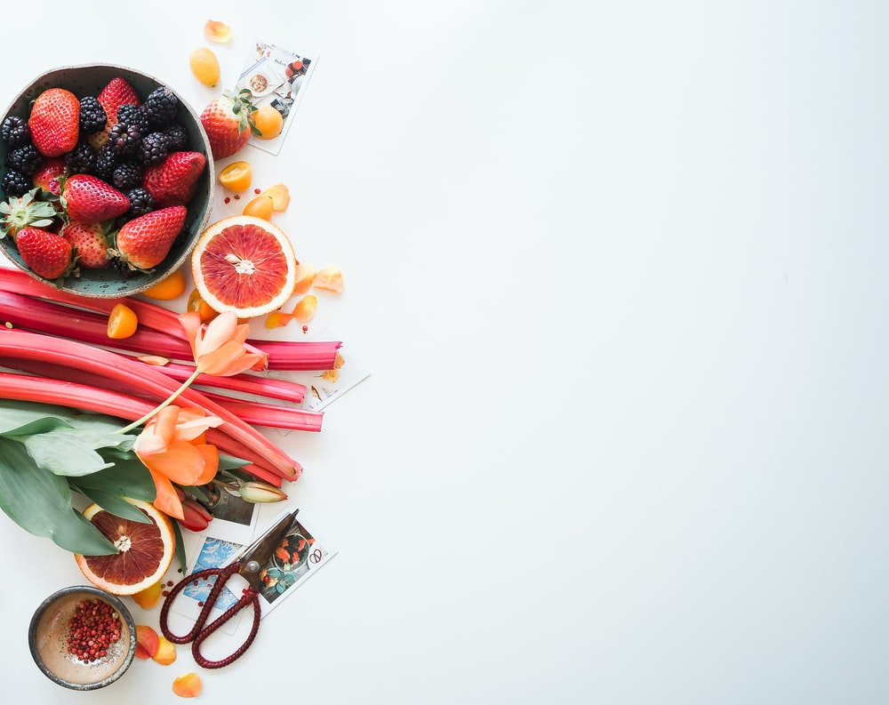
Learning outcomes :
The students will be able to-
Identify, say, read and write the name of some foods.
Classify the healthy and unhealthy foods.

Slide 5
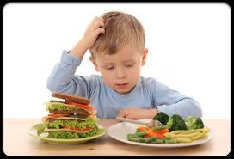
?
!
Thinking !
what about he thinking : look and say

Slide 6
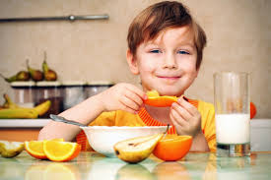
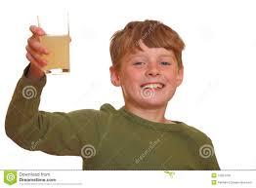
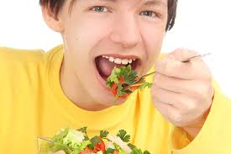
What are they doing : look and say

Slide 7
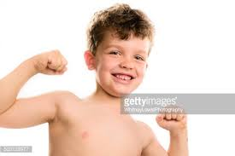
Healthy boy
how ook like the boy : look and say

Slide 8
what food should we eat
Think

Slide 9
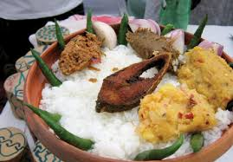
Rice-fish
look and say

Slide 10
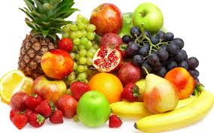
Fruits
look and say

Slide 11
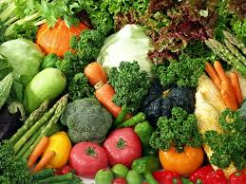
vegetables
look and say

Slide 12
Fast food
Any one say what kind of food is these

Slide 13
vegetables
tomato
cucumber
lettuce
crrot
Listen and say after me

Slide 14
We should eat this food
Healthy Food
pineapple

Slide 15
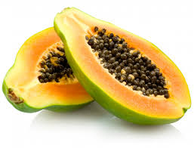
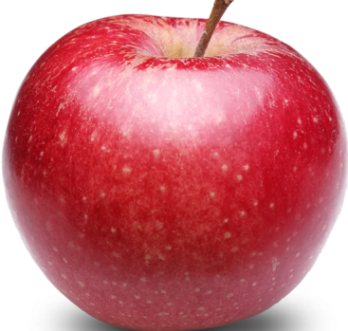
Fruits
mango
pineapple
papaya
apple
Listen and say after me

Slide 16
Listen
Read and
Say :
Loud and silent reading
T-SS

Slide 17
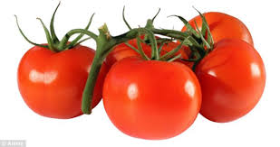
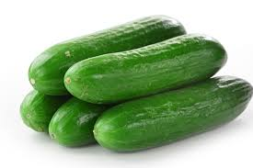
Healthy foods
Now say ,what kind of food is these

Slide 18
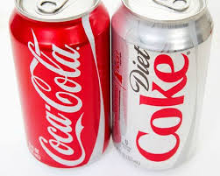
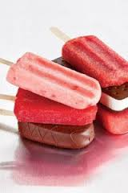
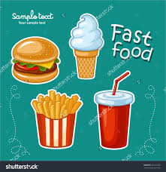
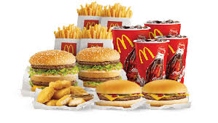
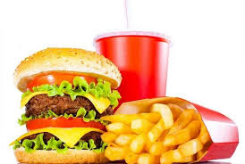
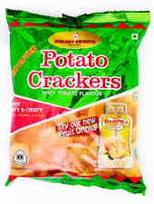
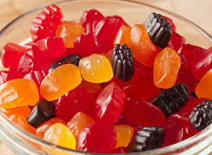
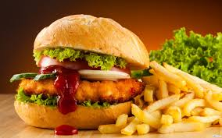
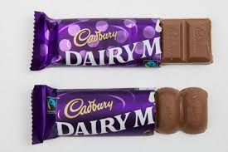
Unhealthy foods
Now say ,what kind of food is these

Slide 19
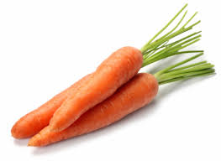
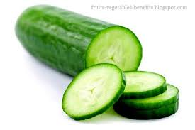
Fruits
carrot
pineapple
Look
And
say
cucumber
papayas

Slide 20
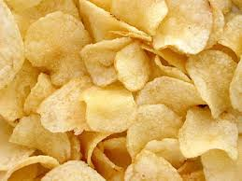
Fast foods
chips
chocolate
Look
And
say
ice-cream
burger

Slide 21
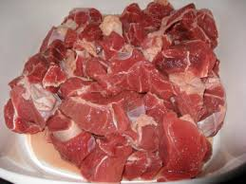
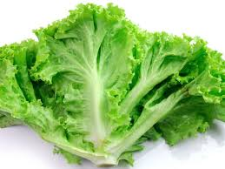
Look , read and match with draw line
lettuce
meat
chocolate
papayas

Slide 22
Which food go awaya from the picture?

Slide 23
Which food enter in to the picture?
carrot
Ice-cream
chips
lattuce
banana
papaya
fish
chocolate

Slide 24
Which food exit from the picture?
carrot
Ice-cream
chips
burger
tomato
papaya
fish
chocolate

Slide 25
papaya, burger, mango,
carrot, chips, ice-cream, chocolate, tomato,
Write the following foods name in correct lists in your note book
that means identyfy hly/uly food
Healthy dood
Unhealthy food
Read out the food names

Slide 26
Papaya
Tomato
Mango
Carrot
Healthy food
Burger
Chips
Chocolate
Ice-cream
Now match with your note book
Unhealthy food

Slide 27
Which foods exit from the table?
We called them…………………… foods
unhealthy
chips
lattuce
Ice-cream
cucumber
burger
tomato
chocolate
papaya

Slide 28
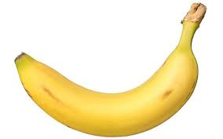
tomato
Like them
papaya
cucumber
like
banana

Slide 29
chips
chocolate
Dislike them
Do not like
ice-cream
burger

Slide 30
Make your
favourite food list
( not more then 10 foods )
Home work
Every body l

Slide 31
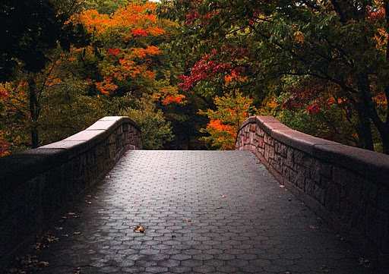
THANKS EVERYBODY

