Slide 1
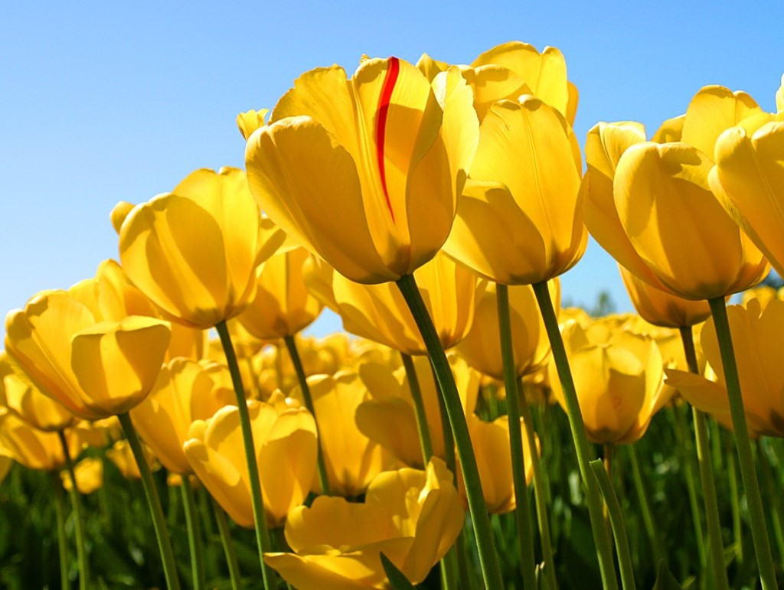
Welcome

Slide 2
Teacher’s Introduction
Md Amir Hossain (M.A.B.Ed)
Head Teacher
Hossainpur Girls High School 79hossainamir@gmail.com
Phone: 01714-315772

Slide 3
English First paper
Class – Nine
Unit – 8
Lesson – Four
02/08/2021

Slide 4
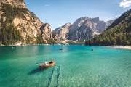
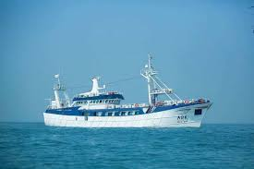
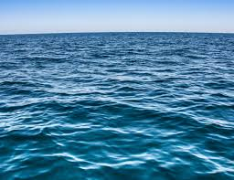
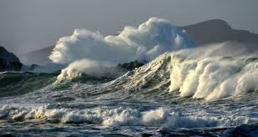
Look at the pictures and discuss

Slide 5
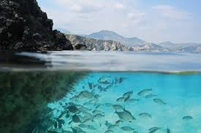
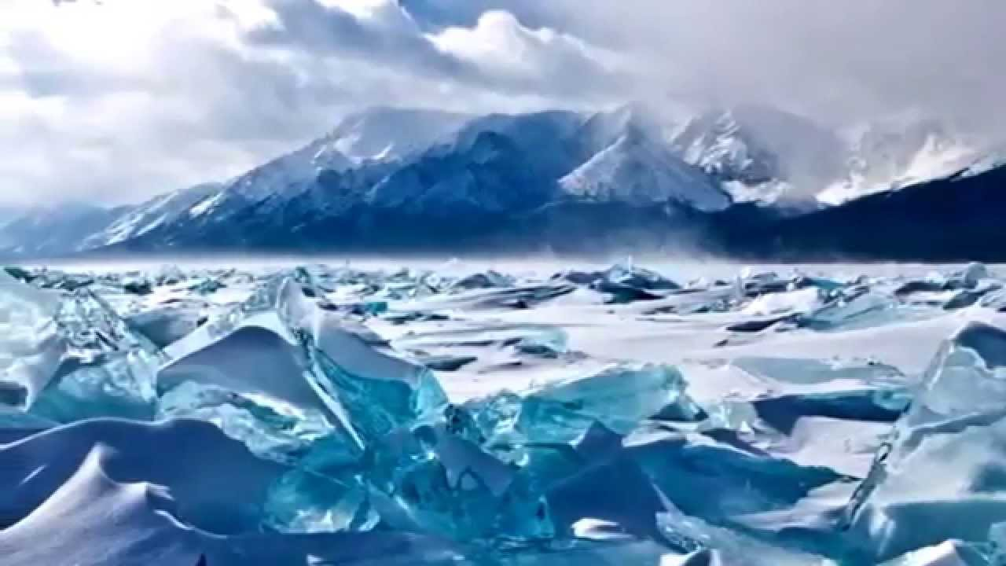
Look at the picture and talk about it.

Slide 6
Click in Video

Slide 7
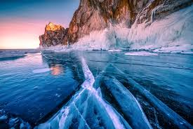
To day our lesson
Lake Baikal

Slide 8
Learning outcomes:
By the end of lesson students will be able to---------------
Speak about the pictures;
Read and understand the text;
Match the words with the meaning;
Complete the chart by the information;
Describe a place;

Slide 9
Click in Video

Slide 10
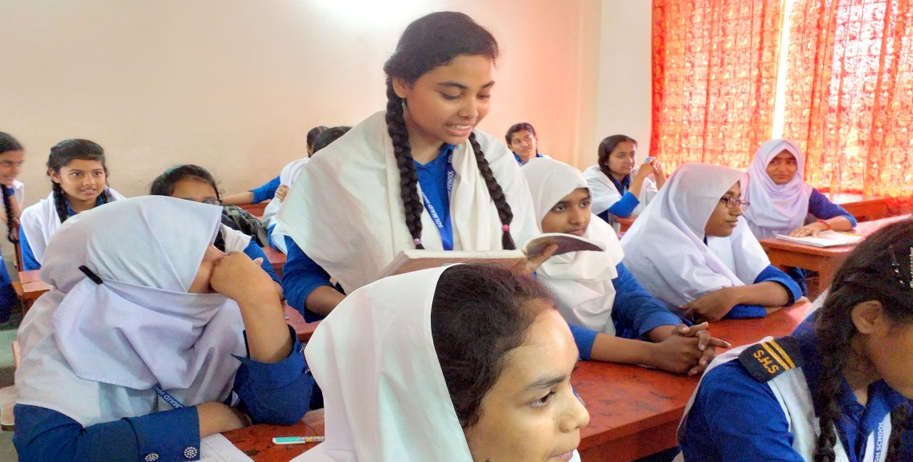
Silent Reading

Slide 11
Vocabulary:Pronunciation and meaning
adj
Extremly large
Gigantic
enormous
Very big in size
adj
occupy
To fill a particular amount of space
verb
average
Usual standard
noun

Slide 12
Reservation
Reserve
Shallowest , Deeply
Deep
Tempestuous, Storm
Stormyy

Slide 13
Individual Work
What do you think it is ?
Where is this situated?

Slide 14
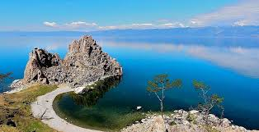
Lake Baikal is the deepest and one of biggest and most ancient lakes of the world.

Slide 15
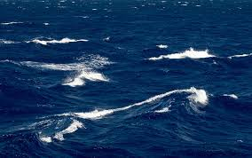
It is situated almost in the centre of Asia.

Slide 16
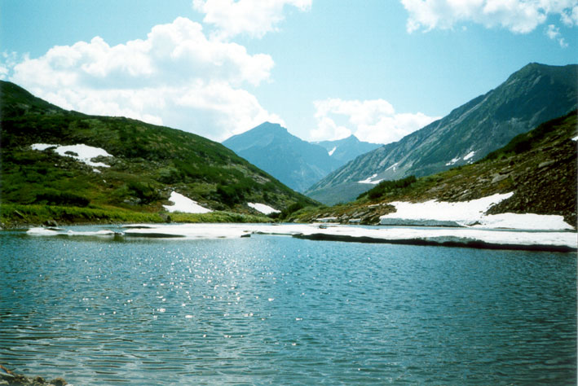
Lake Baikal is a gigantic bowl set at 445 meters above sea level.

Slide 17
Match the words with the meaning (Pair Works )
;
Words | Meanings
miracle
An act believed to be caused by God
basin
Bowl shaped depression filled with water
brook
Small stream
crest
top
exceptional
outstanding

Slide 18
Group works
12
1
11
10
2
Time 8 mins
9
3
8
4
7
5
6
Complete the chart by the information
Location------------------------------------
Setting--------------------------------------
Length--------------------------------------
Width----------------------------------------
Maximum---------------------------------
Highest depth--------------------------
Area-----------------------------------------
Amount of water----------------------

Slide 19
Evuulation
Deepest
Lake Baikal is the _ _ _ _ _ _ _ _ _ lake in the world at 1,642 m (5,387 ft).
world
Baikal is one of the clearest lakes in the _ _ _ _ _ _ _.
Lake Baikal
_ _ _ _ _ _ _ _ _ _ _ _ formed as an ancient rift valley.
Baikal
_ _ _ _ as a number of different tourist activities, depending on the season.

Slide 20
Homework
Make a list of attractive features of Lake Baikal

Slide 21
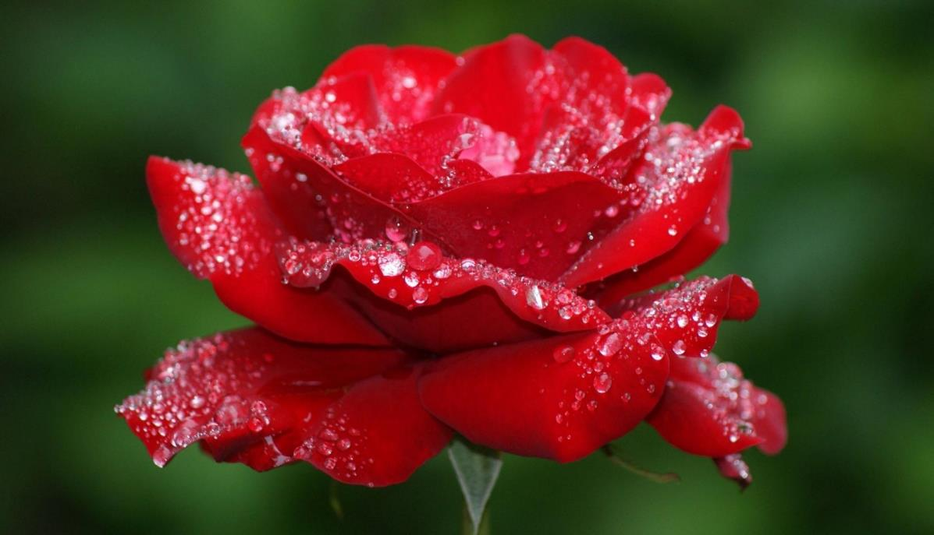
Thanks

