Slide 1
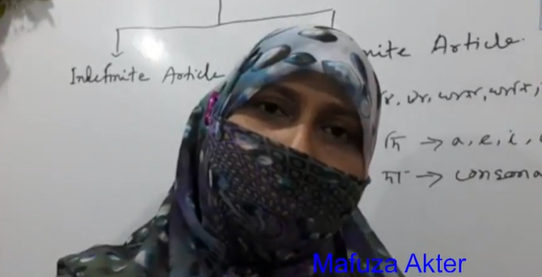
Simple , Complex & Compound
Presented by
Mafuza Akter
Asst. Prof .of English
Kushtia City College, kushtia

Slide 2
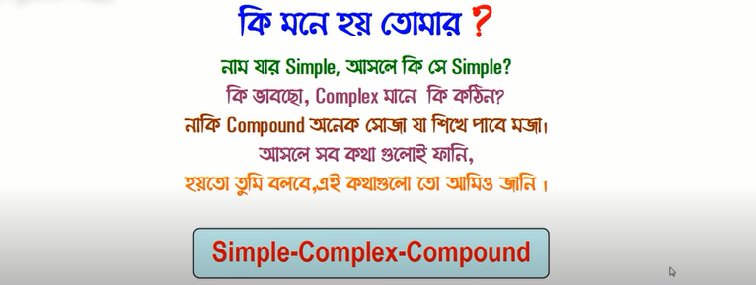

Slide 3
Learning outcomes
At the end of the lesson, Ss will be able to---------
Say the definition of simple ,complex & compound.
Can change into one another.

Slide 4
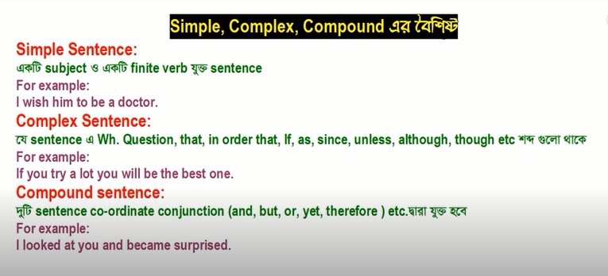

Slide 5
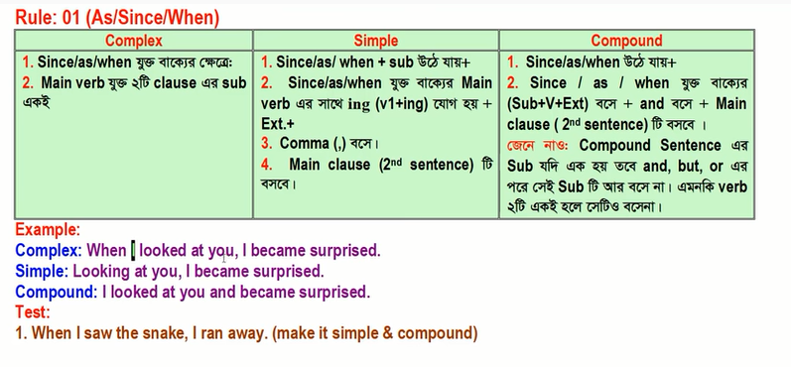

Slide 6
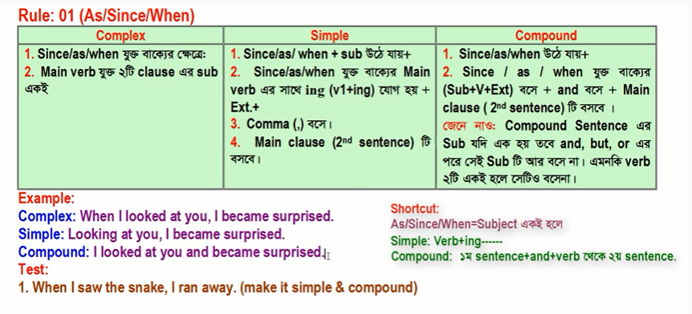

Slide 7
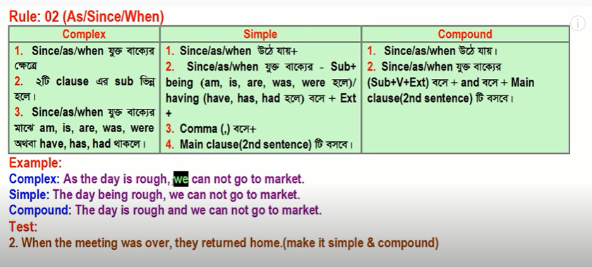

Slide 8
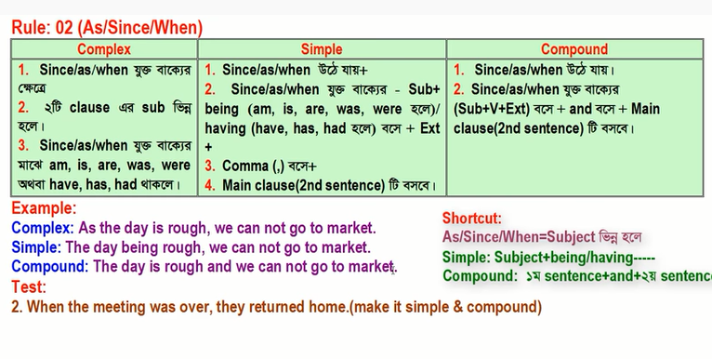

Slide 9
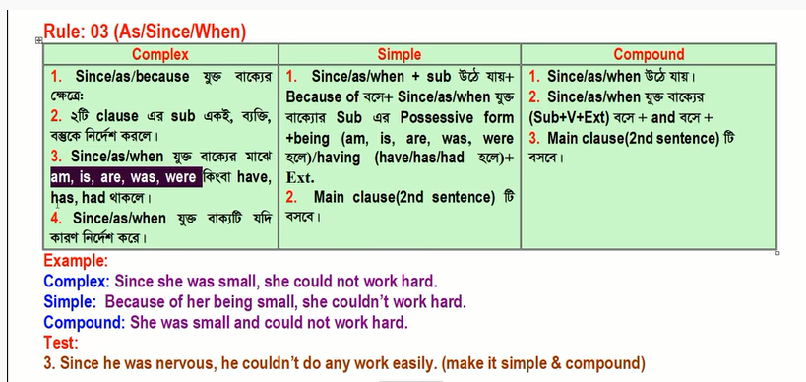

Slide 10
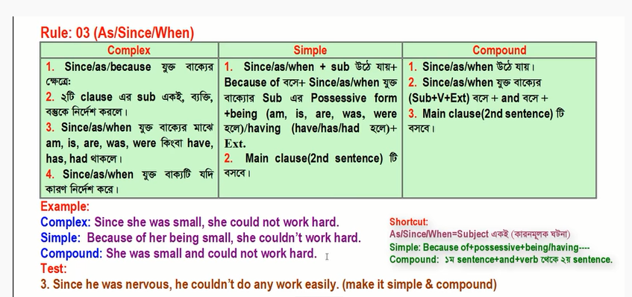

Slide 11
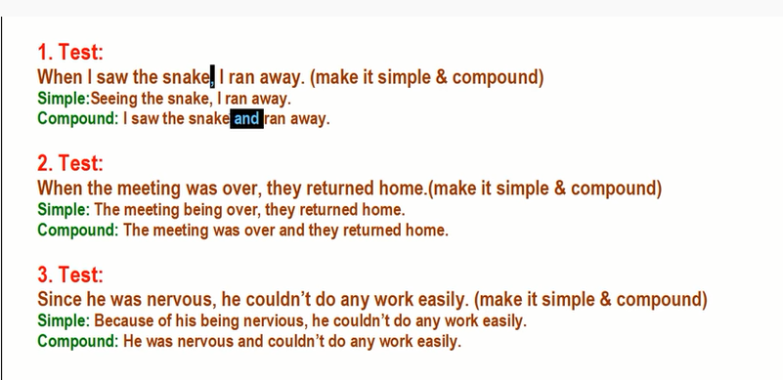

Slide 12


